Slide 1
ARCHEGONIATES
Archegoniate probably originated from an ancestral green alga ’
assemblage of Bryophytes, Pteridophytes and Gymnosperms having archegonia.
a hollow container housing the egg cell.
The egg cell is the precursor of the sporophytic generation.
The archegonium is differentiated into venter and neck
sexual reproduction in the archegoniates is the emergence of heterospory
This phenomenon leads to the formation of spores of two sizes, microspores and megaspores
The zygote, a product of fertilization of the egg cell in the archegonium is the progenitor of the sporophytic generation
Def. - Archegoniates are the group of primitive plants, which bears the female reproductive organ is an archegonium (a multicellular, often flask-shaped, egg-producing organ) occurring in mosses, liverworts, ferns, and most gymnosperms

Slide 2
: Unifying characters of archegoniates:
The archegoniates seem too have originated from a monophyletic group of ancient stock of aquatic green algae.
Present of sexual organs the female called archegonium and the male called the antheridium.
The presence of Chloroplasts containing chlorophyll a, b and carotene.
The presence of multicellular gametophytic and sporophytic generation.
Heteromorphic alternation of generation.
The morphological reduction of the sexual or the gametophytic phase was evident in the life cycle of archegoniate.
Provides protection to their embryo.
Male gametes are flagellated and motile in bryophytes, pteridophytes, (Cycadales, Ginkgoales) while the female gamete (egg) is non-motile.

Slide 3
: Unifying characters of archegoniates:
Bryophytes and Pteridophytes depend upon the presence of “fluid water” for fertilization. In gymnosperms, pollen grains germinate to form a pollen tube (siphonogamy) which is not dependent on external fluid water to reach the archegonial neck.
The transmigration of plants to the land habit led to specialization coupled with varied spore dispersal mechanisms leading to their successful spread on land with genetic variation.
Plants adapted to life on land by internalizing the external atmosphere and exploring the soil in an intensive way.
Spores also became resistant to desiccation through further specialization in seed plants.
Differentiated rhizoids and roots to provide strong anchorage and efficient supply of water and mineral nutrients.

Slide 4
: Unifying characters of archegoniates:
Increased the green surface area to provide more chlorophyll for efficient photosynthesis.
Developed an efficient vascular system to provide water to every part of the plant body.
Evolved the mechanism of transpiration to regulate the internal temperature.
Developed waxy cuticle to restrict water loss and formed stomatas to regulate gaseous exchange.
Differentiated tissues with thickened cell walls (collenchyma) and lignified walls (sclerenchyma) to support the erect habit.
Efficient spore dispersal mechanism.
The archegoniates evolved several adaptive strategies to survive on land

Slide 5
Alternation of generation:
Bryophytes: -
The alternation of generations is very distinct in the archegoniatae.
It appears in the haplodiplontic type of life cycle
The alternation of generation is slight different in Bryophytes, Pteridophytes and Gymnosperms
The life cycle of bryophytes shows regular alternation of gametophytic and sporophytic generations.
The haploid phase (n) is the gametophyte or sexual generation
It bears the sexual reproductive organs, which forms gametes, i.e. antherozoids and eggs
gametic union a zygote is formed which develops into a sporophyte (2n) deploid phase.

Slide 6
Alternation of generation:
Sporophyte forms spores, which always germinate to form gametophytes
During the formation of spores, the spore mother cells divide meiotically and haploid spores are formed.
The production of the spores is the beginning of the gametophytic or haploid phase
The spores germinate and form gametophytic or haploid phase
The spores germinate and produce gametophytes, which bear sex organs
Ultimately, the gametic union takes place and zygote is resulted. It is diploid (2n).
This is the beginning of the sporophytic or diploid phase.

Slide 7
Alternation of generation:
Here the two generations are morphologically different, the type of alternation of generations is called heteromophic
The gametophytic generation is conspicuous and longer-lived phase of life-cycle in comparison to that of sporophyte generation
In bryophytes, the gametophyte is quite independent whereas the sporophyte is dependent somehow or other on the gametophyte for its nutrition
The gametophyte produces sporophyte and sporophyte to the gametophyte and thus there is regular alternation of generations

Slide 8
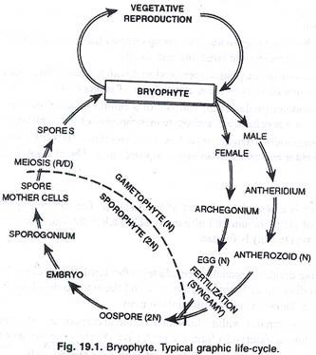

Slide 9
Alternation of generation:
Pteridophytes: -
In Pteridophytes, the haploid phase (n) is gametophytic generation or sexual phase
It bears reproductive organs -anthredia and archegonia.
The Anthredia and archegonia produces flagellate antherozoids and egg respectively
Gametophyte may be monoecious as in homosporous sp. / dioecious in heterosporous sp.
The Gametophyte is independent in Pteris and dependent in Selaginella.
Diploid phase (2n) or sporophytic stage forms from zygote after fertilization

Slide 10
Alternation of generation:
Pteridophytes: -
Meiosis in SMC (spore mother cell) forms non-motile haploid spore, which germinate to form gametophyte again.
This cycle continues with alternation between gametophye and sporophyte.
All spore formed may be of one type i.e. homosporous species (Lycopodium, Dryopteris).
Spores formed may be of two types i. e. heterosporous species (Selaginella, Marsilea).
Microspores/male spores developed in male sporangia germinate to form male gametophyte.
Megaspores/female spore developed in megasporangia germinate to form female gametophyte.

Slide 11
Alternation of generation:
Pteridophytes: -
Sporophyte is dominant phase in life cycle.
It is independent of the gametophyte (prothallus) and grows to a much greater size.
Sporophytes are differentiated into stems, leaves and roots and shows well developed conducting tissues.

Slide 12
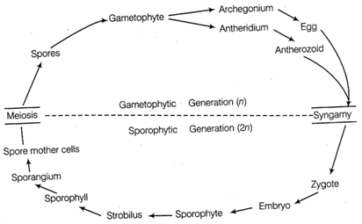

Slide 13
Gymnosperms: -
The dominant phase in the life cycle is the diploid (sporophyte) stage.
The gametophytes are very small and cannot exist independent of the parent plant.
The reproductive structures of the sporophyte (cones), produce two different kinds of haploid spores: microspores (male) and megaspores (female).
This phenomenon of sexually differentiated spores is called heterospory.
These spores give rise to similarly sexually differentiated gametophytes, which in turn produce gametes.
Fertilization occurs when a male and female gamete join to form a zygote.
resulting embryo, encased in a seed coating, become sporophyte.

Slide 14
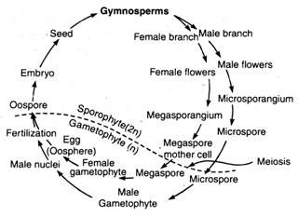

Slide 15
Thank You

