Slide 1
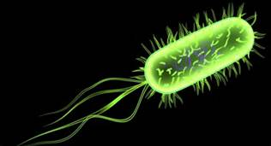
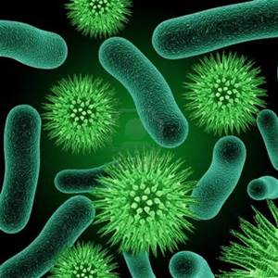
BACTERIA
Microscopic organisms - known as ‘germs’ and ‘microbes’
Simplest prokaryotic unicellular organisms.
Show the characteristics of both plants and animals.
Antoni von leeuwenhoek (1632-1723) was the first to discover bacteria
French scientist louis pasteur (1831-1895) established the science of bacteriology
He was the first to prepare vaccine, used it for hydrophobia
Robert koch showed that, bacteria caused cattle disease- anthrax, tuberculosis and asiatic cholera
Def. - “‘It is a unicellular or multicellular, microscopic prokaryotic micro-organism, usually lacking chlorophyll.

Slide 2
General characters
Found all habitats i.E. Soil, water, air, living, dead
Aerobic & some of them are anaerobic forms.
Living - parasitic or symbiotic, dead - saprophytic.
Archaebacteria grow - high temperature, very high atmospheric pressure & very high salt concentration.
Large group of microscopic prokaryotic microorganisms.
Smallest and most primitive organisms.
Wide range shapes, ranging from spheres to rods and spirals.
Cell wall - amino acid and saccharide sub units.
Well-organized nucleus is absent, nuclear material present.
Mitochondria, golgi bodies, endoplasmic reticulum absent.
Mesosomes perform the function of mitochondria.

Slide 3
General characters
Ribosome are scattered in the cytoplasmic matrix and are of 70S type
Motile bacteria posses one or more flagella or cilia for locomotion.
More than 3000 species of bacteria have been described.
They can survive from hot springs (80⁰C) to refrigerated condition.
They can found from distil water with trace contamination to the Dead Sea
The common method of multiplication is binary fission
Both DNA and RNA are present in Bacterial cell
Gram stain (Gram + ve) or may not (gram – ve) and can grow in aerobic or anaerobic conditions.
Fixation of nitrogen from atmosphere and decay.

Slide 4
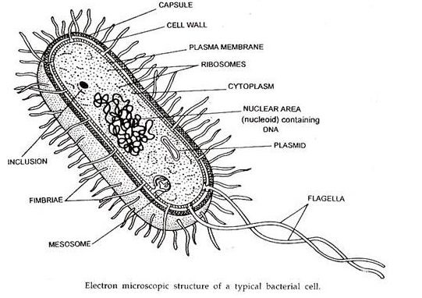
Size of Bacterial Cell

Slide 5
Size of Bacterial Cell
Bacterial cells - very small and visible only under microscope.
bacterial cells are about 1/10th the size of eukaryotic cells approximately 0.5 to 1.0 µm in diameter.
The rod shaped bacteria are of approximately 0.5 to 1.5 µm in diameter and 1.1 to 4.4 µm long.
Some spirilli are quite long about 600 µm in length.
Some bacteria may be even smaller, but these ultra microbacteria are not well studied.
There may be more than 50 billions of bacteria in a single drop of water.
According to Buchanan and Buchanan (1946), one ml. of bacterial culture contains one trillion bacteria of average size.

Slide 6
Structure of Bacteria

Slide 7
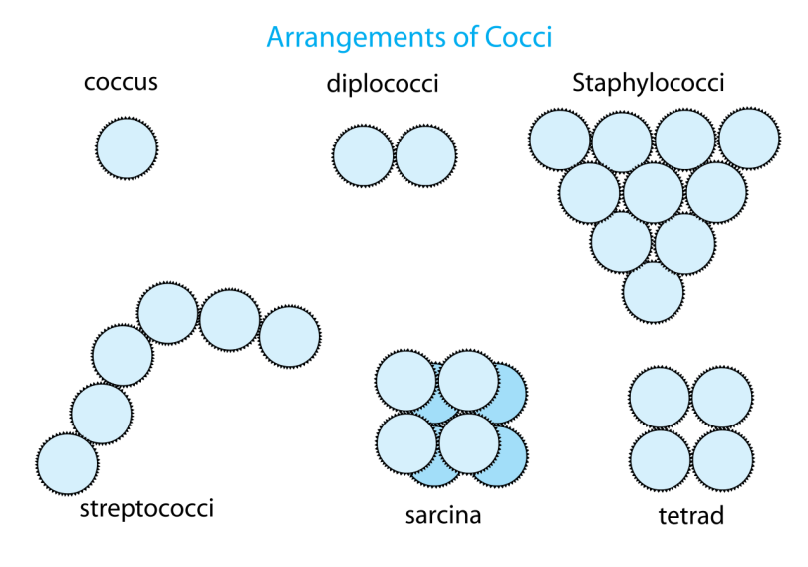
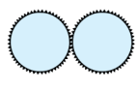

Forms (Shape) of Bacteria
    Coccus (spherical),
    Bacillus (rod shaped),
    Spirillum (spiral).
Coccus (spherical),
cells - rounded or spherical forms are called cocci
They are smallest forms among the bacteria
Range 0.5µ to 1.25µ in diameter; non-motile, nonflagellated
single cells or remain attached on cellular arrangement
    Micrococcus – Cell divide in one plane ,occurs single in number.
    Diplococcus - divide in one plane, attached permanently in pairs.
    Streptococcus –divide in one plane to form a linear chain of cells

Slide 8



Forms (Shape) of Bacteria
    Coccus (spherical),
        Tetracocci – cells divide in two planes, form groups of four cells.
        Staphylococci – cells divide in three planes in an irregular pattern producing bunches of cocci.
      Sarcinae – Cells divide in three planes in regular pattern
      producing bunches of cocci.

Slide 9
    Bacillus - straight rod like bacteria
        Monobacillus – single elongated cells
        Diplobacillus – cells remain adhered and appear in paired form
      Streptobacillus – cells remain attached in chains
      appearing like long chains (filamentous).

Slide 10
    Spirillum - spiral or curved forms are called spirilla
        Vibrioid– cells are curved rods 0.5 μm across and 1.5 to 3.0 μm long, single or strung together in S-shapes or spirals, with one to three whip like flagella at one end.
        Helical (Spirilla) – Cells that have more than one twist form a distinct helical shape (with flagella).

Slide 11
    Other forms
    Pleomorphic – That can exhibit variety of shapes.
    Trichomes – Cells divide in one plane forming a chain that has much larger area of contact between the adjacent cells
    Palisade – The cells are arranged laterally (side by side) to form a matchstick-like structure and at angles to one another.
    Hyphae– Some microorganisms form the multicellular, thin-walled, profusely branched filament called hyphae. The interwoven hyphae are collectively known as mycelium.

Slide 12
Ultrastructure of Bacterial Cell:

Slide 13
cell wall protects osmostic shock and physical damage.
it confers rigidity and shape of bacterial cells.
cell walls all consist of peptidoglycan, also known as murein or mucopeptide,
two groups of bacteria : gram -negative and gram +positive.
cell wall may have a sticky coating - Capsule for attachment to host or other bacteria.
capsules are composed of polysaccharides, polypeptides.
In many bacteria a mucilaginous, slimy layer or capsule covers - called Glycocalyx.
The cytoplasmic membrane encloses the cytoplasm. It regulates the specific transport of substance between the cell and the environment. conjugation.
The cytoplasmic membrane contains two main components: lipid and protein. The lipid component is phospholipid bilayer.

Slide 14
As prokaryotes, lack a true nucleus or membrane-bound organelles like mitochondria, chloroplasts, ER, Golgi complex as in eukaryotic cell.
Like all living organisms, bacteria contain ribosomes Single, circular chromosome in nucleoid region for the production of proteins,
ribosome is different from eukaryotes.
They have 70S type of ribosomes. Ribosome made up of RNA and protein.
Bacteria do not have a membrane-bound nucleus, and their genetic material is scattered as a single circular chromosome in the cytoplasm as - nucleoid. The nucleoid contains the chromosome with associated proteins and RNA.
Flagella- thread like structures for locomotion in most motile bacteria.

Slide 15
Flagella are rigid protein structures, about 20 nm in diameter and up to 20 µm in length,
Fimbriae - Appendages on bacterial cell shorter than pili used for attachment to contact surfaces.
Fimbriae - fine filaments of protein, just 2-10 nm in diameter and up to several micrometers in length. distributed over cell surface, fine hairs when seen under the electron microscope.
Pili (singular: pilus) are cellular appendages on bacterial cell shorter than flagella used for transfer of genetic material between bacterial cells in a process called conjugation.

Slide 16
Economic Importance of bacteria:
Bacteria play a very vital role in human life, and environment. Economic importance of any organism refers to the advantages and disadvantages of that organism to nature, the humans and the environment.
Beneficial effects of Bacteria:
Bacteria play important roles in different fields such as agriculture, industry etc. Some of them are mentioned below.
Role in agriculture
  Scavenging Role –
  Saprophytic bacteria obtain food from organic remains - animal excreta, fallen leaves, meat etc. , decompose these substances by action of digestive enzymes aerobically or anaerobically (known as fermentation). So in sanitation known as scavengers. E.g. Pseudomonas

Slide 17
  b. Nitrification - Rhizobium bacteria, living in root nodules of leguminous plant symbiotically, helps in fixing atmospheric nitrogen. Similarly, Nitrosomanas and Nitrococcus convert ammonium salt to nitrites. Nitrites are further changed to nitrates by Nitrobacter and Nitrocystis. It enables plants to uptake nitrogen.
  c. Production of Organic Manure - As stated above, saprophytic bacteria help in breaking of complex organic substance to simpler forms. Thus, in this process, they help to convert farm refuse, dung and other wastes to manure.
  d. Preparation of Ensilage - Ensilage is preserved cattle fodder prepared by packing fresh chopped fodder sprinkled with molasses. Fermentation activity of bacteria produces lactic acid that acts as preservative in ensilage.
  e. Production of fuel - Bacteria, while converting animal dung and other organic wastes to manure, help in production of fuel that is necessary in gobar gas plant.

Slide 18
  f. Disposal of sewage - Bacteria help in disposal of sewage by decomposing it and thus, help in environmental sanitation.
  g. Biological pesticides - Bacteria can also be used in the place of pesticides in the biological pest control. This commonly involves spores of Bacillus thuringiensis (also called Bt). Subspecies of these bacteria are used as Lepidopteran- specific insecticides under trade names such as Dipel and Thuricide.

Slide 19
2. Role in Industry
  a. Dairy Industry - Bacteria such as Streptococcus lactis convert milk sugar lactose into lactic acid that coagulates casein (milk protein). Then, milk is converted into curd, yogurt, cheese, etc needed for the industry.
  b. Fermented foods - Bacteria such as Lactobacillus and Lactococcus, in combination with yeasts and molds, have been used for thousands of years in the preparation of fermented foods such as soy sauce, vinegar, wine, cheese, pickles etc.
  c. Production of Organic Compounds - Fermentation (breakdown of carbohydrate in absence of oxygen) action of various bacteria produces organic compounds like lactic acid (by Lactobacillus), acetic acid (by Acetobacter aceti), acetone (by Clostridium acetabutylicum) and ethanol, enzymes, perfumes etc.
  d. Fibre Retting - The action of some bacteria like Clostridium, Pseudomonas etc. help in fibre retting i.e. separation of stem and leaf fibre of plants like jute, hemp, flax, etc. from other softer tissue.

Slide 20
  e. Curing - The leaves of tea and tobacco, beans of coffee and coca are cured off their bitterness with the help of action of certain bacteria such as Bacillus megatherium.
  f. Production of Antibiotics - Number of anti bacterial and anti fungal antibiotics such as Hamycin, Polymyxin, Trichomycin etc are obtained from mycelia bacteria (like Streptomyces). Similarly, Bacillus is used for production of antibiotics such as Bacitracin, Gramicidin etc
  g. Production of Vitamins - Different kinds of vitamins are produced from bacteria like Riboflavin from Clostridium butylicum, Vitamin B12 from Bacillus megatherium and Vitamin K and B-complex from Escherichia coli.
  h. Curdling of milk is done by lactic acid bacteria.

Slide 21
3. Role in Medicines –
  a. Genetically modified bacteria are used in production of commercially important products. For example – production of human insulin used against diabetes, human growth hormone somtotrophin used to treat pituitary dwarphism.
  b. Bacteria are capable of digesting the hydrocarbons in petroleum are often used to clean up oil spills. Also used for the bioremediation of industrial toxic wastes. Bacteria are Nature’s Scavengers.
  c. Bacteria present in the mouth, respiratory tract, intestines, etc. kill the foreign invading, disease- causing germs by waging chemical warfare. They secrete antibiotics and guard us from diseases.

Slide 22
B. Harmful effects of Bacteria:
Though bacteria plays important role in agriculture, industries and natural sanitation etc, it has the following harmful effects.
1. Food Spoiling: Saprophytic bacteria always not only help in decomposition of dead matters, but they also cause the rotting of vegetables, stored grains, fruits, meat, fish, bread etc. Similarly, milk and their products are easily contaminated by bacteria and spoiled.
2. Food Poisoning: Bacteria like Staphylococcus aureus cause food poisoning and cause people diarrhea and vomiting.
3. Damaging of domestic articles: Spirochete cytophaga deteriorates cotton, leather and wooden articles.
4. Denitrification: Bacteria such as Thiobacillus and Microbacillus convert nitrate of the soil to the gaseous nitrogen. This hampers plants very much.
5. Desulphurication: Bacteria such as Desulfovibrio convert soil sulphates into hydrogen sulphide.

Slide 23
6. Cause of Diseases:
It is known that over 90% of human diseases and over 10% of plant diseases are caused by bacteria. Some bacteria are pathogenic to animals and human being and cause various and often serious diseases such as Typhoid fever (Salmonella typhi), Cholera, Tuberculosis (Mycobacterium tubercularae) and Tetanus (Clostridium tetani) etc.

Slide 24
Thank You

