Slide 1
bryophytes
Asso. Prof. R. S. Suryavanshi
2.1 – General characters and classification (As per G. M. Smith).
2.2 – Study of Riccia with respect to occurrence, classification, thallus structure and reproduction (without developmental stages).
2.3 – Econonomic importance.
Byophytes

Slide 2
Introduction:
The word bryophyte is derived from the Greek Bryon – Moss, phyton – plant.
Bryophytes usually found in humid and shady places.
Well-defined habitats are the transitory regions, as swamps or banks of rivers and lakes.
They are quite small and incospicuous organisms.
Water is much essential for the completion of their life history, so described as the amphoebians among plants.
They are the intermediates, the amphibians of the plant kingdom. Instead of roots, rhizoids are presents.
Byophytes

Slide 3
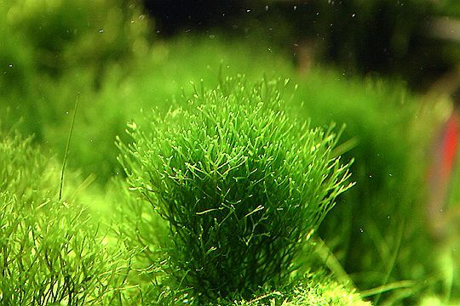
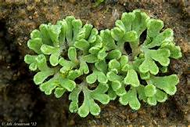
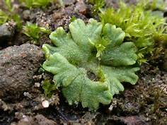
General Characters of Bryophytes:
A - Habit:
Mostly- terrestrial, few aquatic also epiphytic.
simple, primitive and non-vascular plants.
generally grow in moist, shady places.
Aquatic- found floating or are submerged in ponds, pools, lakes & still waters.
terrestrial -found on soils, banks or rivers and lakes, on wet walls and in crevices attached to wet rocks.
epiphytic species grow on branches and trunks of trees, e.g. Funaria.
live in soil but are dependent on water for sexual reproduction so also called amphibians of the plant kingdom.
Byophytes

Slide 4
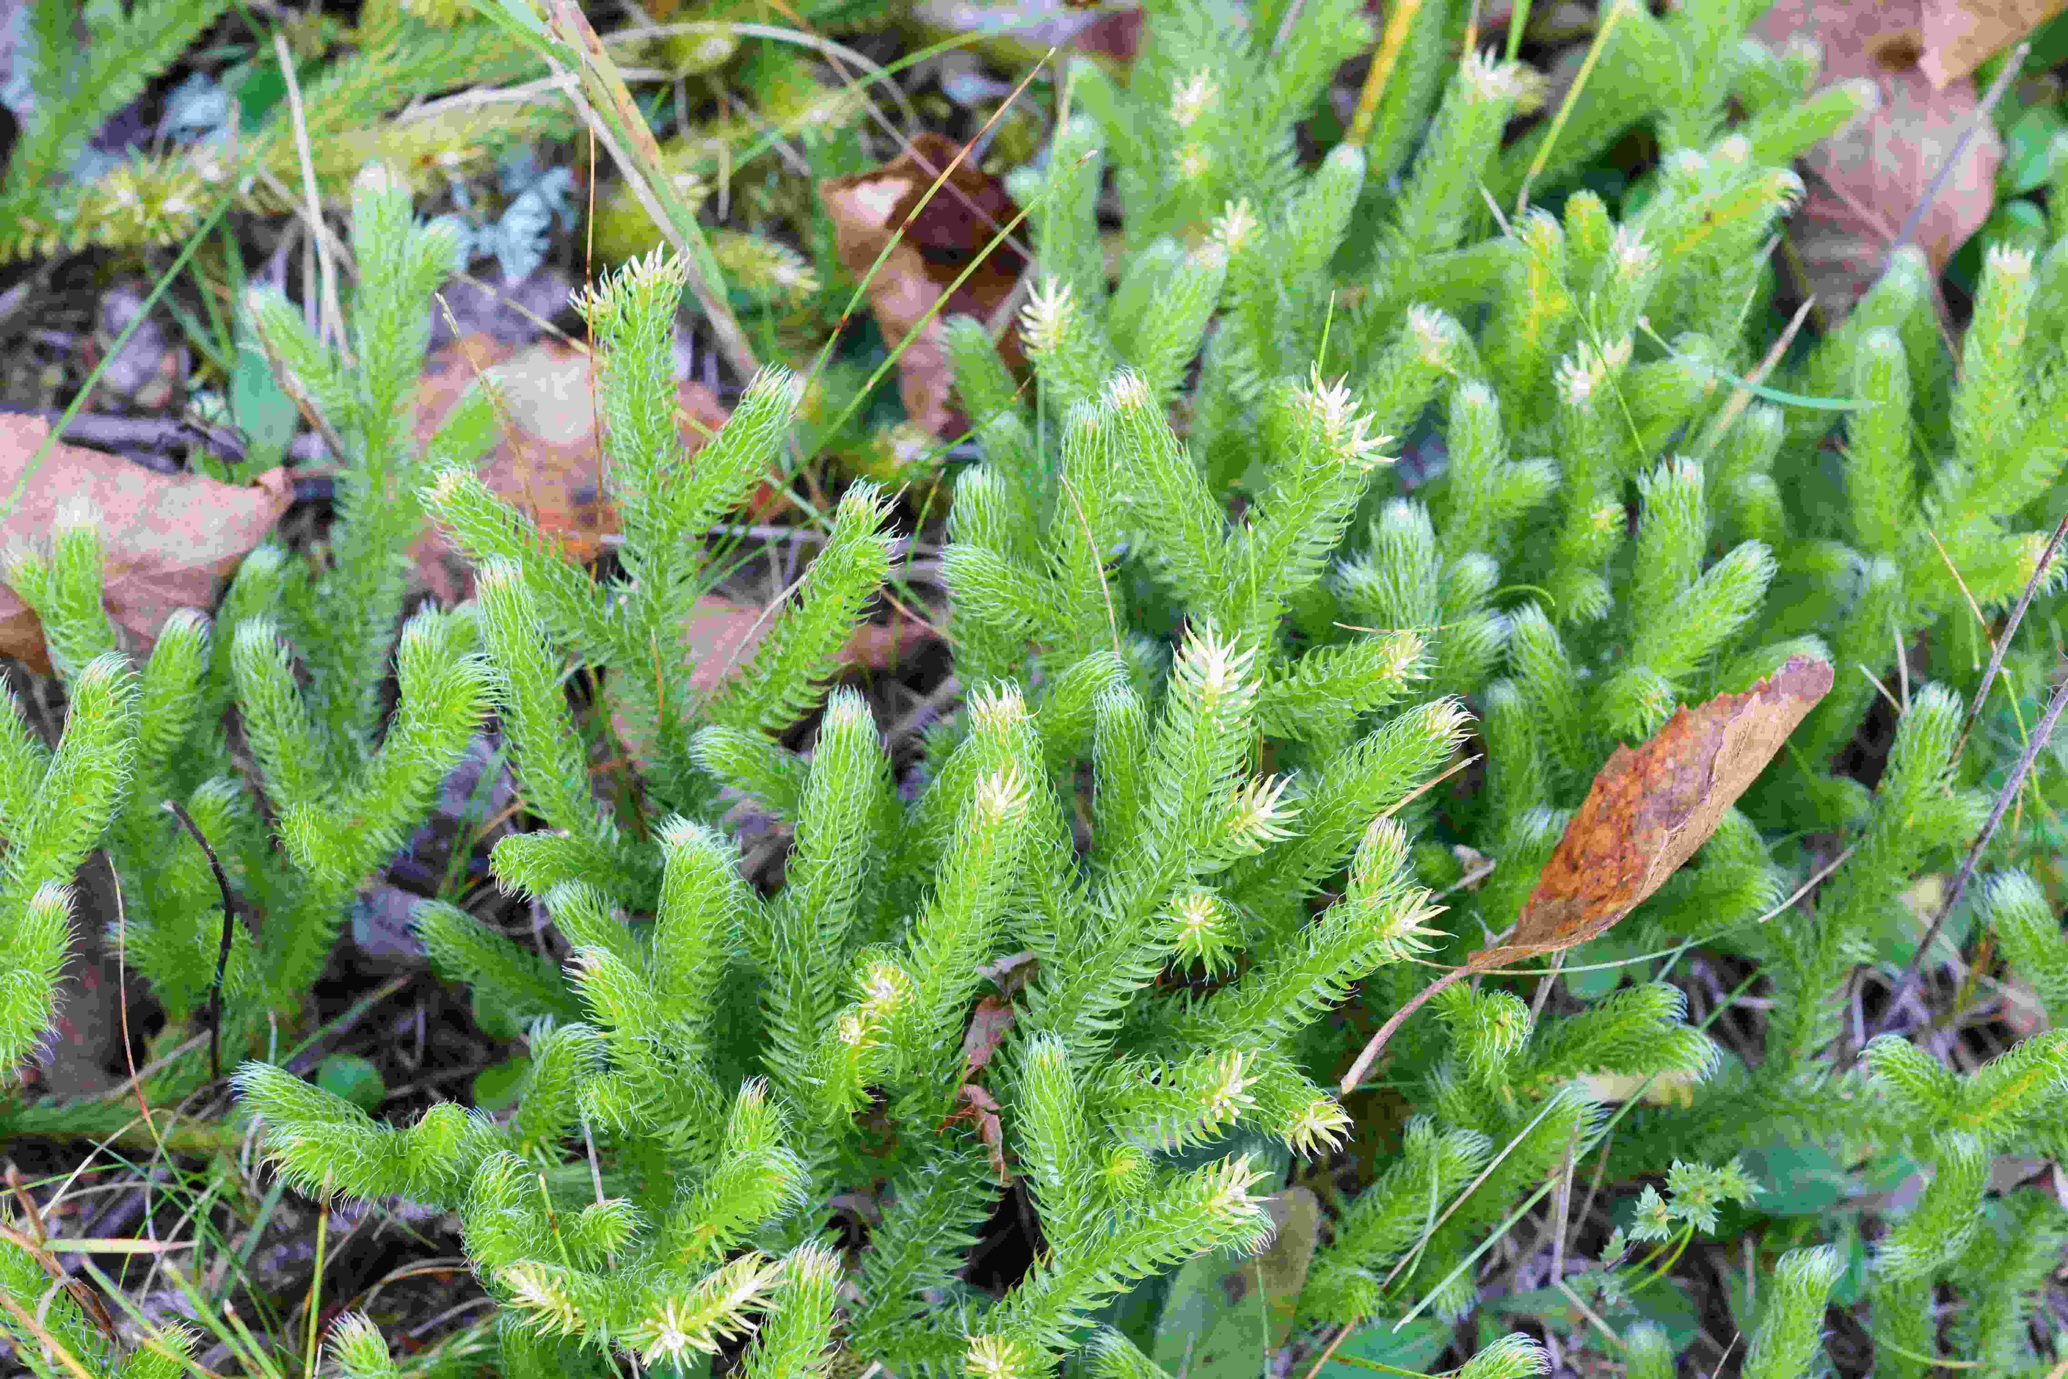
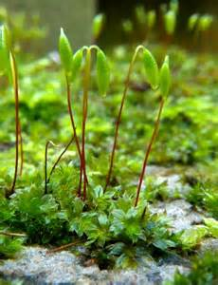
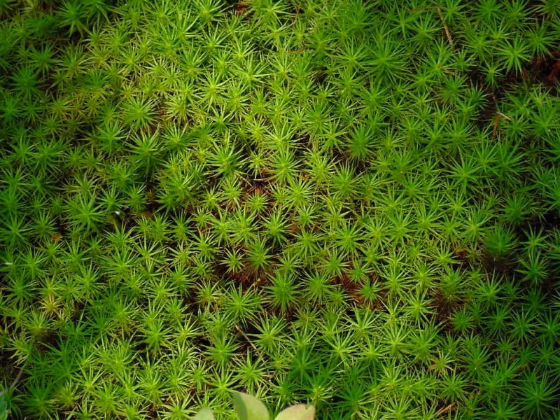
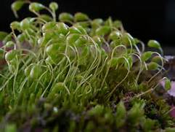
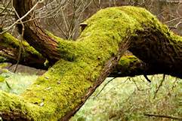
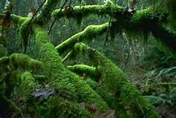
riccia

Slide 5
General Characters of Bryophytes:
B - Thallus: I. Plant body (external)
thallus is dorsiventral and not differentiated into structures like stem, root and leaves.
life cycle shows two distinct generations i.e. the gemetophyte (haploid) & sporophyte (deploid).
main plant body - gemetophytic phase & independent, green and branched, remains for longer duration in life cycle.
sporophytic phase is completely dependent on the gametophyte and it remains for relatively shorter duration in the life cycle.
Byophytes

Slide 6
show two distinct forms. The primitive forms are prostrate and thalloid, while evolved forms shows erect plant body with main axis (stem) and lateral appendages (leaves).
The primitive thalloid forms are attached to the substratum by means of unicellular, unbranched rhizoids.
Erect forms are fixed to the substratum by multicellular-branched rhizoids. In both the forms, true roots are absent.
In Riccia, from the ventral surface develops a number of unicellular rhizoids whose functions are fixation and absorption.
In Marchantia, the thallus is dichotomously branched, and the rhizoides are of two types, simple and tuberculated.
Byophytes

Slide 7
General Characters of Bryophytes:
C – Reproduction: I. Vegetative
Fragmentation: Decay and death of older part of the thallus.
Tuber formation: The tips of branches store food material - swollen - formation of tubers. In favourable condition - new plants.
Adventitious branches: The adventitious branches develop from the lower surface of the thallus. The separated branches develop into new plants.
Persistant apices: The growing apical portion with little portion of thallus tissue became thick-walled, which develops new plant.
Gemma formation: The formation of multicellular, green bodies of different shapes called gemmae, which develops new plant.
Byophytes

Slide 8
General Characters of Bryophytes:
C – Reproduction: II. Sexual
The sexual reproduction is oogamous. The male sex organ is anthredium produces antherozoid and the female, archegonium produces ovum.
An antheridium is formed of stalk and the body. The stalk is multicellular, while body consists of outer jacket called antheridial wall encloses antherozoids. Each antherozoid is small and biflagellated.
Each archegonium is a flask-shaped, having basal swollen region, the venter and the upper slender, elongated region the neck.
Byophytes

Slide 9
General Characters of Bryophytes:
D – Fertilization:
Fertilization takes place only in presence of water. Antherozoid unites with ovum to form zygote. The zygote develops into the diploid generation, the sporophyte.
E – Sporophyte:
The zygote immediately starts development of sporophyte without any dormancy period.
The sporophyte is dependent on the gametophyte for the nutrition.
The sporophyte may be simple or differentiated into foot, seta and capsule.
cells of venter show divisions to form a covering around young sporophyte - calyptra.
Byophytes

Slide 10
General Characters of Bryophytes:
E – Sporophyte:
The foot is embeded in gametophytic tissue and absorbs food meterial.
Capsule consists of capsule wall enclosing spores.
The spores are non-motile and dispersed by wind.
The spores germinates and produces the new plant or the gametophyte.
Bryophytes exhibit regular and distinct alternation of two generations, namely gametophyte and sporophyte.
The gametophyte is the main plant.
Byophytes

Slide 11
Classification of Bryophyts (As per G. M. Smith):
Division: Bryophyta
Class
Hepaticae/ Anthocerotae/ Musci/
Hepaticopsida Anthocerotopsida Bryopsida
1. Sphaerocarpales 1. Anthocerotales
2. Marchantiales
3. Jungermanniales
4. Calobryales
Sphagnidae Andreaeidae Bryidae
Sphagnales Andreaeales
Polytrichales Funariales
Order
Order
Sub-class

Slide 12
G. M. Smith in 1955 has included all Bryophytes into a division Bryophyta. Division Bryophyta is further divided into three classes viz. Hepaticae, Anthocerotae and Musci. Rothmaler (1951) and Proskauer (1957) suggested new names for these classes. There names are according to International code of Botanical Nomenclature.
i.e.
Class : Hepaticae – Hepaticopsida
Class: Anthocerotae – Anthocerotopsida
Class : Musci - Bryopsida
Byophytes

Slide 13
Class I- Hepaticae/ Hepaticopsida (Liverworts)
(4 orders, 9 families, 225 genera and 8,500+- species)
The gametophytes are dorosiventrally differentiated. They may be thalloid (thallose) or differentiated into leaves and stem (foliose).
Leaves, if present, are without mid-rib and are arranged into two or tghree rows on the axis.
The dehiscent mechanism of capsules is indefinite and irregular.
The sporophyte may be simple, or differentiated into foot and capsule, or into a foot seta and capsule.
The sporogenous cells develop from the endothecium of sporogonium.
The sporophyte is completely dependent on gametophytes for its nutritive supply.
The wall of sporogonium is one to several layered thick. The stomata are not present on the wall of sporogonium.
Order - Sphaerocarpales (3 genera and 2 families)
Order – Marchantiales (32 genera and 400 species)
Order – Jungermanniales (220 genera and 8,500 species)
Order – Calobryales (2 genera and 9 species)
Byophytes

Slide 14
Class I- Hepaticae/ Hepaticopsida (Liverworts)
The sporophyte is completely dependent on gametophytes for its nutritive supply.
The wall of sporogonium is one to several layered thick. The stomata are not present on the wall of sporogonium.
Order - Sphaerocarpales (3 genera and 2 families)
Order – Marchantiales (32 genera and 400 spe.)
Order – Jungermanniales (220 genera and 8,500 species)
Order – Calobryales (2 genera and 9 species)
Byophytes

Slide 15
Class II- Anthocerotae/ Anthocerotopsida (Hornworts):
(1 orders, 2 families, 6 genera and 301+- species)
The gametophyte is thalloid and dorsiventral, bearing simple and smooth-walled rhizoides; tuberculate rhizoids and ventral scales are altogether absent.
Thallus is homogenous internally.
Each cell of the thallus is provuded with a hloroplast, a nucleus and a pyrenoid body. Pyrenoid body includes several granules.
The wall of capsule is 4-6 layers of cells thick, and is provided with stomata.
The basal portion of capsule is meristematic. It divides continuously to add to theupper portion.
Byophytes

Slide 16
Class II- Anthocerotae/ Anthocerotopsida (Hornworts):
The sex organs are found to be embedded in the gametophytic tissue.
Sporogenous mass evolve form amphithecium and arches over the columella.
The antheridia arise from the hypodermal cell of the thallus on the dorsal side of it; they develop within the antheridial chambers.
The archegonia are found in sunken conditions on the dorsal side of the thallus, they develop from superficial cells.
Family – Anthocerotaceae (4/5 genera)
Family – Notothylaceae (Single genus – Notothylas)
Byophytes

Slide 17
Class III – Musci/ Bryopsida (Mosses):
(3 orders, 28 families, 660 genera and 14504+- species)
The plants have well differentiated structures including axis, leaves and multicellular rhizoids.
The leaves are arranged in 3-8 rows on the axis. Each leaf has a mid-rib.
The wall of the capsule consists of many layers of chlorophyllous cells and stomata.
sex organs develop on apical portion of stem.
The sporophyte is differentiated into foot, seta and capsule.
The sporogenous mass or archesporium develops from the outer layer of endothecium. Endothecium also forms columella.
The eleters are not present in the sporogonium.
Byophytes

Slide 18
Sub-class I – Sphagnidae/ Spagnobrya
(1 order, 1 family, 1 genus Sphagnum, 326 species)
Sub-class II – Andreaeidae/ Andreaeobrya (1 order, 1 family)
Sub-class III – Bryidae/ Eubrya (650 genera, 14,000 species)
Order I – Polytrichales (1 family, important genera – Polytrichum & Pogonatum)
Order II – Funariales (26 genera and 356 species)
Byophytes

