Slide 1
Crossing over
Asso. Prof. R. S. Suryavanshi
  Definition,
  Mechanism of crossing over
  Theories of crossing over – Darlington's Breakage (Stern & Hotta, 1969)
  Significance of Crossing over

Slide 2
Definition:
Crossing may be defined as
‘reciprocal exchange of segments between homologous chromosomes’
(generally occurring during meiosis, bringing the recombination of the linked genes particularly of those which are not very closely situated).
Crossing Over

Slide 3
Mechanism of Crossing over:
  The whole process of crossingover includes four stages viz.
  Synapsis
  Duplication of chromosomes
  Crossing over and
  Terminalization.
Crossing Over

Slide 4
Synapsis:
  During zygote stage of prophase I of meiosis occurring in the developing sex-cells, the homozygous chromosomes come close to each other and pairing or synopsis between the homozygous chromosomes takes place at synaptotene or zygotene substage.
Duplicationg of chromosomes:
During the pachytene stage of prophase I of meiosis, duplication of chromosomes took place. During this stage, each homologous chromosome of a bivalent split longitudinally into two sister chomatids. Thus the bivalent now consists of four chromatids and is known as tetrad.
Crossing Over

Slide 5
Crossing over:
The crossing over occurs in the homologous only during the four stranded of tetrad stage. During the process of crossinover, two non-sister chromatids first break at the corresponding points due to the activity of a nuclear enzyme called endonuclease.
After this, a segment of one side of each connect with as segment of the opposite side of the break, so that the two non-sister chromatids cross each other at a point of break and exchange. The fusion of the chromosomal segments with that of opposite one take place due to the action of an enzyme called, Ligase. The crossing of the two chromatids is called chiasma formation and the resultant cross as Chiasma or Chiasmata.
Crossing Over

Slide 6
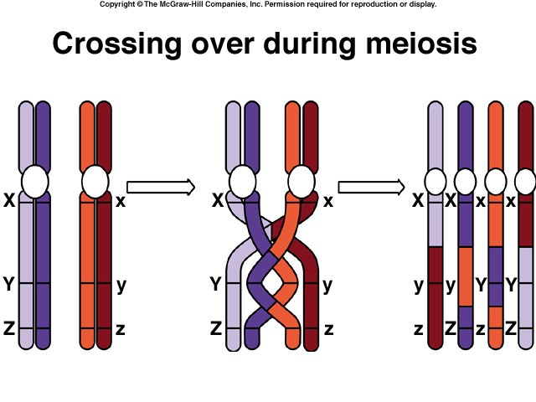
Crossing Over

Slide 7
Terminalization: After the completion of crossing over the non-sister chromatids start repelling each other because the force of synspsis attraction keeping them together lapse. The chromatids separate from the centromere towards the lip and in so doing, the chiasmata also start moving in zipper-like fashion towards the ends. The movement of the chiasmata is known as terminalizaion. Simultaneously, the chromatids condense and get shortened and in diakinesis the homologous chromosomes become separated except at their end.
Crossing Over

Slide 8
Theories of crossing over –
Darlington’s Breakage and reunion theory:
This theory is based on the assumptions that:
1. Prior to crossing over each chromosome of each bivalent get duplicated to form tetrad.
2. Crossing over occurs only between non-sister chromatids.
3. Crossing over involves the mechanical breaks in non-sister chromatids due to twisting around each other and reunion or recombination of chromatids take place.
According to this theory first of all, chromatids break and then form chiasmata. Crossing over does not produce chiasmata but it is caused by chiasmata.
Crossing Over

Slide 9
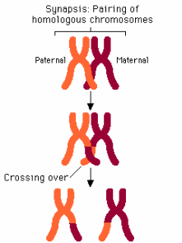
Crossing Over

Slide 10
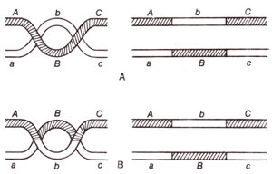
Crossing Over

Slide 11
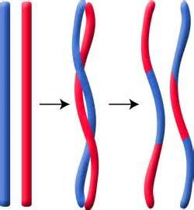
Crossing Over
Thanks

