Slide 1
Linkages
&
Recombination
Asso. Prof. R. S. Suryavanshi
  Definition,
  Types of Linkages - Complete & incomplete
  Linkage Groups
  Significance of linkages

Slide 2
Definition:
The tendency of two or more genes to stay together during inheritance is known as Linkage.
Or
All the genes on a chromosome are said to be linked to one another and belong to the same linkage group. The phenomenon of inheritance of linked genes in same linkage group is called linkage.
Or
The phenomenon of the inheritance of the genes together and to retain their parental combination even in the offspring is known as linkage.
Linkages & Recombination

Slide 3
Two or more genes are linked together because they are located on the same chromosome
Linked genes do not show independent segregation
The concept of linkage originated when Morgan demonstrated in 1910
Linkages & Recombination

Slide 4
Conclusion from his studies:
Genes located on the same chromosome tend to stay together during inheritance; this tendency is called Linkage.
Genes are arranged in a linear fashion in the chromosomes.
The intensity of linkage between two genes is inversely related to the distance between them in the chromosome. He also proposed that,
Coupling and repulsion phases are two aspects of the same phenomenon, i.e. linkage. Later studies have confirmed the above conclusions of Morgan.
Linkages & Recombination

Slide 5
Conclusion from his studies:
Genes located on the same chromosome tend to stay together during inheritance; this tendency is called Linkage.
Genes are arranged in a linear fashion in the chromosomes.
The intensity of linkage between two genes is inversely related to the distance between them in the chromosome. He also proposed that,
Coupling and repulsion phases are two aspects of the same phenomenon, i.e. linkage. Later studies have confirmed the above conclusions of Morgan.
Linkages & Recombination

Slide 6
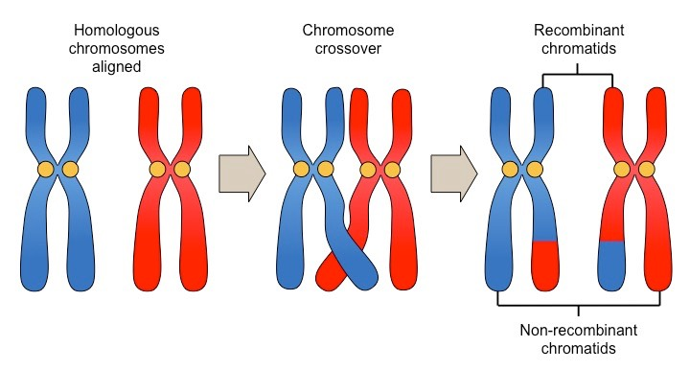
Linkage Types:
Complete linkage:
Incomplete linkage:
Linkages & Recombination

Slide 7
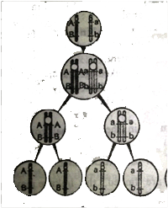
Complete linkage:
genes are so closely located in chromosomes
inherit in same linkage groups for two or more generations
called complete linked genes & such inheritance of completely linked genes is called complete linkage.
Linkages & Recombination

Slide 8
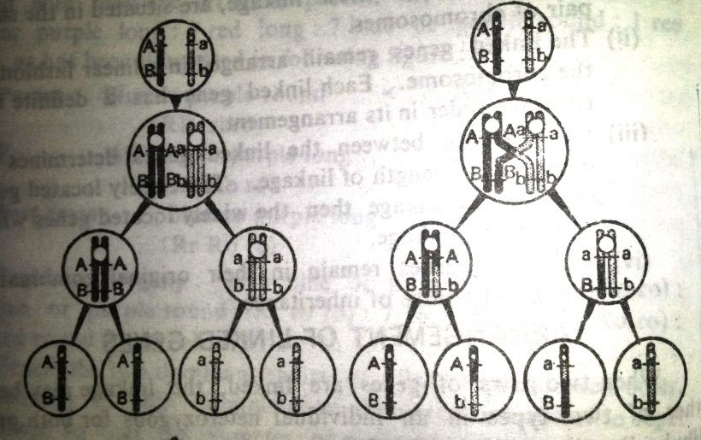
Incomplete linkage:
genes do not always stay together
because homologous non-sister chromatids may exchange segments - meiotic prophase - crossing over
linked genes which are widely located in chromosomes & have chances of separation by crossing over are called incompletely linked genes
Linkages & Recombination
the phenomenon of their inheritance is called incomplete linkage.

Slide 9
Incomplete linkage in Maize:
In Zea mays (maize) a case of incomplete linkage between the alleles for colour and shape of the seed has been observed by Hutchison. When a maize plant with seeds having colour and full endosperms (CS/CS) is crossed with another plants having recessive alleles for colourless, shrunken seeds (cs/cs), the F1 heterozygotes are found with the phenotype of coloured full and genotype of CS/cs. When F1 hybrid is test crossed with double recessive parent (cs/cs) four classes of descendants are obtained instead of two as shown in following figure.
Linkages & Recombination

Slide 10
Coloured full X Colourless shrunken : Parents
CS/CS cs/cs : F1
Coloured full (CS/cs)
Coloured full X Colourless shrunken :Test cross
Linkages & Recombination
Coloured, Coloured Colourless Colourless
full shrunken Full shrunken
CS/ cs Cs/cs cS/cs cs/cs
48% 2% 2% 48%

Slide 11
The test cross results are clearly showing that parental combination of alleles.
(e. g. CS/CS and cs/cs) are those expected from
complete linkage and appear in 96% cases;
new combinations (Cs/cs and cS/cs) - 4% cases.
Thus in 4% cases crossing over have occurred between linked genes.
Linkages & Recombination

Slide 12
The test cross results are clearly showing that parental combination of alleles.
(e. g. CS/CS and cs/cs) are those expected from
complete linkage and appear in 96% cases;
new combinations (Cs/cs and cS/cs) - 4% cases.
Thus in 4% cases crossing over have occurred between linked genes.
Linkages & Recombination

Slide 13
Incomplete linkage in Drosophila:
The wild type Drosophila has gray body and long wigs (b+v+/b+v+), where alleles for gray b+ and v+ dominate over the mutant alleles for black b and vestigial v. when, a gray long fly (b+v+/b+v+) is crossed with a black bodied and vestigial winged fly (bv/bv), the F1 heterozygote is found with gray long phenotype and b+v+/bv genotype. The F1 heterozygote (b+v+/bv) when test crossed with double recessive parent (bv/bv) instead of occurring of two classes of phenotypes in the ratio of 1:1, occur four classes of phenotypes as shown below
Linkages & Recombination

Slide 14
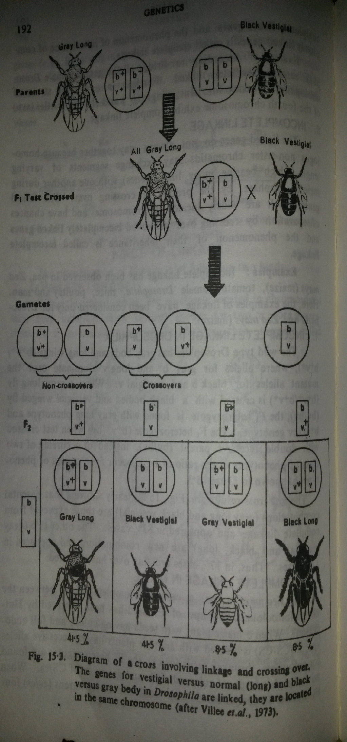
Linkages & Recombination

Slide 15
The test cross results are clearly showing that parental combinations (gray long and black vestigial) are those expected from complete linkage and appeared in 83% cases. The other two (gray vestigial and black, long) are new combinations and appeared in 17% cases. Thus, in 17% cases crossing over has occurred.
Linkages & Recombination

Slide 16
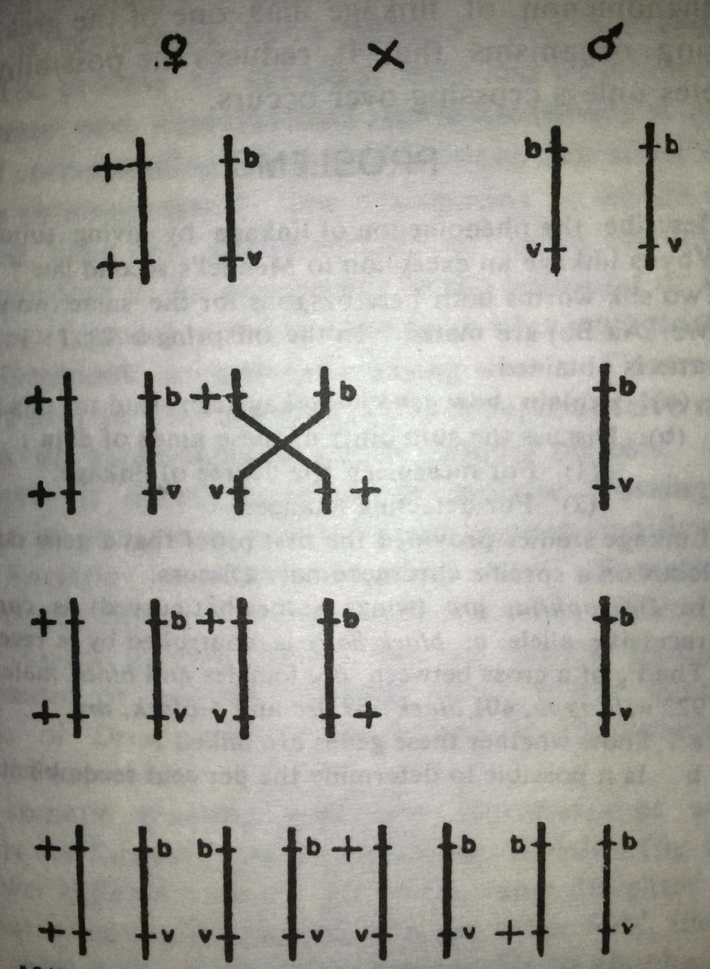
Linkages & Recombination

Slide 17
Linkage groups:
All the genes on a single chromosome.
They are inherited as a group;
during cell division they act and move as a unit rather than independently.
Variations in linkage groups can occur if a chromosome breaks, and the sections join with the partner chromosome, if it has broken in the same places.
This exchange of genes between chromosomes, called crossing-over,
usually it occurs during meiosis.
Sex linkage is the tendency of a characteristic to be linked to one sex;
sex-linked traits in humans include red-green colour blindness and hemophilia.
Linkages & Recombination

Slide 18
Significance of Linkages:
In the improvement of plants, linkage plays a great role in determining the nature and scope of hybridization and selection programs.
it reduces the possibility of variability in gametes unless crossing over occurs.
linkage helps to hold the parental characteristics together.
Linkage serves as a factor of racial and specific cohesion rather than as a barrier between species and between races.
Practical study of sex-linked characters for early determination of sex in the domesticated fowl has its own significance in the poultry farm.
Linkages & Recombination

Slide 19
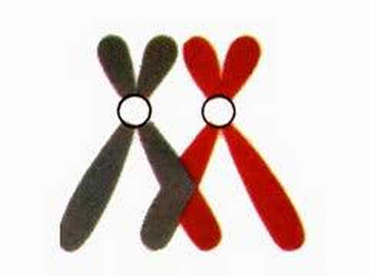
Linkages & Recombination
Thanks

