Slide 1
Study of Plant Pesticides Sources.

Slide 2
Principle:
The plant sources are used as insecticides. The plants contain the secondary metabolites which acts as or having property of insecticides.
    Neem
    Pongamia
    Custard Apple
    Tobacco

Slide 3
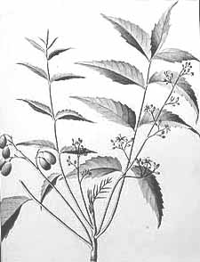
Neem
Botanical name : Azadirachta indica A. Juss.
Family : Meliaceae
Common name : Margosa
Vernacular name : Neem, Limb
Source : Leaves, Seeds, Seed oil, leaf extract, flowers, bark.
Morphology:
It is large and perennial tree about 40-50 feet high, with a straight trunk, much branched. Leaves alternate, imparipinnate, crowded near the ends of the branches, leaflets obliquely lanceolate, dark green above, paler beneath; flowers in axillary panicles, white, fragrant, fruit one seeded drupe with bitter-sweet pulp.

Slide 4
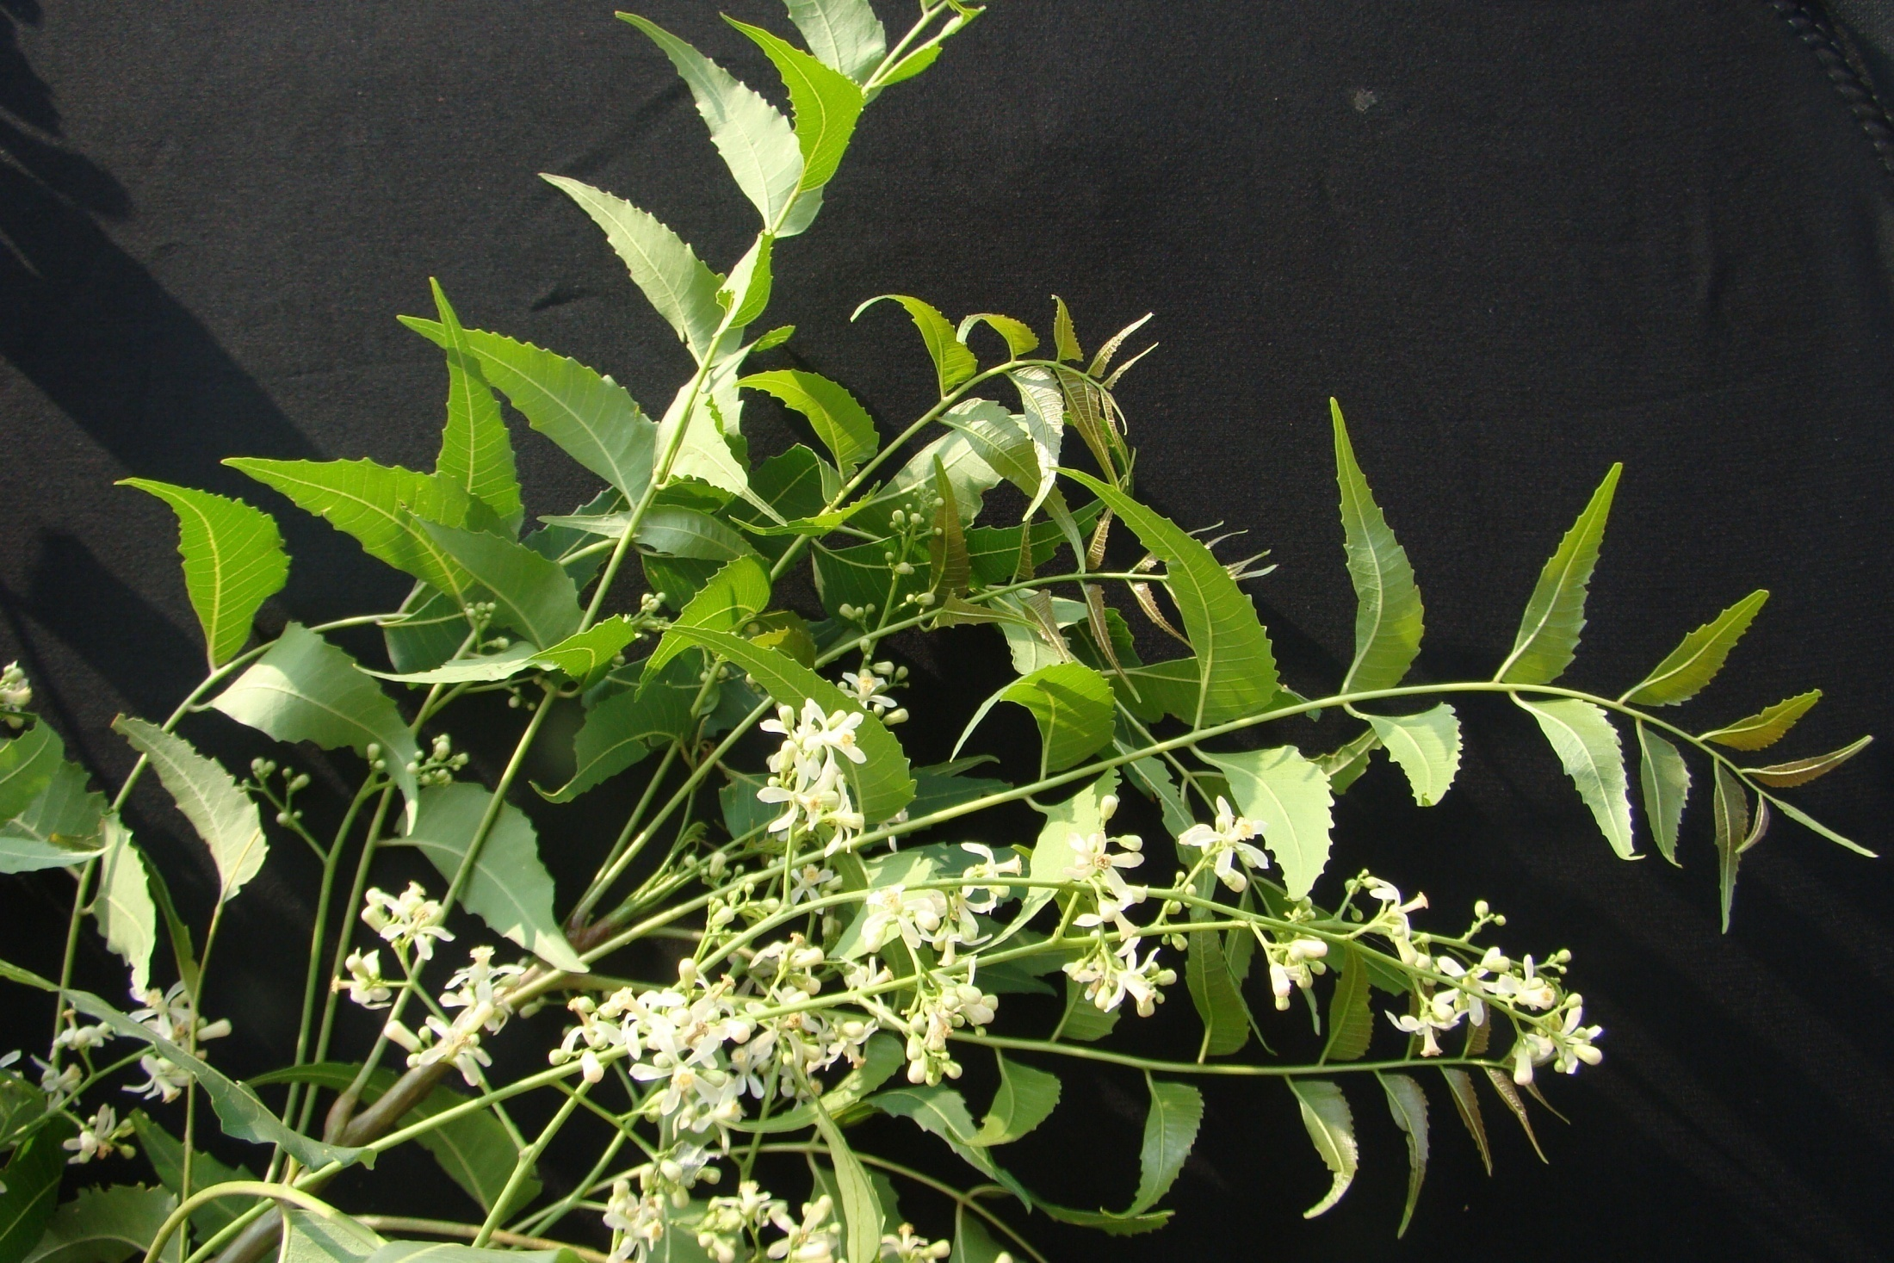

Slide 5
Uses:
Azadirachtin is used as insect repellent, insecticidal and sterilant.
Nimbin, nimbidine, nimbibin and nimbosterine are also used as insect repellent.
All of the alkaloids are useful against several leaf eating pests of crops. e. g. white ants, stripped cucumber beetle, horse flies, Japanese beetle etc.
Now-a-days, leaf extract or seed decoction with other plants extract mixed in it, a formulation prepared which is used by farmers to repel insects, pests (aphides, hoppers, jassids) of vegetable crops.
Dried leaves are used as insect repellant and added in stored grains.
Azadirachtin repel insects, inhibits their feeding practices; affects hormonal balance by mimicking an insects hormone and thereby preventing insects to complete their further life cycle stages.
Oil cake gives protection to crops from grain moth, lesser grain borer and red flour beetle.
Oil cake along with Pongamia oil cake application kills nematodes from soil. It is usually applied to avoid nematode infestation.

Slide 6
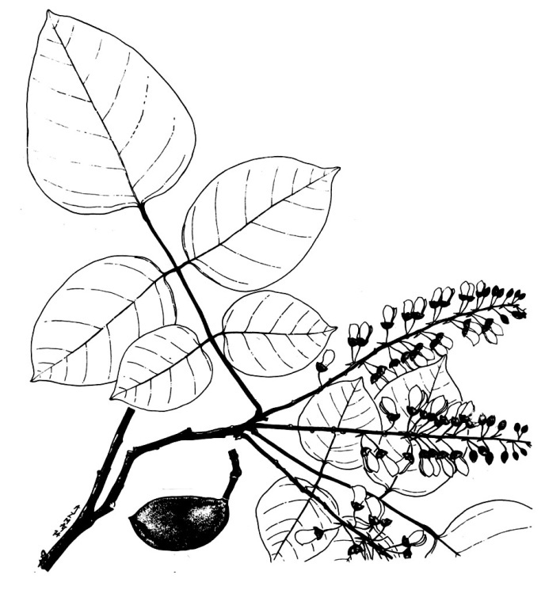
Pongamia
Botanical name: Pongamia pinnata (L.) Pierre
Family : Leguminosae
Sub-family : Papilionaceae (Fabaceae)
Common name: Karanj
Source : Seeds, Seed oil
Morphology:
Middle sized trees; branches drooping, glabrous. Leaves pinnate; leaflets opposite, 5-7, ovate-oblong or elliptic, acute or rounded at base, shortly acuminate. Flower in axillary racemes shorter than the leaves. Corolla pinkish-white. Pods woody, oblong-ellipsoid, compressed, recurved, mucronate. Seed solitary, reniform, brown.

Slide 7
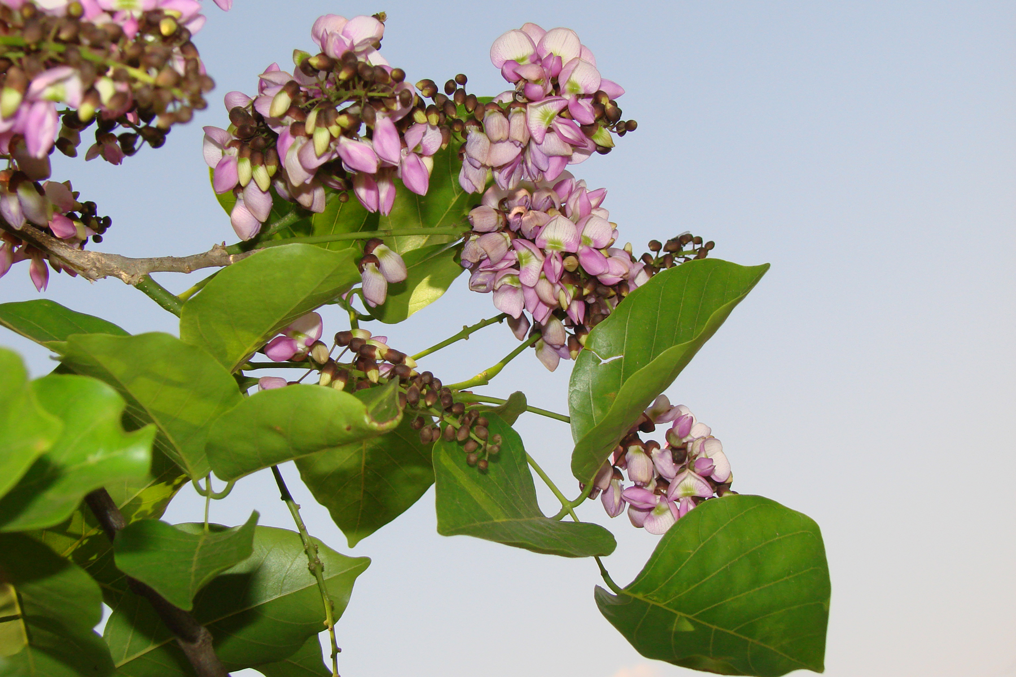

Slide 8
Pongamia
Botanical name: Pongamia pinnata (L.) Pierre
Uses:
Its different parts (viz. leaves, root, bark, flowers and seeds) containng a number of furano-flavonoid compounds are known to possess pesticidal activity.
Mature karanj seed methanolic extract in integrated pest management programmes.
Repeated application of this extract at different stages of insect development can protect the cotton from pests.
Oil on the life cycle (survival, fecundity) of green peach aphid.

Slide 9
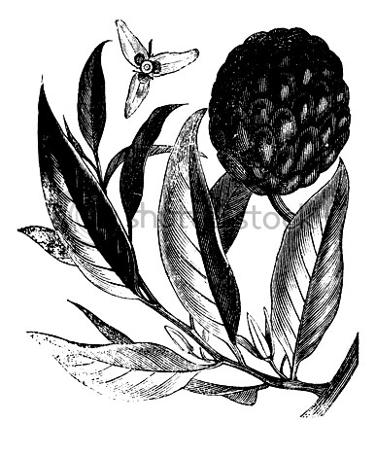
Sitaphal (Custard Apple)
Botanical name : Annona squamosa L.
Family : Annonaceae
Sub-family : Papilionaceae (Fabaceae)
Common name : Sitaphal
Vernacular name : Custard Apple
Source : Seeds, Leaves.
Morphology:
Small trees. Leaves elliptic, oblong-lanceolate, glaucous beneath. Flowers green, solitary or few, leaf opposed. Sepals connate at base. Petals pubescent. Fruits yellowish – green. Seeds brownish black, polished, oblong.

Slide 10
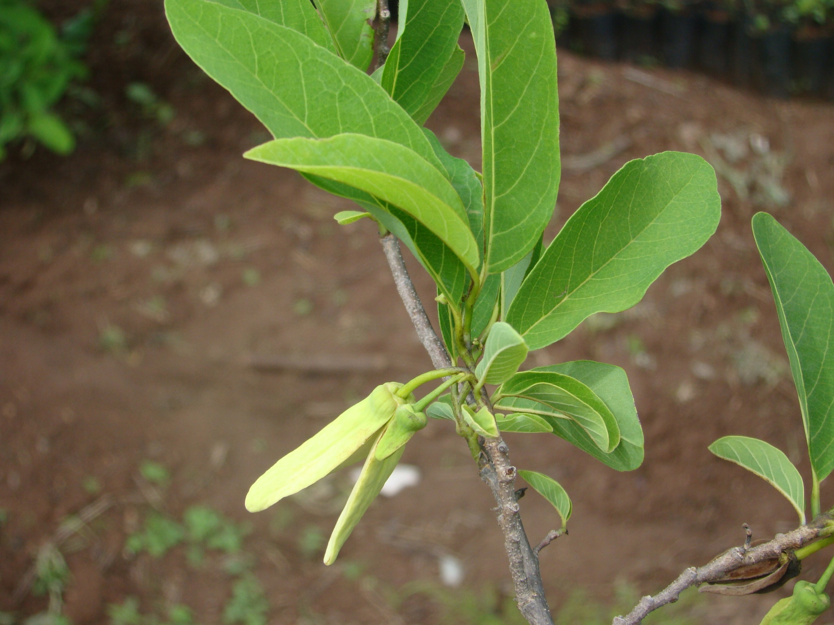

Slide 11
Sitaphal (Custard Apple)
Botanical name : Annona squamosa L.
Uses:
The Custard apple pesticide is inexpensive, environment-friendly and highly effective in containing a variety of pests on a number of crops.
Research studies have shown that acetogenins found in the seeds are toxic to insects. These biologically active ingredients reduce leaf disc feeding and larval massing of the armyworm, Mythimna separata.
The extracts also control stem borer, Chilo partellus. Alcohol extracts were found to be nearly as toxic as nicotine sulfate.
The seed extracts also showed synergistic activity in combination with neem seed extract. This combination works well on several pests, including Callosobruchus chinensis, Rhizopertha dominica and Musca domestica nebulo.
The leaf extract and lichets are control measure for the pests of the bringal.

Slide 12
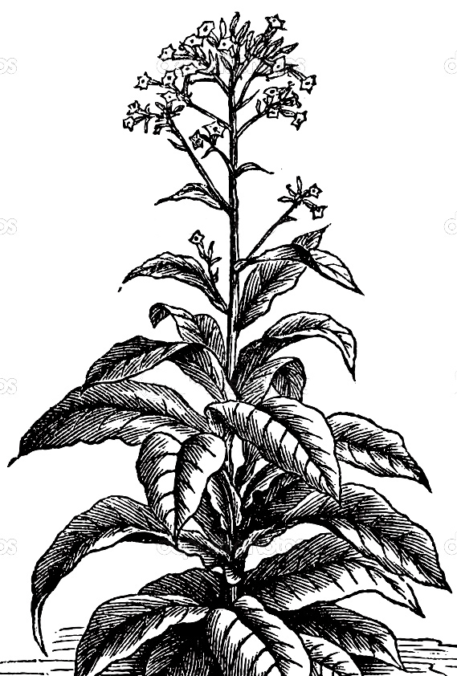
Tobacco
Botanical name : Nicotiana tabacum Linn.
Family : Solanaceae
Common name : Tobacco
Vernacular name : Tambakhu
Source : Leaves - fresh, dried and powdered
Morphology:
It is stout, annual, viscid herb, about 5 feet high, with a slender stout main stem having lateral branches, young branches are with viscid sticky hairs; leaves large, alternate broadly lanceolate, dark or pale green above, paler beneath, with prominent nerves on underside; leaves broad and with sticky tomentum on lower side, inflorescence axillary or terminal branched receme with white campanulate flowers; seeds very small, light in weight, many in each capsule.

Slide 13
Tobacco
Botanical name : Nicotiana tabacum Linn.
Family : Solanaceae
Common name : Tobacco
Vernacular name : Tambakhu
Source : Leaves - fresh, dried and powdered
Uses:
It is used as contact insecticide, acts as contact poison in leaf inhabiting larvae, adults of various insects, pests of crops.
Sometimes it acts as stomach poison to those pest chewing leaves and tender shoots of different crops.
Nicotine is effective against aphids of vegetable crops and various beans.
Nicotine foliar application is effective against leaf hoppers of vegetable crops and cabbage butterfly larvae.
Nicotine in the form of nicotine sulphate is effective against thrips, red mites, white flies of crops and green house ornamentals.

Slide 14
The End

