Slide 1
riccia
Classification (Systematic position) -
Kingdom : Plantae - (Chorophyll is present)
Subking. : Cryptogams - (Non flowering plant)
Division : Bryophyta-
(True roots & true vascular tissues ab.)
Class : Hepaticopsida - (Gametophyte is dorsiventrally flattened thalloid)
Order : Marchantiales - (Thallus dichotomously branched, scales present)
Family : Ricciaceae - (Air pores simple, sex organs develop in the mid dorsal groove. Sporophyte is in the form of capsule)
riccia

Slide 2
Occurrence-
The genus Riccia comprises about 138 species.
About 33 species have been recorded so far R. crystallina, R. kashyapii, R. pandel are endemic in India.
Riccia mainly grows on damp soil and shady places and other similar terrestrial habitats.
Due to dichotomous branching a circular patch of plants is formed which is called rosette.
Plant body represents haploid, the gametophyte generation. R. fluitans, the aquatic species, is partially submerged or it floats in water.
riccia

Slide 3
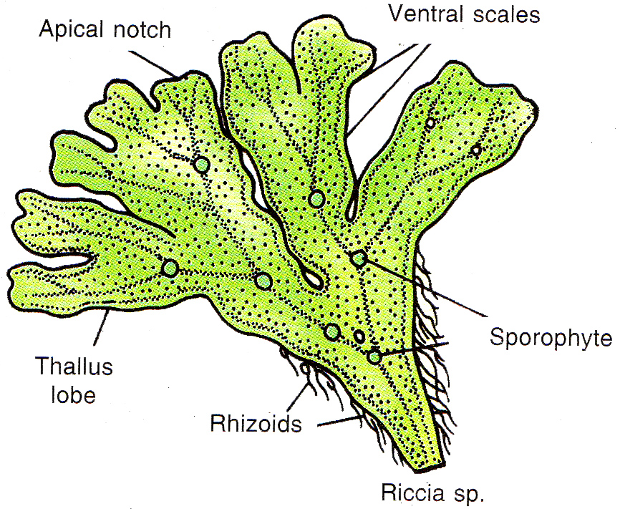
riccia
riccia

Slide 4
External Morphology of thallus –
gametophyte - flat, fleshy, green thalloidal body - growing prostrate on moist ground.
Dichotomously branched, and branches are known as lobes.
Thallus - thick in the middle and it gradually thins or tapers towards the margin.
Thick region - midrib and extends throughout the length of the thallus.
Each thallus lobe terminates into an apical notch or depression in which less the growing point of the thallus.
The thallus is attached to the substratum by means of rhizoids on the lower surface.
riccia

Slide 5
External Morphology of thallus:
Rhizoids are unicellular and unbranched.
Two types of rhizoids, - smooth walled and tuberculated.
rhizoids - fixation and absorption.
The scales in young plants are arranged in one transverse row near the apex.
When the thallus matures, they form two rows near the margin of the thallus.
riccia

Slide 6
Internal structure of thallus –
A vertical section of thallus shows an outline with a depression in the centre termed as the dorsal groove.
The externally simple thallus shows a slight internal differentiation.
The thallus is formed of two distinct regions, viz.
  the lower or ventral storage region and
  an upper or dorsal photosynthetic or assimilatory region
riccia

Slide 7
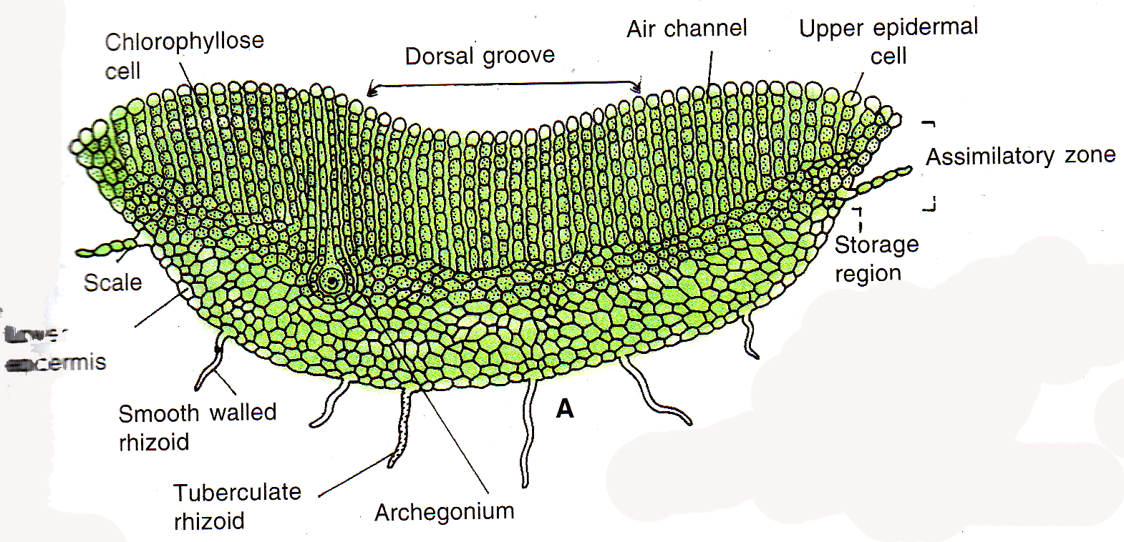

Slide 8
Storage region–
present on the ventral surface - formed of closely packed parenchymatous tissue (no intercellular spaces)
The chloroplasts are absent in this region.
The region acts as storage tissue, storing water and reserved food material (starch).
From the lower epidermal cells, develop rhizoids and amphigastria.
The rhizoids help in absorption while the amphigastria give protection to the plant and retain water.
riccia

Slide 9
Photosynthetic region–
It is present on the dorsal surface of the thallus.
It consists of chlorenchymatous cells arranged in vertical rows of one cell thickness.
The rows of chlorenchymatous cells are called photosynthetic filaments.
Between the chlorenchymatous rows - air chambers, air-canals are air-clefts.
The air chamber lacks photosynthetic filaments.
The air cleft is surrounded by six to eight vertical rows of chlorenchymatous cells.
The outermost or the terminating cell of each row is slightly bigger and colourless.
riccia

Slide 10
Photosynthetic region–
These terminal cells together form an interrupted upper epidermis.
The air-cleft communicate with the outer environment through the gaps in the upper epidermis called air-pores.
In the case of the aquatic species, the epidermis is continuous and air-pores are absent.
The thallus shows large air-cavities which store air and give buoyancy to the plant.
The epidermal cells also show presence of chloroplasts.
riccia

Slide 11
Reproduction–
A. Vegetative
Fragmentation – Due to death and decay the older dichotomy separate - favourable conditions, - new thallus.
Adventitious branches – arise from the mid-ventral surface of the thallus - detached - new plants.
Tubers - The tips of branches store food material and become swollen - tubers. In favourable - new plants.
Persistent apices – prolonged dry conditions, the plant dies except the apical part. This apical part however grows deep into soil and becomes thick. It resumes active growth in next season and develops into a new thallus.
riccia

Slide 12
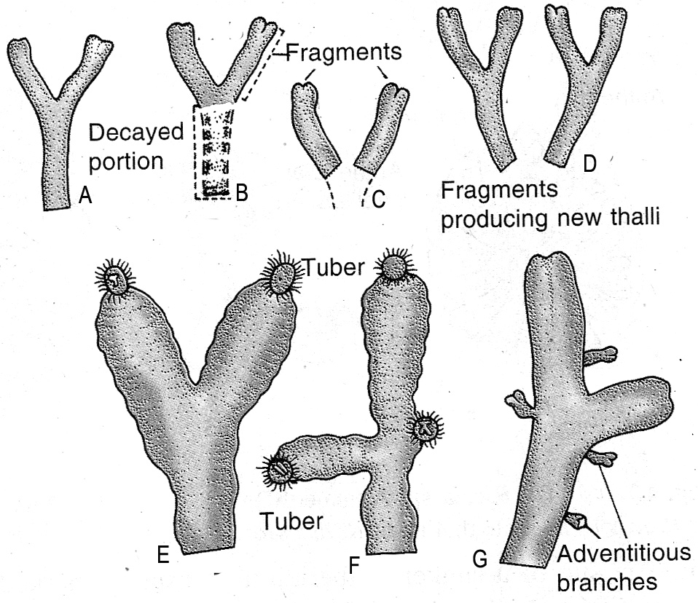
Reproduction–
A. Vegetative
riccia

Slide 13
Reproduction– B. Sexual:
Sexual reproduction in Riccia is oogamous.
The sex organs are well developed, multicellular and separate.
The male reproductive organ is called the antheridium and the gametes, the antherozoid.
The female reproductive organ is called the archegonium and the gamete the ovum.
Both the sex organs - on the same plant- monoecious.
on different plants- dioecious or unisexual.
The sex organs are formed on the dorsal surface and are deeply sunk in the mid-furrow of the thallus.
riccia

Slide 14
Reproduction–
B. Sexual:
Though formed on the dorsal surface, they are enclosed in cavities because of the vigorous growth of the neighboring vegetative cells.
The sex organs are formed in acropetal succession.
A self-fertilization is avoided in monoecious species due to the different maturation periods of the sex organs (prodandrous).
riccia

Slide 15
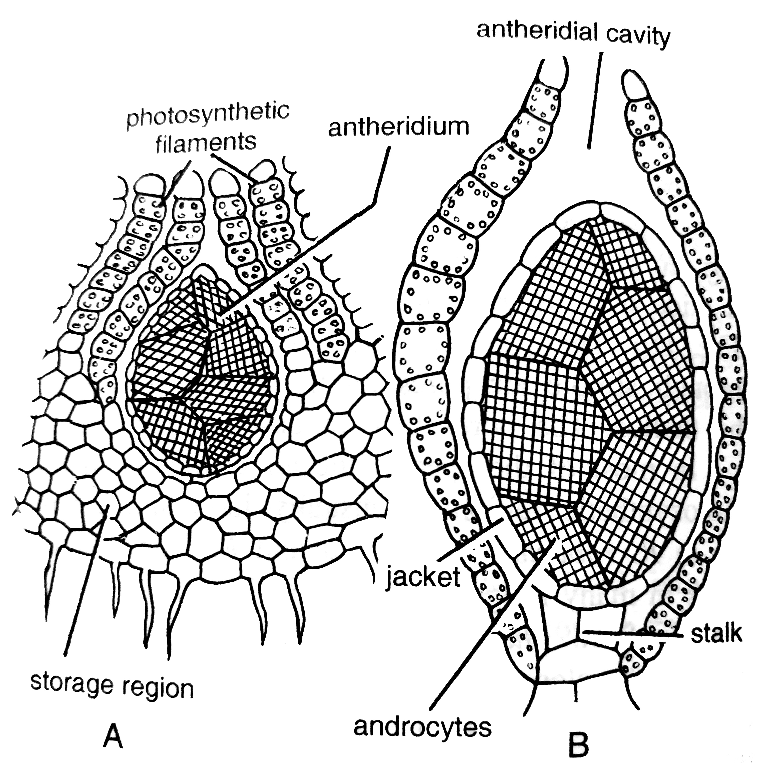
Antheridium :
riccia

Slide 16
Antheridium :
multicellular and elongated structure enclosed in an antheridial cavity
consists of a stalk and a body
body is ovoid or pear-shaped
outermost sterile layer called the jacket layer or the antheridial wall - protective
encloses a mass of fertile, cubical cells called androcyte mother cells
Each mother cell divides diagonally to form two androcytes or spermatids
numerous antherozoids or spermatozoids are formed in an antheridium.
riccia

Slide 17
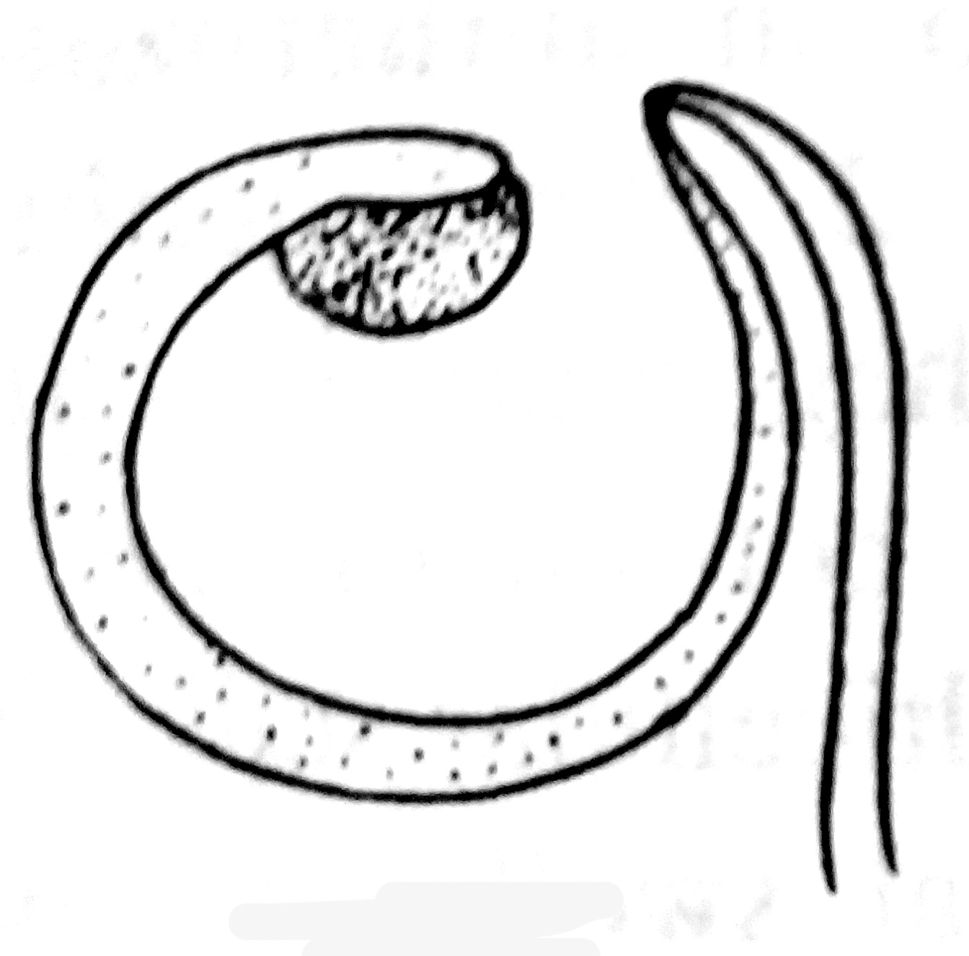
Antherozoid :
spermatozoid is a minute, slender, curved and flagellate structure. Flagella are two in number and are inserted at the anterior end. The body possesses elongated blepharoplast, a nucleus and a little cytoplasm. The unused cytoplasm remains attached to
the posterior end forming a vesicle.
riccia

Slide 18
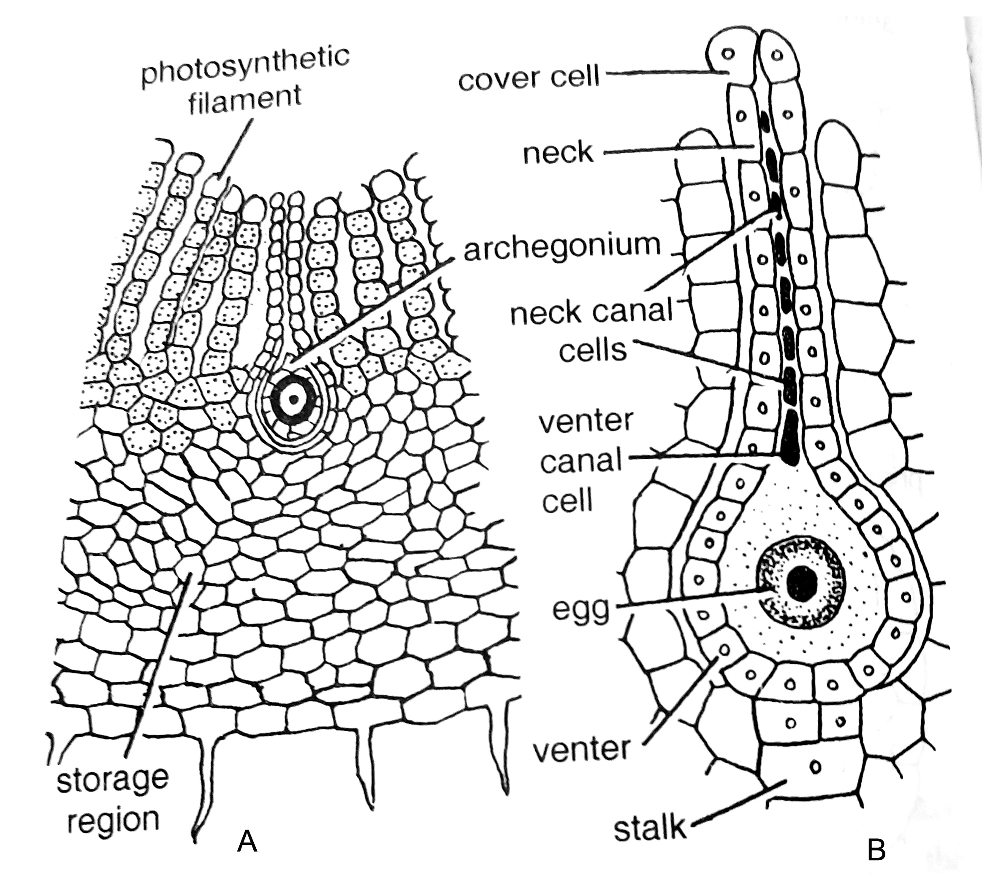
Archegonium :
riccia

Slide 19
Antheridium :
Present in a cavity (Archegonial cavity).
Archegonium is flask shaped.
Archegonium formed of three parts - stalk, ventre and neck
Stalk is small and few celled
Venter is broad & venter wall is one cell in thickness
  Venter encloses a cavity - venter cavity
  two unequal cells
  smaller - ventral canal cell
  larger, posterior cell - ovum or the egg cell
Neck consists of six vertical rows of cells
At the tip - four specialized cells - lid cells or cover cells.
riccia

Slide 20
Dehiscence of Sex organs:
water or even moisture is necessary
spermatozoids lie in the antheridial cavity because the walls of spermatids are already dissolved
water finds its way to the antherdial cavity through the ostiole of the cavity
antheridium bursts liberating antherozoids due to pressure created
archegonium reaches maturity, the ventral canal cell and the neck canal cells disintegrate or degenerate to form mucilage
mucilage absorbs more water and pressure is created separating the lid cells
Sperms reach to the egg cell.
riccia

Slide 21
Fertilization:
Certain chemical substances are exuded along with the mucilage
These chemicals probably attract the spermatozoids.
Only one of the antherozoids surrounding the egg succeeds in uniting with the egg
gamatophytic stage ends with the process of fertilization.
The zygote, the first cell of the sporophytic generation is embedded in venter
riccia

Slide 22
Sporophyte:
Zygote is the first cell of diploid or sporophytic generation
The mature sporophyte of Riccia is the simplest among the sporophytes
It consists of only capsule or the spore sac, while foot and seta are absent
The sporophyte is embedded in the storage tissue of the gametophyte and enclosed in the venter cavity of the archegonium.
zygote divides mitotically to form sporogonium having a single sterile layer, the capsule or jacket wall, enclosing spore mother cells or sporophytes
The sporophytes are last cells of diploid generation
The sporophytes divide meiotically to produce haploid cells
riccia

Slide 23
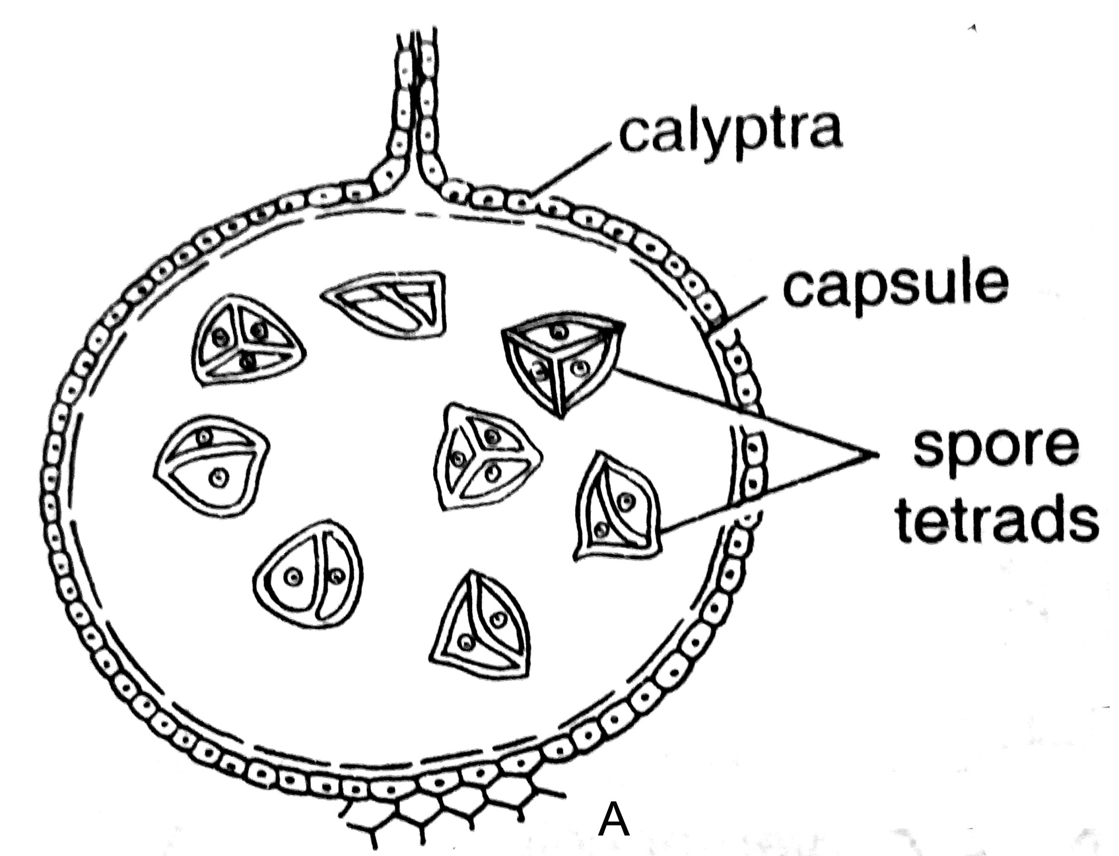
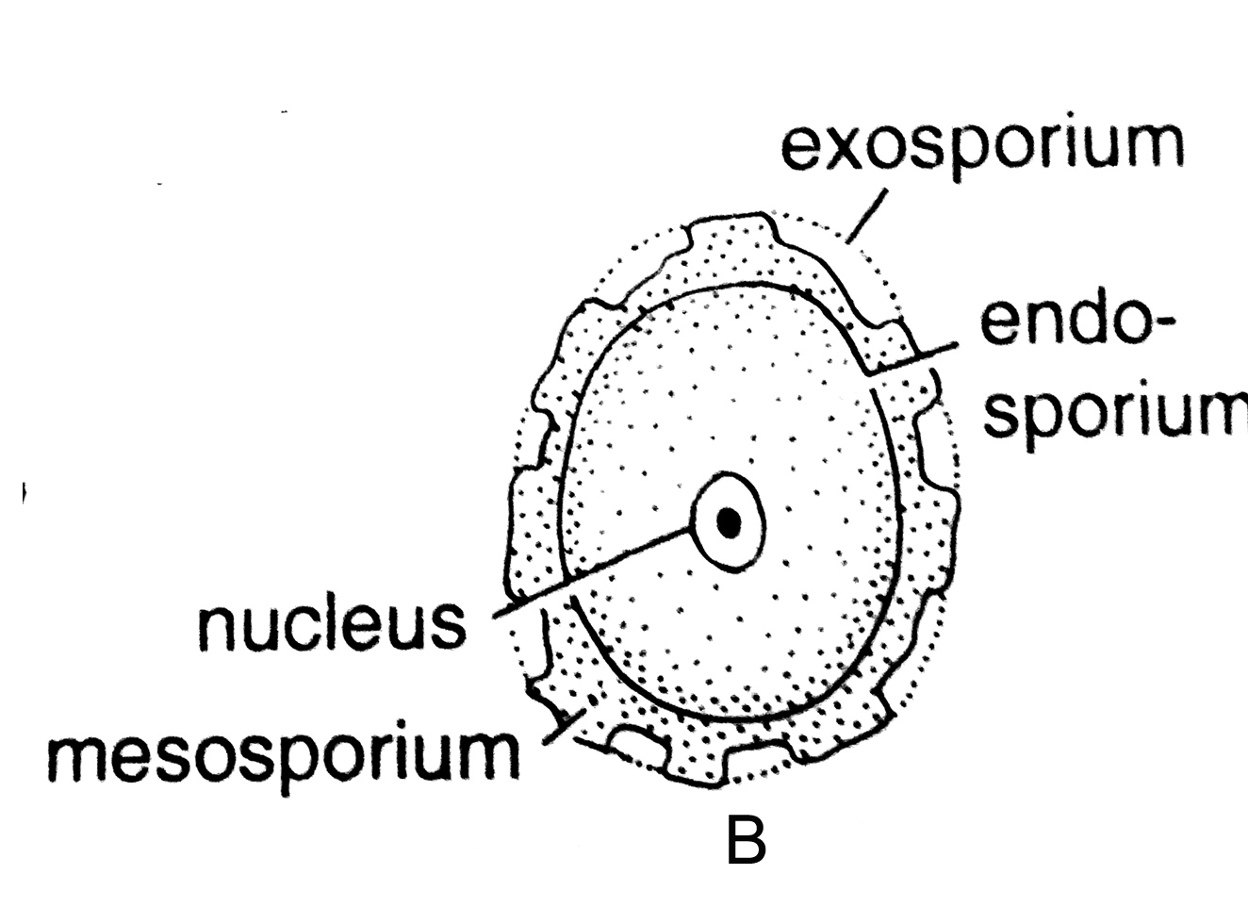
Spores :
riccia

Slide 24
Sporophyte :
sporophyte is completely dependent for nutrition on the gametophyte - complete
sporogonium of Riccia never dehisces
surrounding calyptra decay or disintegrate, the spores remain behind on the soil.
favourable conditions, they germinate to from new plants
riccia

Slide 25
Spores:
spore is tetrahedral
spore wall or sporoderm is formed of two layers, the outer exine (exosporium), and the inner intine (endosporium)
exine is variously ornamented
exine is cuticularised, while the intine is thin walled
riccia

Slide 26
Spore germination:
presence of light and the presence of moisture
spore absorbs water and the pressure created ruptures the exine.
intine comes out forming a short germ tube
contents of the spore migrate to the tip of the germ-tube and a partition is formed
division and redivision of the apical region results into a new gametophyte
riccia

Slide 27
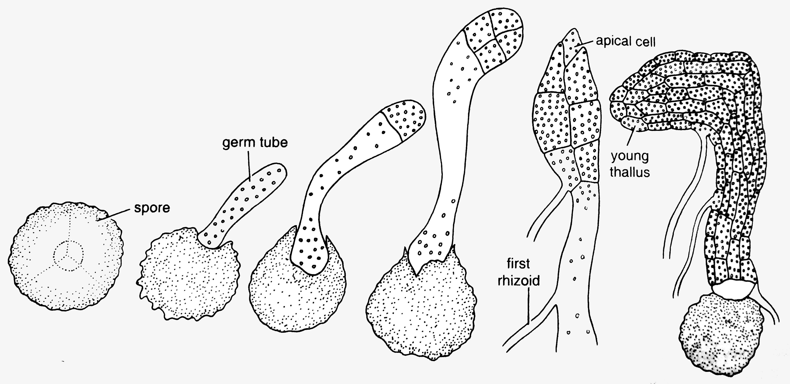
riccia

Slide 28
Alternation of generation:
two distinct generations in the life cycle of Riccia
They are haploid and diploid generations or gametophytic and sporophytic generations.
gametophyte -antheridia and archegonia develop antherozoids and ova respectively
antherozoids unites with the egg resulting in the formation of a zygote (diploid)
sporophyte, a diploid phase is a complete parasite depending for nutrition on the gametophyte
Sporophyte – capsule, within it after reduction division, gives rise to a number of haploid spores.
spore germinates and develops into a gametopyte
gametophyte gives rise - sporophyte and sporophyte gives rise - gametophyte or gametophyte and sporophyte alternate with each other
riccia

Slide 29
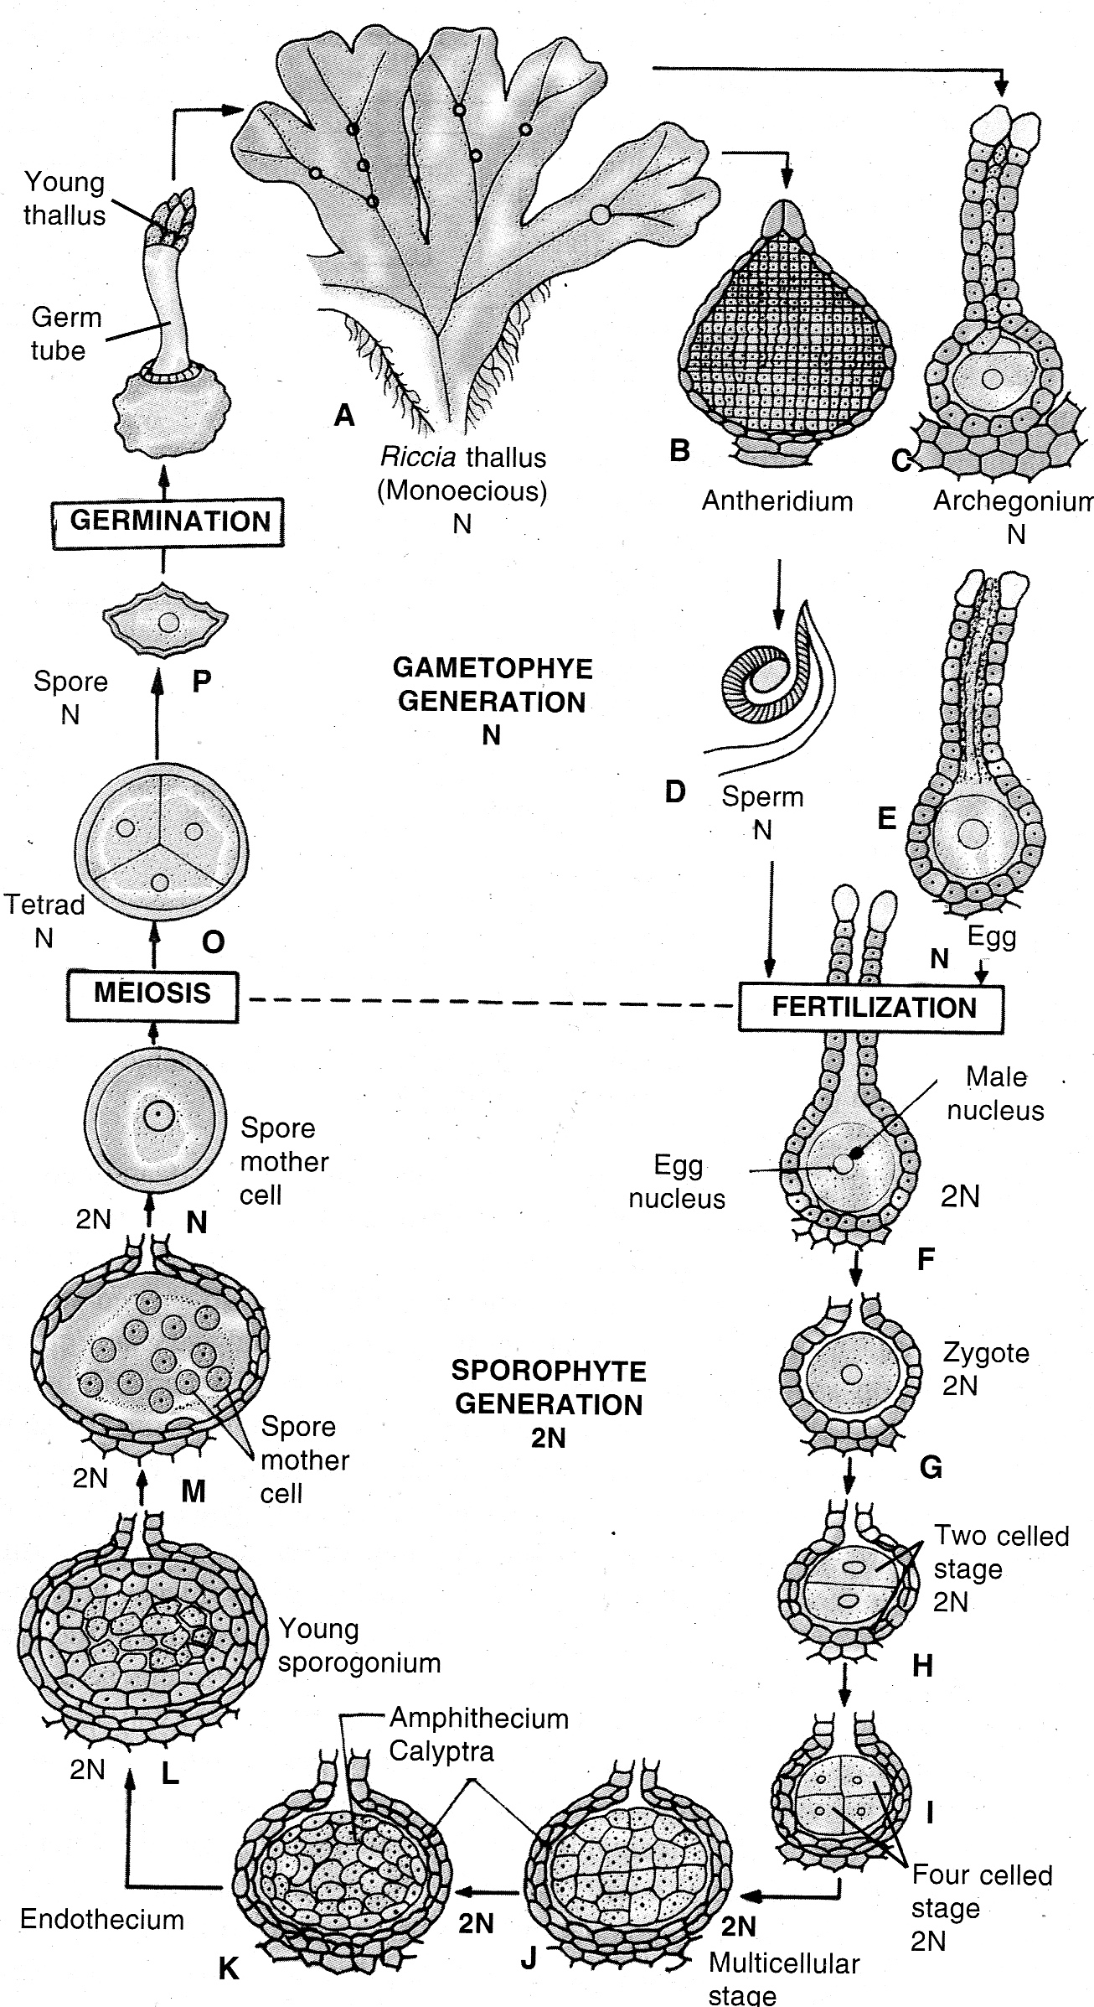
riccia

Slide 30
Economic Importance:
rock builders, in soil conservation and in development of vegetation.
Medicinal uses:
treating liver disorders – so known as Hepatics or liverworts
Marchantia polymorpha has been used to cure disorders of liver and for pulmonary tuberculosis
Decoction of Sphagnum is used in the treatment of acute hemorrhage and diseases of eye
Tea made from leaves of Polytrichum commune helps to dissolve stones of kidney and gall bladder
some antiseptic property and therefore, it is used for filling absorbent bandages in surgical dressings
antibiotics can be obtained from extract mosses like, Sphagnum, Mnium, Polytrichum
riccia

Slide 31
Economic Importance:
B. Horticultural uses:
Sphagnum and peat is used as a packing material for grafting sections.
Sphagnum is also used as packing material for shipment of live plants, cut flowers, vegetables, perishable fruits and tubers.
Peat is added to heavy soils like clayey soils to improve their textures as peat keeps such soil porous and prevents caking it.
Peat is added to dry sandy soils and other humus poor soils to improve water-holding capacity of soil.
Moss sticks are prepared from epiphytic mosses to give support and moisture for weak stem plants like, Pothos, Philodendron.
riccia

Slide 32
Economic Importance:
C. Fuel:
Dried peats are rich in carbon used as fuel on commercial scale.
D. Alcohol preparation:
Cellulose in peat is broken down into sugars and by fermentation; it is converted into ethyl alcohol.
E. For Products preparation:
Peaftar, ammonia, paraffin, nitrate, brown dye and tanning materials are produced from peat.
F. Pollution indicator:
Sphagnum acts as pollution indicator by accumulating heavy metals from the atmosphere.
G. Soil conservation:
The mosses prevent erosion of soil by developing dense mat on the soil.
riccia

Slide 33
Economic Importance:
H. Rock builders:
Mosses like Bryum, Hypnum grow along with other aquatic plants play important role as rock builders.
I. In research:
The liverworts and mosses have played an important role as research tool in various phases of botany like genetics.
J. Soil formation:
Bryophytes play important role in plant succession on bare rocks. When soil is very less, Porella and some mosses grow in scanty soil and help to increase the amount of soil on rock surface, due to which small herbs can grow later, on the surface of rock
riccia

Slide 34
Thank You,
Wish You
All The Best…..

