Slide 1
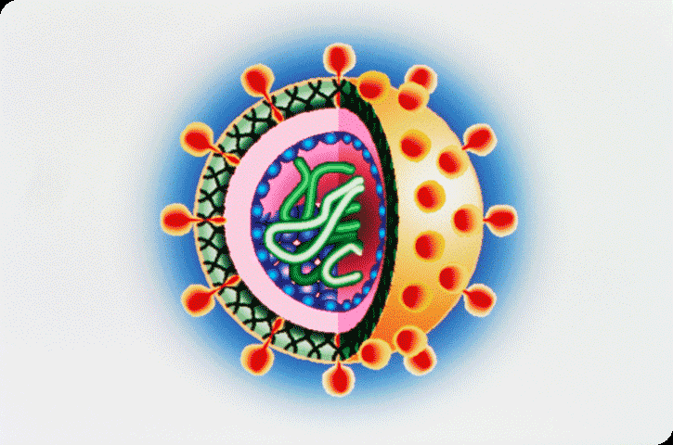
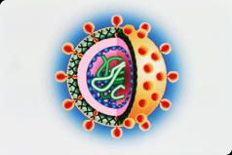
VIRUSES
Virology
Louis Pasteur (1822-1895) and Robert Koch (1843-1910) discovered that microbes were the causes of many diseases.
Pass through specially designed filters
In 1935, W.M Stanley – isolated TM V – find properties of a crystalline solid .
Virus not a simply protein but nucleoprotein
Its infectious principle is the nucleic acid (RNA/DNA)
Stanley was awarded Nobel Prize in 1946.
Def. - “The virus is an obligatory parasitic pathogen with at least one dimension of less than 200 milimicrons (mµ).”

Slide 2
General characters
All the viruses are ultramicroscopic.
All viruses are obligatory intercellular parasites.
The viruses cannot be grown in artificial media.
They are crystalline nucleo-proteins of very high molecular weight and have the power of multiplication.
They can live only in a living cell.
They can infect healthy plants just like bacteria and fungi.
They are too small to be observed under visible light.
They can be crystallized like chemical substance.
They can be sedimented like proteins.
They can responds to stimuli such as acids, alkalies, light and temperature.
They are highly infectious (1/1,000,000 dilutions).

Slide 3
General characters
They can be filtered through Brefeld and Chamberlain filters.
Viruses are transmissible from diseased to healthy plants by animal or insect vectors.
Some viruses, called satellites, can replicate only within cells that have already been infected by another virus.
Influenza viruses are spread by coughing and sneezing. Norovirus and rotavirus are transmitted by faecal – oral route and some viruses are passed from person to person by contact, or enter the body through food or water.
HIV is transmitted through sexual contact and by exposure to infected blood. The range of host cells that a virus can infect is called its host range. This can be narrow or, broad as when a virus is capable of infecting many species.

Slide 4
Structure of Viruses

Slide 5
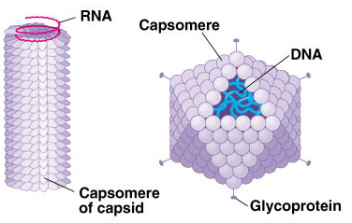

Slide 6
Structure of Viruses
Viruses are small obligate intracellular parasites
made up of a core of genetic material either DNA or RNA.
surrounded by a protective coat called a capsid which is made up of protein.
Sometimes the capsid is surrounded by an additional spikey coat called the envelope.
A complete virus particle is called a virion
virion is to deliver its DNA or RNA genome into the host cell -genome can be expressed (transcribed and translated).
The viral genome, often with associated basic proteins, is packaged inside a symmetric protein capsid.
Viruses are capable of latching onto host cells and getting inside them.

Slide 7
Structure of Viruses
On morphological basis, the viruses are categorized in following three groups
Helical (Cylindrical) Viruses: In this type, the viruses are elongated, rod-shaped, rigid or flexible. Its capsid is a hollow cylinder with a helical structure. Capsid consists of monomers arranged helically in a rotational axis (Fig. 2). It may be
  Naked viruses - This virus is rod shaped measuring about 280 x 150-180 µm. e.g. TMV (Fig. 2).
  Enveloped viruses – When the helical viruses are enclosed within an envelope they are known as enveloped helical viruses e.g. Influenza virus (Fig. 1).

Slide 8
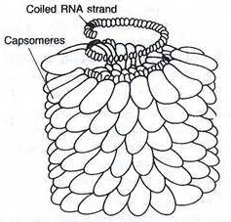
Structure of Viruses
Naked viruses -. TMV
Enveloped viruses –e.g. Influenza virus

Slide 9
Structure of Viruses
2. Polyhedral (Icosahedral) Viruses: Icosahedron is a regular polyhedron with 20 triangular faces and 12 corners. There are several animal, plant and bacterial viruses which have either naked or enveloped icosahedral shape.
  Naked icosahedral viruses – The capsid has the ring like capsomeres each containing pentamers and hexamers. A total of 32 hexamers and 12 pentamers are found in the capsid. e.g. Turnip yellow mosaic virus (TYMV).
  Enveloped icosahedral viruses – The capsid enclosed inside an envelope of 30 nm thickness that is made up of a glycoprotein –lipid complex. The envelope consists of spikes on its surface. e.g. Herpes simplex virus.

Slide 10
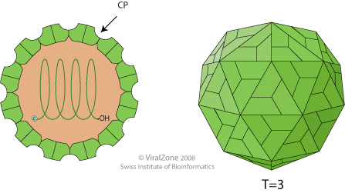
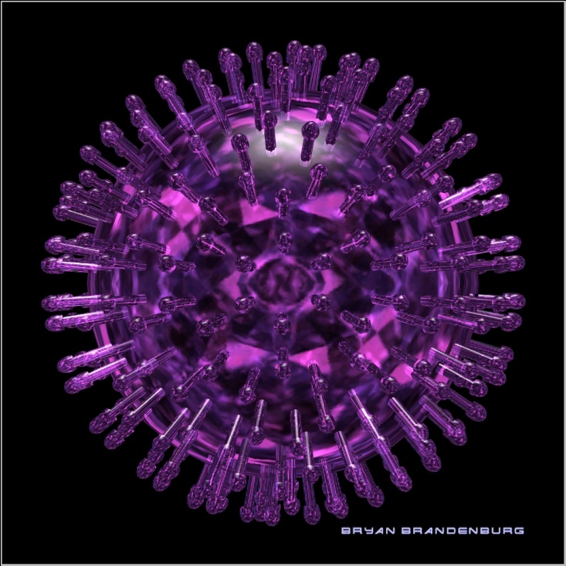
Structure of Viruses
Naked viruses
Enveloped viruses –

Slide 11
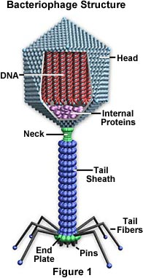
Structure of Viruses
3. Complex Viruses: capsids with additional structures or unidentifiable capsids are called complex viruses
a. Vaccinia virus – definite capsids absent
b. T-even bacteriophages – Capsid present, and consist of a tail. It consists different types of viruses, viz. tadpole shaped viruses (with head and tail e.g. T-even phage) (Fig 3), viruses with tail less head (phage λ, T₁, T₅), virus with brick shaped and devoid of flattened cylinder (pox virus), bullet shaped capsid viruses (e.g. nuclear polyhedrosis or cytoplasmic polyhedrosis viruses).

Slide 12
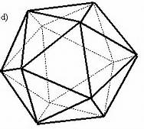
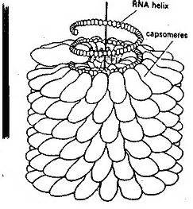
Virus Shape
determined by either its capsid or its nucleic acid.
Icosahedron has 20 trianglular faces -- herpes simplex, chicken pox and polio
Helix is a spiral shape (like DNA) -- rabies, measles and tobacco mosaic virus

Slide 13
Virus Shape
Types of Viruses-
  1)DNA - Replicated in one of two ways.
    Directly produce RNA that makes new viral proteins.
    Join with the host cell’s DNA to produce new viral proteins
  2) RNA-
    Viral RNA is released into the host cell’s cytoplasm and uses the ribosomes to produce new viral proteins.
    Some are known as retroviruses containing an enzyme called reverse transcriptase.
    These use the RNA as a template to make DNA.
    This DNA is integrated into the host cell’s DNA

Slide 14
Classification of Virus
According to the nature of their hosts, viruses are classified as
  plants viruses,
  animal viruses and
  bacteria viruses.

Slide 15
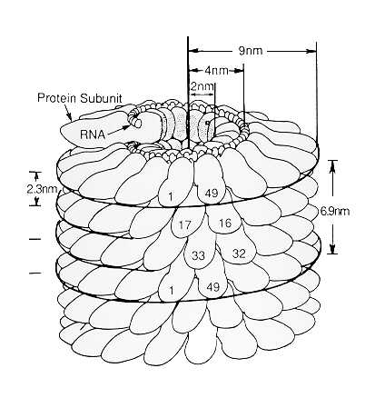
Classification of Virus
Plant viruses-
  Plants viruses occur either as spheres or elongated rods
  In both cases there is some sort of a ribonucleic acid
  RNA core surrounded by protein sheath
  The rod forms of tobacco mosaic also contain a central core of RNA as shown in fig.
  The elongated rod of tobacco mosaic virus is twisted into uniform spiral to form what appears in gross form as a hallow rod.

Slide 16
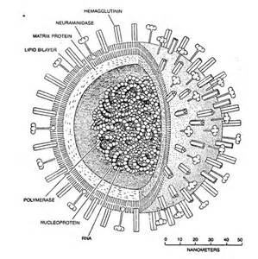
Classification of Virus
Animal viruses
Influenza virus, Pox virus, Reo virus
Influenza virus differ from TMV (Tobacco Mosaic Virus) in that instead of being straight rigid particles, they are apparently more flexible and form loose coils.
A further characteristic is that coils are enclosed in an envelope .
The outside surface of which is covered with minute protein particles probably involved in attaching the virus to the surface of host cells.

Slide 17
Classification of Virus
Bacterial Viruses
attacking bacteria - bacteriophages or phages.
These are tadpole like in shape .
T4 phase attacking the bacterium E. coli is among the most complex of viruses .
It consists head and rather complicated tail.
The shape of head is like an icosahedrons having a length of 1250 A⁰ and width of 859 A⁰ .
The tail is attached to the head through a neck and collar.
The naked tail consists of a distal hexagonal base plate attached to an inner hallow cylinder called the core through which DNA passes on its way into the host cell.

Slide 18
Economic importance of Viruses
"Nuclear Polyhedrosis Virus" used as pesticide to kill pests in agricultural fields.
Bacteriophage T4 and LAMBDA used to sale by companies to biology institutions for experiments to carry out.
Virotherapy is an experimental form of cancer treatment using biotechnology to convert viruses into cancer-fighting agents by reprogramming viruses to attack cancerous cells, while healthy cells remained relatively undamaged.
Usually the viruses used are herpes simplex virus or Adenoviruses.

Slide 19
Economic importance of Viruses
Viruses are used against various diseases, most commonly as a vector used to specifically target cells and DNA in particular. This has been largely attributed to the production of interferon and tumor necrosis factors in response to viral infection, but oncolytic viruses are being designated that selectively target and lyses only cancerous cells.
The computer technicians keep antivirus software developers and removal software.
Viruses in agriculture are used for modification of host genome which results into genetically modified plants and animals.
Edward Jenner used cow pox viruses to inoculate people against small pox infection. Vaccines are also used against polio, chicken pox etc.
Viruses are used in directed enzymes pro drug therapy.

Slide 20
Thank You

