Slide 1
Cyanophyta
NOSTOC
Seema A. Gaikwad
V. M. Sangola

Slide 2
NOSTOC
*Systematic position / classification
Div. – Cyanophyta
Class- Cyanophyceae
Order –Nostocales
Family- Nostocaceae
Genus- Nostoc

Slide 3
Occurence :- The species of Nostoc occurs in fresh water ponds,pools,puddles and ditches.Some species are found on damp soil and some on the wet bark of the trees in irregular mucilaginous masses known as Nostoc colonies which are endophytic also. Certain species of Nostoc are found in paddy fields where they fix atmospheric nitrogen in the soil and enrich the fertility of the soil of the fields

Slide 4
St.of colony :- Innumerable contorted filaments of Nostoc are found embedded in the mucilaginous envelope. The mucilaginous envelope forms more or less a firm boundary known as Nostoc colony. The colonies are spherical in the beginning but later on they become irregular in shape.

Slide 5
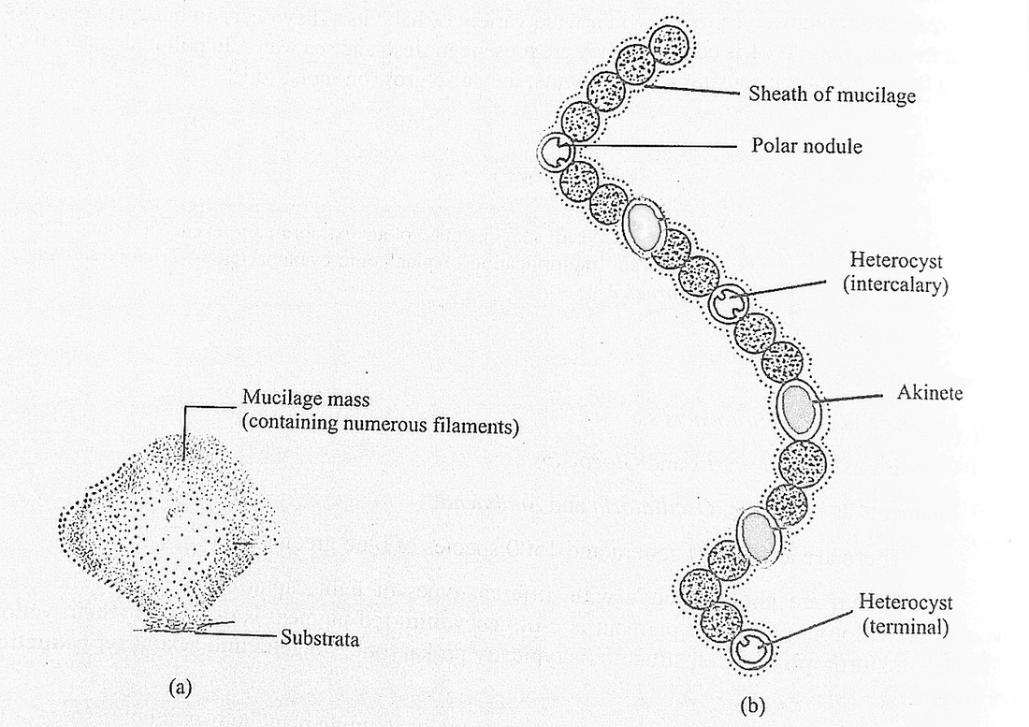

Slide 6
Str.of Trichome /Filament:- Each trichome possesses many spherical bead like cells which gives moniliform appearance to the trichome. Usually each filament is individually ensheathed by mucilaginous sheath. The trichome are of varying length. The negative cells in the trichome are joined end to end like a string of beads. At some intervals along with trichome are found colorless, empty looking ,spherical or barrel shaped cells called heterocysts. They are intercalary or terminal in position somewhat large in size and with thicker wall than vegetative cells.

Slide 7
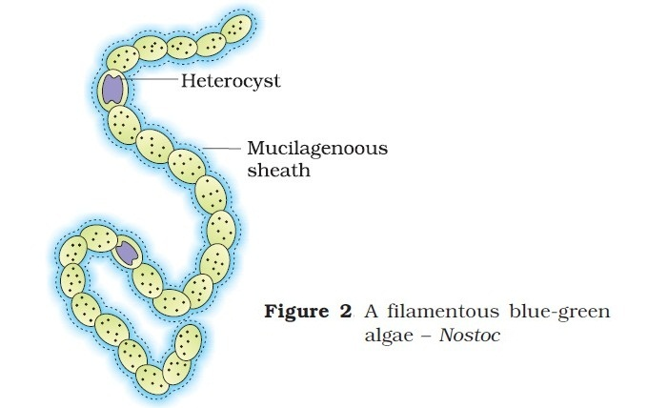

Slide 8
Cell structure :- The cell consist of the cell wall surrounding the protoplast. The protoplast of each cell may easily be differentiated into two regions. The peripheral colored region is called the chromatoplasm.
This regions contains many pigments such as phycocyanin,phycoerythrin ,carotene, xanthophyll ,chlorophyll and food reserves such as glycogen granules etc. The central colorless region of the cells is called centroplasm. True nucleus is absent.

Slide 9
Reproduction:-The reproduction is vegetative and takes places by means of colony fragmentation, hormogones, akinetes and rarely heterocytes.
1.colony fragmentation:-As Nostoc colonies are large in size, frequently breaks into small colonies by an accidents or other disturbances. Each small colony then grows up to the size of parent colony.
2.By hormogones:- In favorable conditions the filaments break in small pieces called the hormogones. Each hormogone consists of two or more cells. Usually the filaments break at the heterocytes. Each hormogone is capable to give rise to a new plants. The hormogones may germinate after gelatinous matrix or still within it.

Slide 10
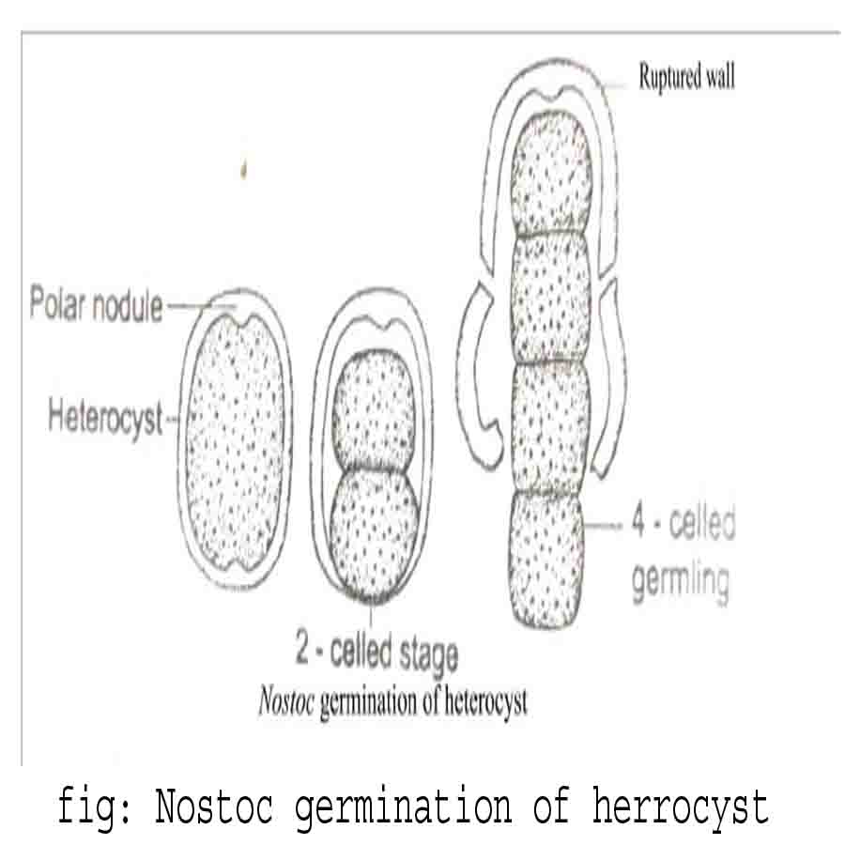

Slide 11
3.Akinetes or resting spores:-The akinetes are produced in mature colonies. They are formed in unfavorable conditions. The akinetes are developed in between the heterocysts of the filament. Each cell develops into a single akinete .There are much food reserve in each cell and the walls are being thickened. They are also called arthospores or resting spores. They survive in adverse conditions even for the years. on the approach of favorable conditions they geminate directly or indirectly giving rise to new filaments.
4.Heterocysts:- The reproduction by heterocyst is very rare. The heterocyst germinate in exceptional cases. The contents of the heterocyct divide giving rise to filament. The newly developed filaments liberate from the heterocysts by breaking their thick walls.

Slide 12
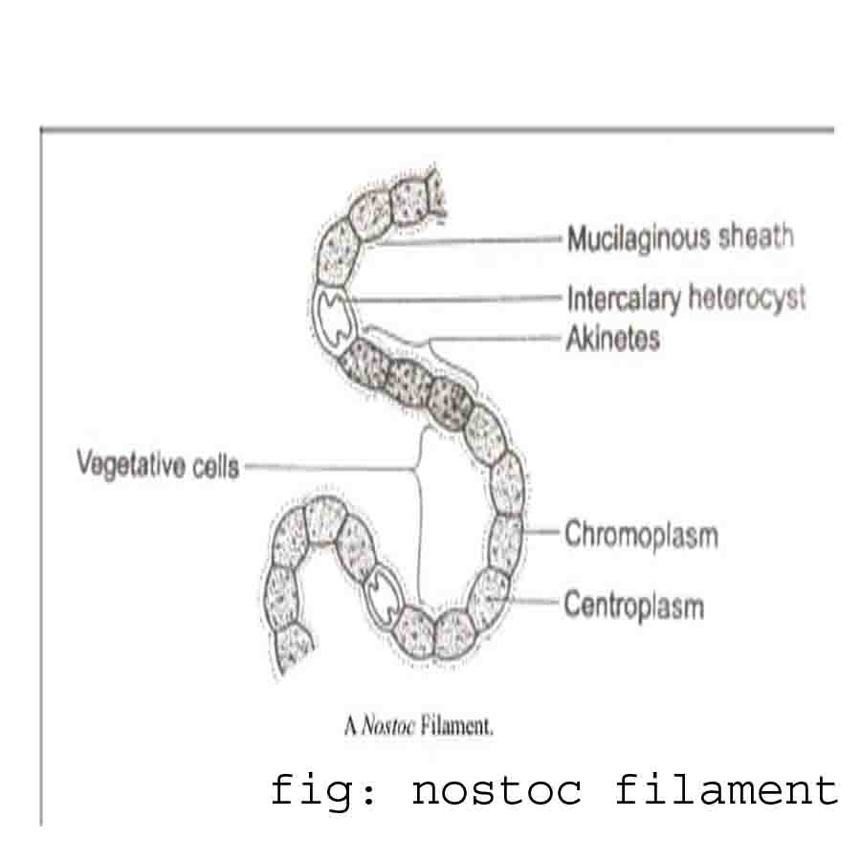
NOSTOC

Slide 13
