Slide 1
Phaeophyta
Sargassum
Seema A. Gaikwad
V. M. Sangola.

Slide 2
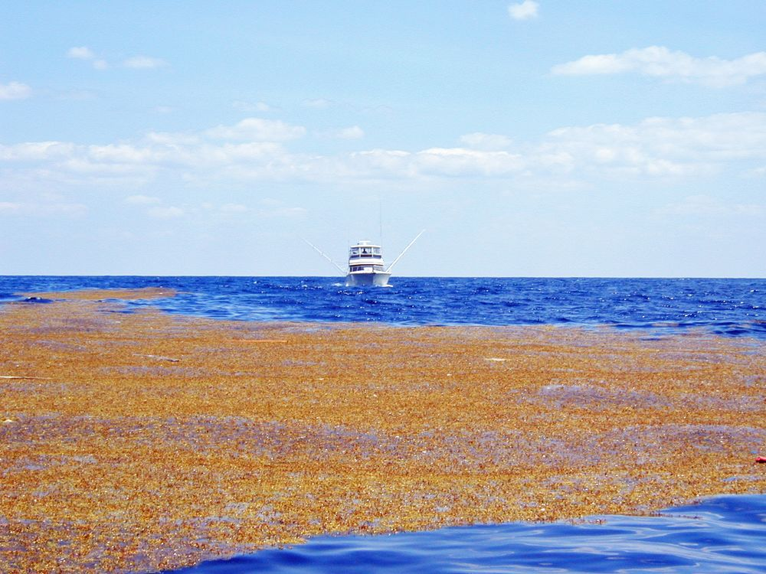
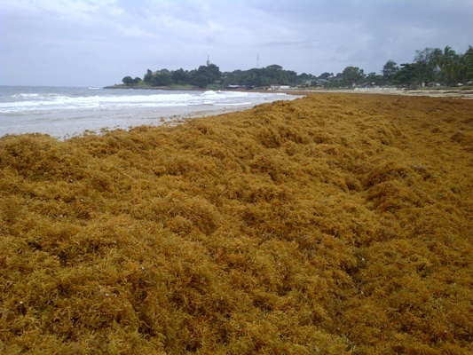
Sargasso Sea

Slide 3
Sargasso Sea

Slide 4
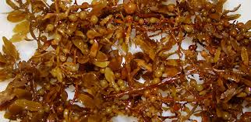
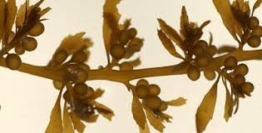
Sargassum Brown Algae

Slide 5
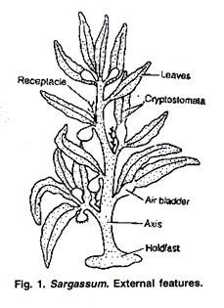
Sargassum Thallus

Slide 6
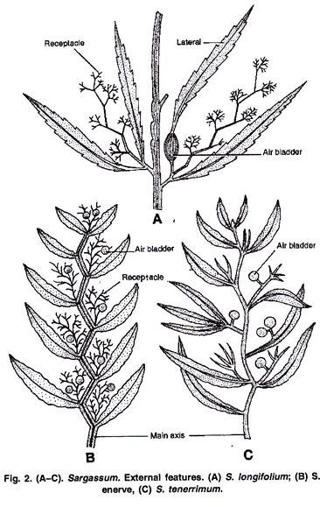
Variation in species thallus

Slide 7
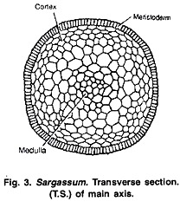
T. S. of Main Axis

Slide 8
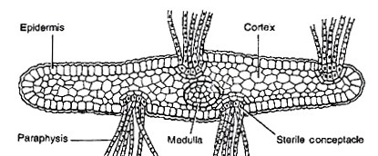
T.S. of Leaf

Slide 9
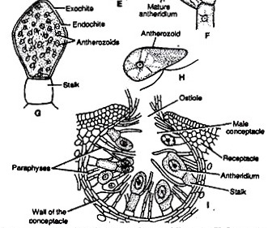
Male Conceptacle

Slide 10
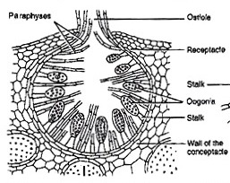
Female Conceptacle

Slide 11
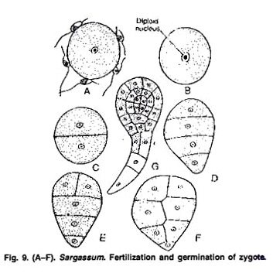
Fertilization

Slide 12
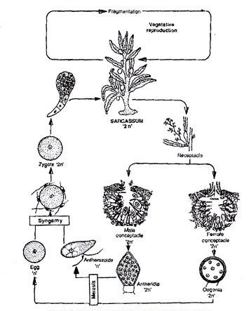
Diagrammatic Life Cycle

Slide 13
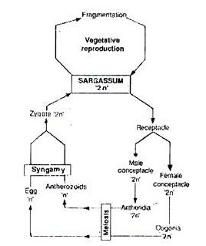
Graphic Life Cycle

