Slide 1
Sem. I, Paper II
Cell Organelle- The Cell
Asso. Prof. Seema A. Gaikwad
Dept. of Botany
Vidnyan Mahavidyalaya, Sangola.

Slide 2
The Cell
The cell is the basic structural, functional and biological unit of all known living organisms. Cells are the smallest unit of life that can replicate independently, and are often called the "building blocks of life".

Slide 3
Cells consist of a protoplasm enclosed within a membrane, which contains many biomolecules such as proteins and nucleic acids.^{[1]} Organisms can be classified as unicellular (consisting of a single cell; including most bacteria) or multicellular (including plants and animals). While the number of cells in plants and animals varies from species to species, humans contain about 100 trillion (10¹⁴) cells.^{[2]} Most plant and animal cells are visible only under the microscope, with dimensions between 1 and 100 micrometres.^{[3]}

Slide 4
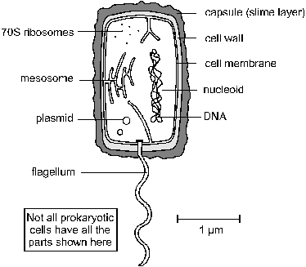
Prokaryotic cell

Slide 5
Cytoplasm. Contains all the enzymes needed for all metabolic reactions, since there are no organelles
Ribosomes. The smaller (70 S) type.
Nucleoid (or Nuclear Zone). The region of the cytoplasm that contains DNA. It is not surrounded by a nuclear membrane.
DNA. Always circular, and not associated with any proteins to form chromatin.
Plasmid. Small circles of DNA, used to exchange DNA between bacterial cells, and very useful for genetic engineering.
Cell membrane. made of phospholipids and proteins, like eukaryotic membranes.
Mesosome. A tightly-folded region of the cell membrane containing all the membrane-bound proteins required for respiration and photosynthesis. Can also be associated with the nucleoid.
Cell Wall. Made of murein (not cellulose), which is a glycoprotein (i.e. a protein/carbohydrate complex, also called peptidoglycan). There are two kinds of cell wall, which can be distinguished by a Gram stain: Gram positive bacteria have a thick cell wall and stain purple, while Gram negative bacteria have a thin cell wall with an outer lipid layer and stain pink.
Capsule (or Slime Layer). A thick polysaccharide layer outside of the cell wall, like the glycocalyx of eukaryotes. Used for sticking cells together, as a food reserve, as protection against desiccation and chemicals, and as protection against phagocytosis.
Flagellum. A rigid rotating helical-shaped tail used for propulsion. The motor is embedded in the cell membrane and is driven by a H⁺ gradient across the membrane. Clockwise rotation drives the cell forwards, while anticlockwise rotation causes a chaotic spin. This is the only known example of a rotating motor in nature.

Slide 6
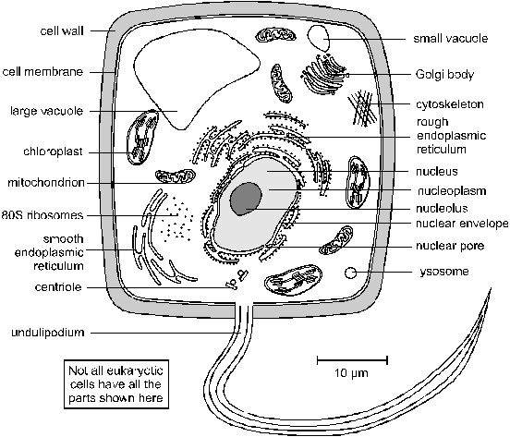
Eukaryotic cell

Slide 7
Cytoplasm (or Cytosol). This is the solution within the cell membrane. It contains enzymes for glycolysis (part of respiration) and other metabolic reactions together with sugars, salts, amino acids, nucleotides and everything else needed for the cell to function.
Nucleus. This is the largest organelle. Surrounded by a nuclear envelope, which is a double membrane with nuclear pores - large holes containing proteins that control the exit of substances such as RNA and ribosomes from the nucleus. The interior is called the nucleoplasm, which is full of chromatin- a DNA/protein complex in a 1:2 ratio containing the genes. During cell division the chromatin becomes condensed into discrete observable chromosomes. The nucleolus is a dark region of chromatin, involved in making ribosomes.
Mitochondrion (pl. Mitochondria). This is a sausage-shaped organelle (8µm long), and is where aerobic respiration takes place in all eukaryotic cells. Mitochondria are surrounded by a double membrane: the outer membrane is simple and quite permeable, while the inner membrane is highly folded into cristae, which give it a large surface area. The space enclosed by the inner membrane is called the mitochondrial matrix, and contains small circular strands of DNA. The inner membrane is studded with stalked particles, which are the site of ATP synthesis

Slide 8
.
Chloroplast. Bigger and fatter than mitochondria, chloroplasts are where photosynthesis takes place, so are only found in photosynthetic organisms (plants and algae). Like mitochondria they are enclosed by a double membrane, but chloroplasts also have a third membrane called the thylakoid membrane. The thylakoid membrane is folded into thylakoid disks, which are then stacked into piles called grana. The space between the inner membrane and the thylakoid is called the stroma. The thylakoid membrane contains chlorophyll and other photosynthetic pigments arranged in photosystems, together with stalked particles, and is the site of photosynthesis and ATP synthesis. Chloroplasts also contain starch grains, ribosomes and circular DNA
Ribosomes. These are the smallest and most numerous of the cell organelles, and are the sites of protein synthesis. They are composed of protein and RNA, and are manufactured in the nucleolus of the nucleus. Ribosomes are either found free in the cytoplasm, where they make proteins for the cell's own use, or they are found attached to the rough endoplasmic reticulum, where they make proteins for export from the cell. They are often found in groups called polysomes. All eukaryotic ribosomes are of the larger, "80S", type.
Smooth Endoplasmic Reticulum (SER). Series of membrane channels involved in synthesising and transporting materials, mainly lipids, needed by the cell.
Rough Endoplasmic Reticulum (RER). Similar to the SER, but studded with numerous ribosomes, which give it its rough appearance. The ribosomes synthesise proteins, which are processed in the RER (e.g. by enzymatically modifying the polypeptide chain, or adding carbohydrates), before being exported from the cell via the Golgi Body.

Slide 9
Golgi Body (or Golgi Apparatus). Another series of flattened membrane vesicles, formed from the endoplasmic reticulum. Its job is to transport proteins from the RER to the cell membrane for export. Parts of the RER containing proteins fuse with one side of the Golgi body membranes, while at the other side small vesicles bud off and move towards the cell membrane, where they fuse, releasing their contents by exocytosis.
Vacuoles. These are membrane-bound sacs containing water or dilute solutions of salts and other solutes. Most cells can have small vacuoles that are formed as required, but plant cells usually have one very large permanent vacuole that fills most of the cell, so that the cytoplasm (and everything else) forms a thin layer round the outside. Plant cell vacuoles are filled with cell sap, and are very important in keeping the cell rigid, or turgid. Some unicellular protoctists have feeding vacuoles for digesting food, or contractile vacuoles for expelling water.
Lysosomes. These are small membrane-bound vesicles formed from the RER containing a cocktail of digestive enzymes. They are used to break down unwanted chemicals, toxins, organelles or even whole cells, so that the materials may be recycled. They can also fuse with a feeding vacuole to digest its contents.

Slide 10
Cytoskeleton. This is a network of protein fibres extending throughout all eukaryotic cells, used for support, transport and motility. The cytoskeleton is attached to the cell membrane and gives the cell its shape, as well as holding all the organelles in position. There are three types of protein fibres (microfilaments, intermediate filaments and microtubules), and each has a corresponding motor protein that can move along the fibre carrying a cargo such as organelles, chromosomes or other cytoskeleton fibres. These motor proteins are responsible for such actions as: chromosome movement in mitosis, cytoplasm cleavage in cell division, cytoplasmic streaming in plant cells, cilia and flagella movements, cell crawling and even muscle contraction in animals.
Centriole. This is a pair of short microtubules involved in cell division. Before each division the centriole replicates itself and the two centrioles move to opposite ends of the cell, where they initiate the spindle that organises and separates the chromosomes (see module 2).
Undulipodium (Cilium and Flagellum). This is a long flexible tail present in some cells and used for motility. It is an extension of the cytoplasm, surrounded by the cell membrane, and is full of microtubules and motor proteins so is capable of complex swimming movements. There are two kinds: flagella (no relation of the bacterial flagellum) are longer than the cell, and there are usually only one or two of them, while cilia are identical in structure, but are much smaller and there are usually very many of them.
Microvilli. These are small finger-like extensions of the cell membrane found in certain cells such as in the epithelial cells of the intestine and kidney, where they increase the surface area for absorption of materials. They are just visible under the light microscope as a brush border.

Slide 11
Cell Membrane (or Plasma Membrane). This is a thin, flexible layer round the outside of all cells made of phospholipids and proteins. It separates the contents of the cell from the outside environment, and controls the entry and exit of materials. The membrane is examined in detail later.
Cell Wall. This is a thick layer outside the cell membrane used to give a cell strength and rigidity. Cell walls consist of a network of fibres, which give strength but are freely permeable to solutes (unlike membranes). A wickerwork basket is a good analogy. Plant cell walls are made mainly of cellulose, but can also contain hemicellulose, pectin, lignin and other polysaccharides. They are built up in three layers called the primary cell wall, the secondary cell wall and the middle lamella. There are often channels through plant cell walls called plasmodesmata, which link the cytoplasms of adjacent cells. Fungal cell walls are made of chitin (poly-glucosamine). Animal cells do not have a cell wall, though they do have a layer of carbohydrate outside the cell membrane called the cell coat, or glycocalyx.

Slide 12
Prokaryotic Cells | Eukaryotic cells
small cells (< 5 mm) | larger cells (> 10 mm)
always unicellular | often multicellular
no nucleus or any membrane-bound organelles, such as mitochondria | always have nucleus and other membrane-bound organelles
DNA is circular, without proteins | DNA is linear and associated with proteins to form chromatin
ribosomes are small (70S) | ribosomes are large (80S)
no cytoskeleton | always has a cytoskeleton
motility by rigid rotating flagellum made of flagellin | motility by flexible waving undulipodium, made of tubulin
cell division is by binary fission | cell division is by mitosis or meiosis
reproduction is always asexual | reproduction is asexual or sexual
huge variety of metabolic pathways | common metabolic pathwa

Slide 13
Thank You

