Slide 1
Cell Organelle-Chloroplast
Asso. Prof. Seema A. Gaikwad
Dept. of Botany
Vidnyan Mahavidyalaya, Sangola.

Slide 2
Chloroplast
Occurrence:-
Chloroplasts are organelles found in plant cells and eukaryotic algae that conduct photosynthesis. Chloroplasts absorb sunlight and use it in conjunction with water and carbon dioxide gas to produce food for the plant.
Chloroplasts capture light energy from the sun to produce the free energy stored in ATP and NADPH through a process called photosynthesis.
Chloroplasts are one of the many unique organelles in the body, and are generally considered to have originated as endosymbiotic cyanobacteria.
In this respect they are similar to mitochondria, but are found only in plants and protista.
Both organelles are surrounded by a double celled composite membrane with an intermembrane space; both have their own DNA and are involved in energy metabolism; and both have reticulations, or many infoldings, filling their inner spaces.

Slide 3
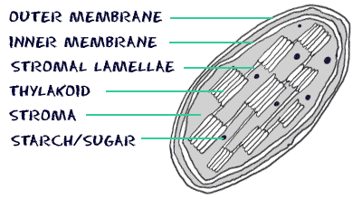
Structure:-
Chloroplasts are the sites of photosynthesis. These double-membrane bound organelles enclose additional membranes called thylakoids. The disc-shaped thylakoids possess an interior space. The thylakoids are stacked to form grana, which are suspended in the stroma of the chloroplasts.

Slide 4
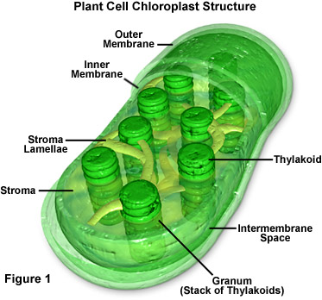

Slide 5
Function of chloroplast:-
1)The main function of chloroplast is to produce or to make food for the plant.
2) The chloroplast to capture light energy which is stored in the energy storage in the molecule ATP.It also aids in the process of food production which helps the plant servive.
3)The chloroplast absorbs light and use it in conjugation with water and carbon dioxide to produce sugars.The raw material for energy and biomass production in all green plants.

Slide 6
Thank You

