Slide 1
Sem.IV, Paper VIII
Meiosis
Seema Gaikwad
Dept. of Botany
Vidnyan Mahavidyalaya,Sangola.

Slide 2
The term ‘meiosis’ (Gr. Meioum-meaning to reduce) was coined by J. B. Farmer & J. E. Moore(1905)
Meiosis is a special type of cell division necessary for sexual reproduction which occurs or has occurred in all eukaryotes, including animals, plants and fungi, including both multi-celled and single-celled organisms. The number of sets of chromosomes in the cell undergoing meiosis is reduced to half the original number, typically from two sets (diploid) to one set (haploid).

Slide 3
Interphase is followed by meiosis I and then meiosis II.
Meiotic division occurs in two stages, meiosis I and meiosis II, dividing the cells once at each stage. Before meiosis begins, during S phase of the cell cycle, the DNA of each chromosome is replicated, so that each chromosome has two sister chromatids; a diploid organism now has a tetraploid DNA amount in the cell.

Slide 4
In meiosis II, an equational division similar to mitosis will occur whereby the sister chromatids are finally split, creating a total of 4 haploid cells
(23 chromosomes, N) – two from each daughter cell from the first division.
Meiosis I
Meiosis I separates homologous chromosomes, producing two haploid cells (N chromosomes, 23 in humans), and thus meiosis I is referred to as a reductional division. A regular diploid human cell contains 46 chromosomes and is considered 2N because it contains 23 pairs of homologous chromosomes.

Slide 5
Prophase I
It is the longest phase of meiosis. During prophase I, DNA is exchanged between homologous chromosomes in a process called homologous chromosomes.
The paired and replicated chromosomes are called bivalents or tetrads, which have two chromosomes and four chromatids, with one chromosome coming from each parent. The process of pairing the homologous chromosomes is called synapsis. At this stage, non-sister chromatids may cross-over at points called chiasmata (plural; singular chiasma).

Slide 6
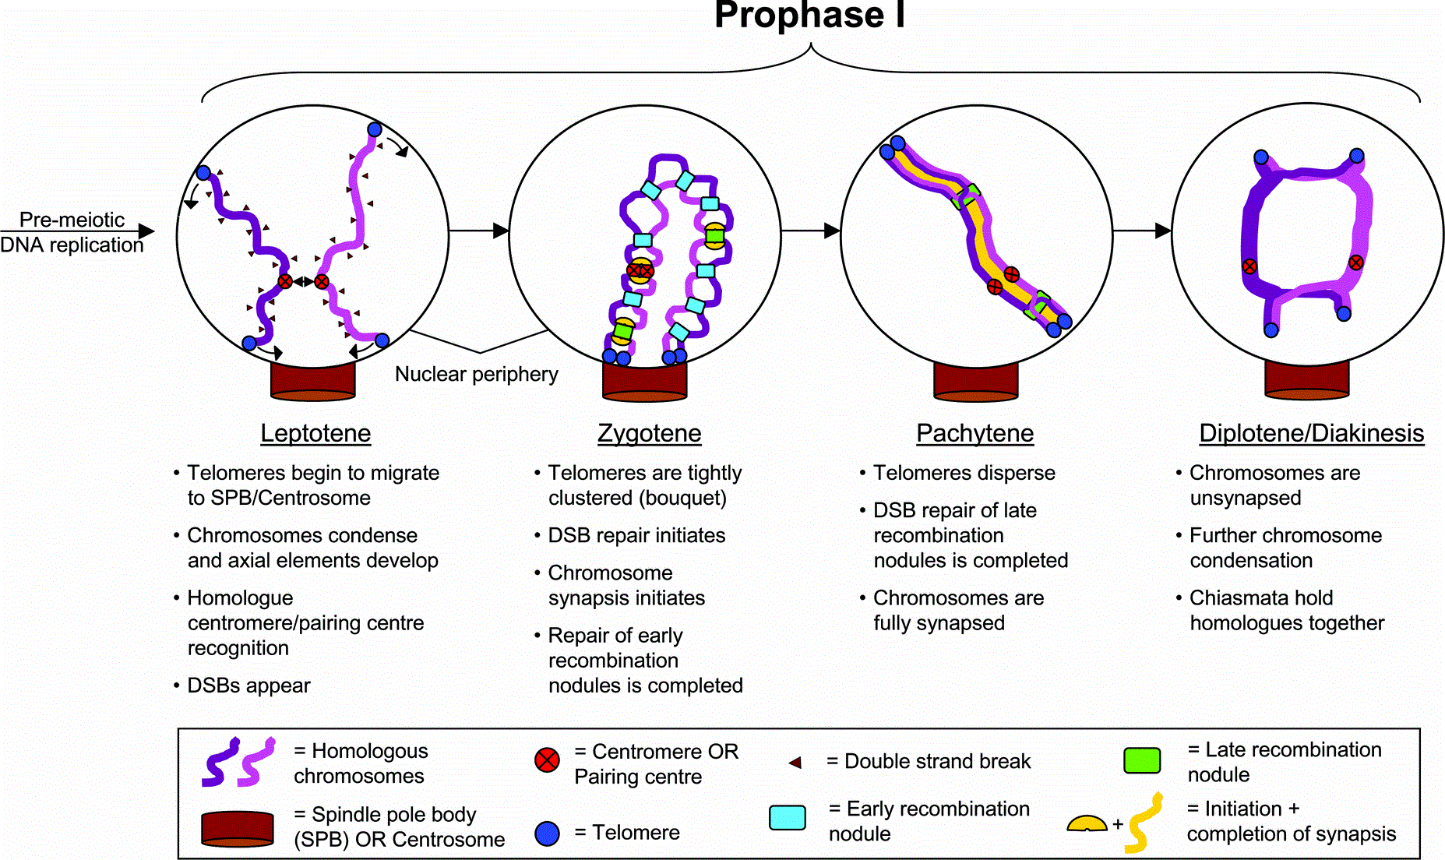

Slide 7
Zygotene: The zygotene stage, also known as zygonema, from Greek words meaning "paired threads",occurs as the chromosomes approximately line up with each other into homologous chromosome pairs.
Leptotene: The first stage of prophase I is the leptotene stage, also known as leptonema, from
Greek words meaning "thin threads". In this stage of prophase I, individual chromosomes—each consisting of two sister chromatid change from the diffuse state they exist in during the cell's period of growth and gene expression, and condense into visible strands within the nucleus.

Slide 8
Diplotene: During the diplotene stage, also known as diplonema, from Greek words meaning "two threads", the synaptonemal complex degrades and homologous chromosomes separate from one another a little
Pachytene: The pachytene (pronounced
stage, also known as pachynema, from
Greek words meaning "thick threads", is
the stage when chromosomal crossover
(crossing over) occurs.

Slide 9
Metaphase I: Homologous pairs move together along the metaphase plate
Diakinesis: Chromosomes condense further during the diakinesis stage, from Greek words meaning "moving through". This is the first point in meiosis where the four parts of the tetrads are actually visible.

Slide 10
Telophase I: The first meiotic division effectively ends when the chromosomes arrive at the poles. Each daughter cell now has half the number of chromosomes but each chromosome consists of a pair of chromatids.
Anaphase I: Kinetochore (bipolar spindles) microtubules shorten, severing the recombination nodules and pulling homologous chromosomes apart.

Slide 11
In metaphase II, the centromeres contain two kinetochores that attach to spindle fibers from the centrosomes (centrioles) at each pole
Meiosis II
Meiosis II is the second part of the meiotic
Process, also known as equational division.
The four main steps of Meiosis II are:
Prophase II, Metaphase II, Anaphase II,
and Telophase II.
In prophase II, there is the disappearance of
the nucleoli and the nuclear envelope again as
well as the shortening and thickening of the
chromatids.

Slide 12
The process ends with telophase II, which is similar to telophase I, and is marked by uncoiling and lengthening of the chromosomes and the disappearance of the spindle. Nuclear envelopes reform
Metaphase II is followed by anaphase II, where the centromeres are cleaved, allowing microtubules attached to the kinetochores to pull the sister chromatids apart.

Slide 13
Cytokinesis – At the end of telophase II, the cytoplasm of each of the two cells of a dyad divides into two, and as a result one parent cell produces four haploid daughter cells after completion of the two meotic divisions. Thus, four daughter cells inside the parent cell wall form the structure called tetrad.

Slide 14
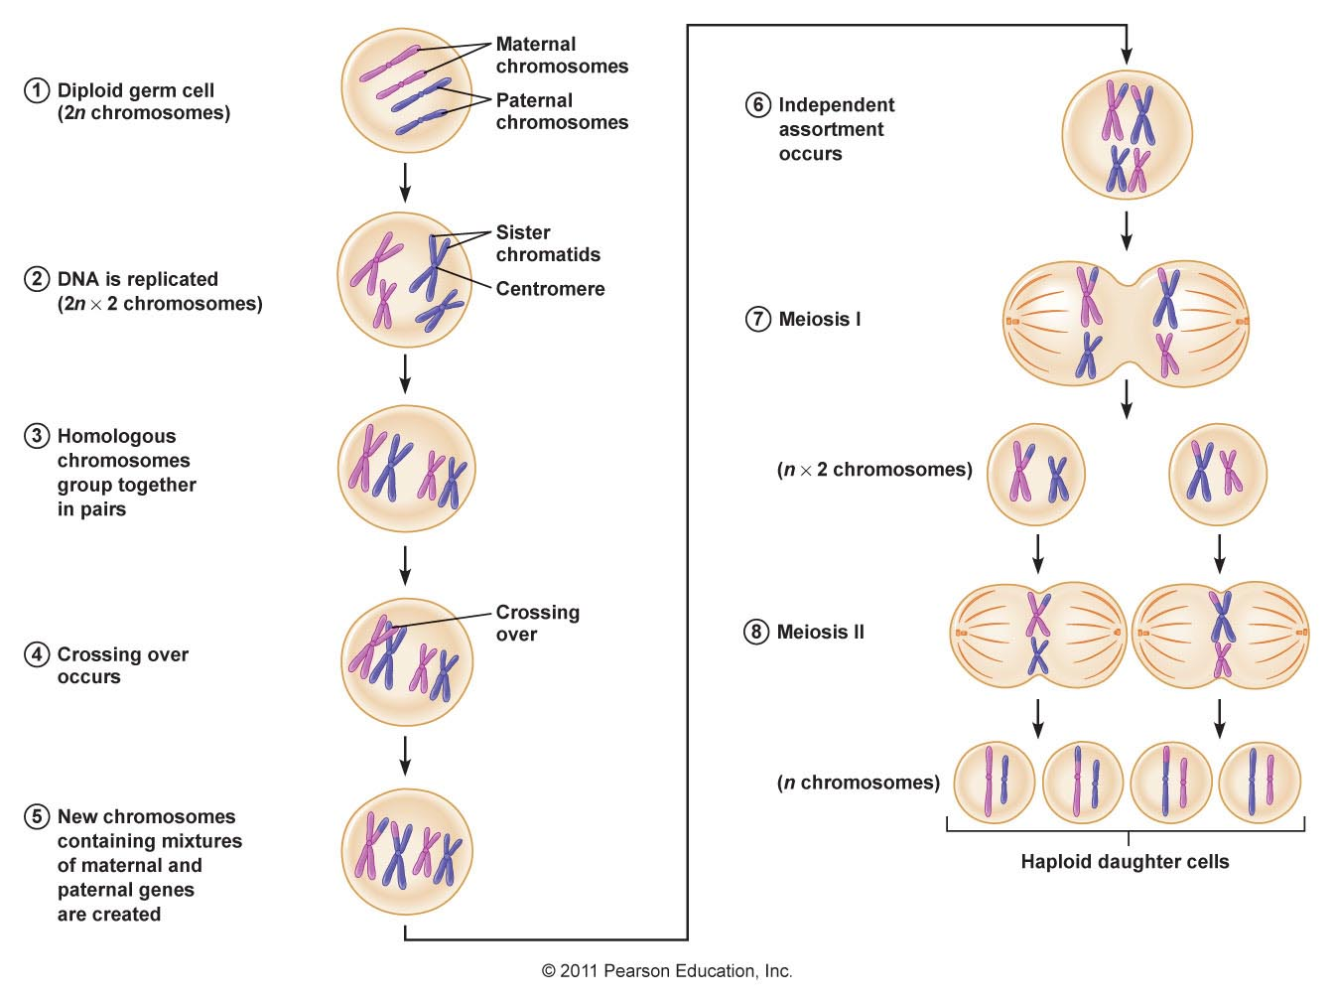

Slide 15
Significance of Meiosis
Meiosis maintains the constant and definite number of chromosomes in the organisms. Thus, the diploid chromosome number remains constant from one generation to the next generation in the systems produced by sexual reproduction. Therefore, sexual reproduction in plants and animals became possible only due to meiotic cell division.
The crossing over in prophase-I provides an opportunity to exchange genes and thus causes genetical variationsessential for evolution among the species.
The segregation of chromosomes result in different combinations of chromosomes & ultimately different combination of characters in all the daughter cells.
Parental characters are reshuffled, due to which every gamete developing from daughter cell shows a distinct set of characters.

Slide 16
Thank You

