Slide 1
Sem.IV, Paper VII
Nitrogen metabolism
Seema Gaikwad
Dept. of Botany
Vidnyan Mahavidyalaya,Sangola.

Slide 2
Introduction:-
Nitrogen is important element of life. In importance it comes only next to carbon, hydrogen, and oxygen. The composition of protein, nucleic acid, growth hormones, and vitamins requires Nitrogen.
The N₂ is present in the atmosphere, in the form of gas. It is about 78%.
Green plants unable to use this N₂ directly in their metabolism. Only some micro-organism can convert this N₂ gas directly into organic form.
The N₂ present in the soil is called soil nitrogen. The plants growing in the soil, mainly utilize the soil N₂ for their metabolic requirements.
In the soil the nitrogen is present in the form of nitrate nitrogen (NO₃, NO₂), ammonia nitrogen (ammonia, ammonium salt), organic nitrogen and molecular nitrogen (N₂).
The converging of the free nitrogen, by natural or physical process is called nitrogen fixation… when Any biological system is involved in this process, then it is called as biological nitrogen fixation……

Slide 3
Nitrogen cycle
All these process indicate that the nitrogen in the atmospheric which enters the biomass through the soil. So atmospheric N₂ completes a cycle forms atmosphere, through soil, biomass and back to the atmosphere. This cycle is known as ‘ Nitrogenen cycle’
Nitrogen fixation,
Ammonification
Nitrification and
Denitrification.

Slide 4
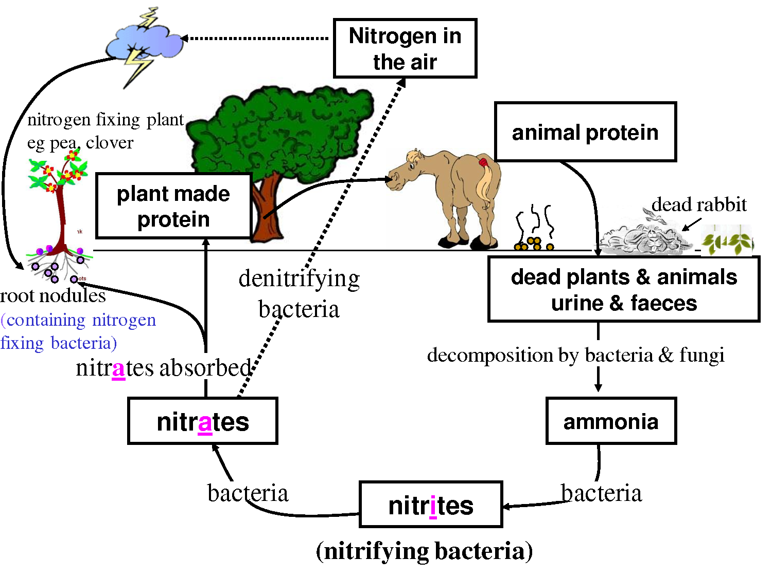

Slide 5
Biological Nitrogen fixation
The conservation of atmospheric free N₂ into organic form is known as nitrogen fixation and when it is carried out whith the help of a biological system(organism) it is called biological nitrogen fixation.
The prokaryotic organisms that carry out N₂ fixation are called nitrogen fixer.The nitrogen fixing organism may be free living (asymbiotic ) or symbiotic. some nitrogen fixer are anaerobic, while some are aerobic organisms. Some N2 fixing organisms are photosynthetic (e.g- Blue green algae) while some are non- photosynthetic (e.g- root nodule bacteria).

Slide 6
Non-symbiotic Nitrogen fixation
Nitogen fixation by free living micro-organism
was identified by in 19th century by
Winogardsky(1894). He isolated free-living
anaerobic bacterium Clostridium pastorianum,
which is a nitrogen fixing organism, The
nonsymbiotic nitrogen fixers can broadly be
classified into 3 categories.
1) Bacteria 2) Blue green algae 3) Fungi

Slide 7
The aerobic bacteria belongs to genera
Azotobactor,Derxia, Mycobacterium,
Azomonas,Arthbacter etc.
The anaerobic facultative bacteria belongs togenera Aerobactor,Klesiella,Chlorobium,Chromatium,Rhodomicrobium, Metanbacterium.
The photosynthetic N₂ fixing bacteria are the species of sulphur bacteria. Rhodomicrobium, Rhodopsuedomonas.
Yeast:- The role of yeast in nitrogen fixation is least known however pink yeast Rhodotorula sp. isolated from soil shows N₂ fixing ability.

Slide 8
Blue Green Algae (BGA)
The blue green algal genera like Anabaena, Anabaenopsis, Aulosira, Nostoc, Haplosiphon, Stigonema, Chlorogloea and Mastigocladus fix biological nitrogen.
Non – heterocystous, filamentous blue green algae like Plectonema, Lyngbya , Oscillatoria and Trichodesmium can fix atmospheric nitrogen.

Slide 9
Symbiotic Nitrogen Fixation
The symbiotic N2 fixing organisms are mainly root nodule bacteria of leguminous plant, bacteria with non-leguminous plant and blue green algae.
Leguminous plant with root nodule bacteria
The root nodule bacterium was isolated by Beijrinck (1888) and named it as Rhizobium. The bacteria belonging to this genus are free living in the soil. Rhizobiumis gram –ve , non-sporulating, aerobic, motile, rod shaped, nodule forming bacterium.

Slide 10
Mechanism of Nitrogen fixation in root nodules
Healthy root nodules in leguminous plants are pink in colour due to red pigment. This pigment is being red due to iron and it is called leghaemoglobin. The healthy nodules with leghaemoglobin can fix N₂. Leghaemoglobin is present out side the bacterial cell but close to membrane and acts as oxygen remover Leghaemoglobin regulatates oxygen concentration and favours nitrogenase activity in swollen form of bacterium ( essential for N₂ fixation) called bacteroid. Leghaemoglobin combines with O₂ to form oxyhaemoglobin and makes low concentration of oxygen in nodules as essential for activity of nitrogenase. It is supposed that Leghaemoglobin takes part in nitrogen fixation, indirectly by protecting nitrogenase from adverse effects of oxygen.

Slide 11
Non – leguminous plant with nodule
There are many non-legume plants which also fix N₂ symbioticlly. These non-legume, root nodule N₂ fixing angiosperms belong to 15 genera of woody and herbaceous nature. These genera are Coriaria, Alnus, Myrica, Casurina, Hippophae, Elaeagnus, Dryas, Purshia, Shephardia, Coenothus, Cerocarpus, and Arctostaphylos.

Slide 12
Non – leguminous plant with nodule
Genus Frankia of actinomycetes fix large amount of nitrogen in root nodules of forest plant like Alnus and Casuarina. It adds about 61.5 to 157 kg. nitrogen/ hectare/ year and 60 kg. nitrogen / hectare / year repectively.
Leaf nodules which are confined to members of Rubiaceae (e.g. Pavetta) and Myrsinaceae,( e.g. Ardisia) are due to Mycobacterium and Flavobacterium, growing in these nodules.

Slide 13
Blue green algae in symbiosis
Algae – fungal assosiation occurs in nature in the form of lichens. The algal genaralike nostoc, Calotrix.fix N2 inlichen genera likeCollema, Leptogium, Lobaria, Pannaria, Parmelia, shows nitrogenase activity. Algal members provide N2 in the form of amino acids to fungal partner for its growth.
The fern Azolla shows association with algae Anabaena. Algae reside in the cavities present on the dorsal lobe of Azolla leaf. This endophytic algae fix atmosperic nirtogen and provides to fern.
The species of Nostoc and Anabarna are present in corolloid root of gymnosperm genera like. Cycas,Zamia, Macro zamia, Ceratozamlia and Stangeria.

Slide 14
Significance of biological Nitrogen fixation
The ammonia which is potentially toxic to the organism, is usually then immediately converted into amino acids or amodes for use by the dizotrophic bacterium in the production of proteins & peptides to facilitate its growth.
The fixed N incorporated into dizotrophic bacteria is then released into the environment when they die, usually in the form of amino acids that then become mineralized & available for uptake by other bacteria & by plants.
Many legumes supportive of bacterial N2 fixation through the development of a specialized structure called the nodule.
The reactions of Nitrogen fixation are limited to the prokaryotic microorganisms as nitrogenase genes have only, been found there. These genes which are associated with nitrogen fixation, are known as nif genes.
Microorganisms have a central role in almost all aspects of nitrogen availability and thus for life support on earth. Some bacteria can convert N2into ammonia by the process nitrogen fixation, some other bring about transformations of ammonia to nitrate while many bacteria & fungi degrade organic matter, releasing fixed nitrogen for reuse by other organisms.
Some of the blue green algae increase the fertility of soil by fixing atmospheric nitrogen.

Slide 15
Thank you

