Slide 1
Sem. V, Paper V
Marsilea
Asso. Prof. Seema Gaikwad
Dept. of Botany
Vidnyan Mahavidyalaya, Sangola

Slide 2
INTRODUCTION
Marsilea, commonly known as water fern, is represented by about 53 living and 10 fossil species. The living species occur in all parts of the world, but are more common in the warmer parts of the world, such as tropical Africa and Australia.
In India, the genus is represented by 9 living species; of these M. minuta is the most widely distributed. It is practically found all over India. In Punjab, it is very common after the rains. M. brachypus, M. quadrifolia, M. rajasthanensis and M. aegyptiaca are the other important Indian species.

Slide 3
SYSTEMATIC POSITION
Kingdom : Plantae
Division : Pteridophyta
Sub-division : Pteropsida
Class : Filicophyta
Order : Marsileales
Family : Marsileaceae
Genus : Marsilea Linn.
Common Name : Water Fern

Slide 4
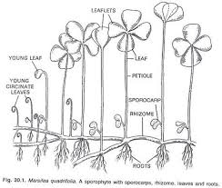
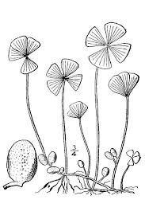
Morphology of Marsilea
The plant body of Marsilea is sporophytic having diploid chromosome number in its somatic cells. During sexual reproduction, it produces male and female gametophytes, which are haploid in nature and form the sperm and egg, respectively. The sporophyte is differentiated into rhizome, roots, and leaves.

Slide 5
Morphology of Marsilea
Rhizome (Stem)
The stem is a long and slender rhizome.
It creeps either on the surface like stolon, or slightly below the surface of the soil like rhizome.
It grows extensively and is branched. The branches arise at the bases of petioles and are extra-axillary in position, arising in the lateral or oblique position.
They run in all directions and may get rooted at the nodes. In this way, a single plant may cover an extensive area of about 20 metre’s diameter or even more.
The stem is divisible into distinct nodes and internodes.

Slide 6
Morphology of Marsilea
Root:
The primary root formed on the stem is short-lived and is soon replaced by adventitious roots, which arise gradually at the nodes on the underside of the stem.
Sometimes, roots may also arise at internodes (Marsilea aegyptiaca), or laterally (M. minuta).
The roots are thin and may be branched or unbranched. They develop in an acropetal sequence, i.e. the youngest root is towards the apex of the rhizome.
The number of roots at a node and their size vary considerably.

Slide 7
Morphology of Marsilea
Leaves
The leaves arise from the upper side of the stem and are arranged in two alternate rows.
They are long-petioled and compound.
The petioles of the submerged plants are long, thin and flexible, with the lamina floating on the surface of water, while the leaves of plants growing in mud or on land have upright, short petioles, with lamina held in a spreading position.
The lamina is usually divided into four leaflets of the same size.

Slide 8
Anatomy of Marsilea
Rhizome (Stem)
Epidermis is single-layered, made up of compactly arranged thick walled cells.
Cortex is differentiated into three regions, viz. outer cortex, the middle cortex and the inner cortex:
a. outer cortex is aerenchymatous, one to several cells in thickness, sometimes also consists of tannin cells,
b. middle cortex consists of sclerenchymatous tissue filled with air cavities arranged in the form of ring, and
c. inner cortex is solid tissue of several cells in thickness. The inner layer of inner cortex is parenchymatous, filled with starch, while outer region of inner cortex is sclerenchymatous in nature.
The vascular cylinder is siphonostele; limited externally and internally by endodermis, hence called outer endodermis and inner endodermis, respectively.
The siphonostele is medullated. The xylem is in the form of ring. Phloem is present on both sides of xylem. Such a stele is called amphiphloic siphonostele.
The deposition of the several tissues from inwards is outer endodermis, outer pericycle, outer phloem, xylem, inner phloem, inner pericycle and inner endodermis.

Slide 9
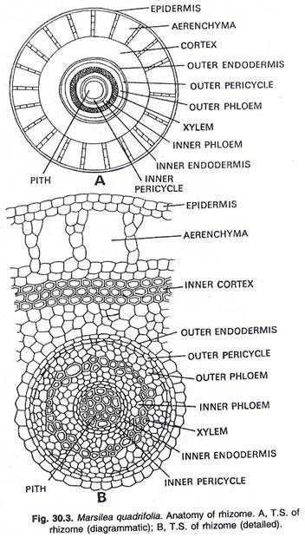
Anatomy of Marsilea

Slide 10
Anatomy of Marsilea
Petiole
Single layered epidermis made up of rectangular cells.
The outer cortex consists of few layers of thin walled cells; middle cortex is aerenchymatous consisting of ring of air-chambers; while the inner cortex is a solid, compact tissue several cells deep. The inner layers of inner cortex are parenchymatous and filled with starch. Here and there tannin-filled cells also occur.
The stele is covered externally by a single-layered distinct endodermis.
It is triangular in outline, lies in the centre, and has a single vascular bundle. The xylem is ‘V’ shaped, with opening towards the axis.
The order of the tissues from inner to outer side of the stele is xylem, xylem parenchyma, phloem, pericycle and endodermis .

Slide 11
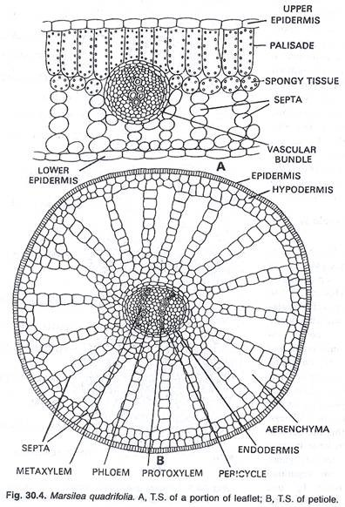
Anatomy of Marsilea

Slide 12
Anatomy of Marsilea
Leaflet
It consists of upper and lower epidermal layers, each made up of a single layer of paranchymatous cells. The continuity of epidermis is interrupted by slightly sunken stomata. Stomata are restricted to the upper epidermis in floating leaves.
The ground tissue (mesophyll) lies between the upper and lower epidermis and is differentiated into palisade and spongy parenchyma:
The palisade part lies just beneath the upper epidermis and consists of columnar cells rich in chloroplasts, while the spongy part faces the lower epidermis and consists of rounded cells
In case of submerged species, there is no distinction between palisade and spongy tissues.
Vascular bundles are embedded in the mesophyll tissue. They are concentric in nature. Each bundle has a central core of xylem, surrounded by phloem.
The arrangement of tissues in the stele is xylem, phloem and bundle sheath.
It consists of piliferous layer instead of epidermis, made up of compactly arranged biconvex cells.
Beneath piliferous layer, the cortex is made up of an outer cortex and inner cortex:
Outer cortex is aerenchymatous, consisting of large air chambers arranged in the form of ring.
Inner cortex is compact, made up of rounded cells containing starch.
Inner cortex is delimited by a single layer of distinct endodermis.
Vascular bundle lies within the endodermis, and is usually diarch and exarch.
The xylem is plate-like and occupies the centre of stele. The protoxylem, consisting of two small mass of cells, is towards the periphery (pericycle), while metaxylem is large, plate-like and occupies the centre.
There is no medullary tissue (pith) in the stele and arrangement of tissue is metaxylem, protoxylem, phloem, pericycle and endodermis .

Slide 13
Reproduction in Marsilea
Marsilea is a sporophyte and reproduces asexually both by vegetative means as well as by means of spores.
Vegetative reproduction: In Marsilea, vegetative reproduction occurs by the formation of tubers, which are small, bud-like structures containing reserve food material, arising from some subterranean branches of the rhizome.
Reproduction by spores (spore formation): Marsilea is a heterosporous fern, which produces two types of spores – microspores and megaspores in separate sporangia, borne in special bean -shaped bodies called the sporocarps.

Slide 14
Reproduction in Marsilea
Structure of sporocarp-
It is green and soft when young, but turns dark-brown at maturity. Usually one sporocarp is present at the base of each petiole, but in some species, the number varies from 2 – 20.
The sporocarp is differentiated into a stalk (pedicel) and a body. The stalk is fused laterally to the back of the body of the sporocarp, generally forming a distinct ridge called ‘raphe’. In some species, the distal (upper) end of the raphe is marked by one or two teeth-like projections, known as tubercles.

Slide 15
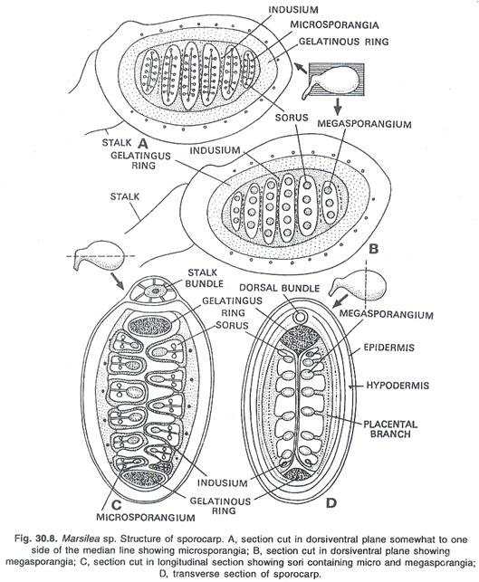
Internal structure of the sporocarp

Slide 16
Dehiscence of sporocarp
There is no special mechanism for the liberation of sporangia from the sporocarp. They are set free only when the wall of the sporocarp splits open. As the sporocarp breaks at one point due to absorption of water, the sori come out along the gelatinous ring of sporocarp. These sori function as mother cells of the gematophytic generation.
The microspores and the megaspores germinate separately to produce male (micro-) and the female (mega -) gametophytes.

Slide 17
Fertilization
The neck canal cells and the ventral canal cell degenerates to form a mucilaginous mass, which attracts sperms chemotactically. One of the sperms fuses with the egg to accomplish fertilization and form the diploid zygote. The zygote is the mother cell of the next sporophytic generation and develops into a young sporophyte within 2-4 days after fertilization.

Slide 18
Embryogeny
The fertilized egg (zygote) enlarges in its size and secretes a thin cellulose wall around it. It enters into rapid divisions, to give rise to a young sporophyte within 2 - 4 days. Zygote divides vertically and produces two unequal cells. The larger cell is known as the epibasal cell, and the smaller one as the hypobasal cell. These two cells undergo transverse divisions to form a quadrant embryo. The cells of the quadrant embryo show definite relation to the primary growth of the embryo. Epibasal half produces shoot and leaf. Hypobasal half produces root and foot. Hence the development is described as lateral. In quadrant embryo, the next divisions are irregular. At the time of differentiation of different primordia in the embryo, the adjoining cells of megagametophyte divide periclinally , forming a thick calyptras, which encloses and protects the developing embryo. The calyptra is greenish in colour. Large number of rhizoids may develop from the base of calyptra. The embryo gives rise to the young seedling that penetrates through the calyptra and grows into a sporophyte .

Slide 19
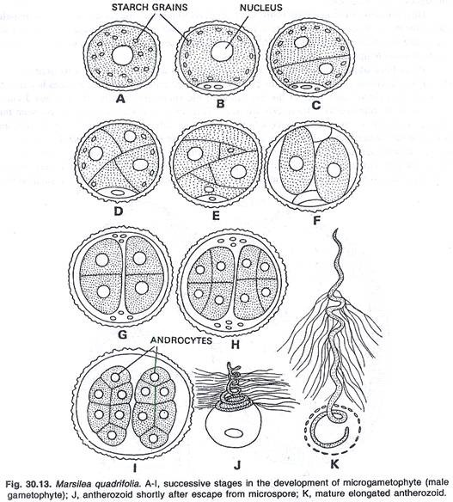
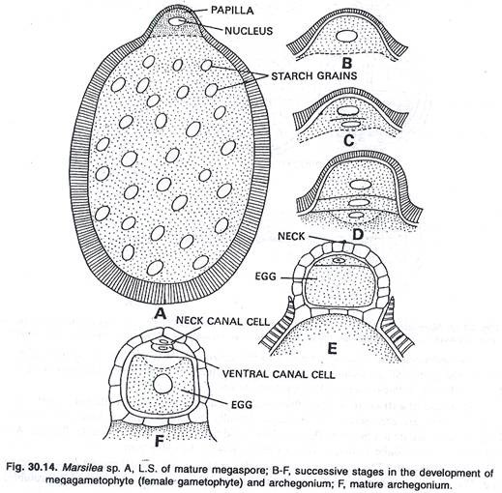
Embryogeny

Slide 20
Life cycle
In the life cycle of Marsilea,alternation of generations are there. Marsilea plant is a sporophyte, which is the dominant phase in the entire life cycle. The sporophyte comprises rhizome, roots and leaves. It reproduces vegetatively, as well as by means of spores. The spores are formed in sporangia on specialized structures called sporocarps. The sporocarps bear two kinds of asexual spores which are formed after meiosis and are, thus haploid (meiospores). The smaller spores are known as microspores. They are produced within microsporangia. The larger spores are known as megaspores, which are formed in the megasporangia. Both the sporangia are produced within the fruit body, the sporocarp.

Slide 21
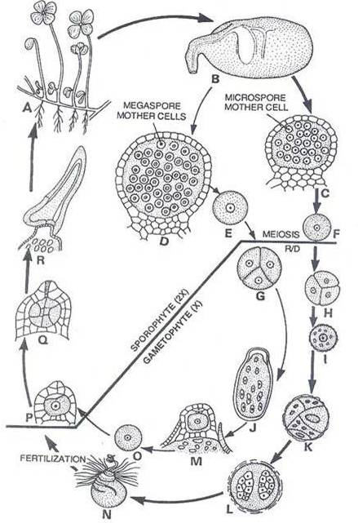
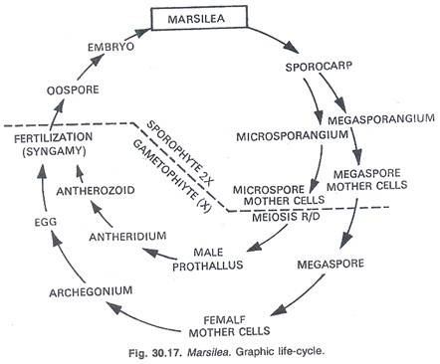
Life cycle

Slide 22
THANK YOU

