Slide 1
Mucor
Mr Hake M. A.
Botany

Slide 2
The vegetative plant body is eucarpic, con­sists of white cottony coenocytic much-branched mycelium. The mycelia ramify all over the sub­stratum. The hyphae are usually prostrate, but some of them penetrate into the substratum and serve the function of both anchorage and absorp­tion of nutrients
The hyphal wall is microfibrillar, consist mainly of chitin-chitosan. In addition, other substances like other polysaccharides, lipids, purines, pyrimidines, protein, Ca and Mg are also present. Inner to the cell wall, cell membrane is present which covers the protoplast. The proto­plast contains many nuclei, mitochondria, endo­plasmic reticulum, ribosomes, oil droplets, small vacuoles and other substances
Description of Mucor:
The genus Mucor (L. muceo, be moldy) is represented by about 80 species, found through­out the world and about 17 species from India, commonly known as mold.
They grow mostly as saprophytes on decaying fruits and vegetables, in soil (Mucor strictus, M. flavus), on various food- stuff-like bread, jellies, jams, syrups. M. mucedo, is a coprophilous species (grows on dungs of herbivorous animals like cow etc.), known as black mold.

Slide 3
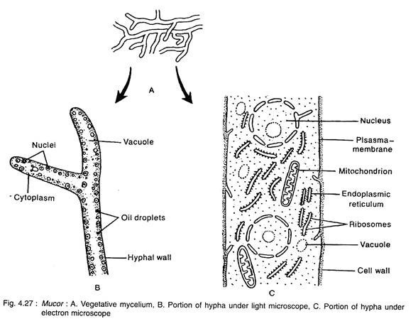

Slide 4
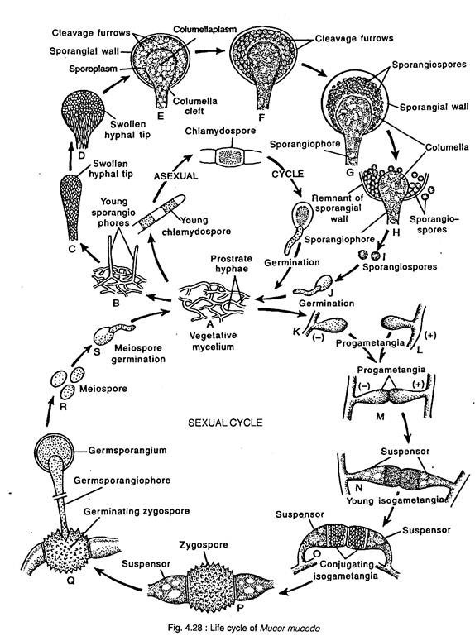
Sexual Reproduction:
Asexual Reproduction:
(a) Sporangiospore Formation:
(b) Oidia:
Chlamydospore:

