Slide 1
Network Security
Security Techniques:
Encryption & decryption :
Encryption and decryption are both methods used to ensure the secure passing of
messages and other sensitive documents and information.
Encryption basically means to convert the message into code or jumbled form, so that anybody who does not have the 'key' to decode the code, cannot view it.
This is usually done by using a 'cipher'. A cipher is a type of algorithm used in encryption that uses a certain described method to scramble the data.
The cipher can only be 'deciphered' with a 'key'. A key is the actual 'described method' that was used to scramble the data, and hence the key can also unscramble the data.
When the data is unscrambled by the use of a key, that is what is known as 'decryption'. It is the opposite of encryption and the 'described method' of scrambling is basically applied in reverse, to unscramble it.

Slide 2
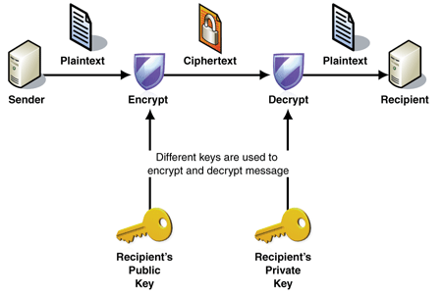
It is used on the internet to safeguard websites and copyrighted material, as well as in bank ATM machines.
The encryption process plays a major factor in our technology advanced lives.
Encryption/decryption is especially important in wireless communications.
This is because wireless circuits are easier to tap than their hard-wired counterparts.
Fig. Encryption & decryption

Slide 3
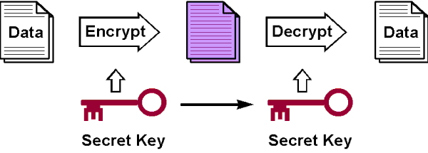
Secret key encryption :-
This scheme uses one algorithm and key (secret Key) that can both encode and decode
a message.
So if Alice wants to send a message to Bob, she encrypts the message:
It is Quite efficient and fast, can encode streams of data.

Slide 4
Public/private key encryption:-
This scheme generates a complementary pair of keys, called the public key and the private key, with the property that anything encrypted with the private key can only be decrypted using the matching public key and vice versa.
Digital Signature : -
A digital signature (not to be confused with a digital certificate) is an electronic signature that can be used to authenticate the identity of the sender of a message or the signer of a document, that has been sent is unchanged.
Digital signatures are easily transportable, cannot be imitated by someone else, and can be automatically time-stamped.
The ability to ensure that the original signed message arrived means that the sender cannot easily reject it later.
A digital signature can be used with any kind of message, whether it is encrypted or not, simply so that the receiver can be sure of the sender's identity and that the message arrived intact.

Slide 5
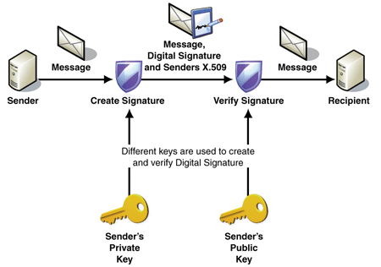
A digital certificate contains the digital signature of the certificate-issuing authority so that anyone can verify that the certificate is real.
Digital signature can be achieved in two ways: signing the document or signing a digest of the document.

Slide 6
Signing the Document :-
Possibly, the easier, but less efficient way is to sign the document itself.
Signing a document is encrypting it with the private key of the sender; verifying the document is decrypting it with the public key of the sender.
Signing the Digest;
In a digital signature system, our messages are normally long, but we have to use public keys.
The solution is not to sign the message itself; instead, we sign a digest of the message.
The sender can sign the message digest, and the receiver can verify the message digest.

Slide 7
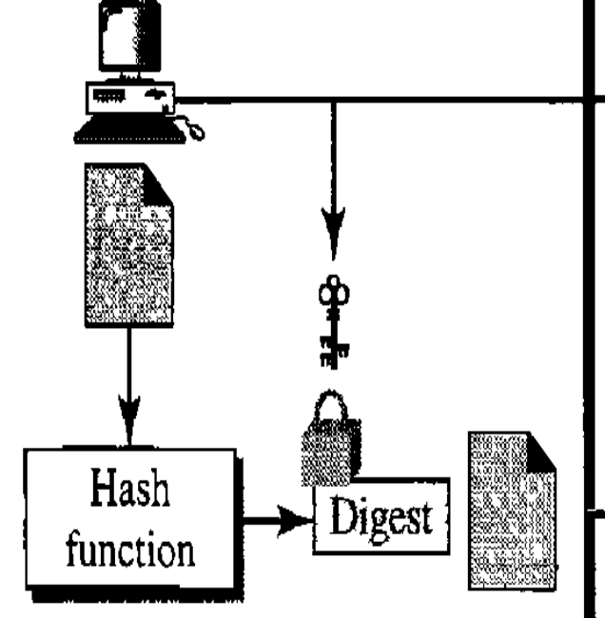
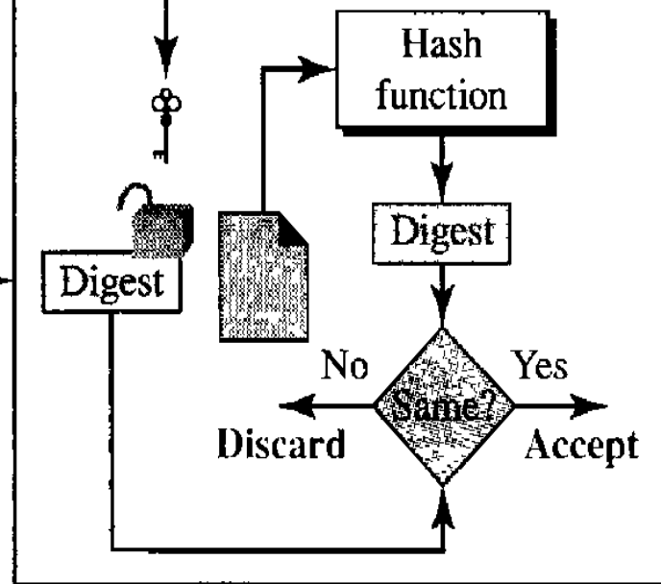
Message
and
signature
A digest is made out of the message at Alice's site. The digest then goes throug
The signing process using Alice's private key. Alice then sends the message and the signature to Bob.
At Bob's site, using the same public hash function, a digest is first created out of the received message.

Slide 8
And then verify the newly created digest and received digest.
If both digests are same the message is accepted; otherwise, it is rejected.
Cryptography :
The word is derived from the Greek kryptos, meaning "secret writing”.
The original message, before being transformed, is called plaintext.
An encryption algorithm transforms the plaintext into ciphertext;
A decryption algorithm transforms the ciphertext back into plaintext.
The sender uses an encryption algorithm, and the receiver uses a decryption
algorithm.
Modern cryptography concerns itself with the following four objectives:
Confidentiality (the information cannot be understood by anyone for whom it was unintended)
Integrity (the information cannot be altered in storage or transit between sender and intended receiver without the alteration being detected)

Slide 9
Non-repudiation (the creator/sender of the information cannot deny at a later stage his or her intentions in the creation or transmission of the information)
Authentication (the sender and receiver can confirm each others identity and the origin/destination of the information)
Advantages And Disadvantages of Cryptography
Advantages:
1. The biggest advantage of public key cryptography is the secure nature of the private key.
2. It enables the use of digital certificates and digital timestamps, which is a very secure technique of signature authorization.
Disadvantages:
1. Transmission time for documents encrypted using public key cryptography are significantly slower then symmetric cryptography.

Slide 10
2. The key sizes must be significantly larger than symmetric cryptography to achieve the same level of protection.
3. Public key cryptography is susceptible to impersonation attacks.
We can divide all the cryptography algorithms (ciphers) into two groups:
1. Symmetric key (also called secret-key) cryptography algorithms
2. Asymmetric (also called public-key) cryptography algorithms.
Symmetric·Key Cryptography
In symmetric-key cryptography, the same key is used by both parties.
The sender uses this key and an encryption algorithm to encrypt data.
The receiver uses the same key and the corresponding decryption algorithm to
decrypt the data.

Slide 11
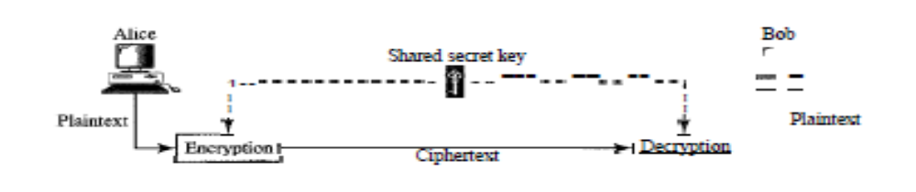
Asymmetric-Key Cryptography
In asymmetric or public-key cryptography, there are two keys: a private key and
a public key.
The private key is kept by the receiver. The public key is announced to the public.
Imagine Alice wants to send a message to Bob. Alice uses the public key to
encrypt the message.
When the message is received by Bob, the private key is used to decrypt the
message.

Slide 12
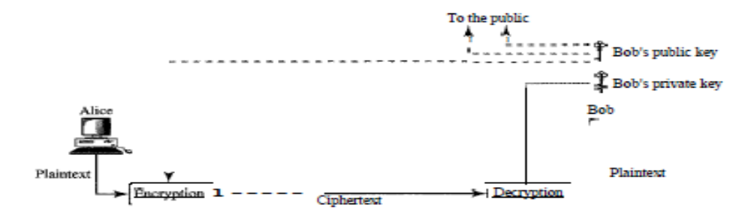
Firewall:
A firewall is a set of related programs, located at a network gateway server,
that protects the resources of a private network from users from other networks.
An company with an intranet that allows its workers access to the wider Internet installs a firewall to prevent outsiders from accessing its own private data resources and for controlling what outside resources its own users have access to.
Basically, a firewall, working closely with a router program, examines each network packet to determine whether to forward it toward its destination.

Slide 13
A firewall also includes or works with a proxy server that makes network requests on behalf of workstation users.
A firewall is often installed in a specially designated computer separate from the rest of the network so that no incoming request can get directly at private network resources.
For mobile users, firewalls allow remote access in to the private network by the use of secure logon procedures and authentication certificates.
A number of companies make firewall products. Features include logging and reporting, automatic alarms at given thresholds of attack, and a graphical user interface for controlling the firewall.
Computer security borrows this term from firefighting, where it originated. In firefighting, a firewall is a barrier established to prevent the spread of fire.

Slide 14
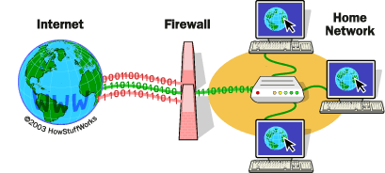
Security Services:-
Network security can provide one of the five services as shown in figure below four of these services are related to the message exchanged using the network message confidentiality, integrity, authentication and nonrepudiation. The fifth service provides entity authentication or identification

Slide 15
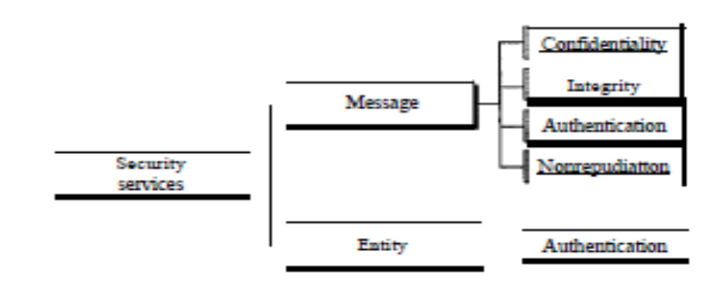
Message Confidentiality:
The Message Confidentiality or privacy means that the sender and receiver expect Confidentiality.
The transmitted message must make sense to only particular receiver, to other the message must be garbage.

Slide 16
The message must be encrypted at the senders site and decrypted at the receivers site.
e.g. A customer communicate with his bank , the customer expects the communication is totally Confidential.
Confidentiality with symmetric -key cryptography:
To provide Confidentiality with symmetric -key cryptography, a sender and receiver need to share a secret key .
In past when data exchange was between two specific persons, it was possible to personally exchange the secret key. Today this is not possible.
To be able to use symmetric-key cryptography, we need to find a solution to the key sharing. This can be done using a session key.
A session key is one that is used only for the duration of one session.
Figure shows the use of a session symmetric key for sending confidential messages from Alice to Bob and vice versa.

Slide 17
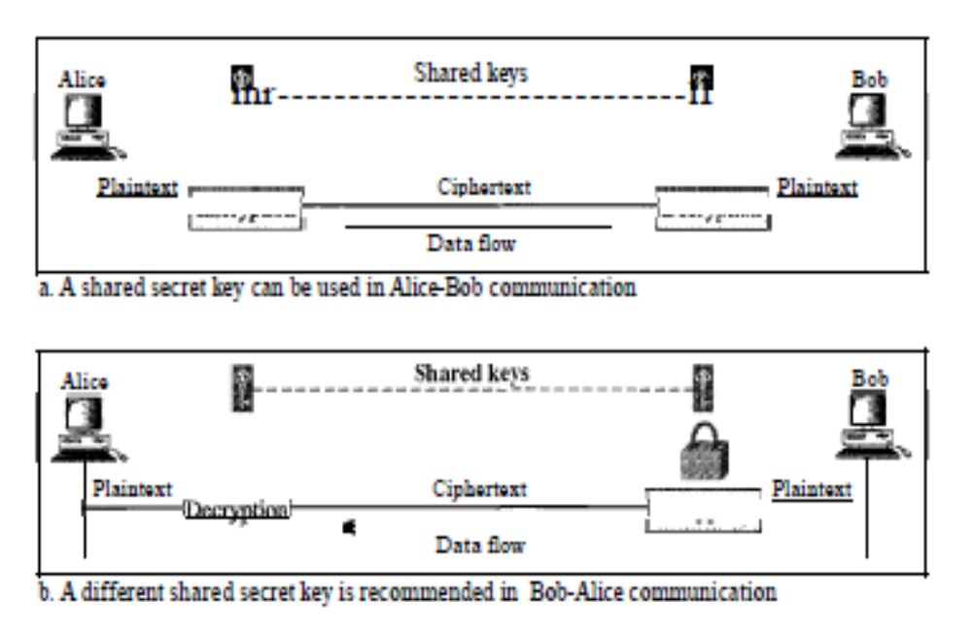
Using two different keys is more secure, because if one key is compromised, the
communication is still confidential in the other direction.

Slide 18
Confidentiality with Asymmetric-Key Cryptography
The problem we mentioned about key exchange in symmetric-key cryptography for privacy culminated in the creation of asymmetric-key cryptography.
Here, there is no key sharing.
Bob creates two keys: one private and one public.
He keeps the private key for decryption; and he publicly announces the public key to the world.
The public key is used only for encryption.
The private key is used only for decryption.
The public key locks the message; the private key unlocks it.

Slide 19
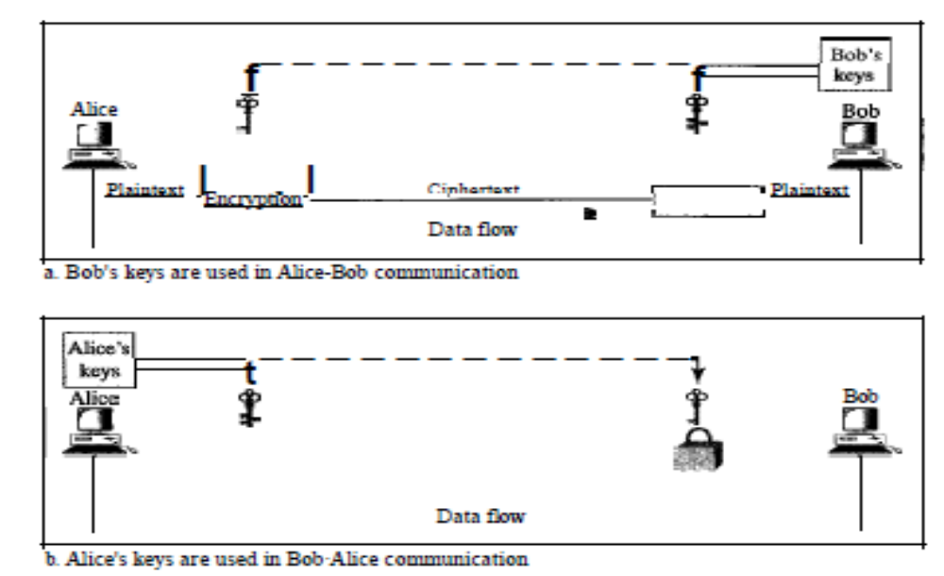

Slide 20
MESSAGE INTEGRITY
Message integrity means that the data must arrive at the receiver exactly as they were sent.
There must be no changes during the transmission.
The integrity of the message must be preserved in a secure communication.
suppose Alice sends a message instructing her banker, Bob, to pay Eve for consulting work.
The message does not need to be hidden from Eve because she already knows she is to be paid. However, the message does need to be safe from Eve
Document and Fingerprint :-
One way to preserve the integrity of a document is through the use of a fingerprint.

Slide 21
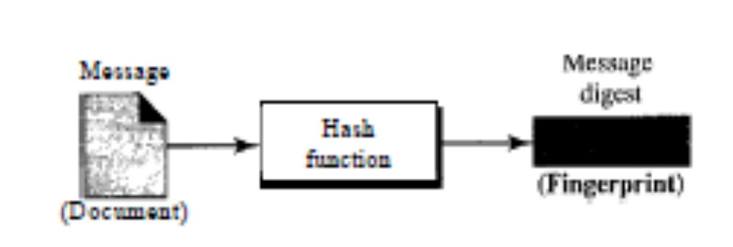
Message and Message Digest
The electronic equivalent of the document and fingerprint pair is the message and message Digest.
To preserve the integrity of a message, the message is passed through an algorithm called a hash function.
The hash function creates a compressed image of the message that can be used as a fingerprint.

Slide 22
Difference
The message digest needs to be kept secret.
Creating and Checking the Digest
The message digest is created at the sender site and is sent with the message to the receiver.
To check the integrity of a message, the receiver creates the hash function again and compares the new message digest with the one received.
If both are the same, the receiver is sure that the original message has not been changed.

Slide 23
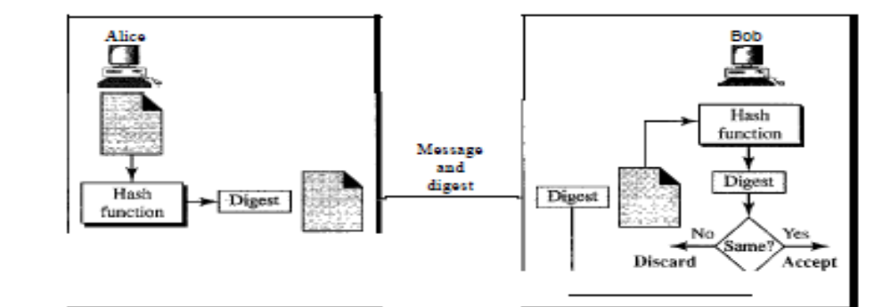
Message Authentication
Message authentication is a service beyond message integrity.
Message authentication means that the receiver is ensured that the message is coming from the intended sender, not an imposter.
In message authentication the receiver needs to be sure of the sender's identity and that an imposter has not sent the message.

Slide 24
A hash function guarantees the integrity of a message.
It guarantees that the message has not been changed.
When Alice sends a message to Bob, Bob needs to know if the message is coming from Alice or Eve.
To provide message authentication, Alice needs to provide proof that it is Alice sending the message and not an imposter.
The digest created by a hash function is normally called a modification detection code (MDC). The code can detect any modification in the message
MAC
To provide message authentication, we need to change a modification detection code to a message authentication code (MAC).
An MDC uses a keyless hash function~ a MAC uses a keyed hash function.
A keyed hash function includes the symmetric key between the sender and receiver when creating the digest.

Slide 25
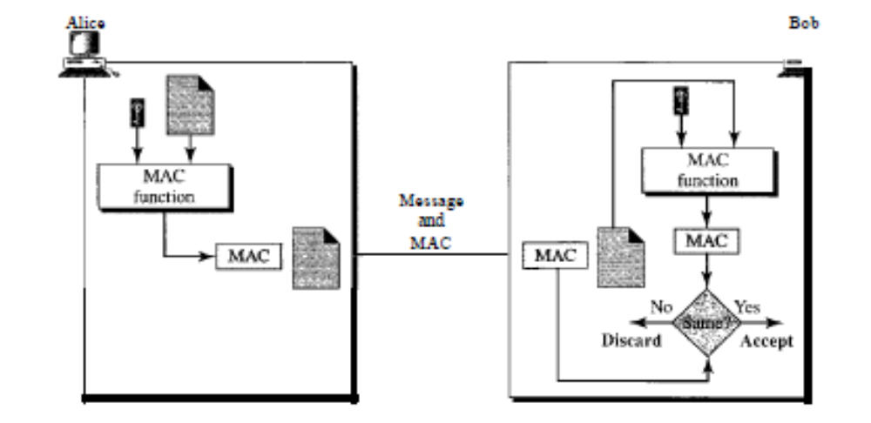
Figure shows how Alice uses a keyed hash function to authenticate her message and how Bob can verify the authenticity of the message.

Slide 26
Alice, using the symmetric key and a keyed hash function to generates a MAC.
She then concatenates the MAC with the original message and sends the to Bob. Bob receives the message and the MAC.
He applies the same keyed hash function to the message using the symmetric key to get a new MAC.
He then compares the MAC sent by Alice with the newly generated MAC.
If the two MACs are identical, the message has not been modified and the sender of the message is identified.
Message Nonrepudiation
Message nonrepudiation means that a sender must not be able to deny sending a message that he or she.
For example, when a customer sends a message to transfer money from one account to another, the bank must have proof that the customer actually requested this transaction.

Slide 27
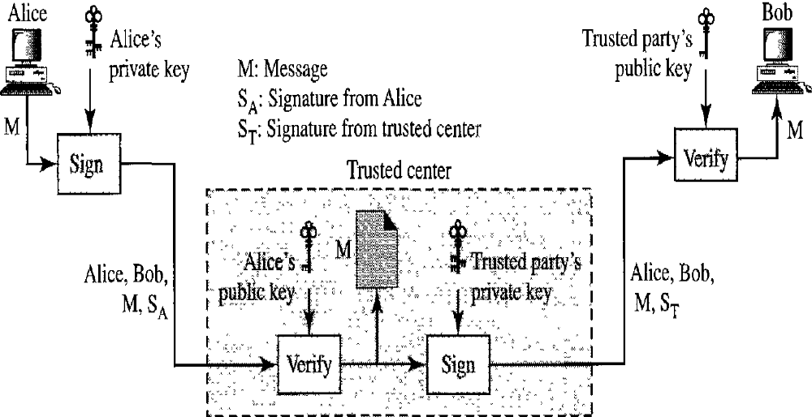
One solution is a trusted third party. People can create a trusted party among themselves.
Figure shows how a trusted party can prevent Alice from denying that she sent the message.

Slide 28
Alice creates a signature from her message and sends the message, her identity, Bob's identity, and the signature to the center. The center, after checking that Alice's public key is valid.
The center then saves a copy of the message with the sender identity, recipient identity,
The center uses its private key to create another signature from the message.
The center then sends the message, the new signature, Alice's identity, and Bob's identity to Bob.
Bob verifies the message using the public key of the trusted center.
If in the future Alice denies that she has sent the message, the center can show a copy of the saved message.
Hence sender cannot deny the message which he sent.

Slide 29
ENTITY AUTHENTICATION
Entity authentication is a technique designed to let one party prove the identity of another party.
An entity can be a person, a process, a client, or a server.
The entity whose identity needs to be proved is called the claimant.
The party that tries to prove the identity of the claimant is called the verifier.
In entity authentication (or user identification) the entity or user is verified prior to access to the system resources (files, for example).
For example, a student who needs to access her university resources needs to be authenticated during the logging process.

Slide 30
There are two differences between message authentication and entity authentication.
First, message authentication may not happen in real time; entity authentication does.
Second, message authentication simply authenticates one message; the process needs to be repeated for each new message. Entity authentication authenticates the claimant for the entire duration of a session.
Passwords
The simplest and the oldest method of entity authentication is the password.
A password is used when a user needs to access a system to use the system's resources (log-in).
We can divide this authentication scheme into two separate groups: the fixed password and the one-time password.

Slide 31
The fixed password
In this group, the password is fixed; the same password is used over and over for every access.
This approach is subject to several attacks.
e.g. Stealing a Password, Accessing a file etc.
One-Time Password
In this type of scheme, a password is used only once. It is called the one-time password.
A one-time password makes eavesdropping and stealing useless.
However, this approach is very complex,

