Slide 1
Network Devices
Hub
Definition:
A central device that connects multiple computers on a single
network.
A network hub has I/O ports that can be used to link several
network devices together.
A signal would enter the hub through one port and the hub will
broadcast it on every other port except the port the data came in through.
There are very few practical applications for a hub today, given the affordability of the much more advanced switch.

Slide 2
Hub(Cont.)
At the bottom of the networking used hubs.
Hubs are used in networks that use twisted- pair cabling to connect devices.
Hubs can also be joined together to create larger networks.
Hubs are simple devices that direct data packets to all devices connected to the hub.
This makes them inefficient devices and can create a performance on busy networks.

Slide 3
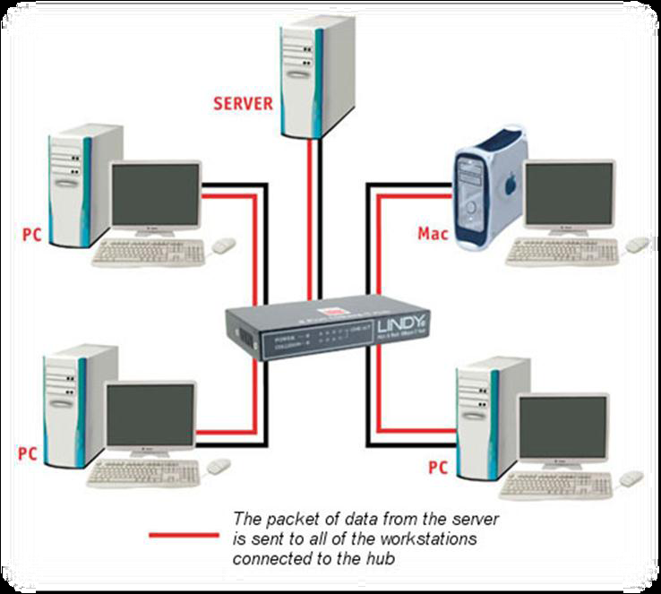
Hub (cont.) The following fig Shows Hubs

Slide 4
Hub(cont.)
In its most basic form , a hub does nothing except provide a pathway for the electrical signals to travel along. Such a device is called a passive hub.
providing a path for the data signals, regenerates the signal before it forwards it to all of the connected devices. Called active hub.
Hubs come in a variety of shapes and sizes.
1) Small hubs with five or eight connection ports are commonly referred to as workgroup hubs.
2) Others can accommodate larger numbers of devices (normally up to 32). These are referred to as high-density devices.
hubs don’t perform any processing, they do little except enable communication between connected devices.

Slide 5
Switches:-
Definition:-
A switch is a computer networking device that connects network segments or network devices together.
Much like a hub, a switch has I/O ports that connect devices together.
Unlike a hub though, switches are smart enough to know which device data packets are meant for and only sends to that device.
The use of a switch is practical for many more applications than a hub.

Slide 6
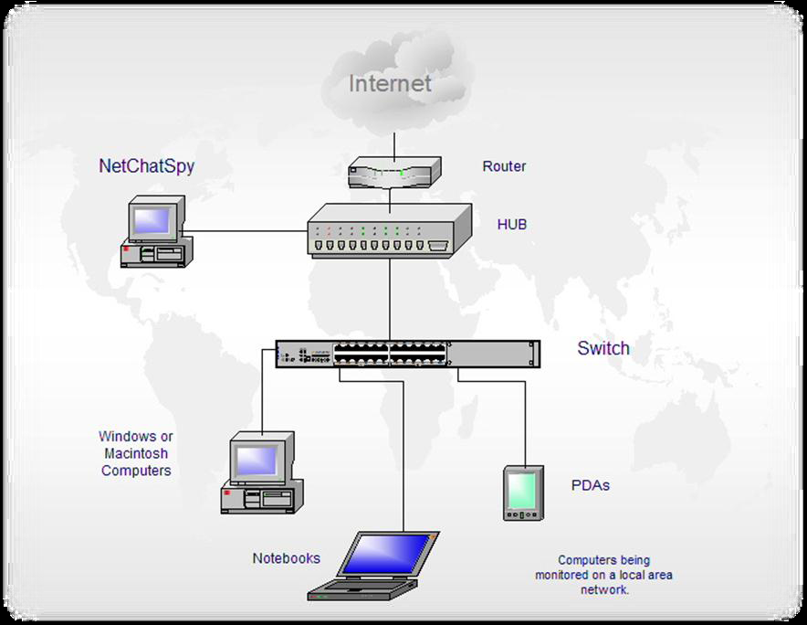
The following shows Switches

Slide 7
Many business and even homes use switches to link their network devices.
Like hubs, switches are the connectivity points of an Ethernet network.
Devices connect to switches via twisted-pair cabling, one cable for each device.
The difference between hubs and switches is in how the devices deal with the data that they receive.

Slide 8
By forwarding data only to the connection that should receive it, the switch can improve network performance in two ways.
by creating a direct path between two devices and controlling their communication, it can greatly reduce the number of collisions on the network.
Collisions occur on Ethernet networks when two devices attempt to transmit at exactly the same time.
In addition, the lack of collisions enables switches to communicate with devices in full-duplex mode.
In a full-duplex configuration, devices can send and receive data from the switch at the same time.

Slide 9
Contrast this with half-duplex communication, in which communication can occur in only one direction at a time.
Full-duplex transmission speeds are double that of a standard, half-duplex, connection.
So, a 10Mbps connection becomes 20Mbps, and a 100Mbps connection becomes 200Mbps.

Slide 10
Bridges:-
Definition:-
A bridge device filters traffic at a network boundary. Bridges reduce the amount of traffic on a LAN by dividing it into two segments.
Bridges are similar in nature to switches, but a bridge inspects all incoming data and decides what to do with it.
Data can be discarded or forwarded by the bridge, eliminating unnecessary incoming traffic.
Bridges can have many uses, but the most practical uses I can think of for use in my home would be for a media bridge.

Slide 11
These smart devices can monitor incoming traffic to your media devices and prioritize audio and video data.
Bridges are used to divide larger networks into smaller sections.
Bridges can also be used to connect two physical LANs into a larger logical LAN.

Slide 12
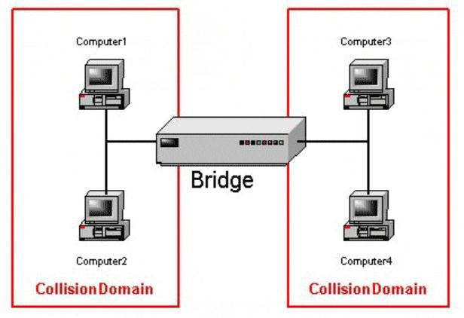
The Following Fig Shows Bridges:-

Slide 13
Types of Bridges:-
Three types of bridges are used in networks:-
➤ Transparent bridge:-
Derives its name from the fact that the devices on the network are unaware of its existence.
A transparent bridge does nothing except block or forward data based on the MAC address.
➤ Source route bridge:- Used in Token Ring networks.
The source route bridge derives its name from the fact that the entire path that the packet is to take through the network is embedded within the packet.
➤ Translational bridge:- Used to convert one networking data format to Another.
for example, from Token Ring to Ethernet and vice versa.

Slide 14
Routers
Definition:-
A device that allows packets of data to be moved efficiently between two points on a network
Routers are used to transfer data packets on a network.
Routers are much smarter than switches in that they route packets based on routing protocols which allows them to more efficiently route data.
Routers can be found in a good percentage of homes and businesses.
Routers assign local IP addresses to devices that are connected to it, and offer a very efficient way for devices to communicate on the network.

Slide 15
Another benefit of a router is that it restricts outside computers from initiating a connection within your local network.
You can make exceptions of course by changing some of the router firewall settings.
routers are used to create larger networks by joining two network segments.
A router can be a dedicated hardware device or a computer
system with more than one network interface and the
appropriate routing software.
All modern network operating systems include the functionality
to act as a router.

Slide 16
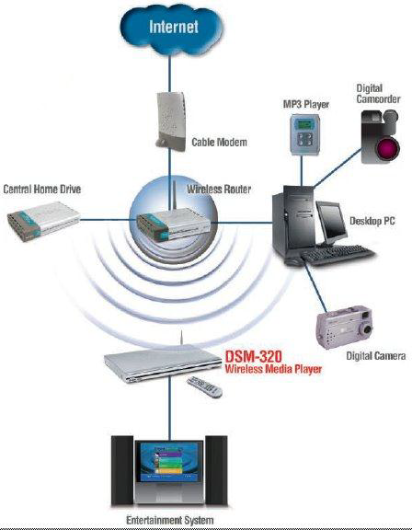
The Following Fig Shows Routers

Slide 17
Gateways:-
Definition:-
A gateway is a network point that acts as an entrance to another network.
Any device that translates one data format to another is called a gateway.
A gateway can convert data packets from one protocol to another.
Additionally it is a network node equipped for interfacing with another network that uses different protocols.
gateways include a router that translates data from one network protocol to another.

Slide 18
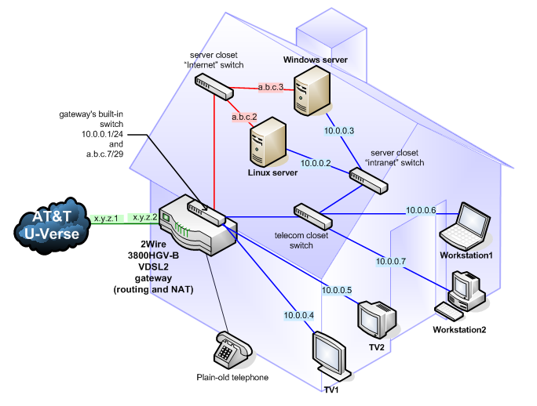
The Following Fig Shows Gateways

Slide 19
The key point about a gateway is that only the data format is translated , not the data itself.
In many cases, the gateway functionality is incorporated into another device.
AT&T for instance provides a residential gateway to their Uverse customers.
This is because there are different protocols for TV, phone, and internet.
The gateway can convert these protocols to the correct format.

Slide 20
Repeaters:-
A repeater (generator) is a device that operates only on the physical layer.
A repeater installed on a link receives the signal before it become too weak or corrupted, regenerates the original bit pattern .
A repeater allow to extend the physical length of the network
Data signals weaken as they travel down a particular medium. This is known as Attenuation.
To increase the distance a signal can travel, you can use repeaters.
Coaxial cable used for network configurations.
So the function of the repeater is to generates the data signals so that they can travel greater distance.

Slide 21
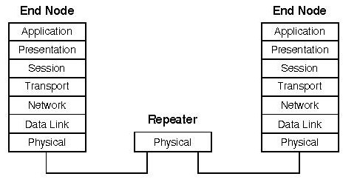
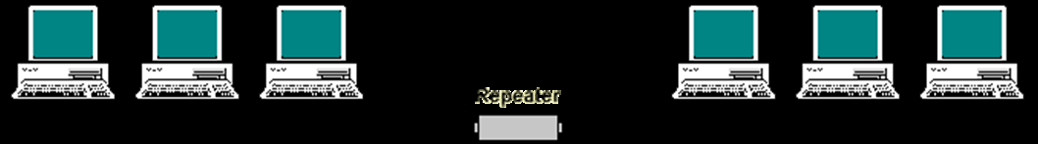
The Following Fig. Shows Repeaters

