Slide 1
The Network Layer
Network Layer Design Issues:
Store-and-Forward Packet Switching
Services Provided to the Transport Layer
Implementation of Connectionless Service
Implementation of Connection-Oriented Service
Comparison of Virtual-Circuit and Datagram Subnets

Slide 2
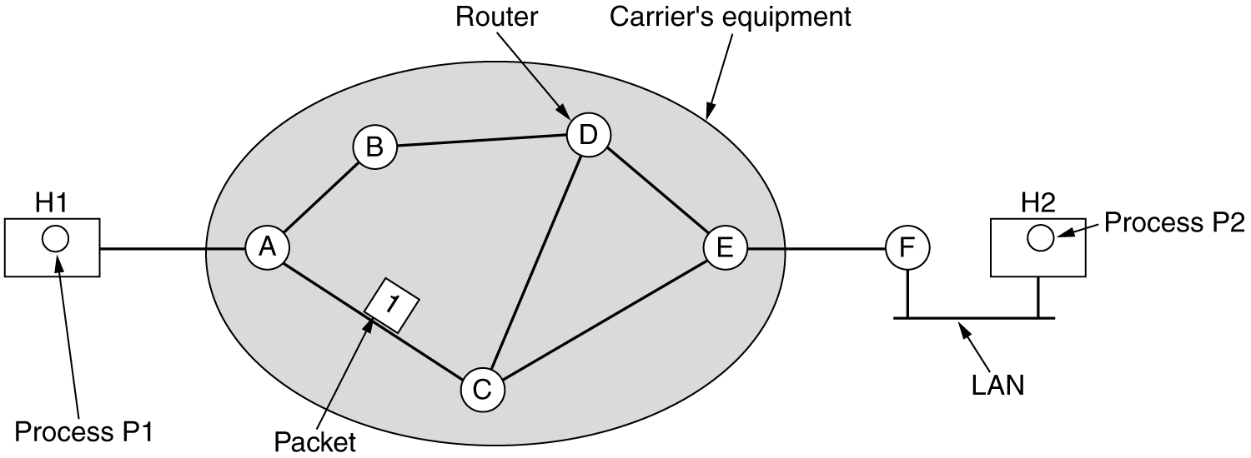
Store-and-Forward Packet Switching:
A host with a packet to send transmits it to the nearest router, either on its own LAN or over a point-to-point link.
Then it is forwarded to the next router along the path until it reaches the destination host, where it is delivered. This mechanism is store-and-forward packet switching.

Slide 3
Services Provided to the Transport Layer
The network layer provides services to the transport layer at the network layer/transport layer interface. The network layer services have been designed with the following goals:
1)The services should be independent of the router technology.
2)The transport layer should be shielded from the number, type, and topology of the routers present.
3)The network addresses made available to the transport layer should use a uniform numbering plan, even across LANs and WANs.
The network layer should provide connection-oriented service or connectionless service

Slide 4
Implementation of Connectionless Service
If connectionless service is offered, packets are injected into the subnet individually and routed independently of each other.
In this context, the packets are frequently called datagram’s and the subnet is called a datagram subnet.
If connection-oriented service is used, a path from the source router to the destination router must be established before any data packets can be sent. This connection is called a VC (virtual circuit) and the subnet is called a virtual-circuit subnet.

Slide 5
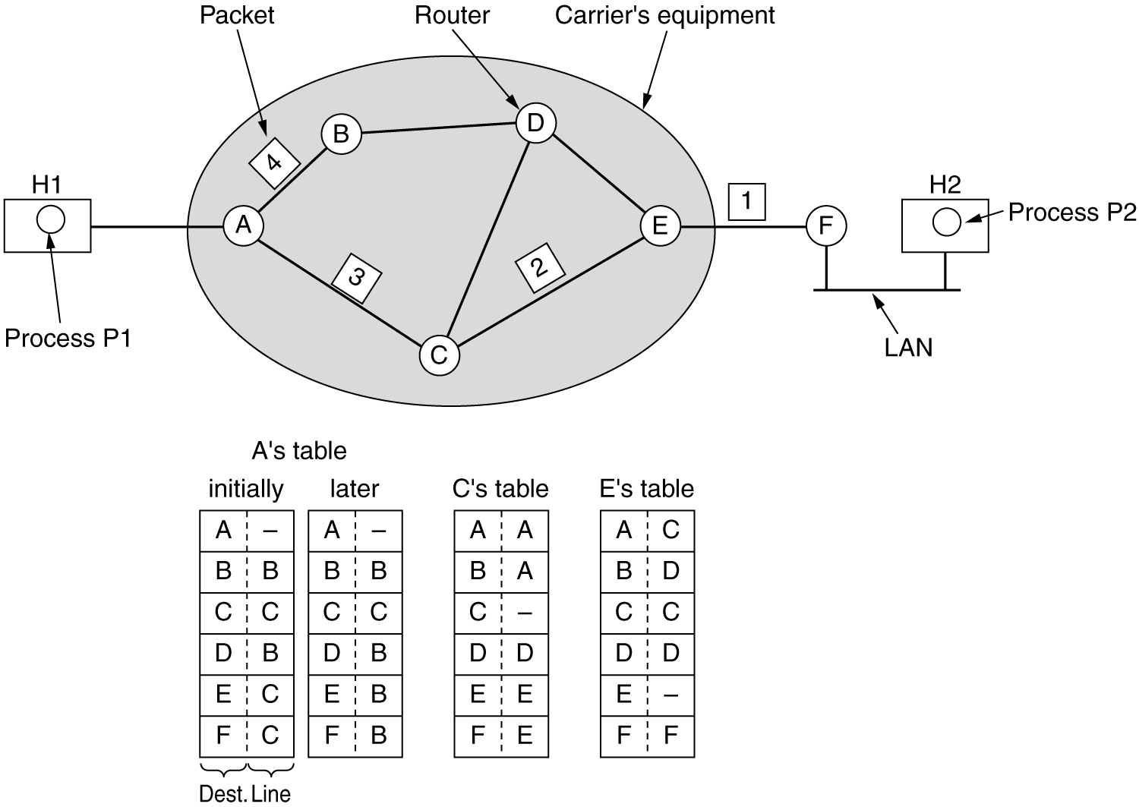
Routing within a diagram subnet.

Slide 6
Implementation of Connection-Oriented Service
For connection-oriented service, we need a virtual-circuit subnet.
The idea behind virtual circuits is to avoid having to choose a new route for every packet sent.
when a connection is established, a route from the source machine to the destination machine is chosen as part of the connection setup and stored in tables inside the routers.
When the connection is released, the virtual circuit is also terminated. With connection-oriented service, each packet carries an identifier telling which virtual circuit it belongs to.

Slide 7
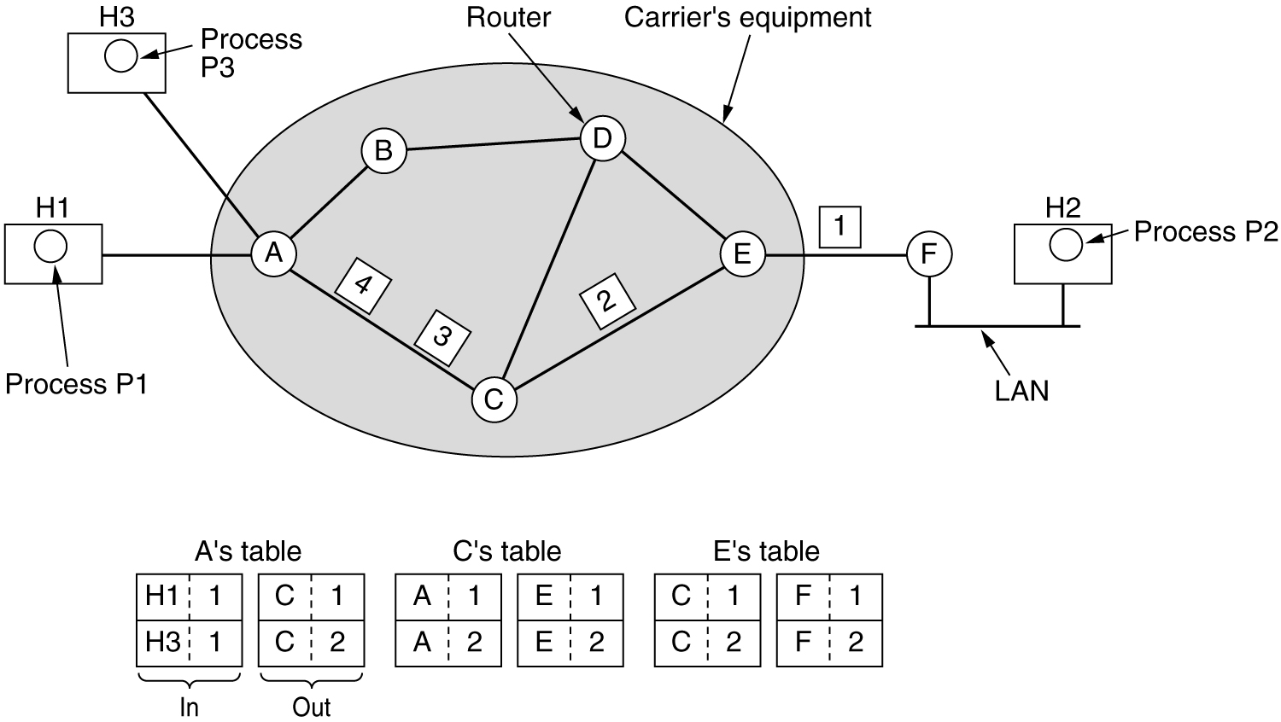
Routing within a virtual-circuit subnet.

Slide 8
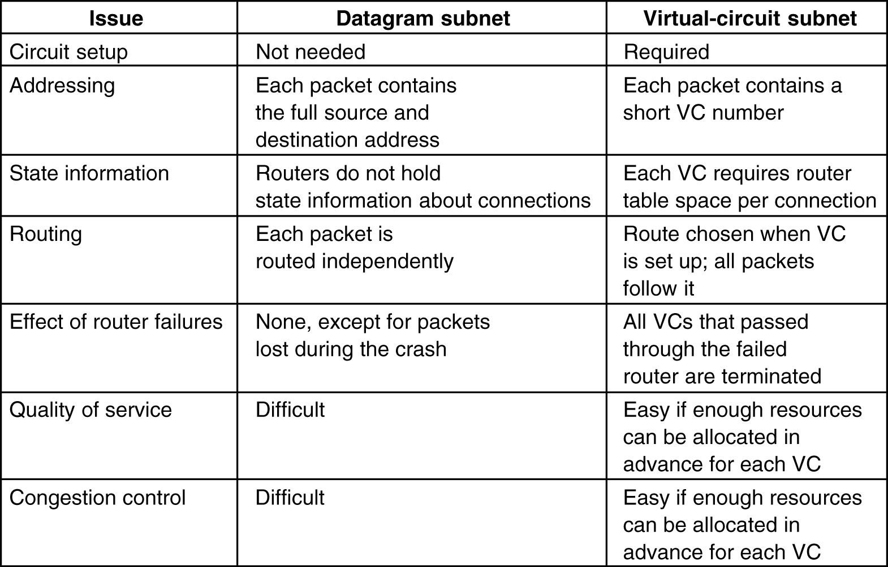
Comparison of Virtual-Circuit and Datagram Subnets

Slide 9
Routing Algorithms
The main function of the network layer is routing packets from the source machine to the destination machine.
The routing algorithm is that part of the network layer software responsible for deciding which output line an incoming packet should be transmitted on.
properties of a routing algorithm:- correctness, simplicity, robustness, stability, fairness, and optimality.
Correctness and simplicity hardly require comment, but the need for robustness may be less obvious at first
Robustness : The routing algorithm should be able to cope with changes in the topology and traffic without requiring all jobs in all hosts to be aborted.
Stability : There exist routing algorithms that never converge to equilibrium, no matter how long they run.
Fairness and optimality may sound obvious—surely no reasonable person would oppose them—but as it turns out, they are often contradictory goals.

Slide 10
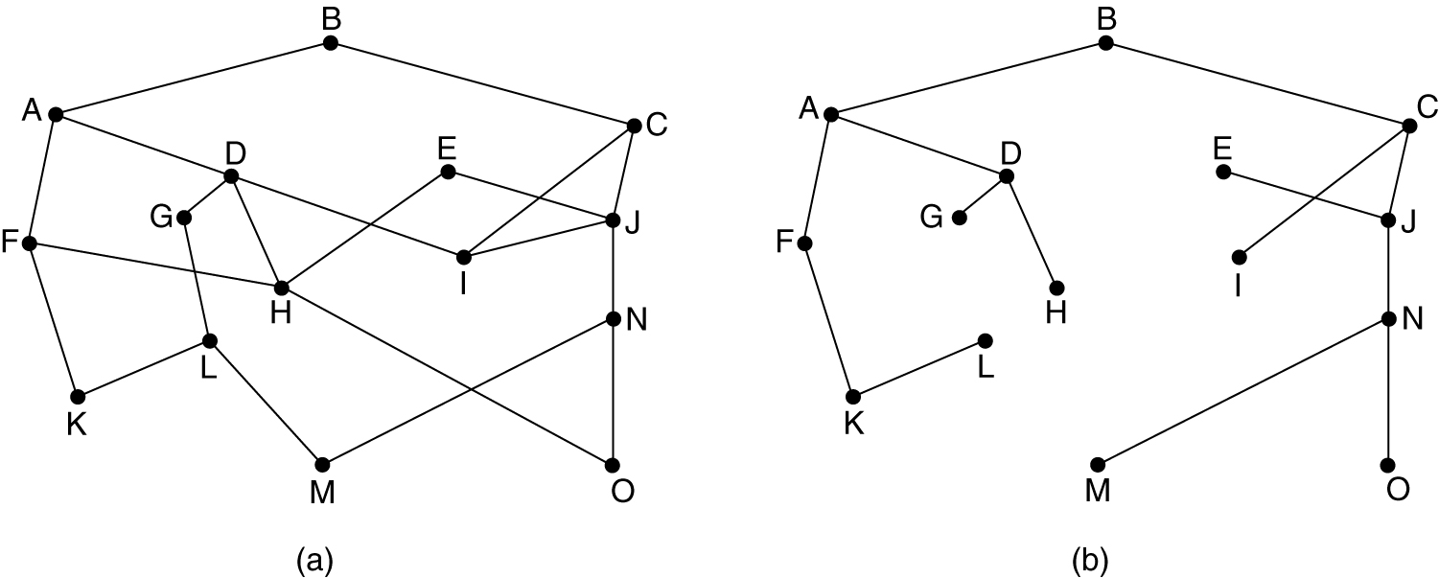
Routing algorithms can be grouped into two major classes: Nonadaptive. In Non adaptive algorithms, routing decisions are not based on measurements or estimates of the current traffic and topology.
Adaptive algorithms, change their routing decisions to reflect changes in the topology.
The Optimality Principle
Optimal routes without regard to network topology or traffic is known as the optimality principle.
The set of optimal routes from all sources to a given destination form a tree rooted at the destination. Such a tree is called a sink tree.
Since a sink tree is indeed a tree, it does not contain any loops, so each packet will be delivered within a finite and bounded number of hops.
(a) A subnet. (b) A sink tree for router B.

Slide 11
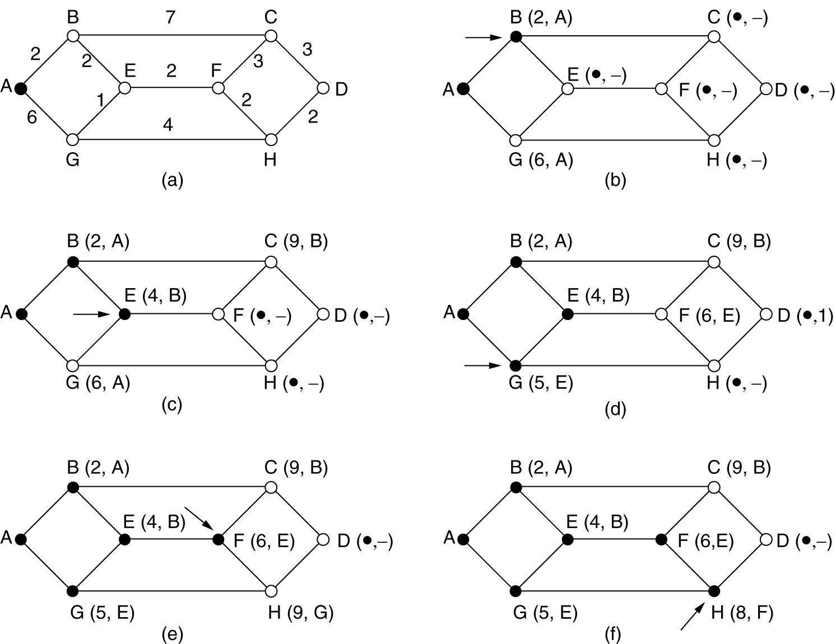
Shortest Path Routing
The concept of a shortest path deserves some explanation. One way of measuring path length is the number of hops.

Slide 12
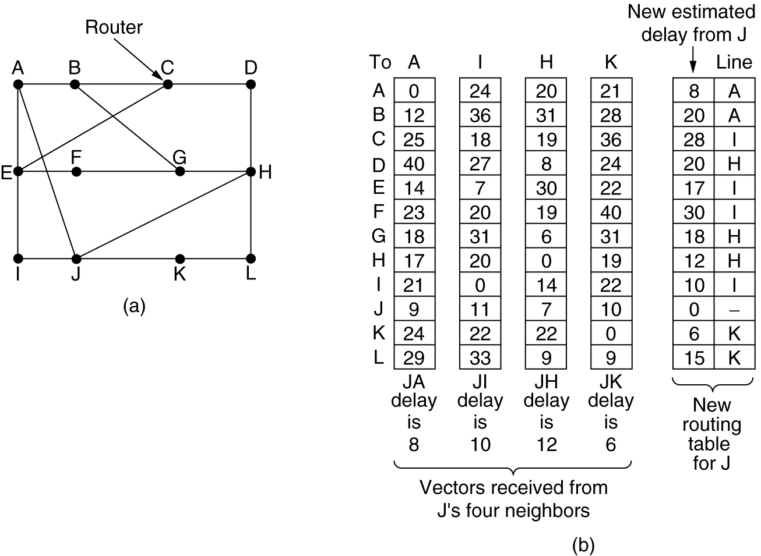
Distance Vector Routing
Two dynamic algorithms in particular, distance vector routing and link state routing, are the most popular.
Distance vector routing algorithms operate by having each router maintain a table (i.e, a vector) giving the best known distance to each destination and which line to use to get there.
The distance vector routing algorithm is sometimes called by other names, most commonly the distributed Bellman-Ford routing algorithm and the Ford-Fulkerson algorithm,

Slide 13
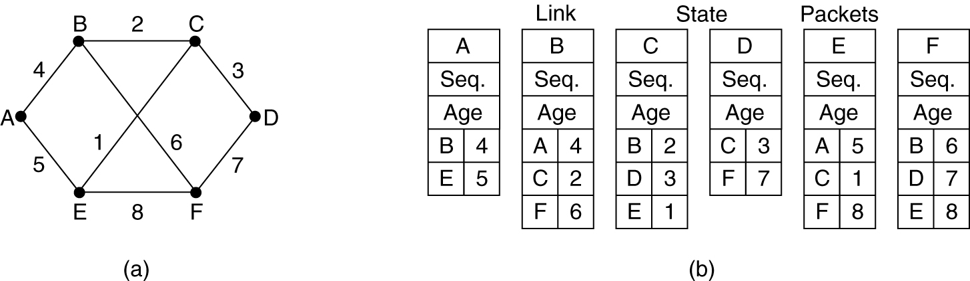
Link State Routing
Distance vector routing algorithm was replaced by an entirely new algorithm, now called link state routing. Variants of link state routing are now widely used.
The idea behind link state routing is simple and can be stated as five parts. Each router must do the following:
Discover its neighbors and learn their network addresses.
Measure the delay or cost to each of its neighbors.
Construct a packet telling all it has just learned.
Send this packet to all other routers.
Compute the shortest path to every other router.

Slide 14
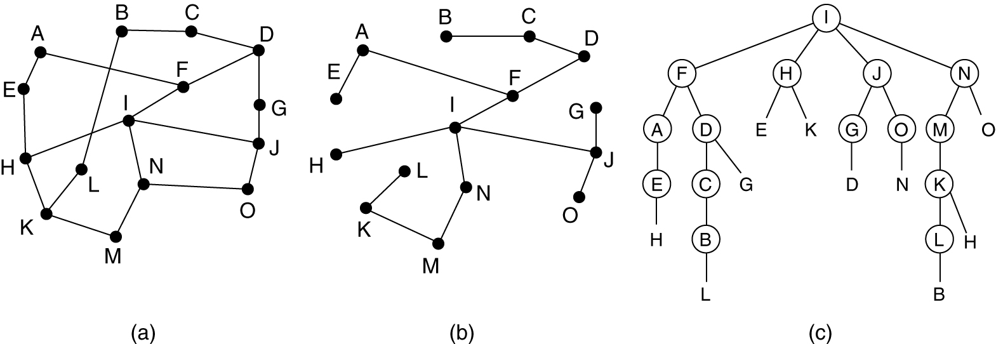
Broadcast Routing
In some applications, hosts need to send messages to many or all other hosts. Sending a packet to all destinations simultaneously is called broadcasting.
One broadcasting method that requires no special features from the subnet is for the source to simply send a distinct packet to each destination.

Slide 15
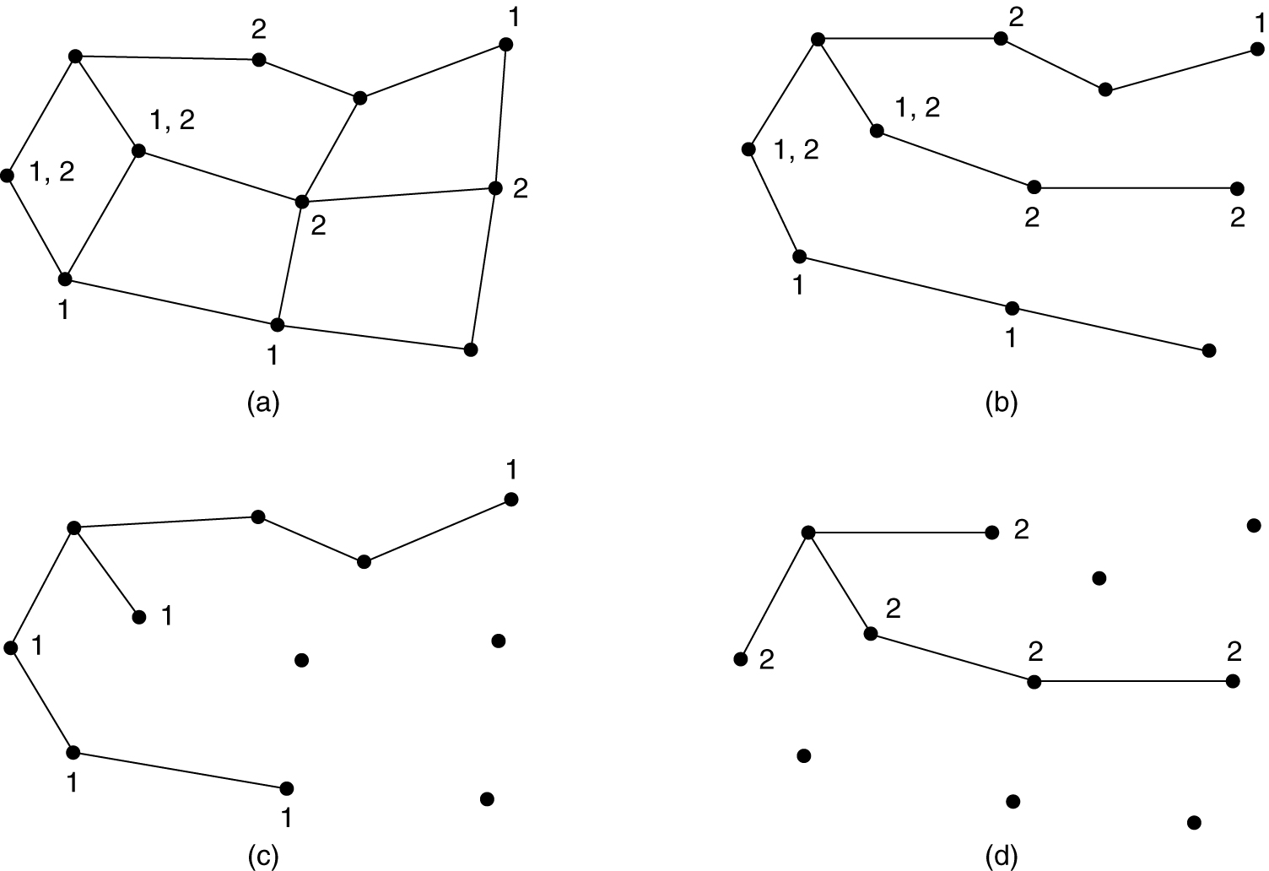
Multicast Routing
Sending a message to a group is called multicasting, and its routing algorithm is called multicast routing.
Multicasting requires group management.

Slide 16
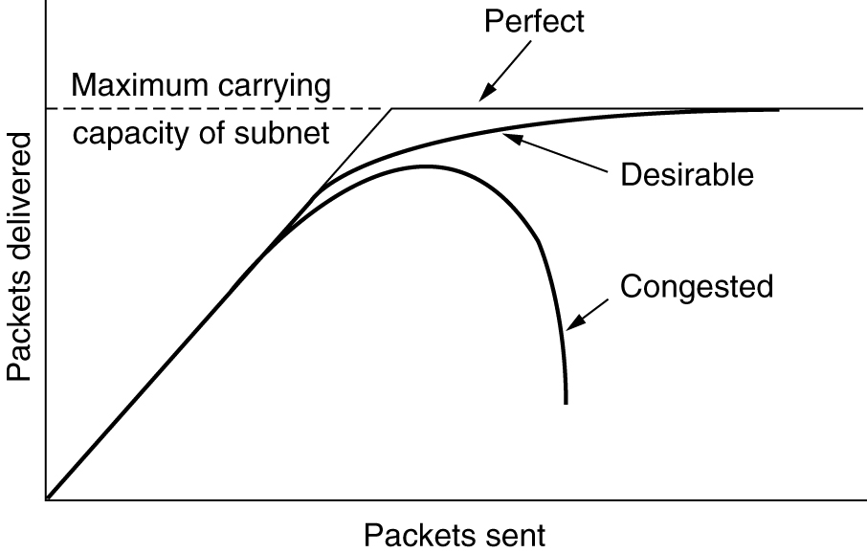
Congestion Control Algorithm
When too many packets are present in (a part of) the subnet, performance degrades. This situation is called congestion.
When the number of packets dumped into the subnet by the hosts is within its carrying capacity, they are all delivered and the number delivered is proportional to the number sent.
Algorithms :
General Principles of Congestion Control
Congestion Prevention Policies
Congestion Control in Virtual-Circuit Subnets
Congestion Control in Datagram Subnets

Slide 17
General Principles of Congestion Control
Monitor the system to detect when and where congestion occurs.
Pass this information to places where action can be taken.
Adjust system operation to correct the problem.

Slide 18
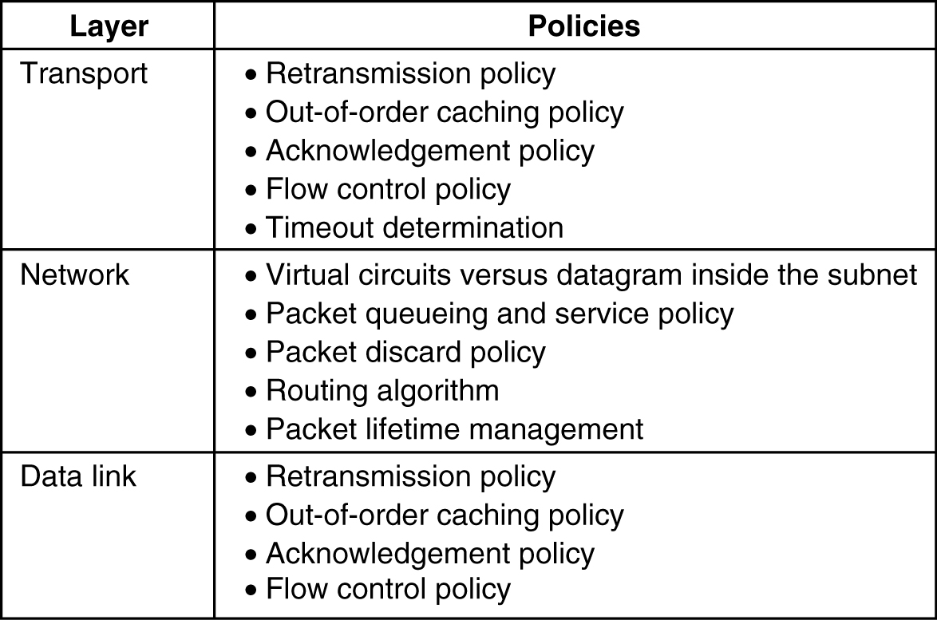
Congestion Prevention Policies

Slide 19
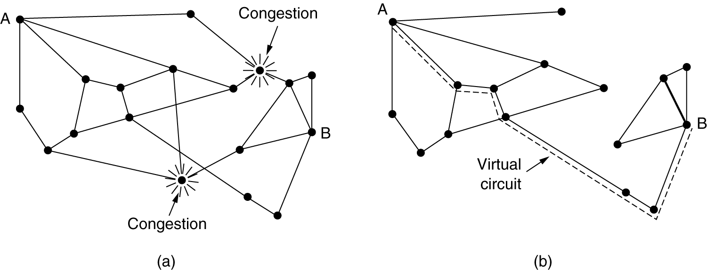
Congestion Control in Virtual-Circuit Subnets
In virtual-circuit subnets you can control congestion dynamically.
One technique that is widely used is admission control.
The idea is simple: once congestion has been signaled, no more virtual circuits are set up until the problem has gone away.
An alternative approach is to allow new virtual circuits but carefully route all new virtual circuits around problem areas. For example, consider the subnet of Fig

Slide 20
Congestion Control in Datagram Subnets
Each router can easily monitor the utilization of its output lines and other resources.
For example, it can associate with each line a real variable, u, whose value, between 0.0 and 1.0, reflects the recent utilization of that line.
Whenever u moves above the threshold, the output line enters a ''warning'' state.
Each newly-arriving packet is checked to see if its output line is in warning state. Following are several alternatives for taking action for warning state.

Slide 21
The Warning Bit:
The old DECNET architecture signaled the warning state by setting a special bit in the packet's header.
When the packet arrived at its destination, the transport entity copied the bit into the next acknowledgement sent back to the source. The source then cut back on traffic.
Choke Packets
In this approach, the router sends a choke packet back to the source host, giving it the destination found in the packet.
The original packet is tagged (a header bit is turned on) so that it will not generate any more choke packets farther along the path and is then forwarded in the usual way.
Hop-by-Hop Choke Packets
At high speeds or over long distances, sending a choke packet to the source hosts does not work well because the reaction is so slow.

