Slide 1
Computer
The word computer comes from the word “compute” which means, to calculate”
There by ,a computer is an electronic device that can perform arithmetic operations at high speed.
A computer is also called a data processor because it can store , process, and retrieve data whenever desired.
A computer is an electronic device that accept data from input devices ,processing on it and display/result.

Slide 2
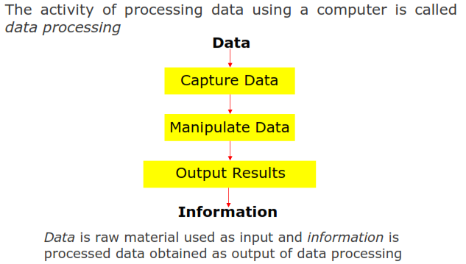
Data Processing

Slide 3

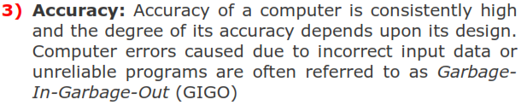

Characteristics of Computer

Slide 4





Slide 5
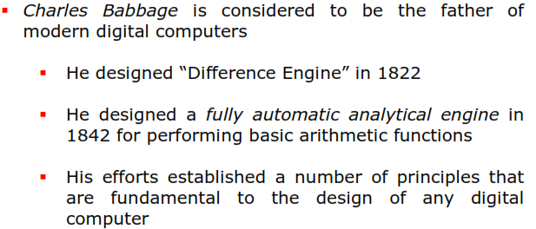
Evolution of computer

Slide 6
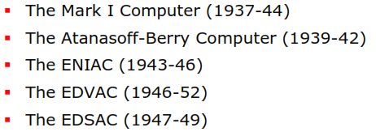

Evolution of computer

Slide 7


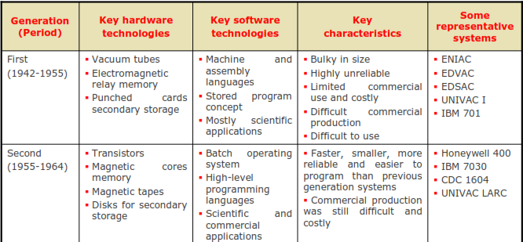
Generation of computer

Slide 8
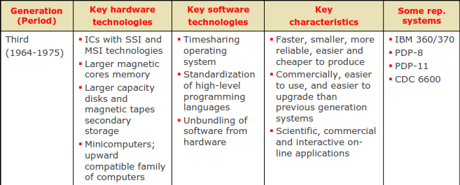
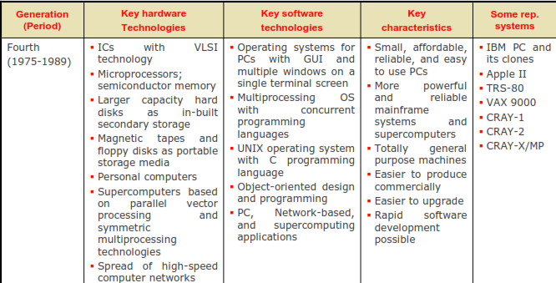

Slide 9
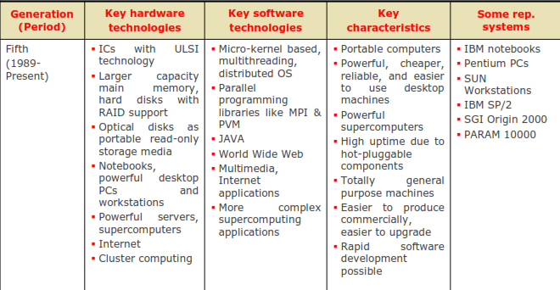

Slide 10
Types of Computer
According to the logic computer can categorized as follows
Analog Computer:-It can processes on analog data
Digital Computer:- It can processes on discrete data.
Hybrid Computer:- It is a combination of analog and digital computer.
According to the size of computer can categorized as follows
Micro Computer :- It can also divided into following types
1) Personal Computer (PC)
2) Workstation
3) Notebook Computer ( Laptop)
Mini Computer
Mainframe Computer
Super Computer

Slide 11
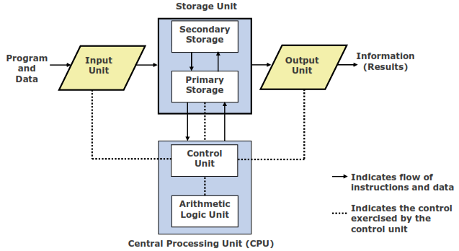
Block Diagram of Computer

Slide 12

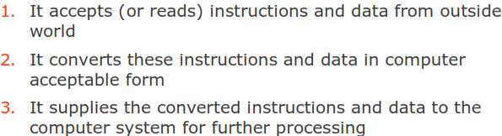
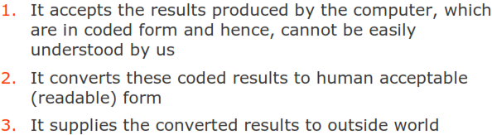

Slide 13
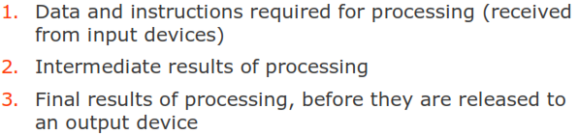

Slide 14



Arithmetic and Logical Unit ( ALU)
Control Unit ( CU )
Central Processing Unit ( CPU )

Slide 15
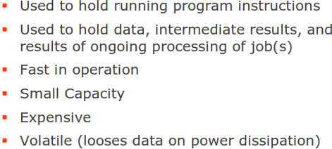
Two Types of Storage

Slide 16
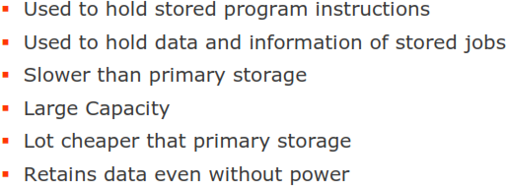

Slide 17



The Five Basic Operations of a Computer System

Slide 18
INPUT DEVICES
Keyboard is the most common type of input device. Ordinary computer keyboards have their keys arranged in a similar way to those on a typewriter.
A mouse is a pointing device. It is the next most common type of input device after the keyboard. A mouse is moved around by the user on a flat surface next to the computer.
Touch pads & trackballs are the same, they are also types of pointing devices. They are often used instead of mouse on portable computers which are laptops.
Joystick The main use of joystick is to play computer games by controlling the way that something moves on the screen. Joysticks can be used to control movement from side to side, up and down & diagonally and horizontally.
Touch screen can detect exactly where on its surface it has been touched.
A scanner can be used to input pictures or text into the computer. There are 2 main types of scanners: hand -held & flat – bed scanners work by passing a beam of bright light over an image.

Slide 19
OUTPUT DEVICES
Monitors A computer display is also called a display screen or video display terminal (VDT). A monitor is a screen used to display the output.
There are two forms of display: cathode-ray tubes (CRTs) and flat-panel display.
A CRT is a vacuum tube used as a display screen for a computer output device. Although the CRT means only a tube, it usually refers to all monitors.
flat-panel display Portable computers such as a lap top use flat panel displays, because they are more compact and consume less power than CRTs.
A printer is an output device that produces a hard copy of data. The resolution of printer output is expressed as DPI.
printers can be classified into two forms according to the use of a hammer.
Impact Printers: Hammer hits ribbons, papers or print head. Dot-matrix and daisy-wheel printers are the example. Noisy.
Nonimpact Printers: They do not have the hammer and do not hit. An example is an ink-jet and laser printer
A plotter is a special-purpose output device that draws images with ink pens. That is, the plotter is a graphics printer for making sophisticated graphs, charts, maps, and three-dimensional graphics as well as high-quality colored documents.
Voice-Output Devices This device produces a human speech like sound, but actually is prerecorded vocalized sounds. Voice output is used in the telephone information system, where the requested number is reported using a voice output system.

Slide 20
Memory
In computing, memory refers to the physical devices used to store programs (sequences of instructions) or data (e.g. program state information) on a temporary or permanent basis.
There are two main types of semiconductor memory: volatile and non-volatile.
Volatile memory is computer memory that requires power to maintain the stored information. Most modern semiconductor volatile memory is either Static RAM or dynamic RAM.
E.g. RAM,ROM ,PROM, EPROM,EEPROM
Non-volatile memory is computer memory that can retain the stored information even when not powered. Examples of non-volatile memory include read-only memory flash memory.
E.g. Hard Disk, Floppy Disk, Pen Drive, CD etc.

Slide 21
Operating System
An operating system, or OS, is a software program that enables the computer hardware to communicate and operate with the computer software. Without a computer operating system, a computer would be useless.
GUI - Short for Graphical User Interface, a GUI Operating System contains graphics and icons and is commonly navigated by using a computer mouse.
Multi-user - A multi-user operating system allows for multiple users to use the same computer at the same time and different times.
Multiprocessing - An operating system capable of supporting and utilizing more than one computer processor.
Multitasking - An operating system that is capable of allowing multiple software processes to run at the same time.
Multithreading - Operating systems that allow different parts of a software program to run concurrently.

Slide 22
Applications of Computer
In Tourism: Hotels use computers to speed up billing and checkout the availability of rooms.
In Banks: Banks also have started using computers extensively. This enables the branches to use the central computer system for information on things such as current balance,deposits, overdrafts, interest charges, etc.
In Industry: Computers are finding their greatest use in factories and industries of all kinds.
In Transportation: Today computers have made it possible for planes to land in foggy and stormy atmosphere also.
In Education: Computers have proved to be excellent teachers. They can possess the knowledge given to them by the experts and teach you with all the patience in the world.
In Entertainment: Computers are also great entertainers. Many computer games are available which are like the traditional games like chess, football, cricket, etc.

