Slide 1
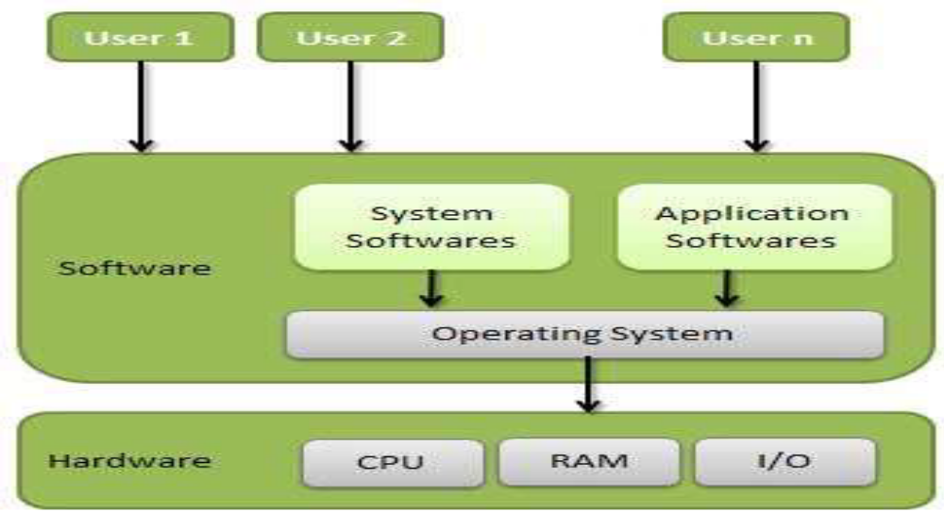
Unit 1: Introduction to Operating System
Definition
An operating system is a program that acts as an interface between the user and the computer hardware and controls the execution of all kinds of programs.
OS is responsible for the management and coordination of activities and the sharing of the resources of the computer.

Slide 2
Goals of an Operating System:-
Simplify the execution of user programs and make solving user problems easier.
Use computer hardware efficiently.
Allow sharing of hardware and software resources.
Make application software portable and versatile.
Provide security and protection among user programs.
Improve overall system reliability.

Slide 3
Computer System Components :-
Hardware Provides basic computing resources (CPU, memory, I/O devices).
Operating System- Controls and coordinates the use of hardware among application programs.
Application Programs- Solve computing problems of users (compilers, database systems, video games, business programs such as banking software).
Users- People, machines, other computers

Slide 4
Important functions of an operating System
Memory Management
Processor Management
Device Management
File Management
Security
Control over system performance
Job accounting
Error detecting aids
Coordination between other software and users

Slide 5
Memory Management
Memory management refers to management of Primary Memory or Main Memory.
Main memory provides a fast storage that can be access directly by the CPU.
The program to be executed, it must in the main memory.
Operating System does the following activities for memory management.
Keeps tracks of primary memory. ( i.e. what part of memory are in use by whom, what part are not in use.)
In multiprogramming, OS decides which process will get memory when and how much.
Allocates the memory when the process requests it to do so.
De-allocates the memory when the process no longer needs it or has been terminated.

Slide 6
Processor Management
OS decides which process gets the processor when and how much time. This function is called process scheduling.
Operating System does the following activities for processor management.
Keeps tracks of processor and status of process.
Allocates the processor (CPU) to a process.
De-allocates processor when processor is no longer required.

Slide 7
Device Management
Operating System does the following activities for device management.
Keeps tracks of all devices.
Decides which process gets the device when and for how much time.
Allocates the device in the efficient way.
De-allocates devices.

Slide 8
File Management
A file system is normally organized into directories for easy navigation and usage.
These directories may contain files and other directions.
Operating System does the following activities for file management.
Keeps track of information, location, uses, status etc.
Decides who gets the resources.
Allocates the resources.
De-allocates the resources.

Slide 9
Other Important Activities
Following are some of the important activities that Operating System does.
Security -- By means of password and similar other techniques, preventing unauthorized access to programs and data.
Control over system performance -- Recording delays between request for a service and response from the system.
Job accounting -- Keeping track of time and resources used by various jobs and users.
Error detecting aids -- Production of dumps, traces, error messages and other debugging and error detecting aids.
Coordination between other software and users -- Coordination and assignment of compilers, interpreters, assemblers and other software to the various users of the computer systems

