Slide 1
What is Computer
A computer is a general purpose device that can be programmed to carry out a finite set of arithmetic or logical operations.
Since a sequence of operations can be readily changed, the computer can solve more than one kind of problem.
The first electronic digital computers were developed between 1940 and 1945 in the United Kingdom and United States. Originally they were the size of a large room, consuming as much power as several hundred modern personal computers

Slide 2
Characteristics of Computers
Speed
Storage
Accuracy
Versatility
Processing
Automation
Diligence
Reliability

Slide 3
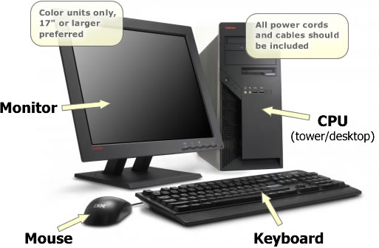
Computer Parts
There are many parts that work together to make a computer work.
Main Three parts
1) Keyboard / Mouse
2) CPU
3) Monitor

Slide 4
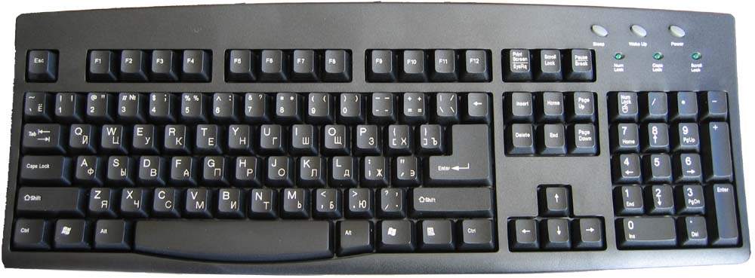
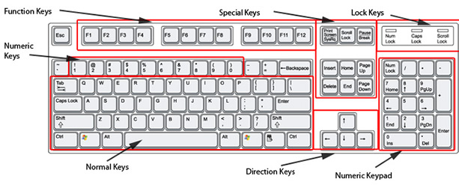
Keyboard/Mouse
Used to enter information into the computer and for giving commands.

Slide 5
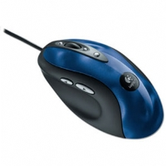
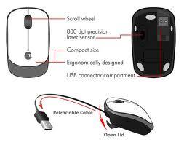
Keyboard/Mouse
The mouse is used to control the on-screen pointer by pointing and
clicking, double-clicking,
or dragging objects on the screen

Slide 6
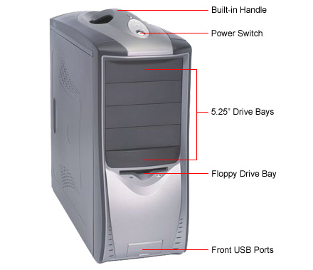
Front of the CPU

Slide 7
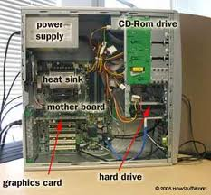
Inside of CPU

Slide 8
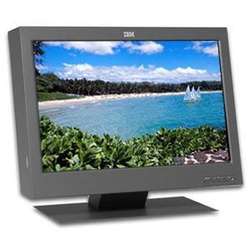
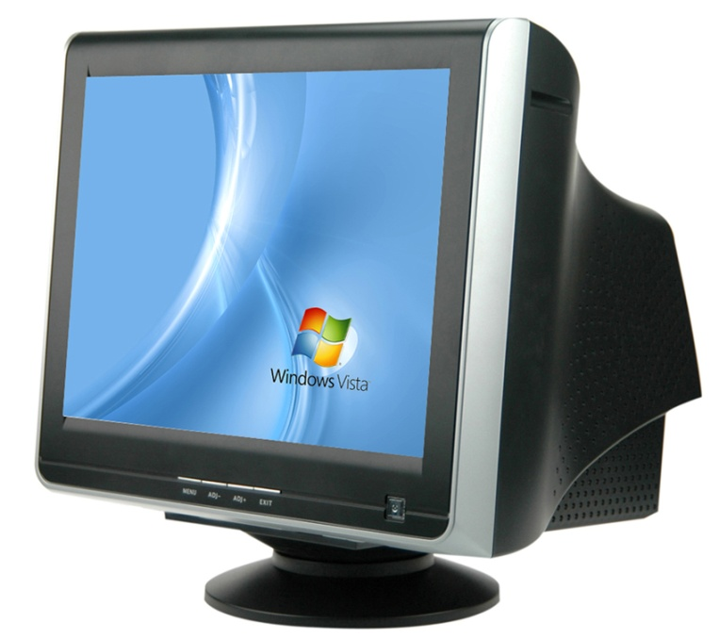
Monitor
A display screen to provide “output” to the user.
It is where you view the information your are working on

Slide 9
Storage device
A storage device is a hardware device capable of storing information. There are two storage devices used in computers.
A Primary storage device such as computer RAM.
A secondary storage device such as a computer hard drive.

Slide 10
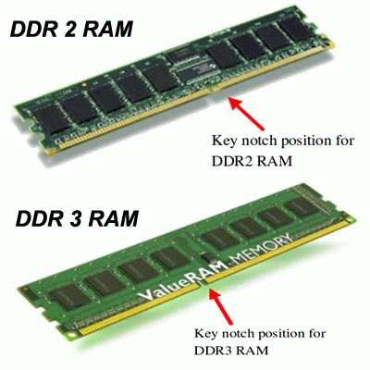
Random Access Memory (RAM)
RAM is a computer’s temporary memory, which exists as chips on the motherboard near the CPU.
It stores data or programs
while they are being
used and requires power.

Slide 11
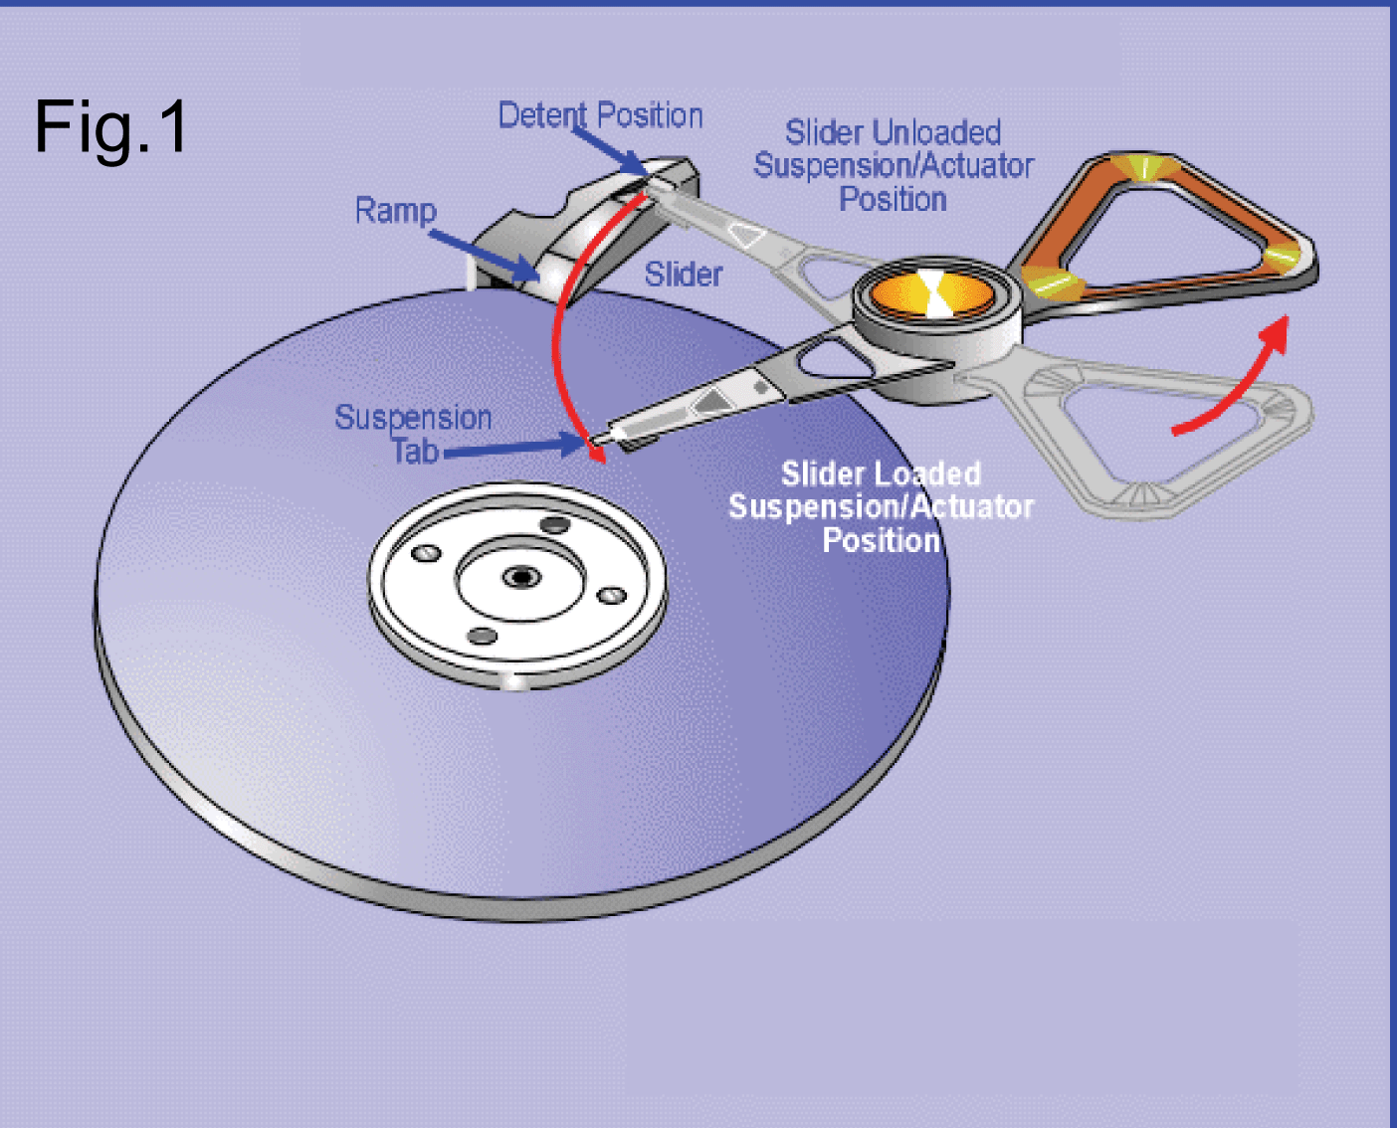
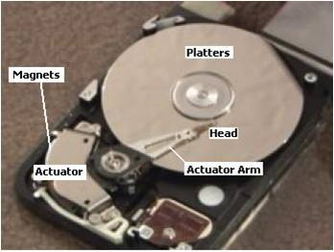
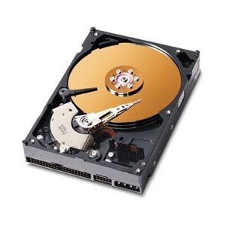
Hard Disk
Magnetic storage device in the computer.

Slide 12
Additional examples of storage devices
Floppy diskette
CD/DVD-ROM disc
USB flash drive

Slide 13
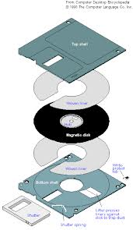
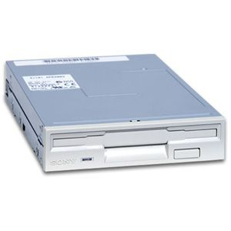
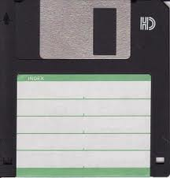
Floppy Disk Drive
A device that holds a removable floppy disk when in use; read/write heads read and write data to the diskette.

Slide 14
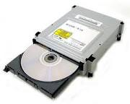
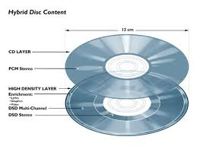
CD ROM Drive
The drive that plays CDs and
reads data that has been
stored on the CD.
Compact Disk –
A type of optical storage
device.

Slide 15
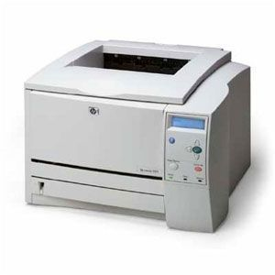
Printer
An output device that produces a hard copy on paper. It gives information to the user in printed form.

Slide 16
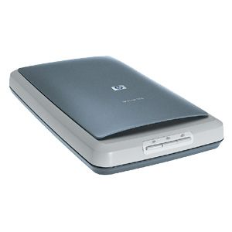
Scanner
A device that allows pictures to be placed into a computer.

Slide 17
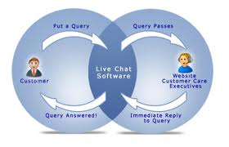
Software's
Programs that tell the computer what to do.
It provides instructions that the CPU will need to carry out.

Slide 18
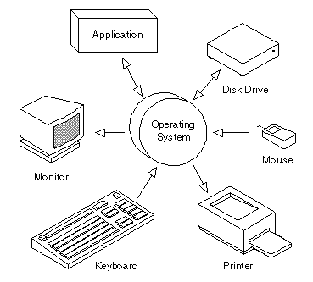
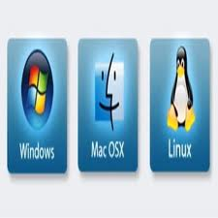
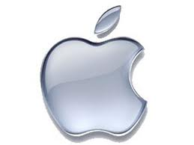

Operating Systems
The operating system is the most important program that runs on a computer.
Every general-purpose computer must have an operating system to run other programs

