Slide 1
Visual C# - GUI and controls - 1
GUI - Graphical User Interface
How your user interfaces with your program
You can make it really easy (or difficult) for the user!
Lots of controls
e.g. buttons, textboxes, labels, menus
You place them on the form
IDE groups similar controls together
You write code for them

Slide 2
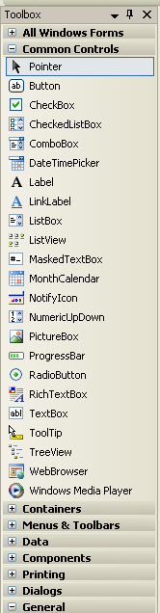
Visual C# - GUI and controls - 2
Common Controls – in Toolbox
Button
TextBox
ListBox (selectable list)
Label
Checkbox
Radio buttons
Picture box
Menu
Others in groups
All have properties and events
Part of OOP
Containers – hold controls, e.g. Panel

Slide 3

Visual C# - GUI and controls - 3
Button Control – properties and events
Main properties:
Appearance – Color [sic], Image, Text
Behavior [sic] – Enabled, Visible
Data – Tag
Design – Name
Layout – Location, Size
Main events:
Click!
Double-click

Slide 4
Visual C# - GUI and controls - 4
TextBox Control
Properties – Similar to button, but also text entry
Text (single line)
Lines (multiline)
MultiLine is a property
ReadOnly
Others - Autocomplete
Events
Keyboard events
TextChanged
Focus – Enter, Leave

Slide 5
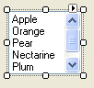
Visual C# - GUI and controls - 5
ListBox – List of selectable items
Properties:
Items (collection)
ScrollBars (H & V)
MultiColumn
Can have checked boxes
Events
Click
SelectedIndexChanged

Slide 6
Visual C# - GUI and controls - 6
TextBox and ListBox text properties
Text – all the text in the text or list box.
Lines[0] – first line of text or list box – read only
AppendText(“new text”); – adds text to textbox
Lines.Length – number of lines in textbox
ListBox
Text – all the text in the listbox.
Items.Add(“new list item”);
Items.Insert(lineNo, “inserted text”);
Clear();
SelectedItem – gets selected
Data always a string – need to convert for numbers.
More later

Slide 7
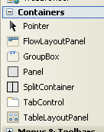
Visual C# - GUI and controls - 7
Containers
Contain other controls
Panel
GroupBox
Tabbed control
More later

Slide 8
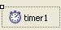
Visual C# - GUI and controls - 8
Non-visual controls
Timer
Displayed in status bar
Properties:
Name, Enabled, Interval, Tag
Event:
Tick – code executes when timer ‘ticks’

Slide 9
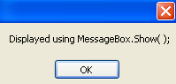
Visual C# - GUI and controls - 9
Dialog Boxes
Easy way to display text information.
Not a control – display when program runs
MessageBox.Show("Message");

Slide 10
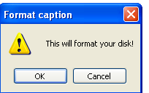
Visual C# - GUI and controls - 10
Dialog boxes:
Can add Caption, buttons and icon:
MessageBox.Show(
"This will format your disk!",
"Format caption",
MessageBoxButtons.OKCancel, MessageBoxIcon.Exclamation);
Can add more lines with escape chars \n, \r
Check response with DialogResult.OK
Note same command does different things!
Depends on no. of parameters - Feature of OOP

Slide 11
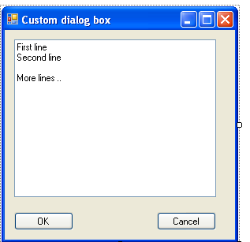
Visual C# - GUI and controls - 11
Input? – Have to create your own form and display it
Create new form
Project> Add Windows Form
(default name – Form2)
Design form:
Display form on button click:
Form2 dialogForm = new Form2( );
if (dialogForm.ShowDialog( ) == DialogResult.OK)
{ .. }
‘new’ instantiates (creates) a new object (our form)

Slide 12
Visual C# - GUI and controls - 12
Weekly tasks:
Example and tasks
Dating form
Splash screen,
Snap program
Watch video: Creating a user interface

Slide 13
Visual C# - GUI and controls - 13
Summary
GUI
Controls
Button, Textbox etc
Properties and Events
Non-visual controls
Dialog boxes
Forms

