Slide 1
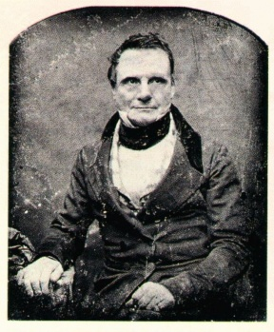
Charles Babbage
English inventor
1791-1871
taught math at Cambridge University
invented a viable mechanical computer equivalent to modern digital computers

Slide 2
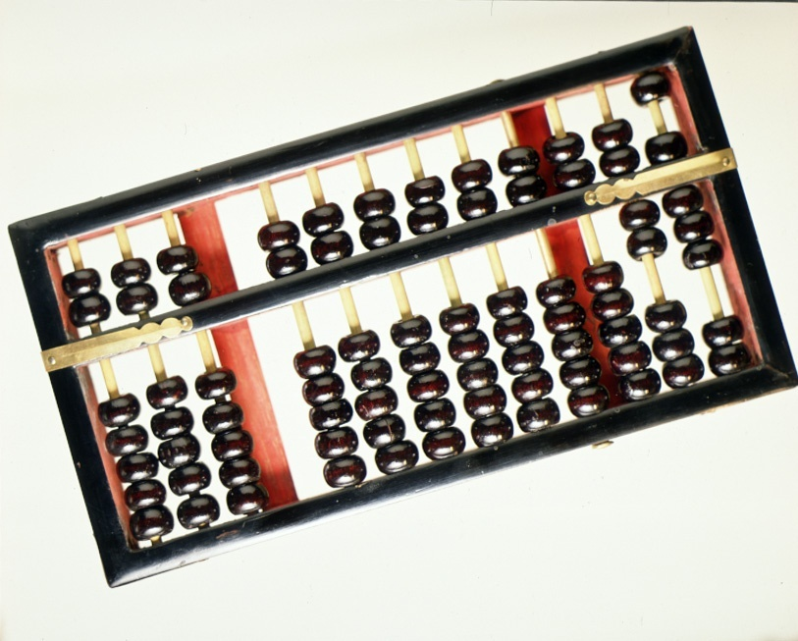
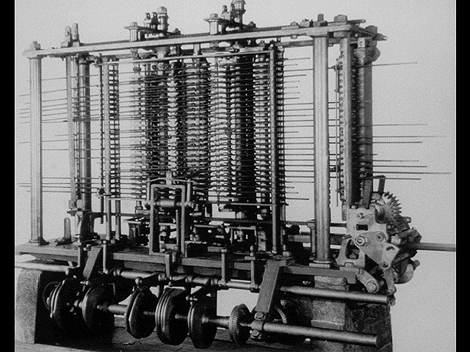
ABACUS
Analytical Engine

Slide 3
Evolution of Computer
MARK I Computer
ENIAC
EDVAC
EDSAC
UNIVAC I

Slide 4
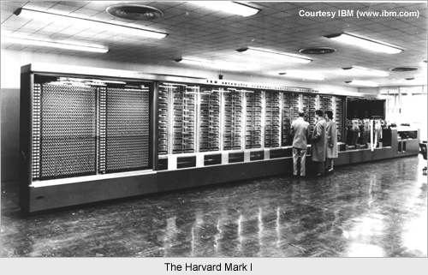
MARK I computer

Slide 5
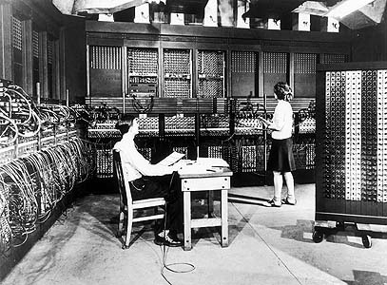
ENIAC

Slide 6
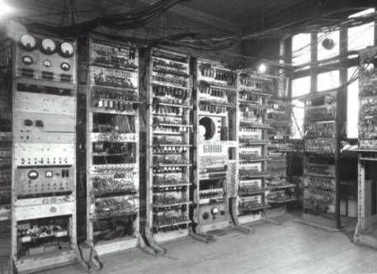
EDVAC

Slide 7
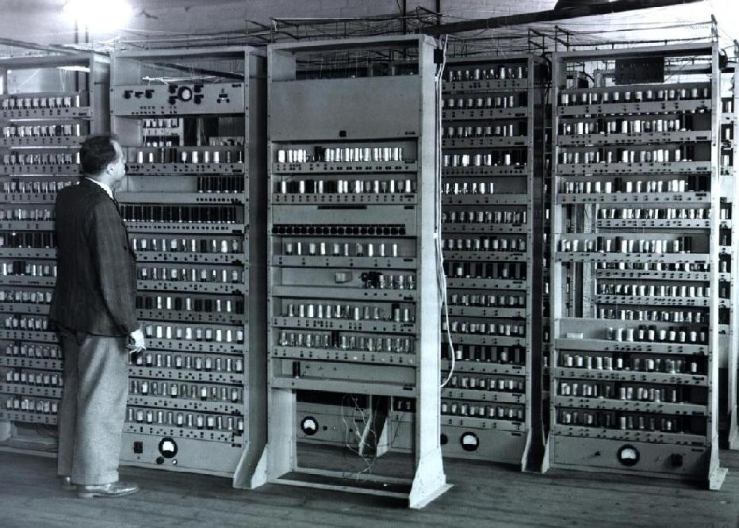
EDSAC

Slide 8
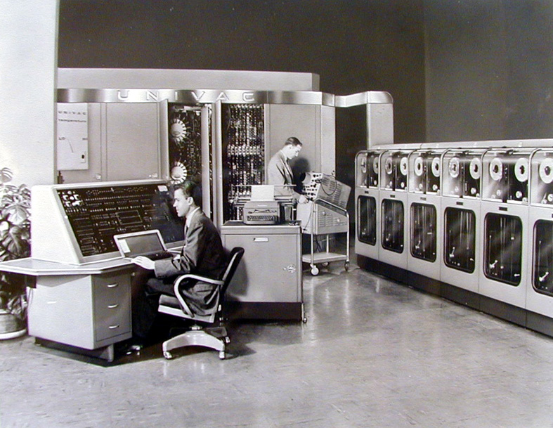
UNIVAC I

Slide 9
GENERATION OF COMPUTER
First Generation - Vacuum Tube
Second Generation - Transistor
Third Generation - IC (Integrated Chip)
Fourth Generation Microprocessor
Fifth Generation - Microprocessor
                (To be developing)

Slide 10
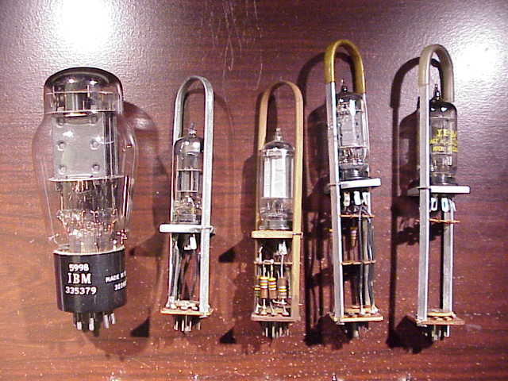
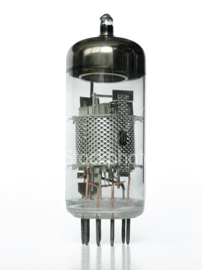
First Generation VACUUM TUBE

Slide 11
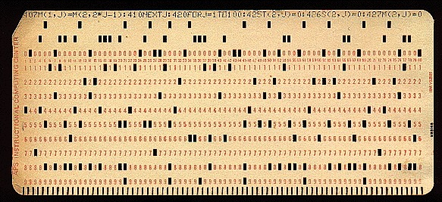
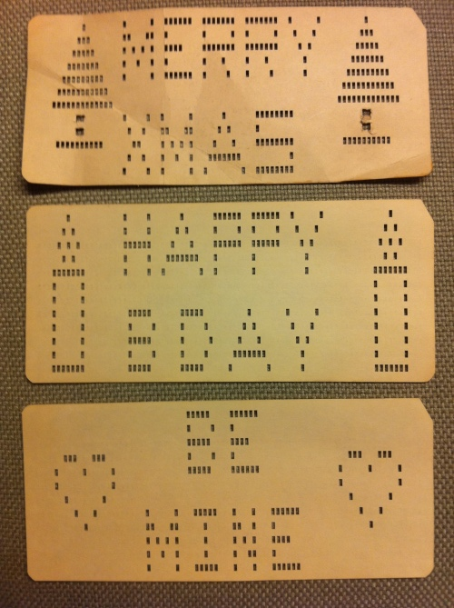
First Generation Punch Card

Slide 12
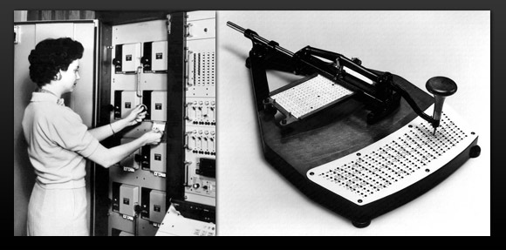
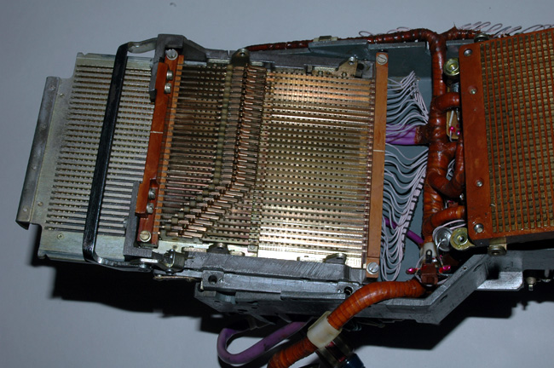
First Generation Card Reader

Slide 13
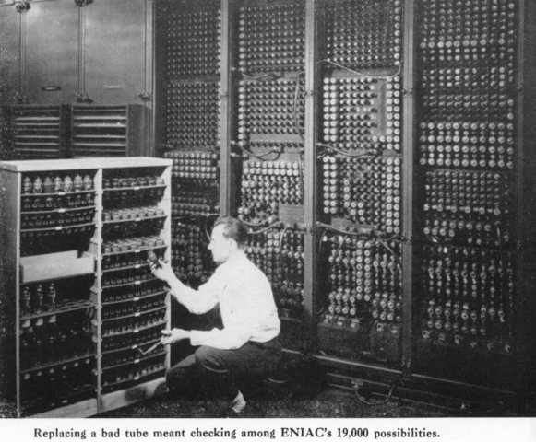

Slide 14
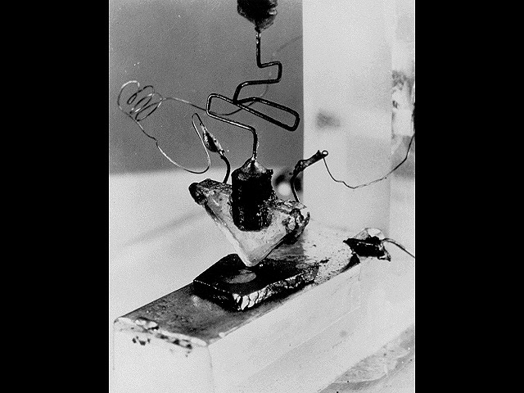
Second Generation First Transistor
Uses Silicon
developed in 1948
won a Nobel prize
on-off switch
Second Generation Computers used Transistors, starting in 1956

Slide 15
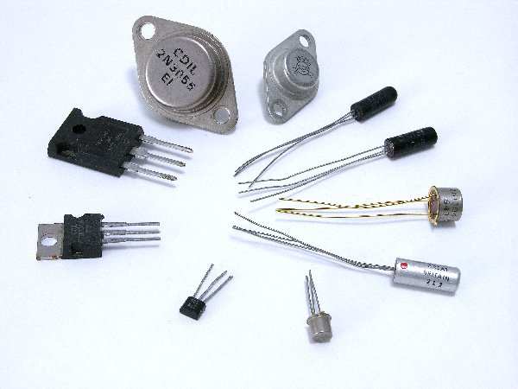
Second Generation Transistor

Slide 16
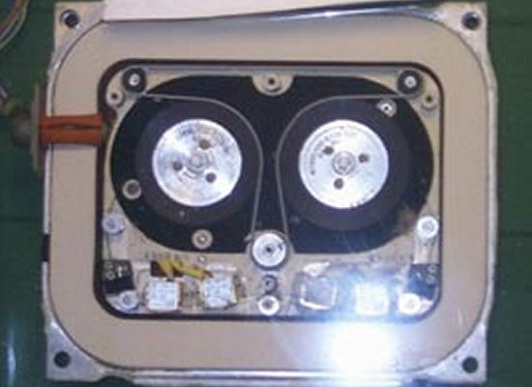
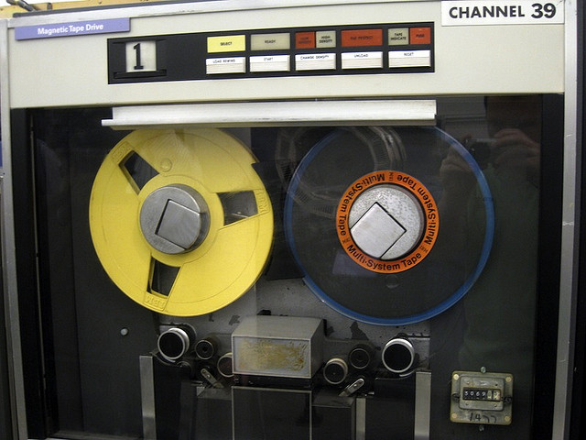
Second Generation – Magnetic Tape

Slide 17
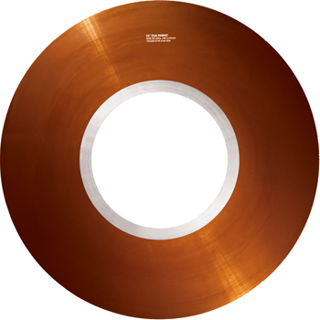
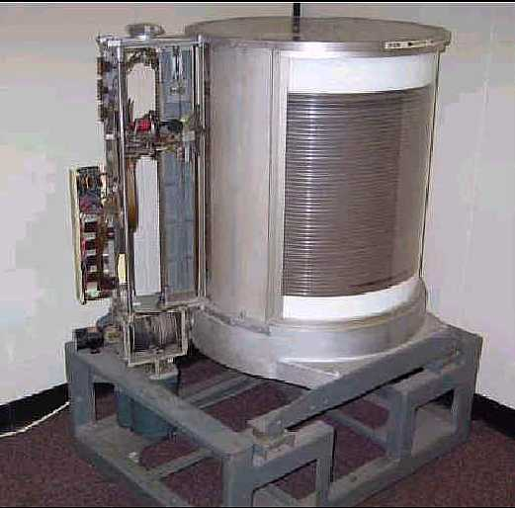
Second Generation – Magnetic Disk

Slide 18
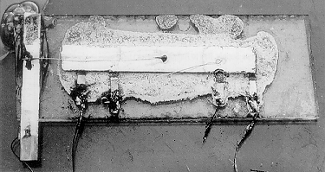
Third Generation Integrated Circuits ( IC )
Third Generation Computers used Integrated Circuits (chips).
Integrated Circuits are transistors, resistors, and capacitors integrated together into a single “chip”

Slide 19
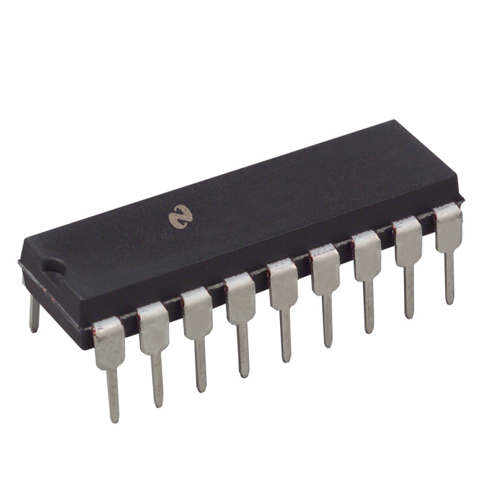
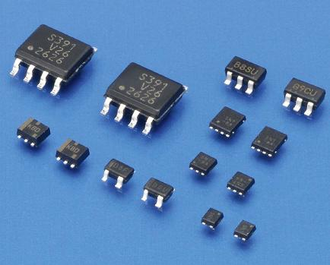
Third Generation Integrated Circuits ( IC )

Slide 20
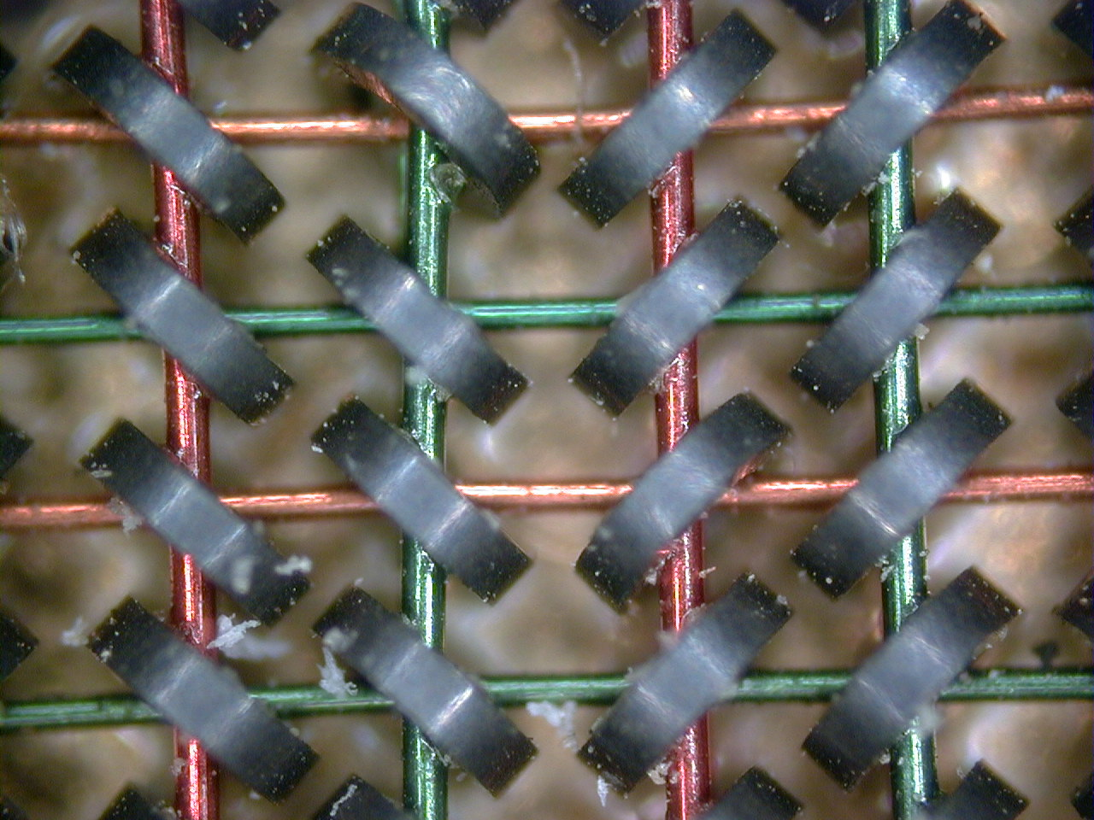
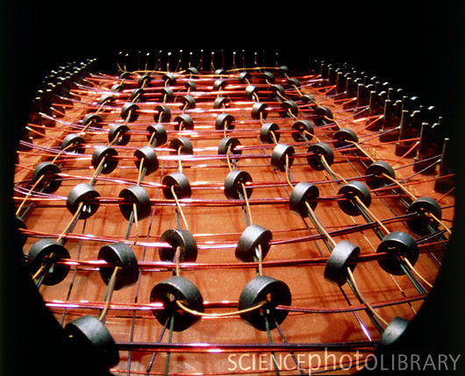
Magnetic Core

Slide 21
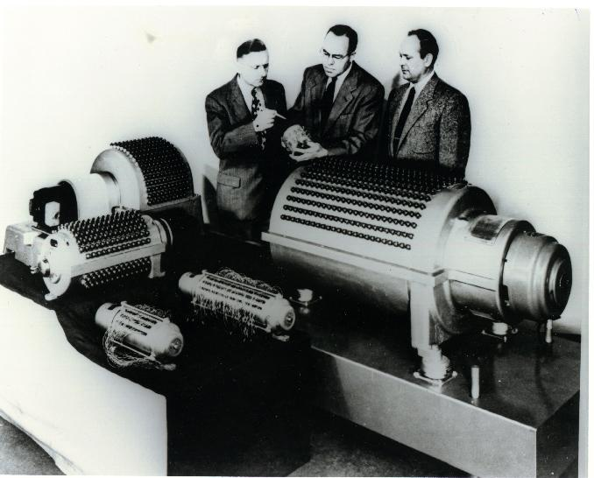
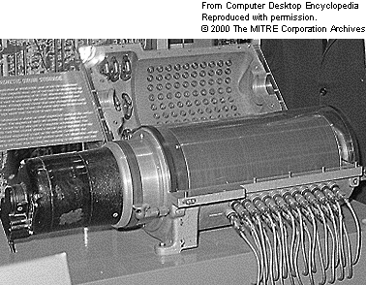
Magnetic Drum

Slide 22
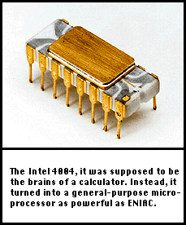
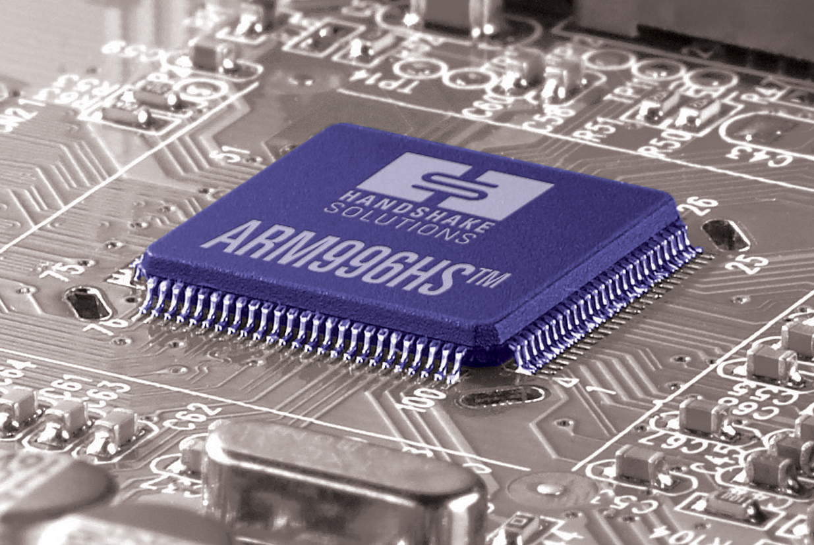
Fourth Generation Microprocessor

Slide 23
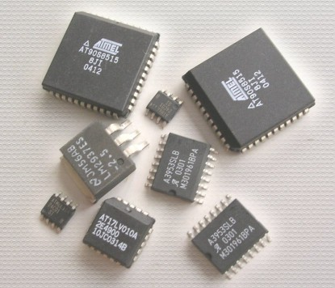
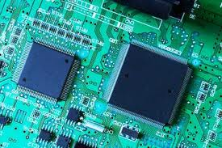
Semiconductor

Slide 24
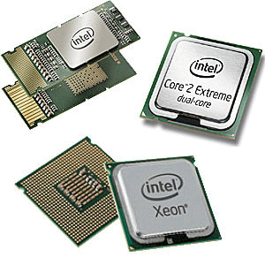
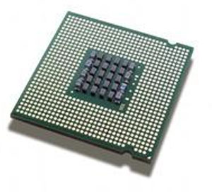
Fifth Generation Microprocessor (ULSI)

Slide 25
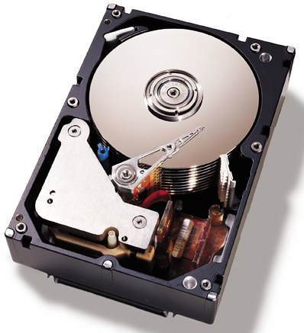
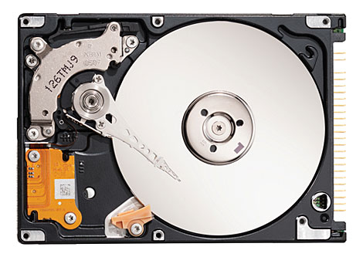
Hard Disk

