Slide 1
Human Resource Management

Slide 2

Human Resources Management

Slide 3
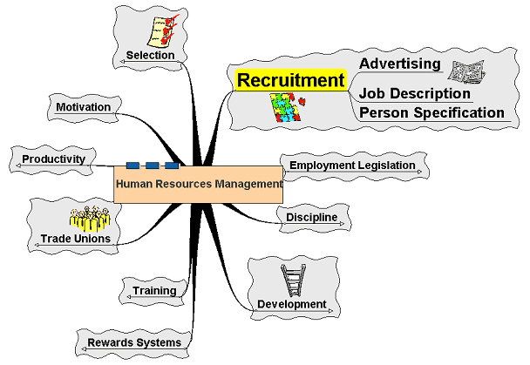
Recruitment

Slide 4
Recruitment
The process by which a job vacancy
is identified and potential employees are notified.
The nature of the recruitment process
is regulated and subject
to employment law.
Main forms of recruitment through advertising in newspapers, magazines, trade papers and internal vacancy lists.

Slide 5
Recruitment
Job description – outline of the role
of the job holder
Person specification – outline
of the skills and qualities required
of the post holder
Applicants may demonstrate their suitability through application form, letter or curriculum vitae (CV)

Slide 6
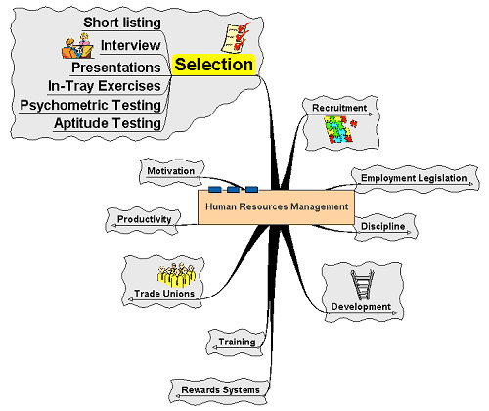
Selection

Slide 7
Selection
The process of assessing candidates and appointing a post holder
Applicants short listed –
most suitable candidates selected
Selection process –
varies according to organisation:

Slide 8
Selection
Interview – most common method
Psychometric testing – assessing the personality of the applicants – will they fit in?
Aptitude testing – assessing the skills
of applicants
In-tray exercise – activity based around what the applicant will be doing, e.g. writing a letter to a disgruntled customer
Presentation – looking for different skills
as well as the ideas of the candidate

Slide 9
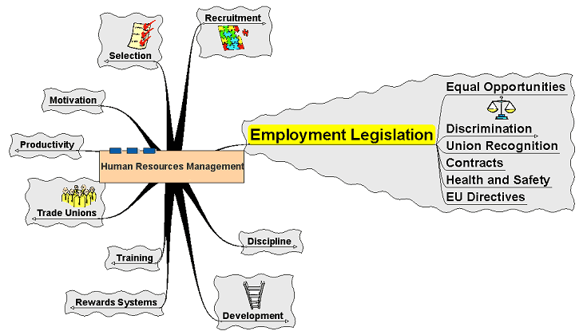
Employment Legislation

Slide 10
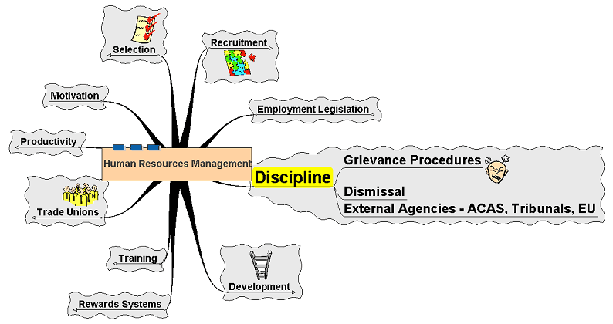
Discipline

Slide 11
Discipline
Firms cannot just ‘sack’ workers
Wide range of procedures and steps
in dealing with workplace conflict
  Informal meetings
  Formal meetings
  Verbal warnings
  Written warnings
  Grievance procedures
  Working with external agencies

Slide 12
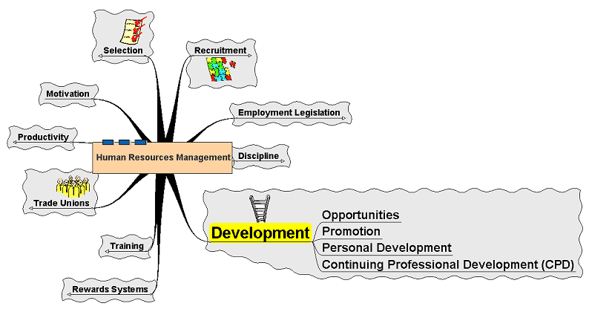
Development

Slide 13
Development
Developing the employee
can be regarded as investing
in a valuable asset
  A source of motivation
  A source of helping the employee fulfil potential

Slide 14
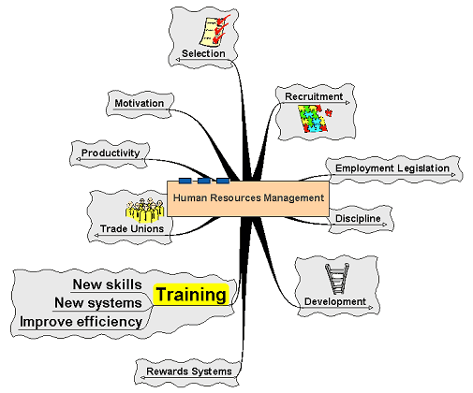
Training

Slide 15
Training
Similar to development:
  Provides new skills for the employee
  Keeps the employee up to date
  with changes in the field
  Aims to improve efficiency
  Can be external or ‘in-house’

Slide 16
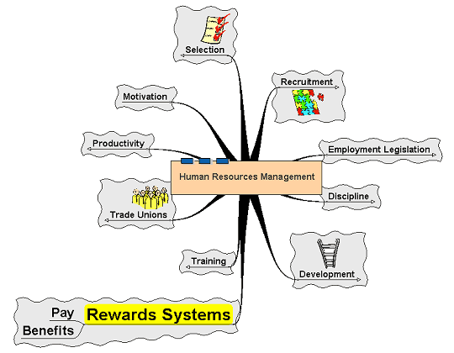
Rewards Systems

Slide 17
Rewards Systems
The system of pay and benefits used by the firm to reward workers
Money not the only method
Fringe benefits
Flexibility at work
Holidays, etc.

