Slide 1
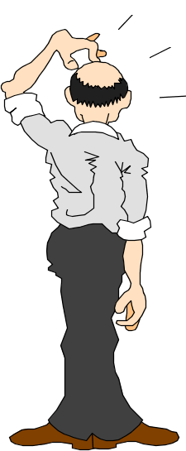
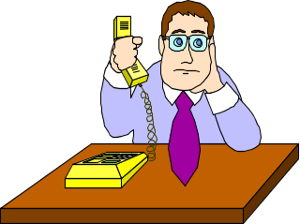



Stress Management
Presented By :-
Aayu

Slide 2


WHAT IS STRESS?
  Stress is your mind and body’s response or reaction to a real or imagined threat, event or change.
  The threat, event or change are commonly called stressors. Stressors can be internal (thoughts, beliefs, attitudes or external (loss, tragedy, change).

Slide 3

LEVELS OF STRESS

Slide 4

EUSTRESS
Eustress or positive stress occurs when your level of stress is high enough to motivate you to move into action to get things accomplished.

Slide 5
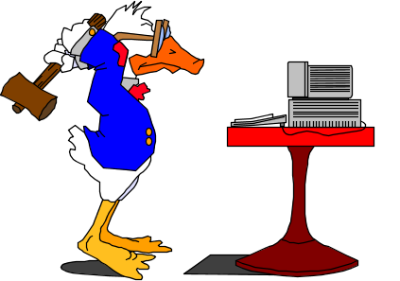
DISTRESS
Distress or negative stress occurs when your level of stress is either too high or too low and your body and/or mind begin to respond negatively to the stressors.

Slide 6
STAGES OF STRESS

Slide 7

ALARM STAGE
As you begin to experience a stressful event or perceive something to be stressful psychological changes occur in your body. This experience or perception disrupts your body’s normal balance and immediately your body begins to respond to the stressor(s) as effectively as possible.

Slide 8
EXAMPLES
  Cardiac - increased heart rate
  Respiratory - increased respiration
  Skin - decreased temperature
  Hormonal - increased stimulation of adrenal genes which produce an adrenal rush.

Slide 9
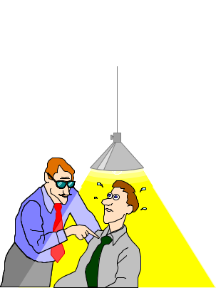
RESISTANCE STAGE
During this stage your body tries to cope or adapt to the stressors by beginning a process of repairing any damage the stressor has caused. Your friends, family or co-workers may notice changes in you before you do so it is important to examine their feedback to make sure you do not reach overload.

Slide 10
EXAMPLES
  Behavior indicators include: lack of enthusiasm for family, school, work or life in general, withdrawal, change in eating habits, insomnia, hypersomnia, anger, fatigue.
  Cognitive Indicators include: poor problem solving, confusion, nightmares, hyper-vigilance.

Slide 11
RESISTANCE STAGE
MORE EXAMPLES
Emotional indicators include:
  tearfulness
  fear
  anxiety
  panic
  guilt
  agitation
  depression
  overwhelmed.

Slide 12
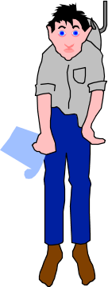
EXHAUSTION STAGE
During this stage the stressor is not being managed effectively and the body and mind are not able to repair the damage.

Slide 13
EXAMPLES
Digestive disorders, withdrawal, headaches, tension, insomnia, loss of temper.

Slide 14
STUDENT STRESS RATING SCALE
The following are events that occur in the life of a college student. Place a check in the left-hand column for each of those events that has happened to you during the last 12 months.
Death of a close family member - 100 points
Jail term - 80 points
Final year or first year in college - 63 points
Pregnancy (to you or caused by your) - 60 points
Severe personal illness or injury - 53 points
Marriage - 50 points
Any interpersonal problems - 45 points
Financial difficulties - 40 points
Death of a close friend - 40 points
Arguments with your roommate (more than every other day) - 40 points
Major disagreements with your family - 40 points

Slide 15
Major change in personal habits - 30 points
Change in living environment - 30 points
Beginning or ending a job - 30 points
Problems with your boss or professor - 25 points
Outstanding personal achievement - 25 points
Failure in some course - 25 points
Final exams - 20 points
Increased or decreased dating - 20 points
Changes in working conditions - 20 points
Change in your sleeping habits - 18 points
Several-day vacation - 15 points
Change in eating habits - 15 points
Family reunion - 15 points
Change in recreational activities - 15 points
Minor illness or injury - 15 points
minor violations of the law - 11 points

Slide 16
INTERPRETING YOUR SCORE
  Less than 150 points : relatively low stress level in
  relation to life events
  150 - 300 points : borderline range
  Greater than 300 points : high stress in relation to life
  events
  Note: From Girdano, D.A., Everly, G. S., Jr., & Dusek, D. E. (1990). Controlling stress and tension (3rd edition), ENnglewood Cliffs, NJ: Prentice Hall.

Slide 17
I’M IN CONTROL - DISTRESS RELIEF STRATEGIES
Feeling good about yourselves can be an effective buffer against stress. Eliminate unnecessary worries.
Most worries are either passed on to us by another or conjured up in our imagination.
GET PHYSICAL
1. Relax neck and shoulders
2. Take a stretch
3. Get a massage
4. Exercise
GET MENTAL
5. Count to 10
6. Control your thoughts
7. Fantasize
8. Congratulate yourself
9. Ignore the problem if appropriate, after evaluation
10. Perform self maintenance
11. Talk to a counselor

Slide 18
GET SPIRITUAL
12. Meditate
13. Pray
14. Remember your purpose
USE YOUR BODY AND MIND TOGETHER
15. Take a break
16. Get hug therapy
17. Try progressive relaxation
18. Try yoga
19. Try aroma therapy
20. Laugh
DEVELOP NEW SKILLS
21. Prioritize daily tasks
22. Learn something
23. Practice a hobby

