Slide 2
Introduction to Art

Slide 3
Introduction to Art
Part One: What is Art?
Part Two: Art Criticism and Aesthetic Judgment
Part Three: Aesthetic Theories

Slide 4
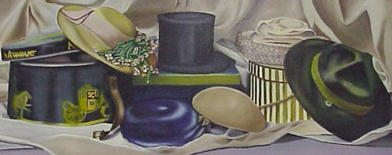

Slide 5

What Is Art?
Part One

Slide 6
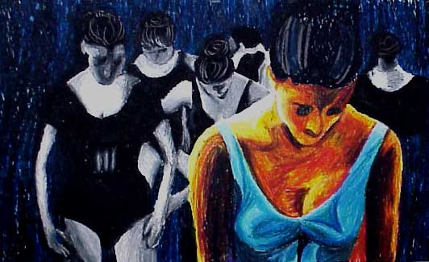
What are the Fine Arts?
Visual Art
Music
Dance
Drama

Slide 7
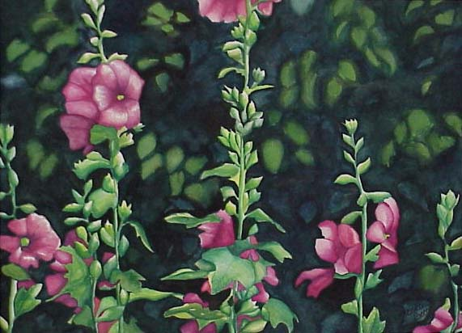
What is needed to make art?
Good Composition
Media Skill
Expression

Slide 8
What is Composition?
Elements: The Tools
  (The cat looks very funny singing songs.)
Principles: The Rules
  (Uncle Frank raises violet plants by Mary’s café.)

Slide 9
Elements
(The Cat Looks Very Funny Singing Songs)
Texture
Color
Line
Value
Form
Shape
Space

Slide 10
Principles
(Uncle Frank Raises Violet Plants By Mary’s Café.)
Unity
Focal Point (or emphasis)
Repetition (or Rhythm)
Variety
Proportion
Balance
Movement
Contrast

Slide 11
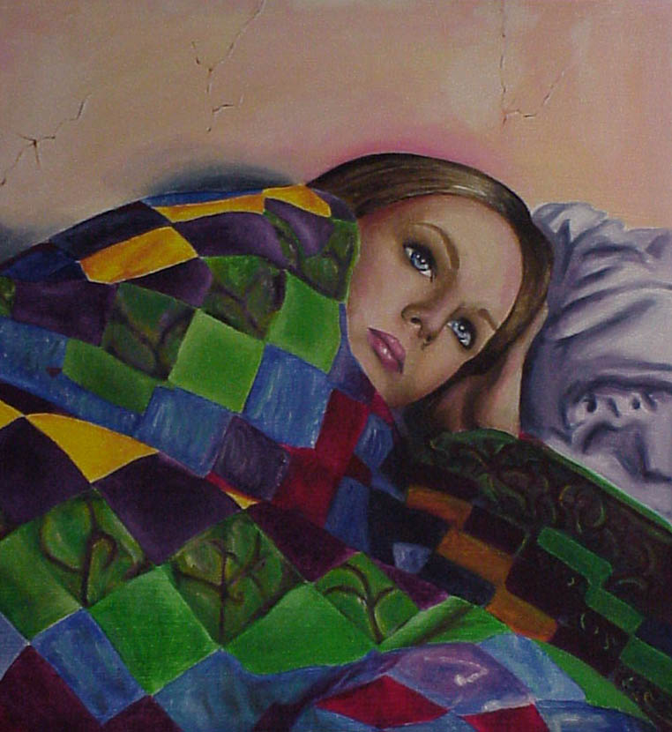

Slide 12
Art Criticism and Aesthetic Judgment
Part Two

Slide 13
Criticism
Judging work of art using specific criteria.

Slide 14
Aesthetic
The study of the nature of beauty and art.

Slide 15
How do you know if an artwork is good?
Use the 4 steps in art criticism.
  Description
  Analysis
  Interpretation
  Evaluation

Slide 16
While viewing artwork ask yourself….
What do I see? (Description)
How is the work organized? (Analysis)
What is the artist saying? (Interpretation)
In this a successful work of art? (Judgment)

Slide 17
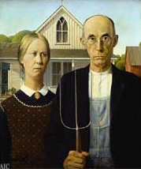
1.) Description (What do I See?)
Make a list of all the things you see in the work.
You must be objective, list only the facts.
Include the size of the work and medium used. (Find in credit line)
American Gothic, 1930; Oil on beaverboard; 74.3 x 62.4 cm; Friends of American Art Collection, 1930.934

Slide 18
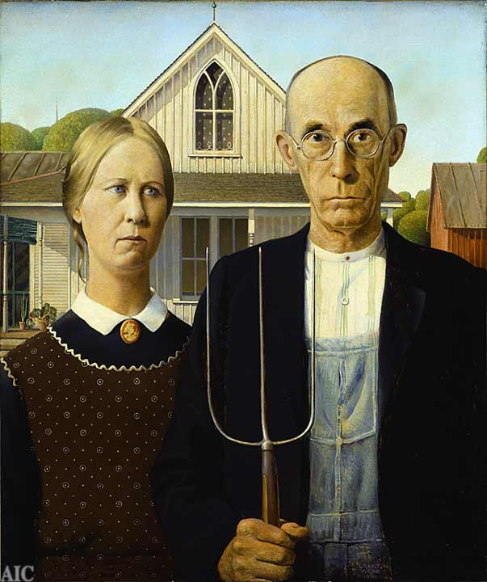
2.) Analysis (How is the work organized?)
You are still collecting facts, however, attention is paid to the elements and principles.
You discover how the work is organized.

Slide 19
3.) Interpretation
(What is the artist saying?)
You will explain or tell the meaning or mood of the work. It is in this step that you can make guesses.

Slide 20
4.) Judgment
(Is this a successful work of art?)
You determine the degree of artistic merit.
This is the time to give your opinions.
Notes:
This painting has become a symbol of what people mean when they talk about, “the goold old days.” It represents a Midwestern farmer and his daughter. The models were the artist’s sister and his dentist. By using formal balance, Wood gives the work a stiff, serious mood, but by switching to approximate symmetry rather than pure symmetry, he adds that nostalgic, “folksy” look.

Slide 21
Judging Your Own Work
Art criticism will help you analyze your own works of art.
The four steps of art criticism will help you be as honest and unbiased as possible.
The analysis step may be the most useful. It will help you perceive how you have organized the elements using the principles of design.
When you apply all four of the steps of art criticism to your work, you should find out why your work either needs improvement or is a success.

Slide 22
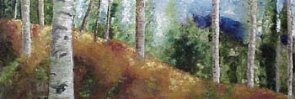

Slide 23
Aesthetic Theories
Part Three

Slide 24
Aesthetic Theories.
The chief goal of aesthetics is to answer the question “What is successful art?” In their search for an answer, aestheticians have put forth different views on what is important in a work of art. These ideas, or schools of thought, on what to look for in works of art are called aesthetic theories.

Slide 25
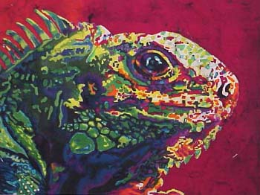
Aesthetic Theories
Imitationalism
Formalism
Emotionalism

Slide 26
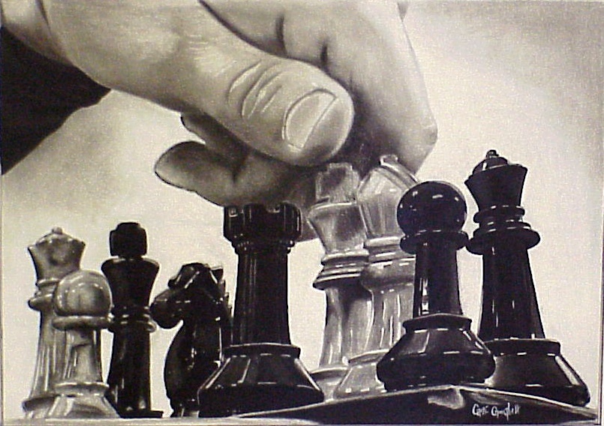
Imitationalism: Literal Qualities
  Focuses on realistic presentation of subjects matter.

Slide 27
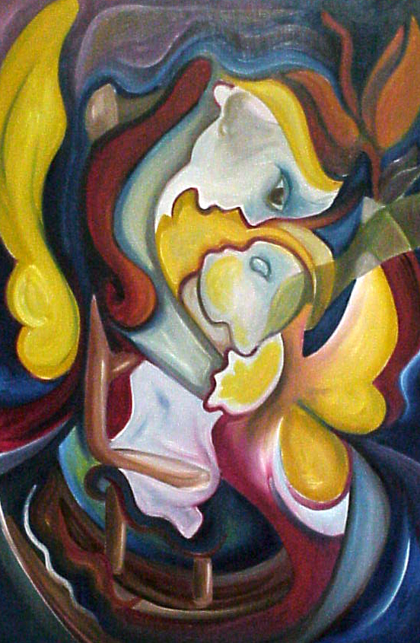
Formalism: Design Qualities
  Places emphasis on the design qualities, the arrangement of the elements of art using the principles of design.

Slide 28
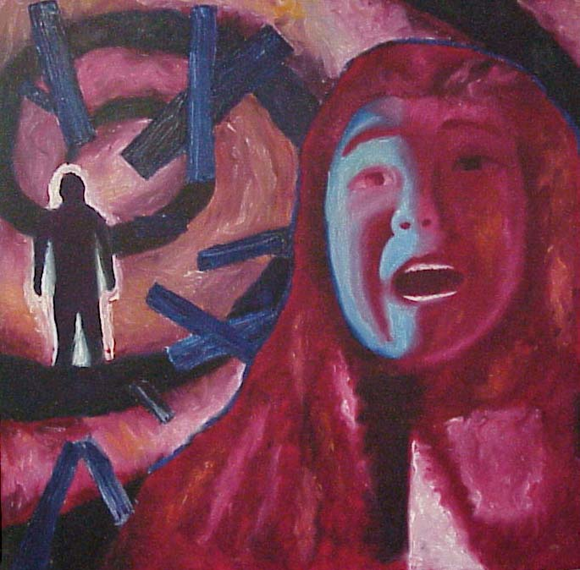
Emotionalism: Expressive Qualities
  Requires a strong communication of feelings, moods, or ideas from the work to the viewer.

Slide 29
What is needed to make art?
Aesthetic Theories
Good Composition
Media Skill
Expression
Formalism
Imitationalism
Emotionalism
Do you see the connection?

Slide 30
Ways to establish CONTRAST
Large vs. small
Warm vs. cool
Textured vs. smooth
Geometric vs. organic
Hard edges vs. soft edges
Pattern vs. no pattern
Complementary colors
Dark vs. light

Slide 31
Ways to establish UNITY
Proximity – cluster objects closer together.
Overlapping
Repetition of an element style (any of the elements or brush stroke style)
Line up with an edge or contour
Developing and using a consistent style (same as # 3)
Feeling of space receding

Slide 32
The 5 Basic Rules of Space
Creating Depth
Overlapping
Position
Objects rise on the picture plane
Size
  Objects gets smaller as they rise on the picture plane
Converging Lines (Linear Perspective)
  Converging lines meet at the vanishing point on the horizon line
Aerial Perspective
  Atmospheric effects on color, value and detail

Slide 33
Review Questions:
What are the fine arts?
What is needed to make art?
What is the sentence for the elements?
What is the sentence for the principles?
Lists the elements.
Lists the principles.
What are the four steps in art criticism? Explain each.
What are the three aesthetic theories? Explain each.
Name at least 4 of the 8 ways to establish contrast.
Name at least 4 of the 6 ways to establish unity.

Slide 34
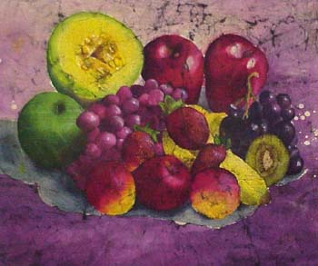

Slide 35
Unity
6 ways to establish Unity
Proximity
  Cluster objects closer together
Overlapping
Repetition of an element / style
  Color, shape, line, texture, form…
  Brushstrokes… (What makes your work special)
Line up with an edge or contour
Developing and using a consistent style
Feeling of space receding

Slide 36
Contrast
8 ways to establish Contrast
Large vs. small
Warm Vs. cool colors
Textured vs non textured
Geometric vs. organic
Hard edges vs. soft edges
Pattern vs. non pattern
Complementary colors
Dark vs. light value

