Slide 1
Critical Approaches to Literature
Literary Theory

Slide 2
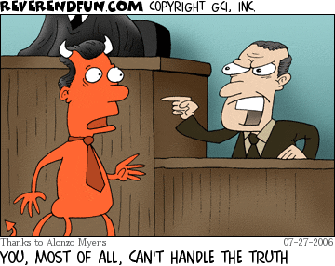
Unit Focus Questions
How do we study literature?
How do viewpoint and bias affect our perception of reality?

Slide 3

Critical Approaches to the Study of Literature
Critical Approaches are different perspectives we consider when looking at a piece of literature.
They seek to give us answers to these questions, in addition to aiding us in interpreting literature.
1. What do we read?
2. Why do we read?
3. How do we read?

Slide 4
Critical Approaches to Consider
Reader-Response Criticism
Formalist Criticism
Psychological/Psychoanalytic Criticism
Sociological Criticism
  A. Feminist/Gender Criticism
  B. Marxist Criticism
Biographical Criticism
New Historicist Criticism

Slide 5

Questions to Ponder for Each Theory/Approach
What are the benefits of each form of criticism?
What are potential problems with each form?
Is there a “right” or a “wrong” form?
Can the mode of criticism alter the entire meaning of a text?

Slide 6
1. The Reader-Response Approach
Reader-Response Criticism asserts that a great deal of meaning in a text lies with how the reader responds to it.
  Focuses on the act of reading and how it affects our perception of meaning in a text (how we feel at the beginning vs. the end)
  Deals more with the process of creating meaning and experiencing a text as we read. A text is an experience, not an object.
  The text is a living thing that lives in the reader’s imagination.
  READER + READING SITUATION + TEXT = MEANING

Slide 7


1. The Reader-Response Approach
2 Important Ideas in Reader-Response
An individual reader’s interpretation usually changes over time.
Readers from different generations and different time periods interpret texts differently.
Ultimately… How do YOU feel about what you have read? What do YOU think it means?

Slide 8
2. The Formalist Approach
Formalist Criticism emphasizes the form of a literary work to determine its meaning, focusing on literary elements and how they work to create meaning.
  Examines a text as independent from its time period, social setting, and author’s background. A text is an independent entity.
  Focuses on close readings of texts and analysis of the effects of literary elements and techniques on the text.

Slide 9

2. The Formalist Approach
Two Major Principles of Formalism
A literary text exists independent of any particular reader and, in a sense, has a fixed meaning.
The greatest literary texts are “timeless” and “universal.”

Slide 10

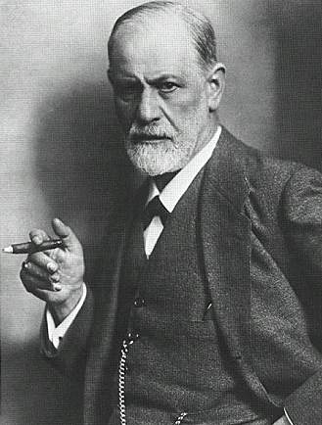
3. The Psychological/ Psychoanalytic Approach
Psychological Criticism views a text as a revelation of its author’s mind and personality. It is based on the work of Sigmund Freud.
  Also focuses on the hidden motivations of literary characters
  Looks at literary characters as a reflection of the writer

Slide 11

4. The Sociological Approach
Sociological criticism argues that social contexts (the social environment) must be considered when analyzing a text.
  Focuses on the values of a society and how those views are reflected in a text
  Emphasizes the economic, political, and cultural issues within literary texts
  Core Belief: Literature is a reflection of its society.

Slide 12
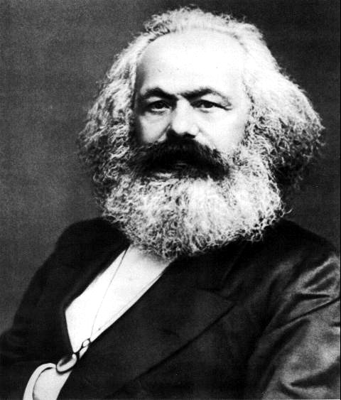


4A. The Marxist Approach
Marxist Criticism emphasizes economic and social conditions. It is based on the political theory of Karl Marx and Friedrich Engels.
  Concerned with understanding the role of power, politics, and money in literary texts

Slide 13
4A. The Marxist Approach
Marxist Criticism examines literature to see how it reflects
  The way in which dominant groups (typically, the majority) exploit the subordinate groups (typically, the minority)
  The way in which people become alienated from one another through power, money, and politics

Slide 14

4B. The Feminist Approach
Feminist Criticism is concerned with the role, position, and influence of women in a literary text.
  Asserts that most “literature” throughout time has been written by men, for men.
  Examines the way that the female consciousness is depicted by both male and female writers.

Slide 15
4B. The Feminist Approach
4 Basic Principles of Feminist Criticism
Western civilization is patriarchal.
The concepts of gender are mainly cultural ideas created by patriarchal societies.
Patriarchal ideals pervade “literature.”
Most “literature” through time has been gender-biased.

Slide 16
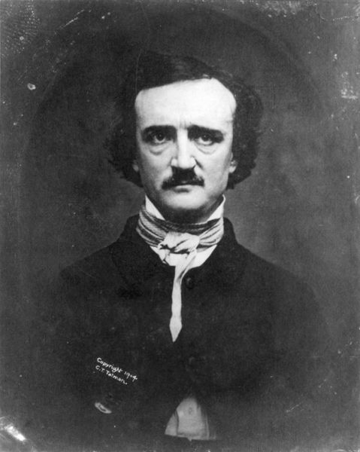
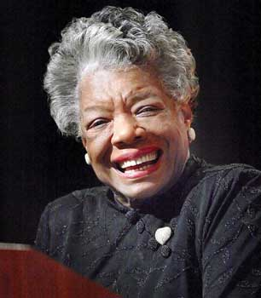
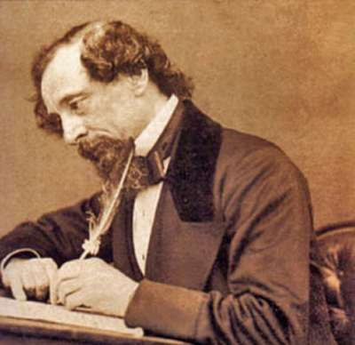
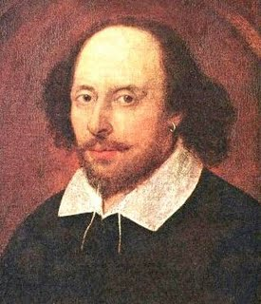
5. The Biographical Approach
Biographical Criticism argues that we must take an author’s life and background into account when we study a text.

Slide 17
5. The Biographical Approach
Three Benefits:
Facts about an author’s experience can help a reader decide how to interpret a text.
A reader can better appreciate a text by knowing a writer’s struggles or difficulties in creating that text.
A reader can understand a writer’s preoccupation by studying the way they apply and modify their own life experiences in their works.

Slide 18
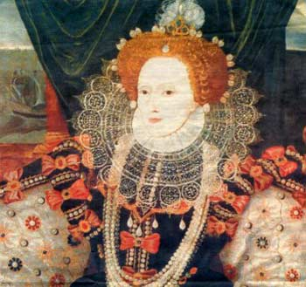
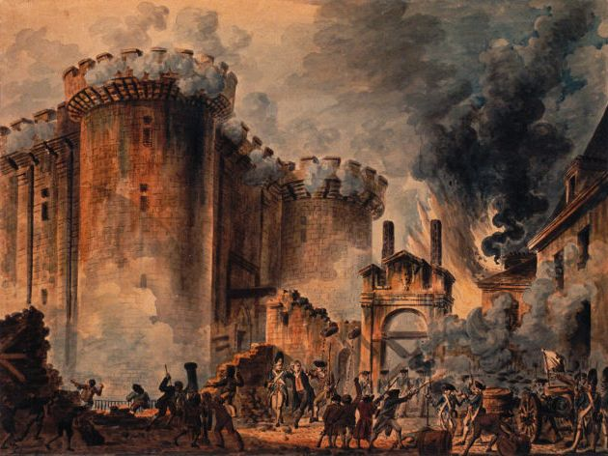

6. The New Historicist Approach
New Historicist Criticism argues that every literary work is a product of its time and its world.

Slide 19
6. The New Historicist Approach
New Historicism:
Provides background information necessary to understand how literary texts were perceived in their time.
Shows how literary texts reflect ideas and attitudes of the time in which they were written.
New historicist critics often compare the language in contemporary documents and literary texts to reveal cultural assumptions and values in the text.

Slide 20
REMEMBER…
We will never look at a text STRICTLY from one standpoint or another, ignoring all other views. That is antithetical to what we are trying to do.
We should always keep our focus on the text and use these critical approaches to clarify our understanding of a text and develop an interpretation of it.

