Slide 1

Psychological Approach to Literary Analysis
Catherine Wishart
Adjunct Instructor
Copyright © 2011

Slide 2
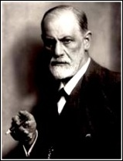
The Importance of Freud
(1856 – 1939)
As the father of modern psychology, Freud has had an impact on many areas of human thought and analysis
Freud also helped shape our thoughts toward sexuality. He is most widely known for the “Oedipus Complex.”
Freud said that “we do things… really weird and silly things sometimes, for reasons that are to some degree hidden, inaccessible, beyond our direct control or awareness” (Lynn 199).
Many of Freud’s theories about human thought and motivations have been altered by more contemporary psychologists and psychiatrists.
Freud’s beliefs about human psychological motivations can be applied directly to analyzing authors and characters in literature.

Slide 3
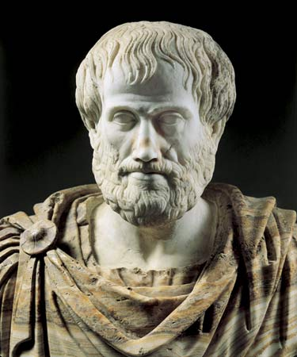
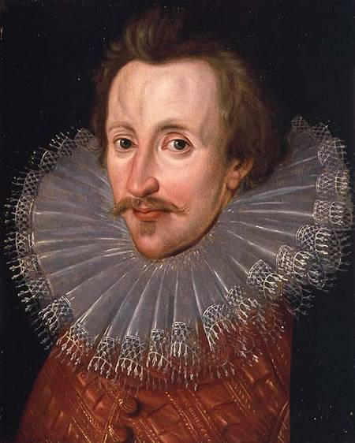
Freud is Not the Father of the Psychological Approach to Literature
Aristotle used a psychological approach in Ancient Greece.
  His definition of tragedy is “combining the emotions of pity and terror to produce catharsis” (Guerin et al 153).
    Catharsis: emotional response – purging of emotions or relieving of emotional tensions
Sir Philip Sidney talked about the moral effects of poetry.
  He was analyzing how poetry can have a psychological impact on readers.

Slide 4
Freud Has Heavily Impacted the Psychological Approach
“The foundation of Freud’s contribution to modern psychology is his emphasis on the unconscious aspects of the human psyche” (Guerin et al 154).
“Freud changed our notions of human behavior by exploring new or controversial areas such as wish fulfillment, sexuality, the unconscious, and repression” (Kennedy 1477).
Freud also believed that sexual taboos repress many human desires.
The repression of thoughts and desires is what causes the unconscious to harbor many human wants. Freud “examined symbols… to study how the unconscious mind expressed itself in coded form to avoid censorship of the conscious mind” (Kennedy 1477).
The levels of mental controls are described by specific Freudian terms.

Slide 5
Denotations of Id, Ego, Super-Ego
The Oxford English Dictionary (www.oed.com) defines these terms:
Id: The inherited instinctive impulses of the individual, forming part of the unconscious.
Ego: That part of the mind which is most conscious of self; in the work of Freud that part which, acted upon by both the id and the super-ego, mediates with the environment.
Super-ego: A Freudian term for that aspect of the psyche which has internalized parental and social prohibitions or ideals early in life and imposes them as a censor on the wishes of the ego; the agent of self-criticism or self-observation.

Slide 6
The Id, Ego, and Super-Ego More Closely Examined
The Id – based on biological impulses, the id always seeks pleasure. This search is referred to as the “pleasure principle.” The id is also where the libido is located. The id works to gain satisfaction for instinctual needs. Furthermore, the id is the source of human aggression. The id harbors no morality.
The Ego – what people decide to display to the world at large. The ego is ruled by the “reality principle.” The ego helps keep impulses by the id under control. Often the ego responds and controls the id in order to avoid unpleasant consequences, such as being punished.
The Super-Ego – where the conscience is located. The super-ego helps inhibit the id based on a person’s idealized view of himself or herself. The super-ego is controlled by our perspective of social expectations.

Slide 7
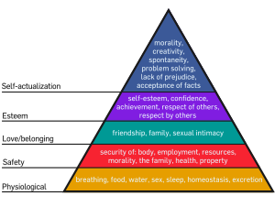
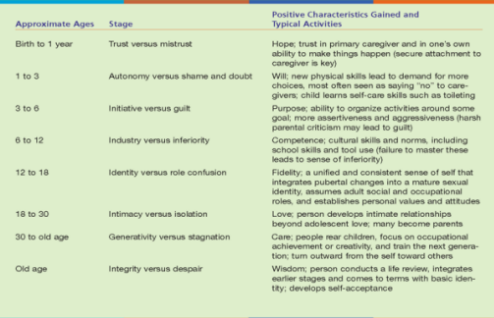
Other Theories to Use for Psychological Criticism
Maslow’s hierarchy of needs:
Erikson’s stages of Development:

Slide 8
Methods of Dealing with Conflict:
Repression: hiding one’s desires and fears in the unconscious
  “Selectively forgetting about whatever is troubling” (Lynn 211)
Isolation: disconnecting one’s emotions from a traumatic event
  “Understanding something should be upsetting, but failing to react to it” (Lynn 211)
Sublimation: redirecting an unacceptable desire into a creative act
Displacement: replacing an unacceptable object of one’s emotion
  “Shifting one’s emotion s from a threatening target to a less threatening one” (Lynn 224)
Denial: refusing to accept one’s unacceptable desires or fears, or refusing to accept a traumatic event.
Projection: placing one’s unacceptable or unworthy desires or fears onto another.
Intellectualization: avoiding one’s desires and fears by analyzing and rationalizing them – instead of feeling them.
Reaction Formation: believing the opposite is true to avoid facing the truth about a traumatic event.

Slide 9
Psychological Criticism: What to Look For
Instances of repression, isolation, sublimation, displacement, denial, projection, intellectualization, and/or reaction formation in the actions of characters.
Internal conflicts present in characters that cause them difficulty fitting into society or being happy.
Expressions of the unconscious in characters – dreams, voices, creative acts (or any actions), slips of the tongue, jokes, etc.
Descriptions of the unconscious in texts.
Patterns or repeated behavior in the text.
How a character’s identity is developed.

Slide 10
The Issue of Over-Analyzing
One of the biggest criticisms of psychological approach is the tendency to see sex in everything.
  Any concave item (ponds, cups, vases, caves) viewed as female symbols
  Any elongated item (towers, mountains, peaks, snakes) viewed as phallic symbols
  Certain activities (dancing, riding, flying) viewed as symbols of sexual pleasure
What makes sense for psycho-analysis does not necessarily make sense for literary analysis.
Another area of concern about the psychological approach is the belief that sexuality is present from infancy on through life.
  The erogenous zones
  Oral fixations
  Oedipus complex comes to fruition around age 5
    Analyzing children in literary works from a sexual perspective is very disconcerting.

Slide 11
“Young Goodman Brown”: Id versus Super-ego
Theme of innocence betrayed
Classic traumatic experiences of youth (events in forest)
Changed man
“Young Goodman Brown” means more than it says:
  Village a place of light and order
    Consciousness – the ego
    Conscience – the super-ego
  Move to forest is move to the night, the unknown
    Unconscious – the id
  Brown becomes the mediator between the super-ego and the id
  The devil is seated at the foot of an old tree (the apple tree from Adam and Eve?)
  Is the devil Brown’s alter-ego?
  Satan’s staff is like a “great black snake” – a phallus?
  Pink ribbons – mixture of purity (white) and passion (red)
    Don’t men dream of the pure woman who can unleash her passions?

Slide 12
Brown’s Idealized View of Himself
Comes back from the forest disillusioned
Suppresses his own libido
Sees himself as the only “pure” soul in town
  Isolates himself because of his idealized view of himself
Puritans saw “nature” as synonymous with “sin”
  Entering the forest was entering an area for “sin”
  Brown willing to enter, but not willing to have wife there
    Wife’s job is to remain pure
Is Brown’s trek into the forest a view of his evil side, or natural youthful curiosity?
Are his reactions an observation of his own repressions, or his moral compass coming into control?

Slide 13
The Death Wish in Poe
Does Montresor view Fortunato as a father figure?
Does he want the father-figure dead because of an Oedipus complex?
Does he want Fortunato dead because he is rejecting Fortunato’s place in society?
How does Poe’s loss of his mother at an early age effect his writing?
According to Bonaparte, “Ever since he was three, in fact, Poe had been doomed by fate to live in constant mourning. A fixation on a dead mother was to bar him forever from earthly love, and make him shun health and vitality in his loved ones” (83).
Since Montresor recalls the murder 50 years later, does part of him want to be entombed with Fortunato?
How interesting is it that there is no female character in “The Cask of Amontillado”?

Slide 14
Two-Pronged Approach
Psychological Analysis can look closely at the characters and the psychological motivations present in their story and/or back story.
Psychological Analysis can also look closely at the life of the author to determine what in his/her life caused him/her to write characters in a specific way and give the characters specific attributes.

Slide 15
DiYanni’s “Checklist of Psychological Critical Questions”
What connections can you make between your knowledge of an author’s life and the behavior and motivation of characters in his or her work?
How does your understanding of the characters, their relationships, their actions, and their motivations in a literary work help you better understand the mental world and imaginative life, or the actions and motivations, of the author?
How does a particular literary work – its images, metaphors, and other linguistic elements – reveal the psychological motivations of its characters or the psychological mindset of its author?
To what extent can you employ the concepts of Freudian psychoanalysis to understand the motivations of literary characters?
What kinds of literary works and what types of literary characters seem best suited to a critical approach that employs a psychological or psychoanalytic perspective? Why?
How can a psychological or psychoanalytic approach to a particular work be combined with an approach from another critical perspective – for example, that of biographical or formalist criticism, or that of feminist or deconstructionist criticism?

Slide 16
Works Cited
DiYanni, Robert. Literature Approaches to Fiction, Poetry, and Drama. Boston: McGraw Hill, 2008.
Guerin, Wilfred L., Labor, Earle, Morgan, Lee, Reesman, Jeanne C., Willingham, John R. A Handbook of Critical Approaches to Literature. 5th ed. NY: Oxford U P, 2005. (152-163, 169-71, 172). Print.
Note: Slides 4, 8, 9-12 directly quote and rely heavily on Guerin’s text.
Kennedy, X. J. and Gioia, Dana. Literature: An Introduction to Fiction, Poetry, Drama, and Writing. Revised edition for Burlington County College. NY: Pearson, 2011. Print.
Lynn, Steven. Texts and Contexts: Writing About Literature with Critical Theory. 5th ed. NY: Pearson, 2008. Print.

