Slide 1
CHAPTER-5
NANOSTRUCTED MATERIALS

Slide 2


Slide 3
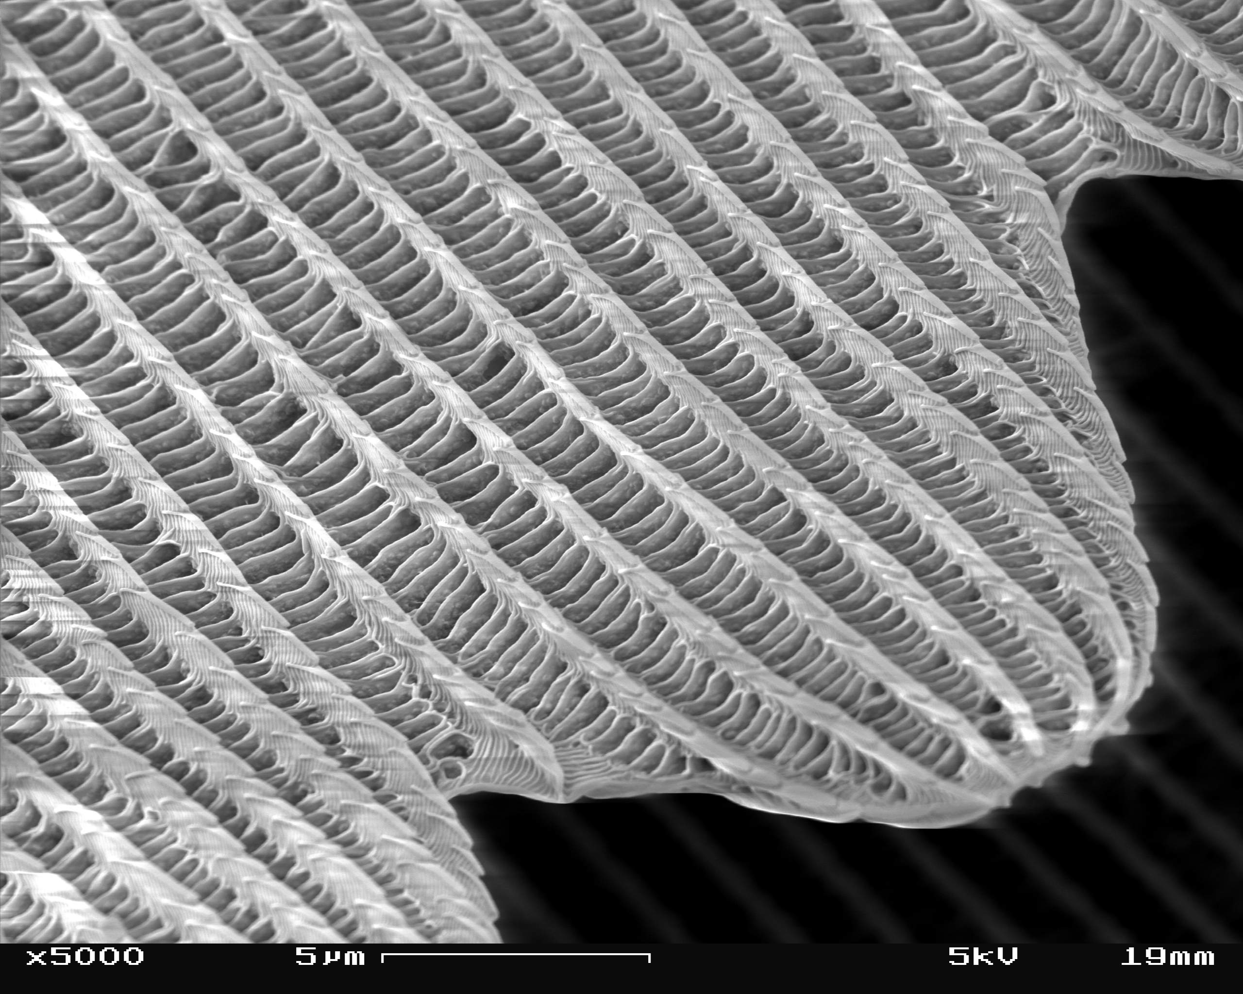

Slide 4
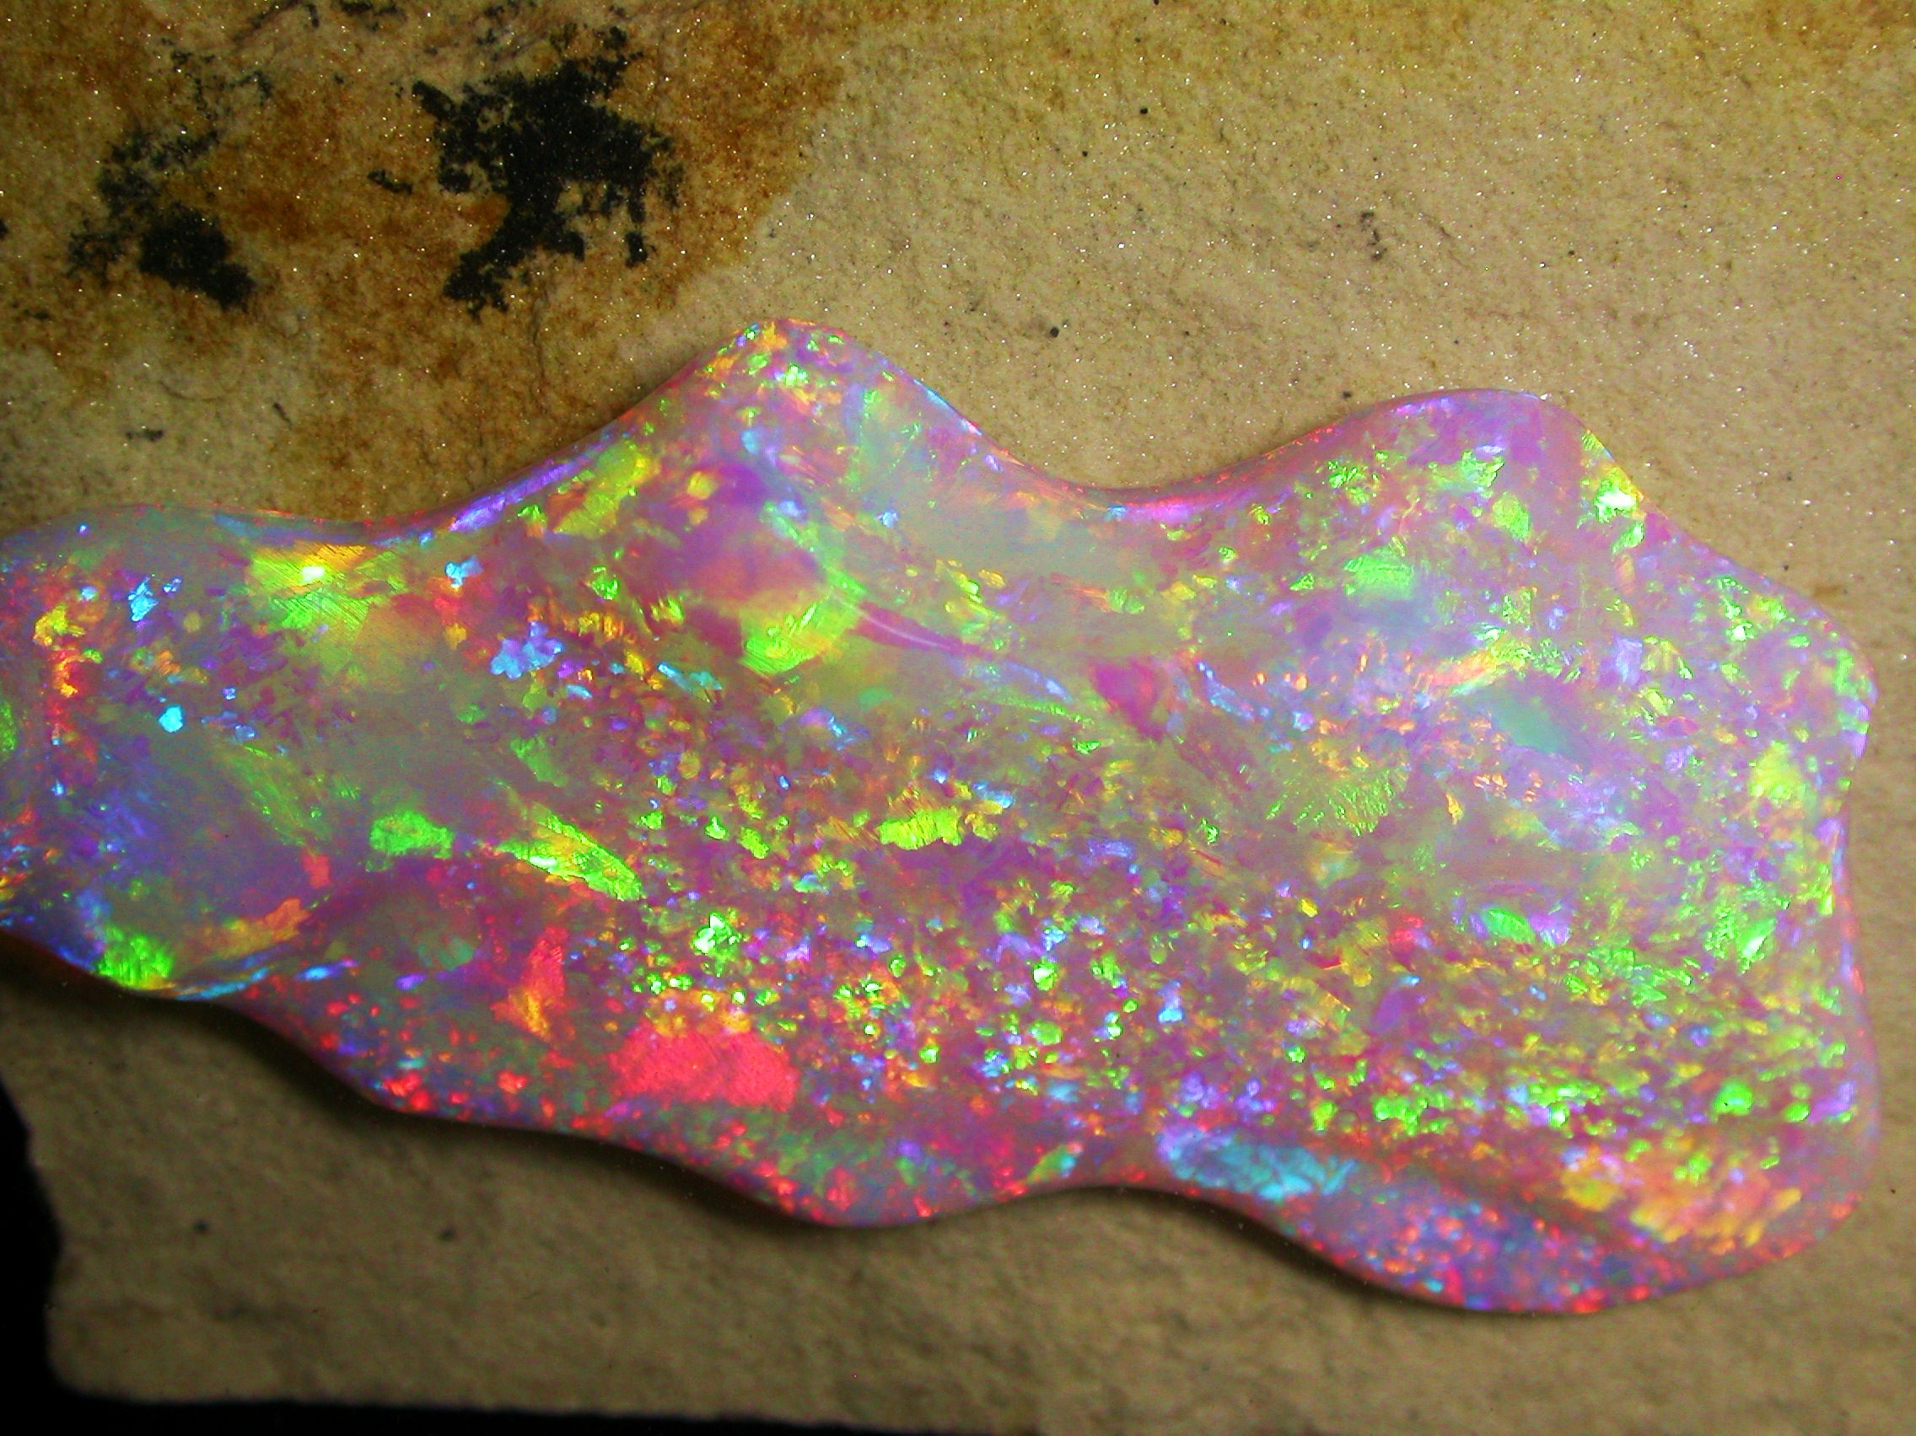
BRAZILIZN CRYSTAL OPAL

Slide 5

GECKO’S FOOT ON GLASS

Slide 6

GECKO

Slide 7
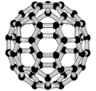

Slide 8
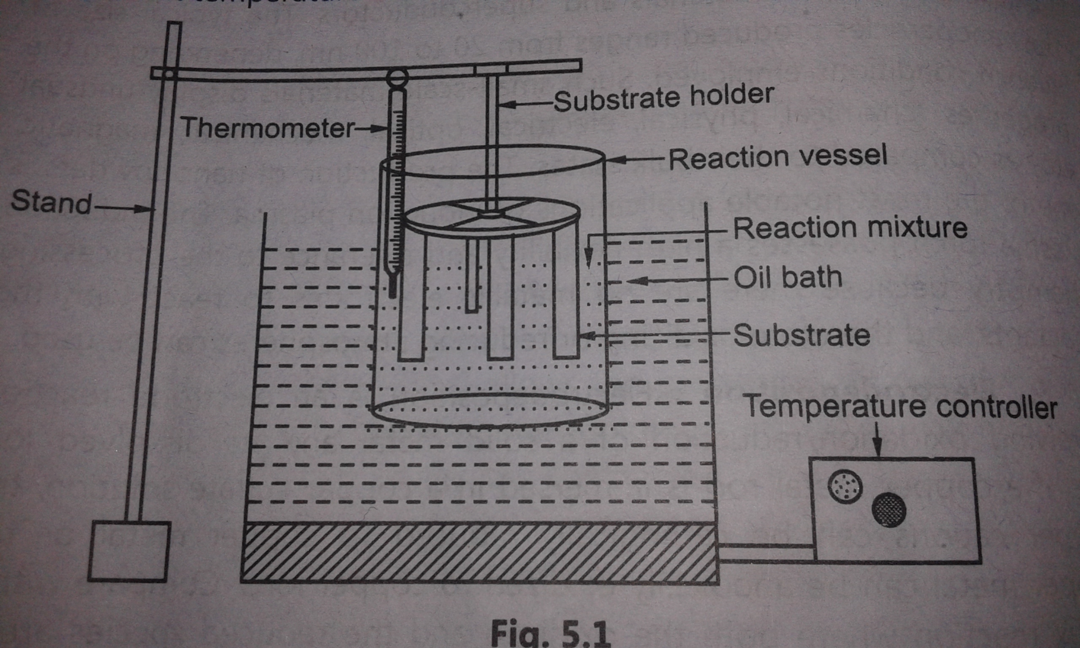
CHEMICAL BATH DEPOSITION METHOD OF THIN FILM

Slide 9
Laser ablation
Laser ablation is the process of removing material from a solid surface by irradiating it with a laser beam. At low laser flux, the material is heated by the absorbed laser energy and evaporates At high laser flux, the material is typically converted to a plasma. Usually, laser ablation refers to removing material with a pulsed laser, but it is possible to ablate material with a continuous wave laser beam if the laser intensity is high.

Slide 10
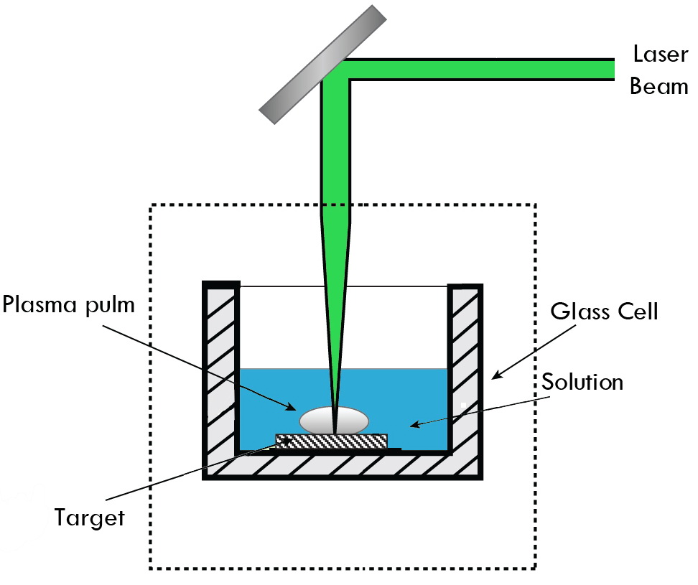
Reflector

Slide 11
The basic idea of laser ablation is quite simple. A high power pulsed laser is focused onto the target material .When the laser exceeds the ablation, chemical bonds are broken and the material is fractured into energetic fragments, typically a mixture of neutral atoms, molecules, and ions. Since the material leaves the reaction zone as an energetic plasma, gas and solid mixture, the ablation process produces explosive evaporation of the material. A unique property of the ablation process is that most of the absorbed energy is deposited in the ejected material, so that there is little or no thermal damage to the surrounding target material.

Slide 12
The plasma plume created thus then expands in vacuum or a reactive atmosphere, before condensing on a suitable substrate (in the case of material deposition). The properties of thin films produced in such a way then depend on the substrate temperature, laser power density, target to substrate distance, the nature and pressure of the reactive gas in the deposition chamber and the target material.

Slide 13
PROPERTIES OF NANOSTRUCTURED MATERIALS
Nanostructured materials are strong, hard, brittle than bulk materials.
The reduction in grain size lowers the transition temperature in steel from ductile to brittle.
Nanostructured materials deforms withot cracking or fracture.
Nanomaterials have a relatively larger surface area when compared to the same mass of material produced in a larger form.
The band gap is increases with reducing the size of the particles
Metals with a grain size of around 10 nanometers are as much as seven times harder and tougher than their ordinary counterparts with grain sizes in the micro meter range.
The Nano particles affects many properties such as Melting point, Boiling point, Band gap, Optical properties, Electrical properties, Magnetic properties.
The structure of materials changes with respect to Size.
The total surface area (or) the number of surface atom increases with reducing size of the particles

Slide 14
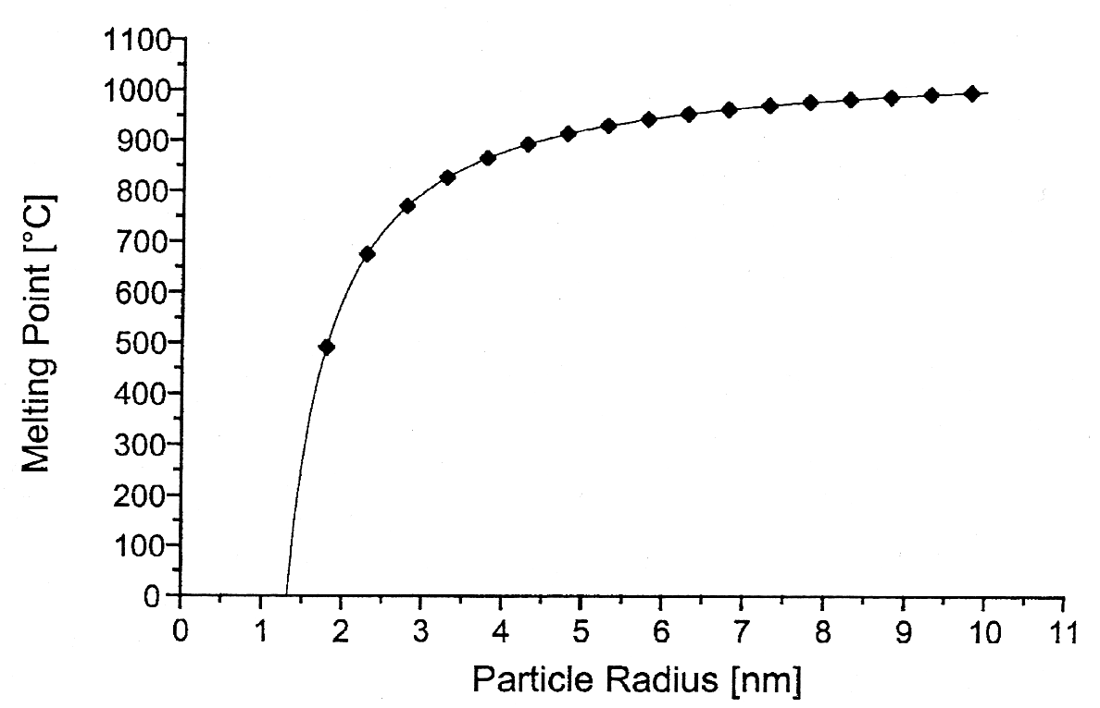
Melting Point
The melting point decreases dramatically as the particle size gets below 5 nm

Slide 15
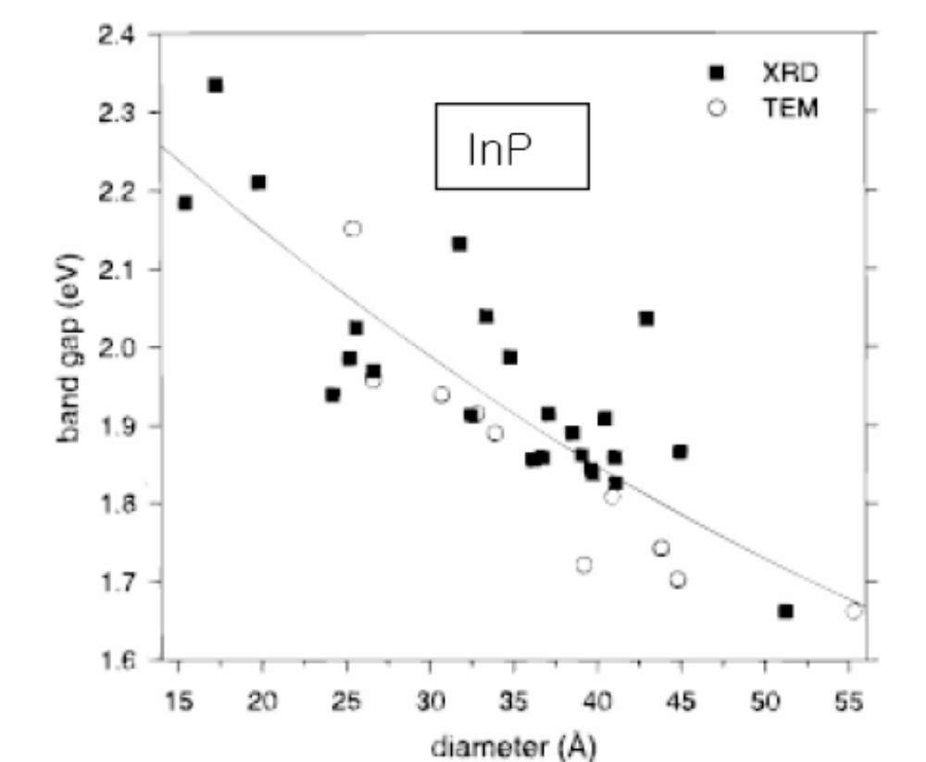
The band gap is increases with reducing the size of the particles

Slide 16
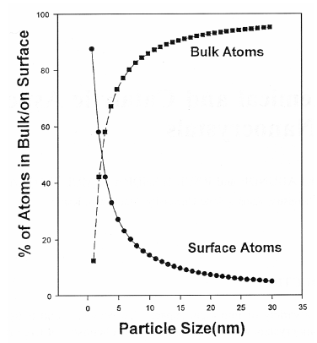
The total surface area (or) the number of surface atom increases with reducing size of the particles

Slide 17

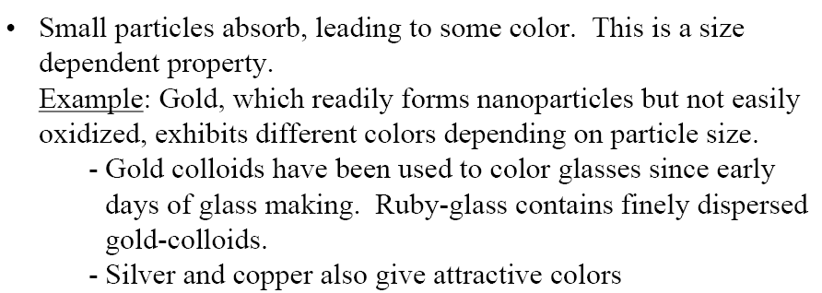

Slide 18
Size-Dependent
Properties of semiconductor and magnetic materials
For semiconductors such as ZnO, CdS, and Si, the bandgap changes with size
- Bandgap is the energy needed to promote an electron from the valence band to the conduction band
- When the bandgaps lie in the visible spectrum, changing bandgap with size means a change in color
• For magnetic materials such as Fe, Co, Ni, Fe₃O₄, etc., magnetic properties are size dependent
- The ‘coercive force’ (or magnetic memory) needed to reverse an internal magnetic field within the particle is size dependent
- The strength of a particle’s internal magnetic field can be size dependent

Slide 19
Nanotube properties
Superior stiffness and strength to all other materials
Extraordinary electric properties
Reported to be thermally stable in a vacuum up to 2800 degrees Centigrade (and we fret over CPU temps over 50º C)
Capacity to carry an electric current 1000 times better than copper wires
Twice the thermal conductivity of diamonds
Pressing or stretching nanotubes can change their electrical properties by changing the quantum states of the electrons in the carbon bonds
They are either conducting or semi-conducting depending on the their structure

Slide 20
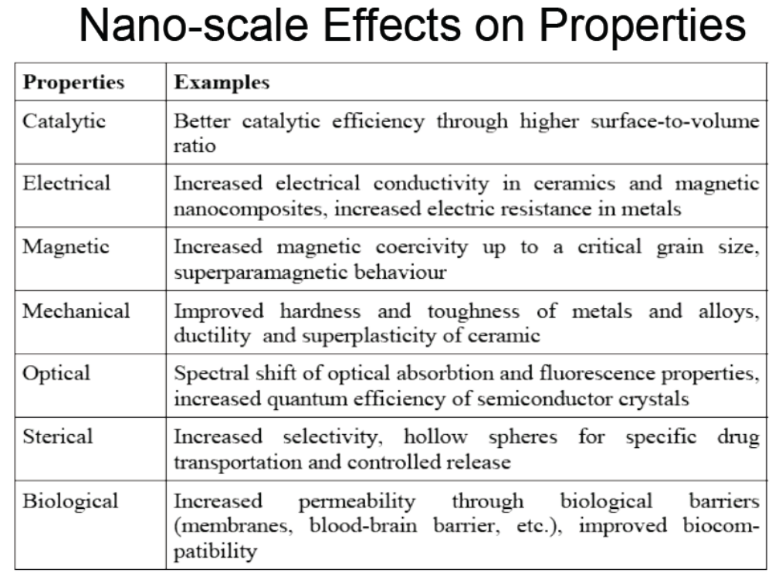

Slide 21
CHARACTERIZATION OF NANO-STRUCTED MATERIALS
The characterization of nano-structed materials are very important due to their special physical and chemical properties.
There are several techniques used to understand these characterization parameters in nanoparticles. T
hey include:
electron microscopy including TEM and SEM
atomic force microscopy (AFM)
x-ray photoelectron spectroscopy (XPS)
powder X-ray diffraction (XRD)
Fourier transform infrared spectroscopy (FTIR)
ultraviolet-visible spectroscopy
nuclear magnetic resonance (NMR)

Slide 22
Microscopes
For the characterization of nano structured materials special microscopes are required due to their low dimension. They includes
Scanning Electron Microscope (SEM)
Transmission Electron Microscope (TEM)
Scanning Tunneling Microscope (STM)
Atomic Force Microscope (AFM)

Slide 23
Scanning Electron Microscope (SEM)
A scanning electron microscope (SEM) is a type of electron microscope that produces images of a sample by scanning it with a focused beam ofelectrons. The electrons interact with atoms in the sample, producing various signals that contain information about the sample's surface topography and composition.
SEM can achieve resolution better than 1 nanometer.
The types of signals produced by an SEM include secondary electrons (SE), reflected or back-scattered electrons (BSE), photons of characteristic X-rays

Slide 24
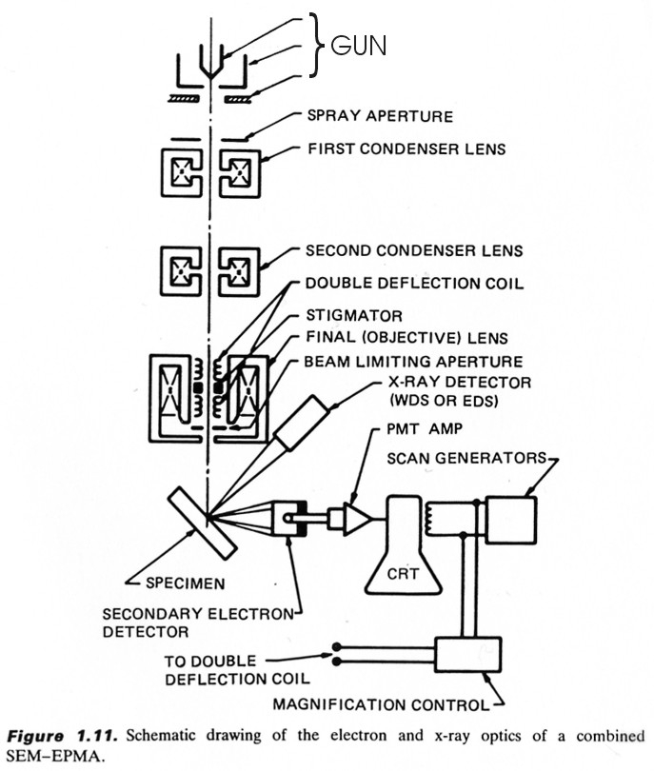
SEM

Slide 25
Transmission Electron Microscope

Slide 26
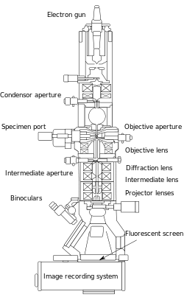
Transmission Electron Microscope (TEM)

Slide 27
APPLICATIONS OF NANOMATERIALS
We know that nanomaterials possess unique chemical, physical and mechanical properties with reduction in grain size hence they can be used for variety of applications in different fields.
As magnetisation and coercivity of nanomaterials are higher hence such materials are used in nanotransistor, memory devices etc.
Nanomaterials like Zinc selenide, Zinc Sulphate, Cadmium Sulphate and Lead Telluride are used for improving resolution of TV. Nanophosphors are also used in high- definition televisions (HDTV) because good quality and clearance in picture.
The sensors made by nanomaterials are extremely sensitive such as smoke detectors, ice detectors on aircraft wings, automobile engines etc.
Nanotechnology plays very important role in medical field for disease diagnosis, drug delivery and molecular imaging .
Conventional and rechargeable high energy batteries made by nanomaterials are used in automobiles, laptops, computers, electrical vehicles, , cellular phones, toys, watches, calculators etc.
Devices such as computer hard disks storage capacity is increased with Magnetic Nano materials
Nanomaterials lead to applications in motors, analytical instruments like magnetic resonance imaging (MRI), used widely in hospitals, and microsensors.

Slide 28
APPLICATIONS OF NANOMATERIALS
8. Nanocrystalline silicon carbide is a candidate material for artificial heart valves primarily because of its low weight, high strength and inertness.
  9. Harder Nanomaterials like Tungsten carbide, tantalum carbide, and titanium carbide are used as more durable cutting materials.
10. Spark plugs made by nanomaterials improve fuel efficiency for cars.

Slide 29
Nanotechnology Applications in Medicine
Because of their small size, nanoscale devices can readily interact with biomolecules on both the surface of cells and inside of cells.
By gaining access to so many areas of the body, they have the potential to detect disease and the deliver treatment.
Nanoparticles can can deliver drugs directly to diseased cells in your body.
Nanomedicine is the medical use of molecular- sized particles to deliver drugs, heat, light or other substances to specific cells in the human body.

Slide 30
Quantum dot- that identify the location of cancer cells in the body.
Nano Particles - that deliver chemotherapy drugs directly to cancer cells to minimize damage to healthy cells.
Nanoshells - that concentrate the heat from infrared light to destroy cancer cells with minimal damage to surrounding healthy cells.
Nanotubes- used in broken bones to provide a structure for new bone material to grow.

Slide 31
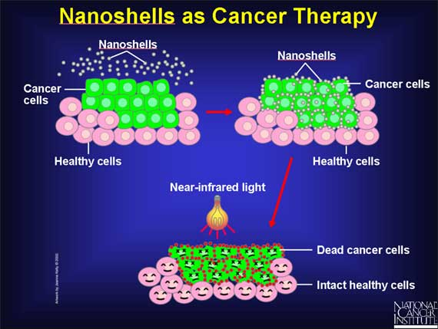
Nano shells as Cancer Therapy
Nano shells are injected into cancer area and they recognize cancer cells. Then by applying near-infrared light, the heat generated by the light-absorbing Nano shells has successfully killed tumor cells while leaving neighboring cells intact.

Slide 32
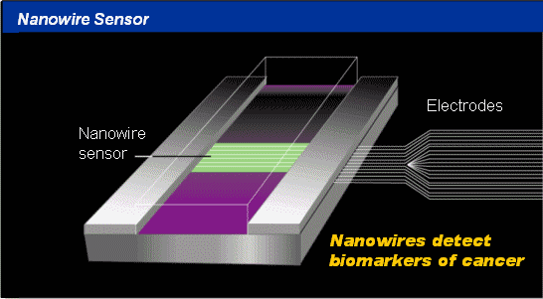

Slide 33
3. Sunscreens and Cosmetics
Nanosized titanium dioxide and zinc oxide are currently used in some sunscreens, as they absorb and reflect ultraviolet (UV) rays.
Nanosized iron oxide is present in some lipsticks as a pigment.
4. Fuel Cells
The potential use of nano-engineered membranes to intensify catalytic processes could enable higher-efficiency, small-scale fuel cells.
5. Displays
Nanocrystalline zinc selenide, zinc sulphide, cadmium sulphide and lead telluride are candidates for the next generation of light-emitting phosphors.
CNTs are being investigated for low voltage field-emission displays; their strength, sharpness, conductivity and inertness make them potentially very efficient and long-lasting emitters.

Slide 34
6. Batteries
With the growth in portable electronic equipment (mobile phones, navigation devices, laptop computers, remote sensors), there is great demand for lightweight, high-energy density batteries.
Nanocrystalline materials are candidates for separator plates in batteries because of their foam-like (aerogel) structure, which can hold considerably more energy than conventional ones.
Nickel–metal hydride batteries made of nanocrystalline nickel and metal hydrides are envisioned to require less frequent recharging and to last longer because of their large grain boundary (surface) area.
7. Catalysts
In general, nanoparticles have a high surface area, and hence provide higher catalytic activity.

Slide 35
8. Magnetic Nano Materials applications
It has been shown that magnets made of nanocrystalline yttrium–samarium–cobalt grains possess unusual magnetic properties due to their extremely large grain interface area (high coercivity can be obtained because magnetization flips cannot easily propagate past the grain boundaries).
This could lead to applications in motors, analytical instruments like magnetic resonance imaging (MRI), used widely in hospitals, and microsensors.
Nanoscale-fabricated magnetic materials also have applications in data storage.
Devices such as computer hard disks storage capacity is increased with Magnetic Nano materials

Slide 36
9. Medical Implantation
Unfortunately, in some cases, the biomedical metal alloys may wear out within the lifetime of the patient. But Nano materials increases the life time of the implant materials.
Nanocrystalline zirconium oxide (zirconia) is hard, wear resistant, bio-corrosion resistant and bio-compatible.
It therefore presents an attractive alternative material for implants.
Nanocrystalline silicon carbide is a candidate material for artificial heart valves primarily because of its low weight, high strength and inertness.
.
10. Water purification
Nano-engineered membranes could potentially lead to more energy-efficient water purification processes, notably in desalination process.

Slide 37
11. Military Battle Suits
Enhanced nanomaterials form the basis of a state-of- the-art ‘battle suit’ that is being developed.
A short-term development is likely to be energy-absorbing materials that will withstand blast waves;
longer-term are those that incorporate sensors to detect or respond to chemical and biological weapons (for example, responsive nanopores that ‘close’ upon detection of a biological agent).

