Slide 1
Class :- B.Sc.III (Physics)
Semester VI
Paper : Atomic, Molecular Physics and Quantum Mechanics (XV)
Chapter :- Molecular Spectra And Raman Effect
-BY PROF. KAMBALE A M
DEPT. OF PHYSICS
VIDNYAN MAHAVIDYALAYA SANGOLA

Slide 2
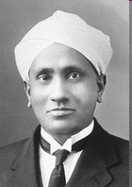
Raman Effect
Assist.Prof. Ashok M Kamble

Slide 3
In physics, the term light sometimes refers to electromagnetic radiation of any wavelength, whether visible or not. In this sense, gamma rays, X-rays, microwaves and radio waves are also light.
Light is a transverse, electromagnetic wave that can be seen by humans. The wave nature of light was first illustrated through experiments on diffraction and interference. Like all electromagnetic waves, light can travel through a vacuum. The transverse nature of light can be demonstrated through polarization.
In longitudinal waves the displacement of the medium is parallel to the propagation of the wave. A wave in a "slinky" is a good visualization. Sound waves in air are longitudinal waves.

Slide 4
When a Light beam Strikes a Particle light gets scattered
that is:
Diffracted
Reflected
Refracted
Absorbed and Reradiated

Slide 5
In 1928, the famous Indian Physicist, C.V.Raman observed this effect.
Statement:
When monochromatic visible light is passed through a transparent liquid e.g., benzene or toluene, the light scattered at right angles to the direction of incident had some components in it having wavelengths longer as well as shorter than the wavelength of the incident light.
This Phenomenon is known as Raman Effect.
Raman awarded Nobel Prize in Physics for this very important discovery in 1930.

Slide 6
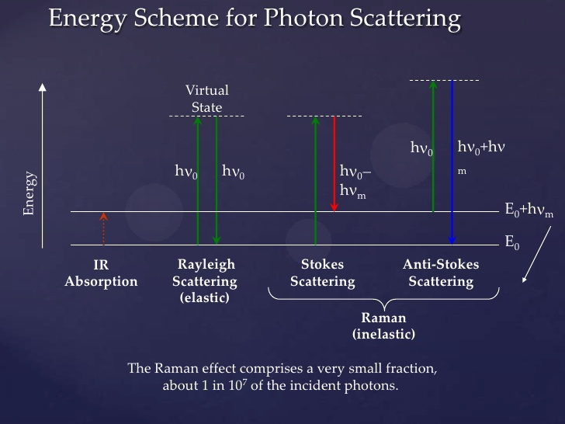

Slide 7
The frequency or wavelength of scattered radiation is same as that of incident radiation and is known as Rayleigh’s Scattering or Central line.
A series of displaced lines with frequency on both side of central line. This phenomenon of scattering with modified frequency is called as Raman Scattering.
The lines of frequency less than that of Rayleigh line are called as Stokes’s lines.
The lines of frequency greater than that of Rayleigh line are called Anti-stoke’s lines.
The frequency shift (Raman Shift) is the difference between frequency of Rayleigh line and a particular Raman Line

Slide 8
Characteristics Properties of RAMAN LINES
Raman lines are very weak in intensity as compared to the Rayleigh line.
Stokes lines are more intense as compare to Anti stokes lines.
Raman lines are symmetrically displaced from parent line (Rayleigh Scattered line).
The Raman Shift (∆υ), generally lies in the infra-red region of the spectrum.
The Raman shift represent the frequency of infra-red vibrational frequency of the absorption bond of the scattering material.
Even though Raman shift (∆υ) corresponds to infra-red region, Raman lines appears in visible region.

Slide 9
Classical theory of Raman Effect
The classical theory of the Raman effect is based upon polarizability of molecules, which reflects how easy an electron cloud of a molecule can be distorted by an electric field (light).
The technique is based on molecular deformations in electric field E determined by molecular polarizability α.
The laser beam can be considered as an oscillating electromagnetic wave with electrical vector E. Upon interaction with the sample it induces electric dipole moment P = αE which deforms molecules.
Because of periodical deformation, molecules start vibrating with characteristic frequency.
The scattered light can have a frequency equal to the incident light (Rayleigh), equal to the incident light minus the vibrational frequency (Stokes) and equal to the incident light plus the vibrational frequency (anti-Stokes).

Slide 10
Quantum Theory of Raman Effect
According to the quantum theory of Raman effect when a photon of energy hυ is incident upon a molecule, the following three processes may occur:
The Photon may be scattered without causing any change in the quantum state of the molecule
that means no change in the frequency or wave number of photon.
A small fraction of the energy of the photon may be transferred to the molecule during the photon –molecule collision.
as a result, the photon loses some energy so that its frequency and wave number are reduced and we get the stokes line.
If the photon encounters a molecule in a excited state, then it may gain some energy from the molecule.
as a result, the frequency and wave number of the photon are increased which gives rise to the anti-Stokes line.

Slide 11
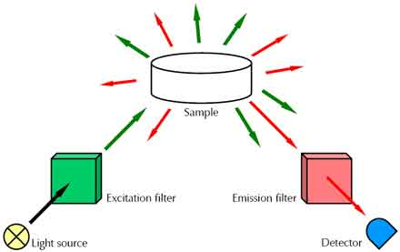
Setup of a Raman experiment.

Slide 12
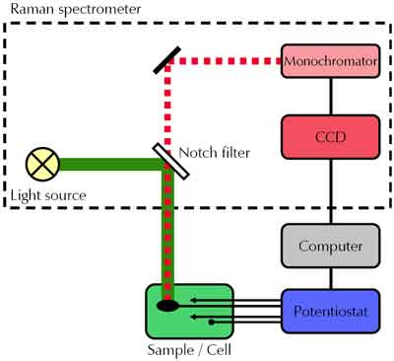
Experimental setup for spectroelectrochemical Raman experiments.

Slide 13
Raman spectrum
In Raman spectra, the intensity of measured Raman scattering is plotted versus the Raman shift.
The Raman shift is defined as difference between the measured frequency of scattered light and incident light beam.
Hence Raman spectra are independent of the wavelength of the light source.
However, instead of using the wavelength, the Raman shift is given as change of the wavenumber n (cm⁻¹) which is inversely proportional to the wavelength.

Slide 14
Raman spectroscopy is useful in
Carbon Materials ,Purity of carbon nanotubes (CNTs), sp2 and sp3 structure in carbon materials
Pharmaceuticals and Cosmetics, Compound distribution in tablets, Polymorphic forms, Contaminant identification
Life Sciences, Bio-compatibility DNA/RNA analysis, Drug/cell interactions, Photodynamic therapy (PDT).
Geology and Mineralogy, Gemstone and mineral identification, Fluid inclusions, Mineral and phase distribution in rock sections, Mineral behaviour under extreme conditions

Slide 15


