Slide 1
Electronics and Instrumentation
Electron Microscopy
by
Dr. J. V. Thombare,
Assistant Professor,
Department of Physics,
Vidnyan Mahavidyalaya, Sangola.
E-mail-jagannaththombare@gmail.com

Slide 2
Outline of presentation
Introduction
Distinction between magnification and resolution
Construction and working of Scanning electron microscopy (SEM)
Applications of SEM

Slide 3
History
Introduction
TEM constructed in 1931
Von Ardenne first STEM in 1938 by rastering the electron beam in a TEM
Zworykin et al. 1942, first SEM for bulk samples
1965 first commercial SEM by Cambridge Scientific Instruments
Resolution at that time ~ 50 nm : Today < 1 nm
Morphology only at that time : Today analytical instrument

Slide 4
Magnification and resolution
Magnification: Ratio of size of image to the size of object (actual size)
Size of object
Size of image
SEM have maximum magnification of X 100000 and
TEM have maximum magnification of X 500000.

Slide 5


Resolution : The minimum distance that can be separated as two distinguishable points using instruments
Instrument | Resolution
Human eye | 0.2 mm
Light microscope | 0.2 μm
SEM | 1 nm
TEM | 0.1 nm
Resolution of microscope is limited by wavelength of source used.
Electron have much lower wavelength compared to light i.e. it can produce a image with the resolution of 0.1 nm.

Slide 6
What is SEM?
It is a microscope that produces an image by using an electron beam that scans the surface of a specimen inside a vacuum chamber.
What can we study in a SEM?
Topography and morphology
Chemistry
Crystallography
Orientation of grains
In-situ experiments:
  Reactions with atmosphere
  Effects of temperature
“Easy” sample
preparation!!
“Big” samples!

Slide 7
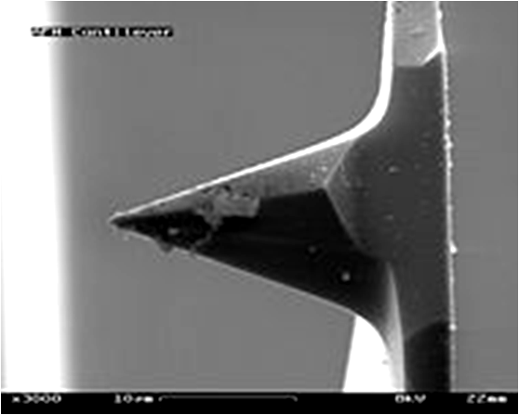

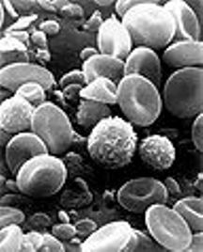
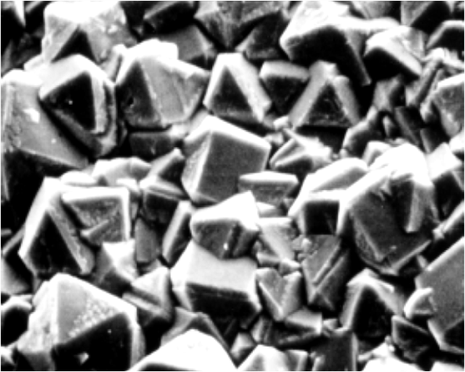
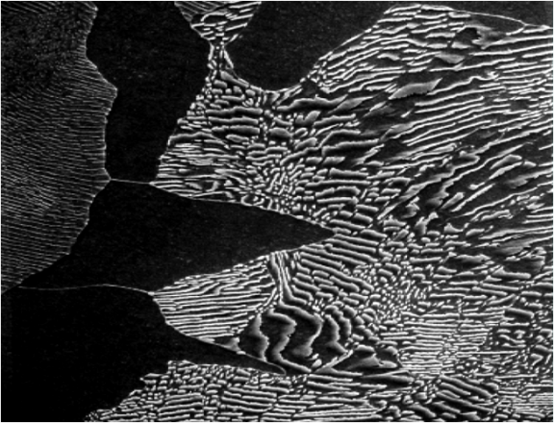
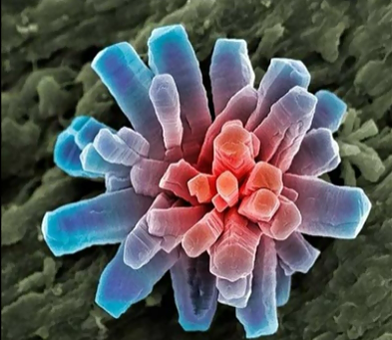
What does it looks like….
AFM Cantilever Tip
Ant Head
Blood Cells
Diamond Thin Film
(Numerous Multifaceted Micro-crystals)
Microstructure of a plain carbon steel that contains 0.44 wt% of carbon
Calcium Phosphate Crystal

Slide 8
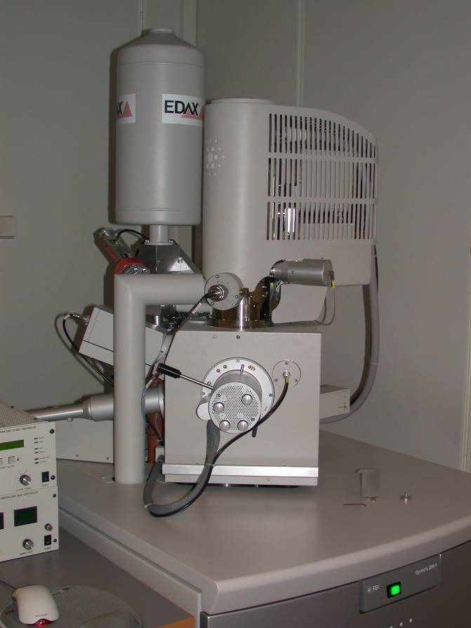
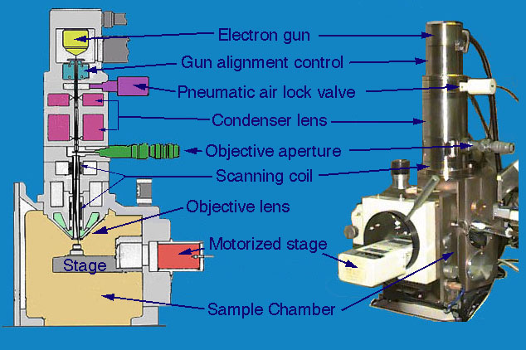
The instrument in brief

Slide 9
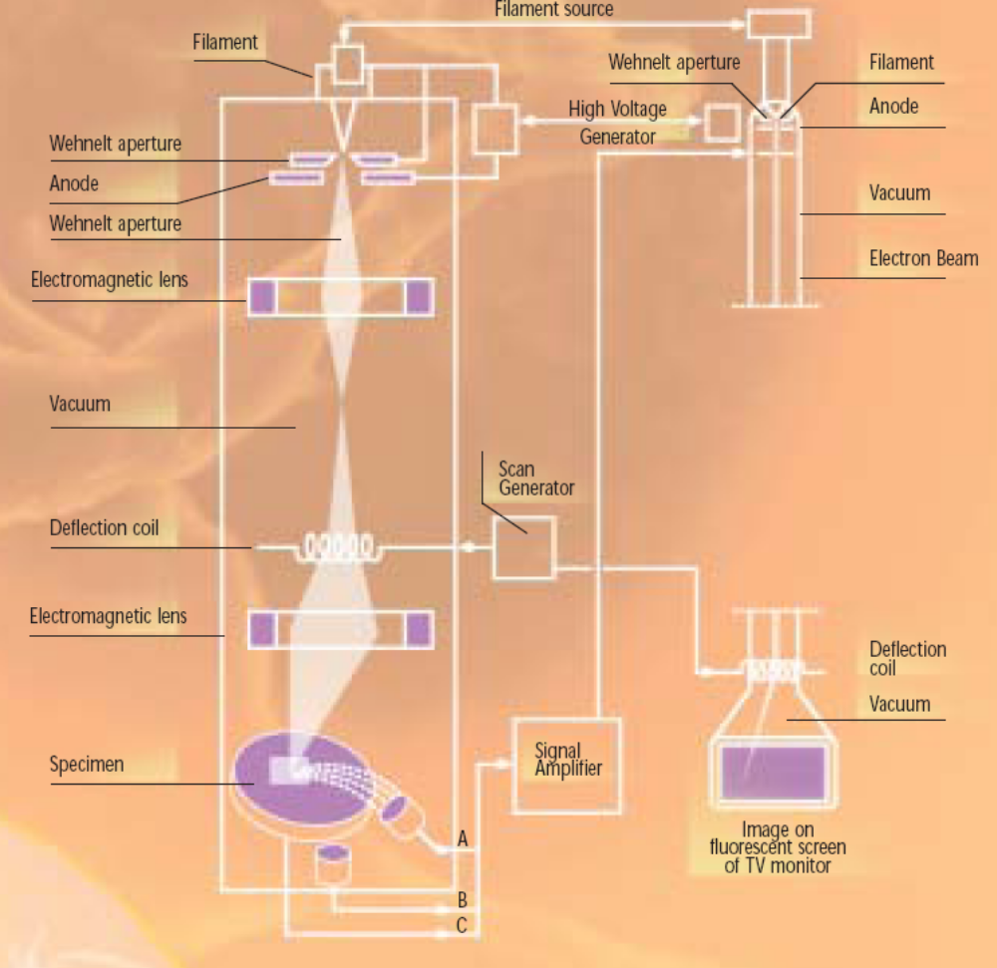
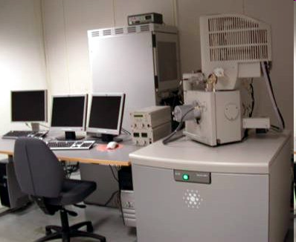
Components of the instrument
electron gun (filament)
electromagnetic optics
scan coils
sample stage
detectors
vacuum system
computer hardware and software (not trivial!!)

Slide 10
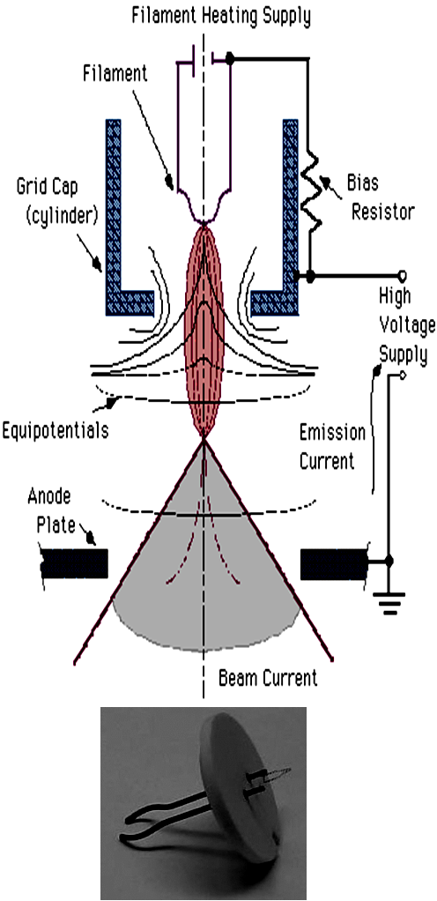
Electron guns
We want many electrons per unit time per unit area (high current density) and as small electron spot as possible
Traditional guns: thermionic electron gun (electrons are emitted when a solid is heated)
  W-wire, LaB₆-crystal
Modern: field emission guns (FEG) (cold guns, a strong electric field is used to extract electrons)
  Single crystal of W, etched to a thin tip

Slide 11
Lens system
  Below electron gun lens system
  Two lenses namely condenser lens and objective lens
  Together works like magnetic lens
  Magnetic lens consist of coil of wire.
  When current passed though coil magnetic field is produce by changing current we change magnetic field and hence power of les.
  This generated magnetic field is used for focusing of electron beam.
  If lens action of condenser lens is strengthened, electron beam becomes narrower whereas if weakened the electron beam becomes broader.
  The focusing of final diameter of electron beam is further done by objective lens.

Slide 12
Scanning coils
Deflects the electron beam and sweep it over the specimen surface
A cathode ray display tube is scanned synchronously with the electron beam for the display of image.

Slide 13
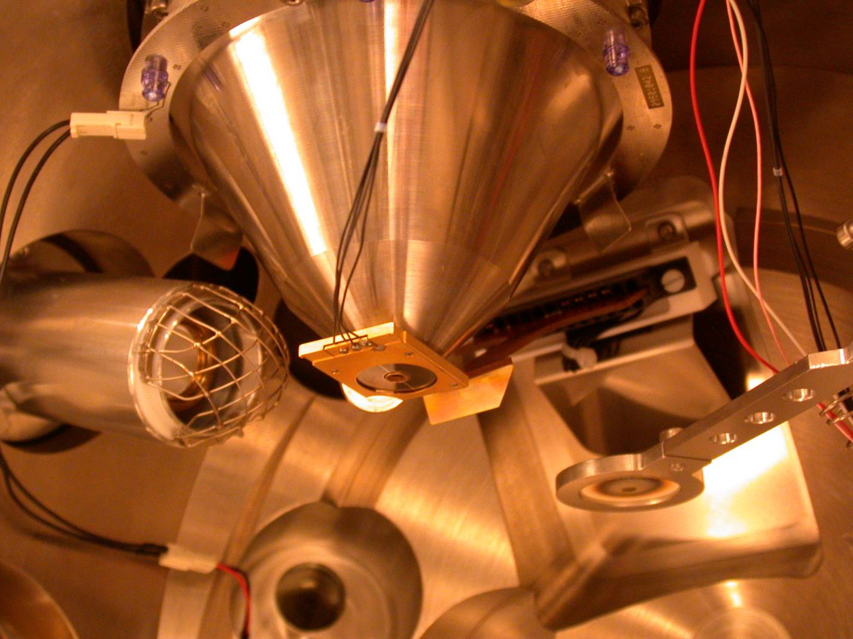
Detectors
Our traditional detectors
Backscattered electron detector:
(Solid-State Detector)
Secondary electron detector:
(Everhart-Thornley)
Secondary electrons: Everhart-Thornley Detector
Backscattered electrons: Solid State Detector
X-rays: Energy dispersive spectrometer (EDS)

Slide 14
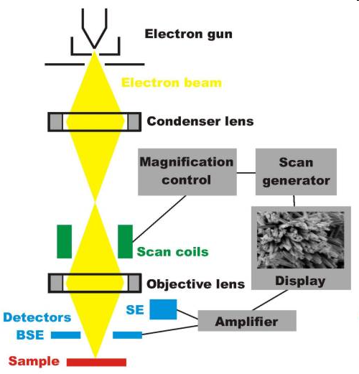
HOW THE SEM WORKS?
The SEM uses electrons instead of light to form an image.
A beam of electrons is produced at the top of the microscope by heating of a metallic filament.
The electron beam follows a vertical path through the column of the microscope. It makes its way through electromagnetic lenses which focus and direct the beam down towards the sample.
Once it hits the sample, other electrons
( backscattered or secondary ) are ejected from the sample. Detectors collect the secondary or backscattered electrons, and convert them to a signal that is sent to a viewing screen similar to the one in an ordinary television, producing an image.

Slide 15
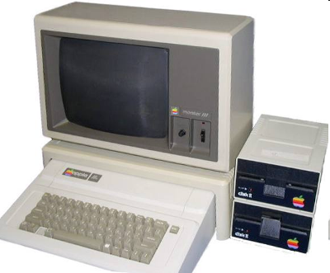
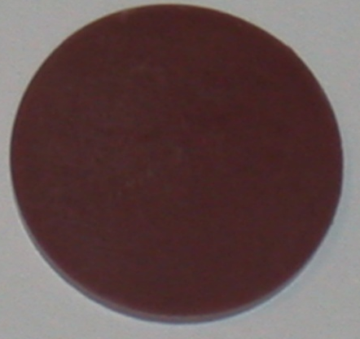
How do we get an image?
Electron gun
156 electrons!
288 electrons!
Detector
Image

Slide 16
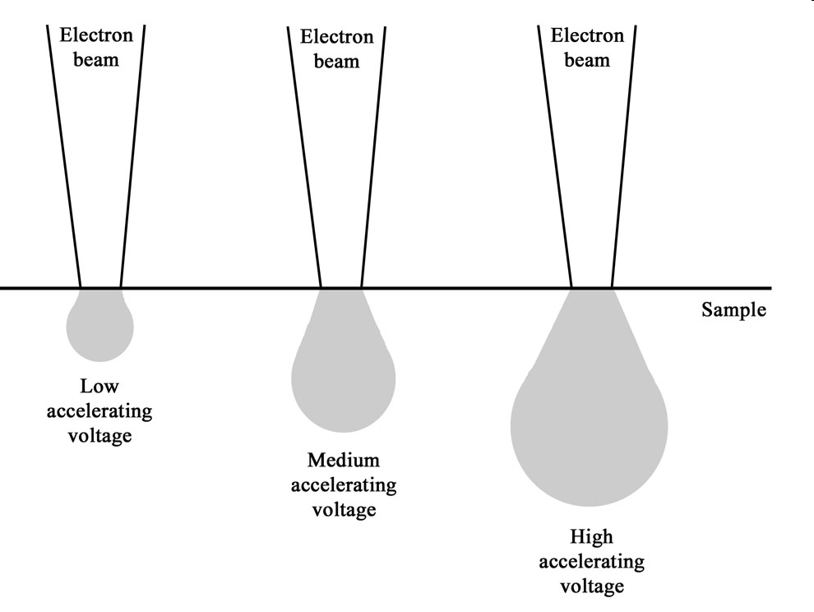
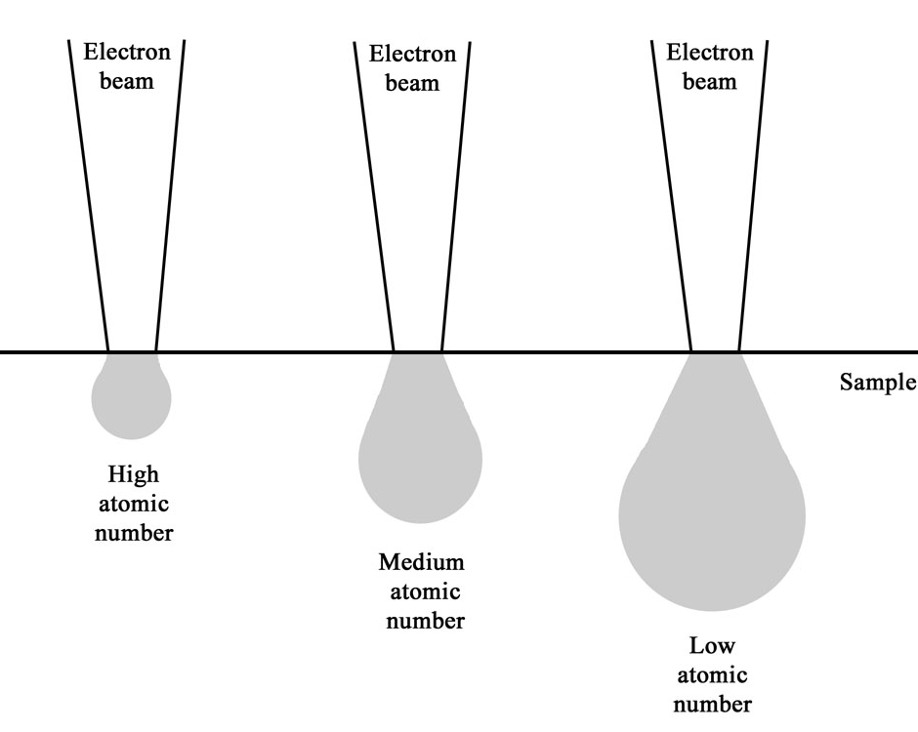
Electron beam-sample interactions
The incident electron beam is scattered in the sample, both elastically and inelastically
This gives rise to various signals that we can detect (more on that on next slide)
Interaction volume increases with increasing acceleration voltage and decreases with increasing atomic number

Slide 17
Signals from the sample
Incoming electrons
Secondary electrons
Auger electrons
Backscattered
electrons
Cathodo-
luminescence (light)
X-rays
Sample

Slide 18
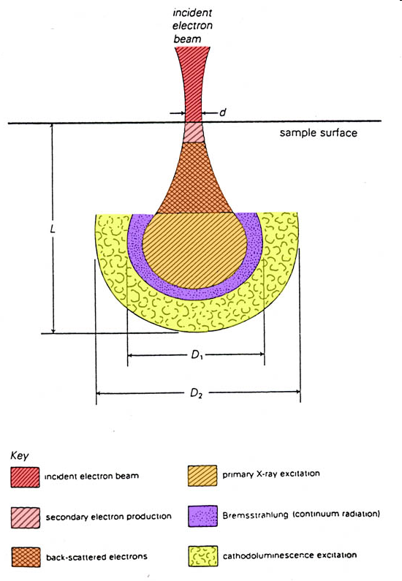
Where does the signals come from?
Diameter of the interaction volume is larger than the electron spot
→ resolution is poorer than the size of the electron spot

Slide 19
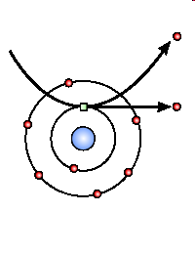
Secondary electrons (SE)
Generated from the collision between the incoming electrons and the loosely bonded outer electrons
Low energy electrons (~10-50 eV)
Only SE generated close to surface escape (topographic information is obtained)
Number of SE is greater than the number of incoming electrons
We differentiate between SE1 and SE2

Slide 20
SE1
The secondary electrons that are generated by the incoming electron beam as they enter the surface
High resolution signal with a resolution which is only limited by the electron beam diameter
SE2
The secondary electrons that are generated by the backscattered electrons that have returned to the surface after several inelastic scattering events
SE2 come from a surface area that is bigger than the spot from the incoming electrons → resolution is poorer than for SE1 exclusively
Incoming electrons
SE2
Sample surface

Slide 21
Backscattered electrons (BSE)
A fraction of the incident electrons is retarded by the electro-magnetic field of the nucleus and if the scattering angle is greater than 180° the electron can escape from the surface
High energy electrons (elastic scattering)
Fewer BSE than SE
We differentiate between BSE1 and BSE2

Slide 22
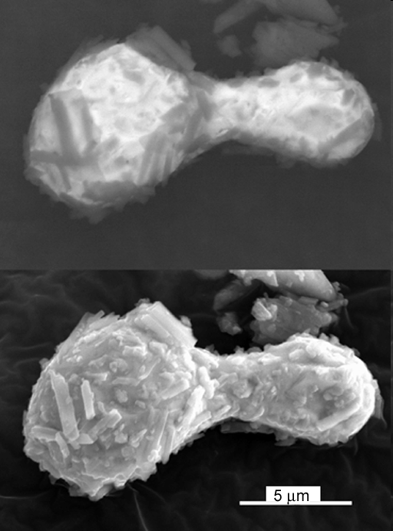
BSE vs SE
SE produces higher resolution images than BSE
By placing the secondary electron detector inside the lens, mainly SE1 are detected
  Resolution of 1 – 2 nm is possible

Slide 23
X-rays
Photons not electrons
Each element has a fingerprint X-ray signal
Poorer spatial resolution than BSE and SE
Relatively few X-ray signals are emitted and the detector is inefficient
  → relatively long signal collecting times are needed

Slide 24
Applications of SEM
For studying topographical, morphological and compositional information of materials
To detect and analyze surface fractures, inhomogeneties and imperfections in metals, crystals and ceramics.
Useful for Biologists to examine the structure of cells, bacteria, viruses and colloidal particles.
In geology, for details study of rocks, minerals and fossils.
Useful for elemental analysis of materials
Industrial and technological applications such as semiconductor inspection and assembly of microchips for computers.

Slide 25
Thank you one and all !!!!!!!!

