Slide 1
Department of Physics
B.Sc.-II
Dr. J. V. Thombare
Assistant Profeesor
Vidnyan Mahavidyalaya, Sangola

Slide 2
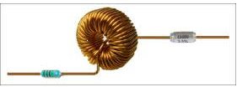
SERIES AND PARALLEL RESONANT CIRCUITS

Slide 3
AIM:
To show that
1.The impedance of series LC circuit is minimum at the resonance frequency.
2. The impedance of parallel LC circuit is maximum at the resonance frequency.
Instruments: Signal generator.
Electric components: Resistor(1kΩ),Inductor(100mH),Capacitor(0.033µF).

Slide 4
Series resonant circuit:
SG
R
L
C
1KΩ
100mH
0.033μF
V_{R}
V_{L}
V_{C}
V_{Z}

Slide 5
Observation table : For series LCR circuit
F | V_{R} | V_{Z} | V_{Z}/V_{R} | V_{app}
KHz | volts | volts |  | volts
1 | 0.219 | 0.911 | 4.16
2 | 0.582 | 0.649 | 1.115
2.2 | 0.671 | 0.512 | 0.763
2.4 | 0.74 | 0.351 | 0.474
2.6 | 0.782 | 0.178 | 0.228
2.8 | 0.786 | 0.143 | 0.182
3 | 0.756 | 0.288 | 0.381
3.2 | 0.712 | 0.419 | 0.589
3.4 | 0.66 | 0.528 | 0.8 | 1
3.6 | 0.615 | 0.617 | 1.003
3.8 | 0.57 | 0.678 | 1.19
4 | 0.528 | 0.726 | 1.375
4.5 | 0.442 | 0.809 | 1.83
5 | 0.372 | 0.859 | 2.309
5.5 | 0.332 | 0.889 | 2.678
6 | 0.295 | 0.91 | 3.085
6.5 | 0.265 | 0.927 | 3.498
7 | 0.24 | 0.939 | 3.913

Slide 6
Graph: Now plot the graph of Vz/V_{R} against the Frequency ‘f’ in KHz.
A plot of V_{z}/V_{R} against frequency in kHz for the series resonant circuit.

Slide 7
Parallel resonant circuit:
SG
R
L
1KΩ
100mH
V_{R}
C
0.033μF
V_{Z}

Slide 8
Observation table : For parallel LCR circuit
f | V_{R} | V_{Z} | V_{Z}/V_{R} | V_{app}
KHz | volts | volts |  | volts
1 | 0.654 | 0.492 | 0.752
1.2 | 0.597 | 0.572 | 0.958
1.4 | 0.531 | 0.651 | 1.226
1.6 | 0.454 | 0.714 | 1.573
1.8 | 0.372 | 0.772 | 2.075
2 | 0.296 | 0.821 | 2.774
2.2 | 0.207 | 0.856 | 4.135
2.4 | 0.138 | 0.88 | 6.377
2.6 | 0.063 | 0.896 | 14.222
2.8 | 0.043 | 0.903 | 21 | 1
3 | 0.148 | 0.906 | 6.122
3.2 | 0.165 | 0.899 | 5.449
3.4 | 0.195 | 0.895 | 4.59
3.6 | 0.263 | 0.881 | 3.35
3.8 | 0.329 | 0.863 | 2.623
4 | 0.377 | 0.845 | 2.241
4.5 | 0.473 | 0.798 | 1.687
5 | 0.549 | 0.751 | 1.368
5.5 | 0.611 | 0.703 | 1.151
6 | 0.656 | 0.66 | 1.006
6.5 | 0.725 | 0.632 | 0.872
7 | 0.758 | 0.596 | 0.786

Slide 9
Graph:
Now plot the graph of Vz/V_{R} against the Frequency ‘f’in KHz
(V_{Z}/V_{R}) against frequency in kHz for
a parallel resonant circuit

Slide 10
Result:
The impedance of series LC circuit is=_____ Ω at Resonance Frequency
2. The impedance of parallel LC circuit is=_____ Ω at Resonance Frequency
Conclusion:
1.The impedance of series LC circuit is minimum at the resonance frequency.
2.The impedance of parallel LC circuit is maximum at the resonance frequency.

Slide 11

Principle:
At the resonance frequency
And
The impedance of an inductance is
The impedance of an capacitance is

Slide 12
When the inductance and capacitance are connected in series the total impedance is,
This has a minimum value R_{L} at the resonance frequency .At any other frequency the impedance is more then R_{L} .
If the inductance and capacitance are connected in parallel , the effective impedance is
At resonance frequency Z_{L}+Z_{C} is minimum .
If R_{L}=0, then Z_{L}Z_{C} would be impedance of frequency while if Z_{L}+Z_{C} would be zero at resonance frequency making the effective impedance infinite at resonance frequency.
However R_{L} is non-zero and small for the coil .This make the impedance go through a finite but maximum value at frequency close to resonance frequency.

Slide 13
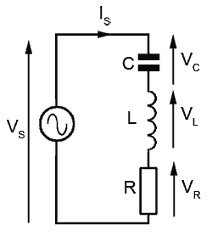
Series LC-resonance circuit :

Slide 14
Series LC-resonance circuit :
A series combination consist of an inductor of inductance L,capacitor of capacitance C and resistor of resistance R. These are in series across signal generator.
If sinusoidal voltage of RMS value V of variable frequency is applied across R-L-C circuit, then alternating voltage across R is V_{R} ,L is V_{L} and C is V_{C.}
Let,
V_{R} =I*R ……………………… in phase with I
V_{L} =I*L ……………………… leading I by 90˚
V_{C} = I*C ……………………… lagging I by 90˚
As frequency increased , X_{L} is increased ,but X_{C} is decreased because
X_{L}=2ΠfL X_{L} α f ………………………(1)
X_{C} α 1/f ………………….(2)
The instantaneous alternating current is given by ,
……………………………(3)

Slide 15
where,
I₀=maximum or peak value of current(Amp)
The instantaneous emf (or voltage) V is equal to sum of voltage drop across R,L and C respectively .
From Kirchhoff's law , we have,
V=V_{R}+V_{L}+V_{C} …...……………(4)
………………..(5)
Substituting equation (3) in above equation we get,

Slide 16
multiply and dividing R.H.S. by
From figure we have,
C
X_{L}
B
Z
X_{L}-X_{C}
ф
A
O
R
X_{C}
D

Slide 17
Substitute these value in equation (5) we get,
Let,
Now equation (6) becomes,
Eq.(7) can be written as
Compare this eq. with Ohms law it can be conclude that the quantity,

Slide 18
indicates the resistance offered by RLC series circuit to the flow ofalternating
current, hence it is called impedance and it is given by,
The RMS value of current flowing through RLC series circuit is given by,
If X_{L}=X_{C} then Z=R,
I_{rms}=V_{rms}/R
Thus the circuit action as a purely resistive circuit. Hence impedance of the
circuit become minimum and RMS current through the circuit become
maximum .this condition is called as resonance condition .The RLC series at
resonance is called series resonant circuit.

Slide 19
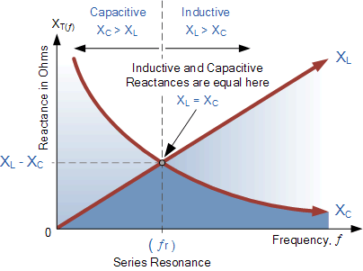
Series LC-Resonance frequency:

Slide 20
Resonant Frequency:
The minimum frequency of applied alternating e.m.f at which inductive reactance is equal to capacitive reactance is called as resonant frequency.
It is denoted by ‘fr’.
Thus at resonance, X_{L}=X_{C}
We know that, ω=2пfr ……………….>

Slide 21
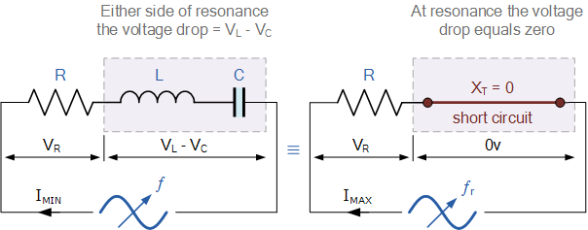
Series RLC circuit at resonance:

Slide 22
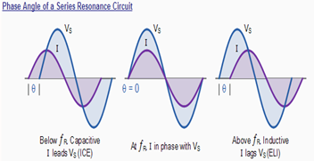
Phase angle of series resonance circuit:

Slide 23
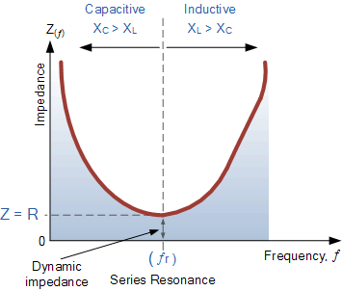
Impedance in a series resonance circuit:

Slide 24
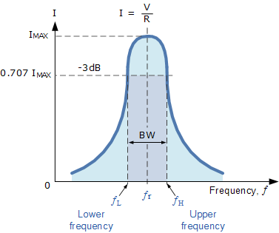
Resonance curve:
The graphical representation between the frequency of applied alternating emf and rms value of current through circuit is called as resonance curve .
The nature of resonance curve for series resonance circuit is as shown in fig.
.

Slide 25
Characteristics of series resonance:
At resonance
Therefore,
Net reactance X=X_{L}-X_{C}
Impedance Z=R +j (0)=R->maximum value.
2.Current
So current has maximum value.
3.Phase difference ø between V & I=0
4.Power factor=cos ø=cos(0)=1(unity).
5.The circuit behaves as a purely resistive circuit.
6.Quality factor(Q-factor)=
7.Bandwidth(ΔF)=f2-f1=

Slide 26
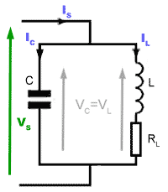
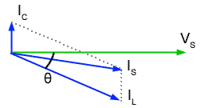
Parallel resonant circuit:

Slide 27
Parallel resonant circuit:
Consider inductor of inductance L of negligible small resistance and condenser of capacitance C are connected in parallel across alternating source .When fed from AC voltage source ,the capacitor draws a leading current where as coil draws lagging current .
This current resonates to a frequency which makes X_{L}=X_{C.} .So that the two branch current are equal but opposite in direction because when coil draws in the current ,the capacitor discharges at the same time and vise versa. Hence they cancel out with the result that current drawn from supply is zero.
The alternating emf given by ,
……………………..(1)
Let I_{L} and I_{C} be current flowing through the inductor and condenser respectively from fig. we have, I=I_{L} +I_{C}

Slide 28
Let, which is called as maximum or peak value of current.
………………………..(3)

Slide 29
Comparing eq. (3)with eq (1) it can be concluded that alternating current through
the circuit lead alternating emf by phase angle of Π/2 radian .
From eq. (2 ) we have,
Compare this eq with Ohm’s law it can be concluded that the quantity,
indicates resistance offered by parallel circuit .
To flow alternating current hence it is called impedance . It is given by
If X_{L}=X_{C} then Z=infinity i.e. maximum hence RMS value of current going through
circuit is minimum
i.e. I_{rms} =0 this condition called resonance .
The parallel LC circuit at resonance is called as Parallel resonance circuit .
At resonance parallel resonant circuit ,rejects current of resonant frequency hence it is
called rejecter circuit

Slide 30
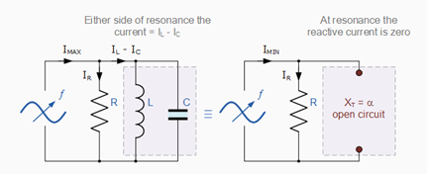
Parallel RLC circuit at resonance:

Slide 31
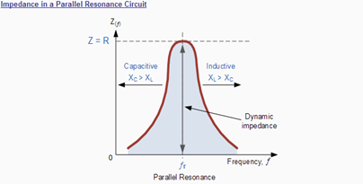
Impedance in a Parallel Resonant Circuit:

Slide 32
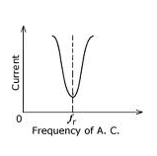
Resonance curve:
The graphical representation between frequency of applied alternating e.m.f and R.M.S. value of current through circuit called resonant curve .
Resonant curve for parallel resonant circuit is as shown in fig below.

Slide 33
Characteristic of parallel resonant circuit:
Resonanance occur when,
(1)
(2)
(3)
(4)Power factor=
(5)Resonant Frequency using impure components:

Slide 34
Thank you
one and all

