Slide 1
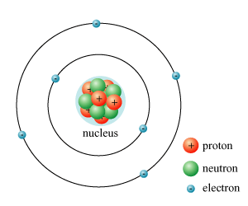
SEMISTER- V
PHYSICS PAPER- X
NUCLEAR PHYSICS

Slide 2
CHAPTER- I
NUCLEAR STRUCTURE AND
PROPERTIES

Slide 3
POINTS TO BE STUDY
1.1 Composition of nucleus
1.2 Nuclear radius
1.3 Nuclear spin
1.4 Nuclear magnetic moment
1.5 Electric quadruple moment
1.6 Mass defect
1.7 Binding energy
1.8 Packing fraction
1.9 Liquid drop model of nucleus
1.10 Semi-empirical mass formula

Slide 4
The atomic nucleus is the small, dense region consisting of protons and neutrons at the center of an atom, discovered in 1911 by Ernest Rutherford

Slide 5
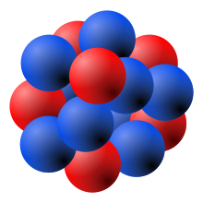
MODEL OF ATOMIC NUCLEUS
A model of the atomic nucleus showing it as a compact bundle of the two types of nucleons: protons (red) and neutrons (blue). In this diagram, protons and neutrons look like little balls stuck together, but an actual nucleus (as understood by modern nuclear physics) cannot be explained like this, but only by using quantum mechanics. In a nucleus which occupies a certain energy level (for example, the ground state), each nucleon can be said to occupy a range of locations.

Slide 6
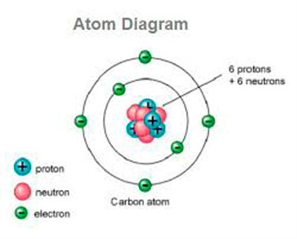
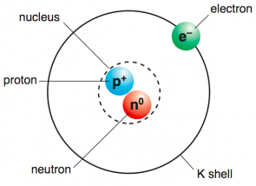
COMPOSITION OF NUCLEUS

Slide 7
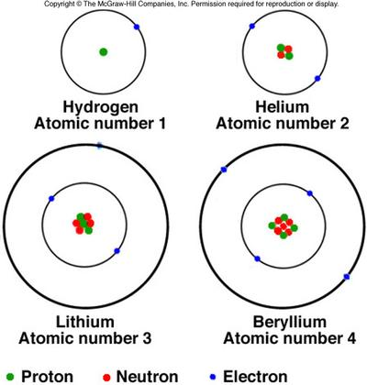
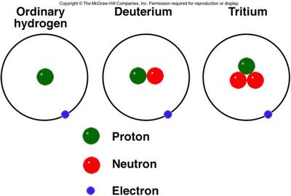
8-2. Nuclear Structure
The nucleus of ordinary hydrogen is a single positively charged proton; other nuclei contain electrically neutral neutrons as well as protons. The number of protons is the atomic number.

Slide 8
Nuclear Components
Nucleus contains nucleons: protons and neutrons
Atomic number Z = number of protons
Neutron number N = Mass number (A) – Atomic number (Z)
Mass number A = number of nucleons = Z + N
Each element has unique Z value
Isotopes of element have same Z, but different N and A values
Isobars of element have same N and A values but different Z
Isomers of elements have same Z and A values but different physical and chemical properties

Slide 9
NUCLEAR RADIUS
Protons and neutrons are bound together to form a nucleus by the nuclear force. The diameter of the nucleus is in the range of 1.75 fm(1.75×10⁻¹⁵ m) for hydrogen (the diameter of a single proton) , 15 fm for the heaviest atoms, such as uranium.
( fm means Femtometer)

Slide 10
NUCLEAR MAGNETIC MOMENT
The nuclear magnetic moment is the magnetic moment of an atomic nucleus and arises from the spin of the protons and neutrons
The nuclear magnetic moment varies from isotope to isotope of an element. For a nucleus of which the numbers of protons and of neutrons are both even in its ground state (i.e. lowest energy state), the nuclear spin and magnetic moment are both always zero. In cases with odd numbers of either or both protons and neutrons, the nucleus often has nonzero spin and magnetic moment

Slide 11
ELECTRIC QUADRAPOLE MOMENT
The nuclear electric quadrupole moment is a parameter which describes the effective shape of the ellipsoid of nuclear charge distribution. A non-zero quadrupole moment Q indicates that the charge distribution is not spherically symmetric.
The simple example of quadrupole moment is a set of two electric dipole moments parallel but appositely directed
Q = 2/5 ( a²-b²)e. Z

Slide 12
ELECTRIC QUADRAPOLE MOMENT
The simple example of quadrupole moment is a set of two electric dipole moments parallel but appositely directed
- +
+ -
The quadrupole moment is given by
Q = 2/5 ( a²-b²)e. Z

Slide 13
ELECTRIC QUADRAPOLE MOMENT
i) For spherically symmetric nucleus a=b hence Q =0.
ii) For prolate spheroid shape a>b, hence Q >0
a
b
a
b

Slide 14
ELECTRIC QUADRAPOLE MOMENT
iii) For oblate spheroid shape a<b hence Q<0
a
b

Slide 15
MASS DEFECT (ΔM)
Nuclei are made up of protons and neutron, but the mass of a nucleus is always less than the sum of the individual masses of the protons and neutrons which constitute it.
Mass defect is the difference between the mass of a composite particle and the sum of the masses of its parts.
OR
Mass defect is the difference between actual mass and atomic mass
ΔM = actual mass – atomic mass
ΔM = [ ZM_{p} + (A-Z) M_{n} + ZM_{e}] – M
Here Me is negligible hence
ΔM = [ZM_{p} + (A-Z) M_{n} ] – M

Slide 16
BINDING ENERGY
The minimum amount of energy required to break the nucleus into its constituent particles is called “binding energy”
Binding energy = ΔMC²
Where c is velocity of light which is constant
Hence mass defect ΔM is responsible for binding energy.

Slide 17
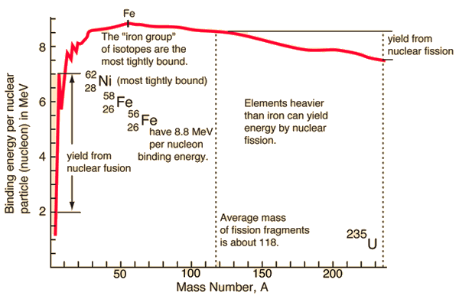
BINDING ENERGY CURVE

Slide 18
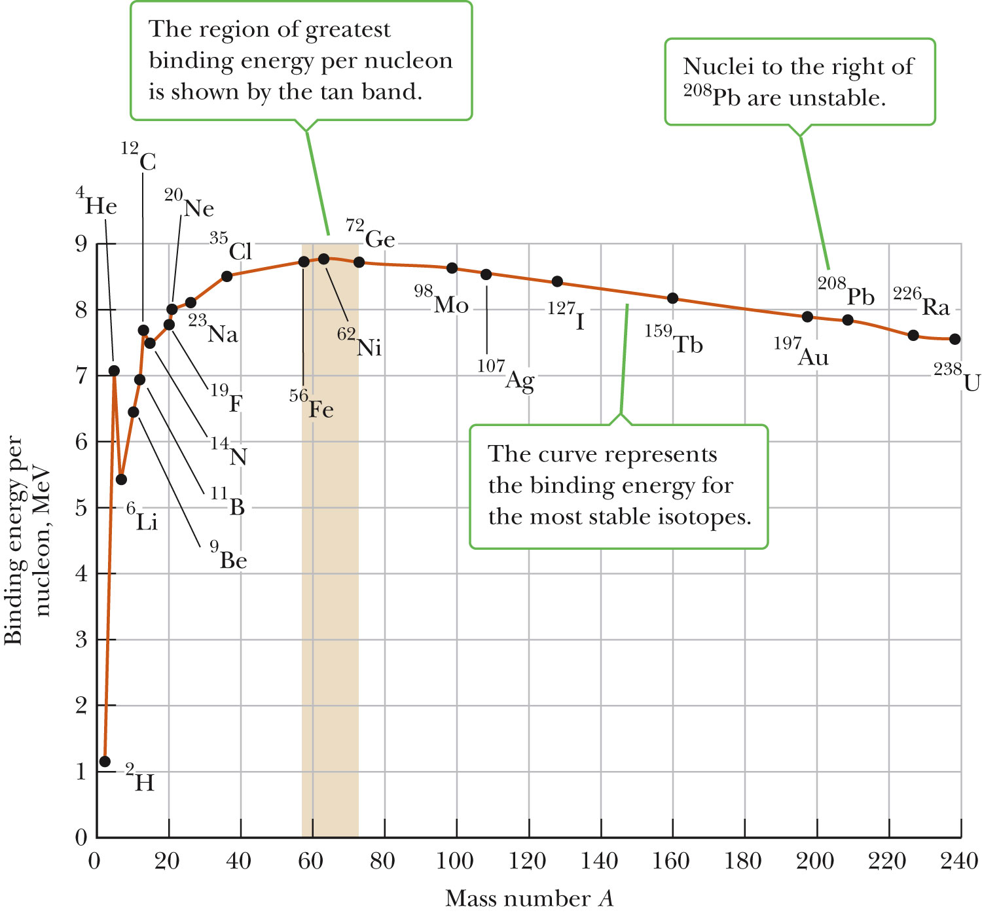
Binding Energy
Total energy of nucleus is less than combined energy of individual nucleons
Difference is called the binding energy (aka mass defect)
Energy required to separate nucleus into its constituents
Binding Energy vs. Mass Number
Fig. 29.4, p. 961

Slide 19
Packing fraction (P)
Mass defect per nucleon is called Packing fraction
i. e P = ΔM/A
Packing fraction may be positive or negative but mass defect is always positive
Packing fraction curve:
+P
12 50 180
A
-P

Slide 20
LIQUID DROP MODEL OF NUCLEUS
This model was proposed by Niels Bohr in 1936. This is based on the external analogy between the nucleus and a liquid drop.
The nucleus is considered as a droplet of dense liquid composed of sub droplets of nucleons.
The close packing of nucleons, density and short range forces are similar to the drop of liquid.
The molecules in the liquid drop are in random motion and frequently collide with each other and the nucleus posses the same properties
Similarities between liquid drop and nucleus.
In a stable state, the nucleus is spherical in shape just as the liquid drop is spherical due to the symmetrical surface tension.
The force of surface tension acts on the surface of the liquid drop, similarly there is a potential barrier at the surface of the nucleus.
The density of the liquid drop is independent of its volume, similarly the density of the nucleus is independent of its volume, i.e mass number.
The molecule evaporates from a liquid drop on raising the temperature of liquid due to their increased energy, similarly when energy is given to a nucleus by bombarding a nuclear projectile, a compound nucleus is formed which emits nuclear radiation immediately.
The nuclear force is short range force, similarly as that of liquid drop in which intermolecular forces are short range forces.
When a drop of liquid is allowed to oscillate, it breaks up into two smaller drop of equal size. The process is similar in which nucleus breaks up into smaller nuclei.
When two small drop of liquid is brought in contact they combine to form a drop of bigger size, the process is similar in which two lighter nucleus combines to form a single heavy nuclei.

Slide 21
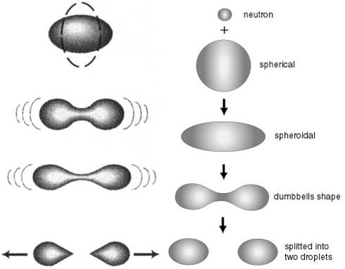
LIQUID DROP MODEL OF NUCLEUS
LIQUID DROP
NUCLEUS

