Slide 1
CHAPTER-2
NUCLEAR REACTIONS

Slide 2
POINTS TO BE STUDY
2.1 General scheme of nuclear reactions
2.2 Q value of nuclear reactions
2.3 Threshold energy
2.4 Cross section of nuclear reactions (qualitative)
2.5 Stripping reactions
2.6 Pick-up reactions

Slide 3
Nuclear reaction is semantically considered to be the process in which two nuclei of an atom and a subatomic particle (such as a proton, neutron, or high energy electron) from outside the atom, collide to produce one or more nuclides that are different from the nuclide(s) that began the process.

Slide 4
Q-value and energy balance
In writing down the reaction equation, in a way analogous to a chemical equation, one may in addition give the reaction energy on the right side:
nucleus + projectile → Final nucleus + ejectile + Q.
The reaction energy (the "Q-value") is positive for exothermal reactions and negative for endothermal reactions

Slide 5
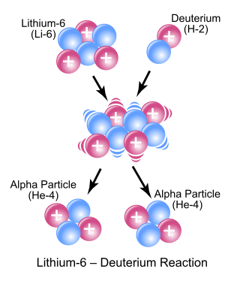

Slide 6
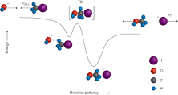
STRIPPING REACTION MECHANISM

Slide 7
PICKUP REACTION
What is PICK-UP REACTION?
Nuclear reaction in which an incident particle collects a nucleon from a target atom and proceeds with it.

