Slide 1
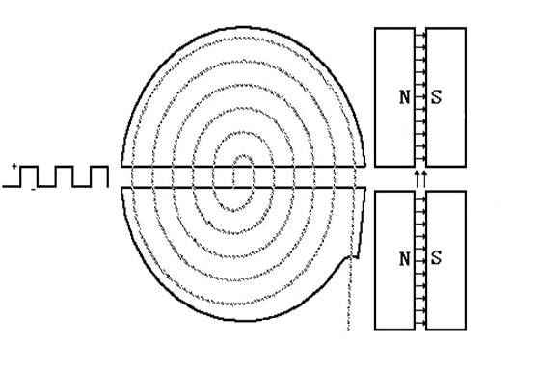
PARTICLE ACCELERATOR

Slide 2
Cyclotron Schematic
Top View Side View
Injected ions
Uniform
B-field
region
Alternating
E-field
Ejected ions
www.hyperphysics.com
Notes:
Brittany

Slide 3
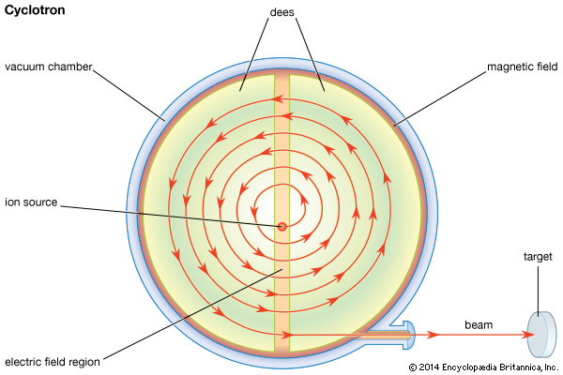

Slide 4
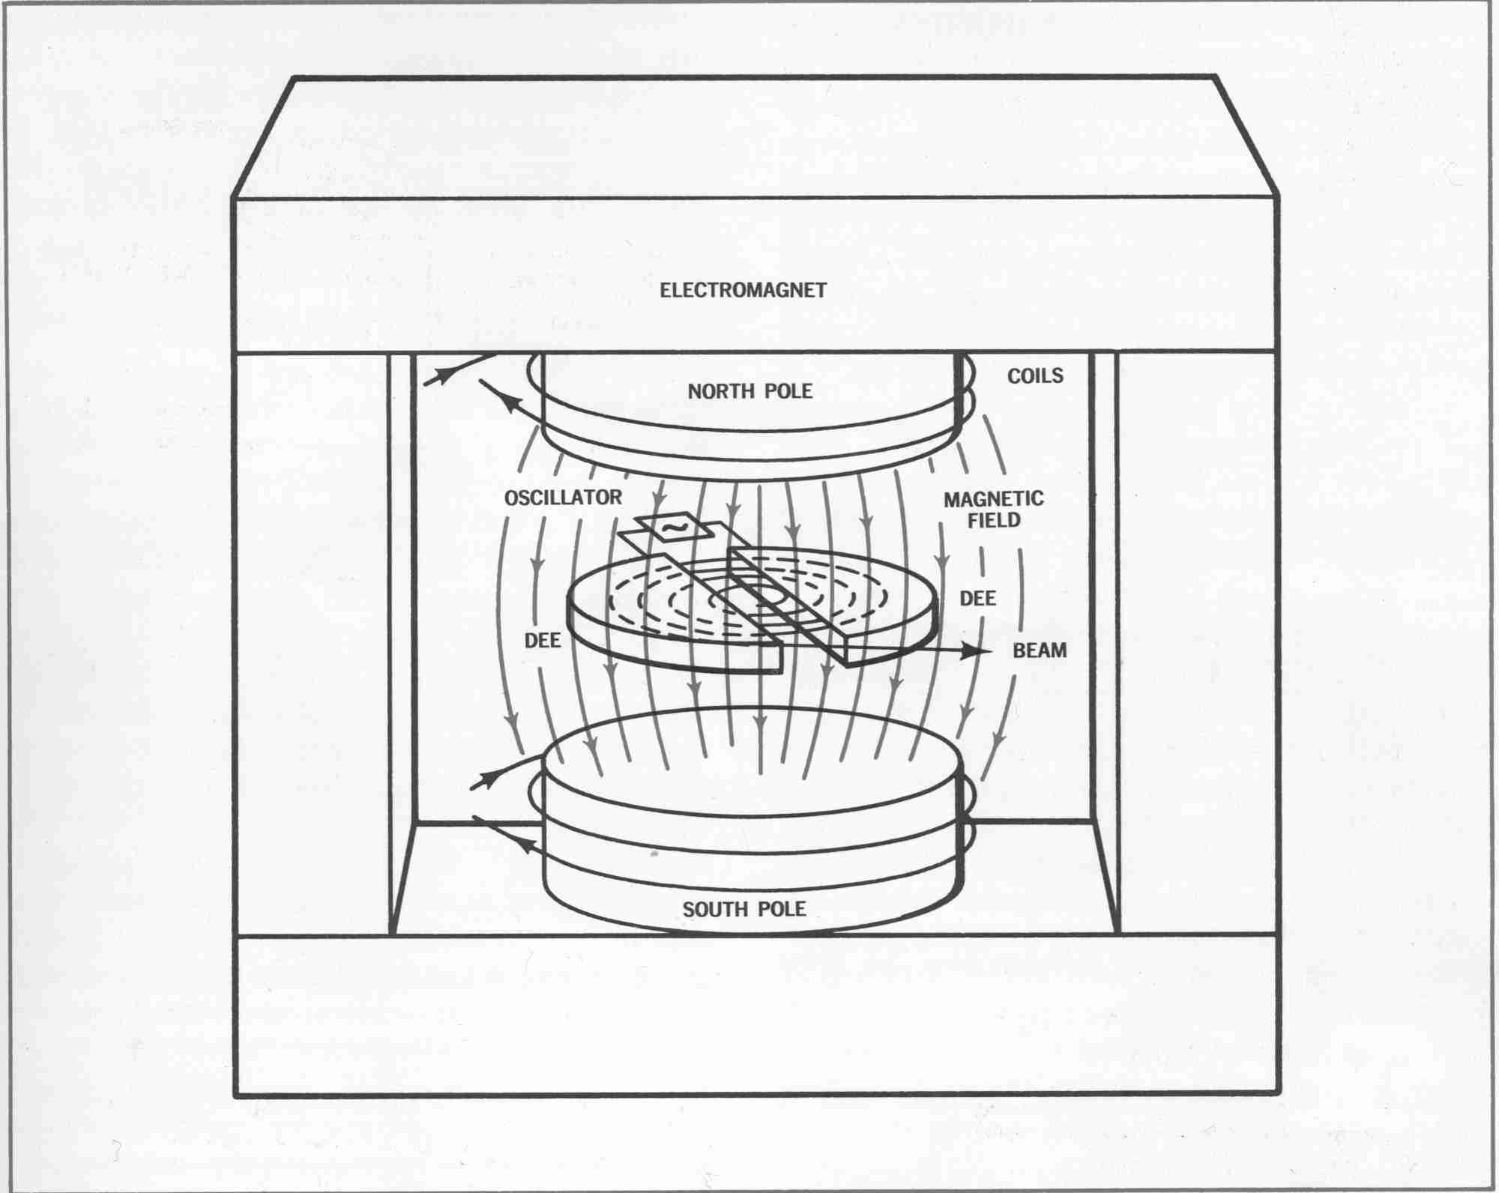
3D View
http://www-nsd.lbl.gov/
Notes:
Juliana

Slide 5
The Cyclotron
B
Period is independent of velocity
  Particle steered by magnet
    Moves in larger circles in equal amounts of time
    Gains more & more energy
Accelerates to large energies without large voltages
  Energy limits- disk size, B-field strength ~~ 100 MeV
F
v
F= ma
q(v×B)= mv²/ r
For circular orbits,
q(v×B)= qvB
r= mv/qB
ω= v/ r= qB/m
→”cyclotron frequency” f=ω/2π = qB/2πm
Notes:
Juliana…an orbiting particle in a magnetic field takes the same time to make one revolution, regardless of radius or energy. Thus the alternating voltage on the dees can be set to match the revolution frequency of all the particles in the cyclotron. A couple of important things to note are that 1:these dees are in a vacuum, so that the ions are not scattered by any particles in the air, and 2: the ions are shielded from the electric field while they are traversing the circle; they only feel its force at the junctions between the dees.

Slide 6
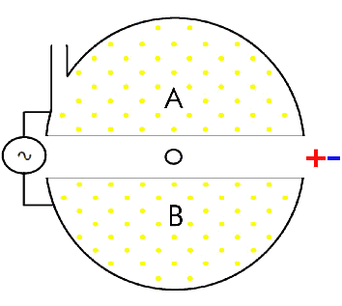
Cyclotron

Slide 7
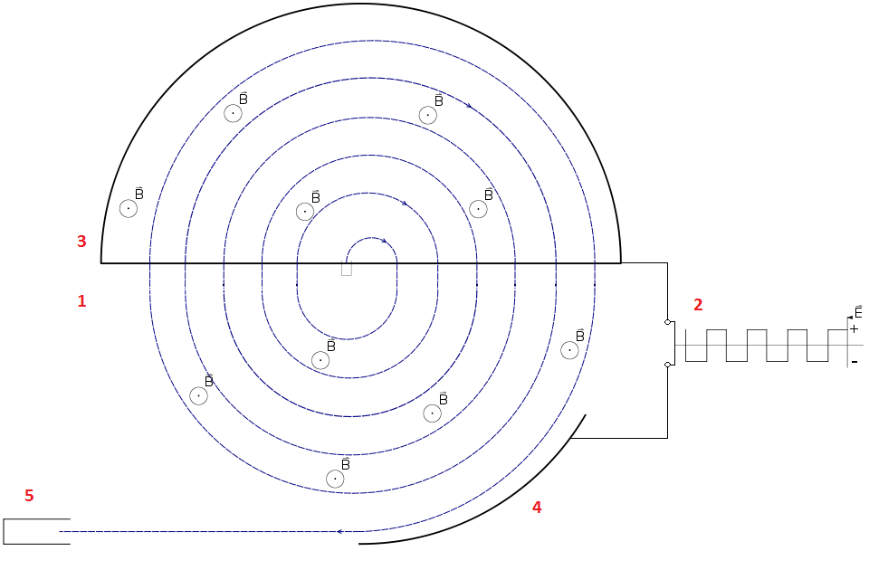
SYNCHROCYCLOTRON

Slide 8
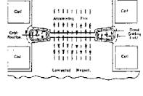
BETATRON

Slide 9
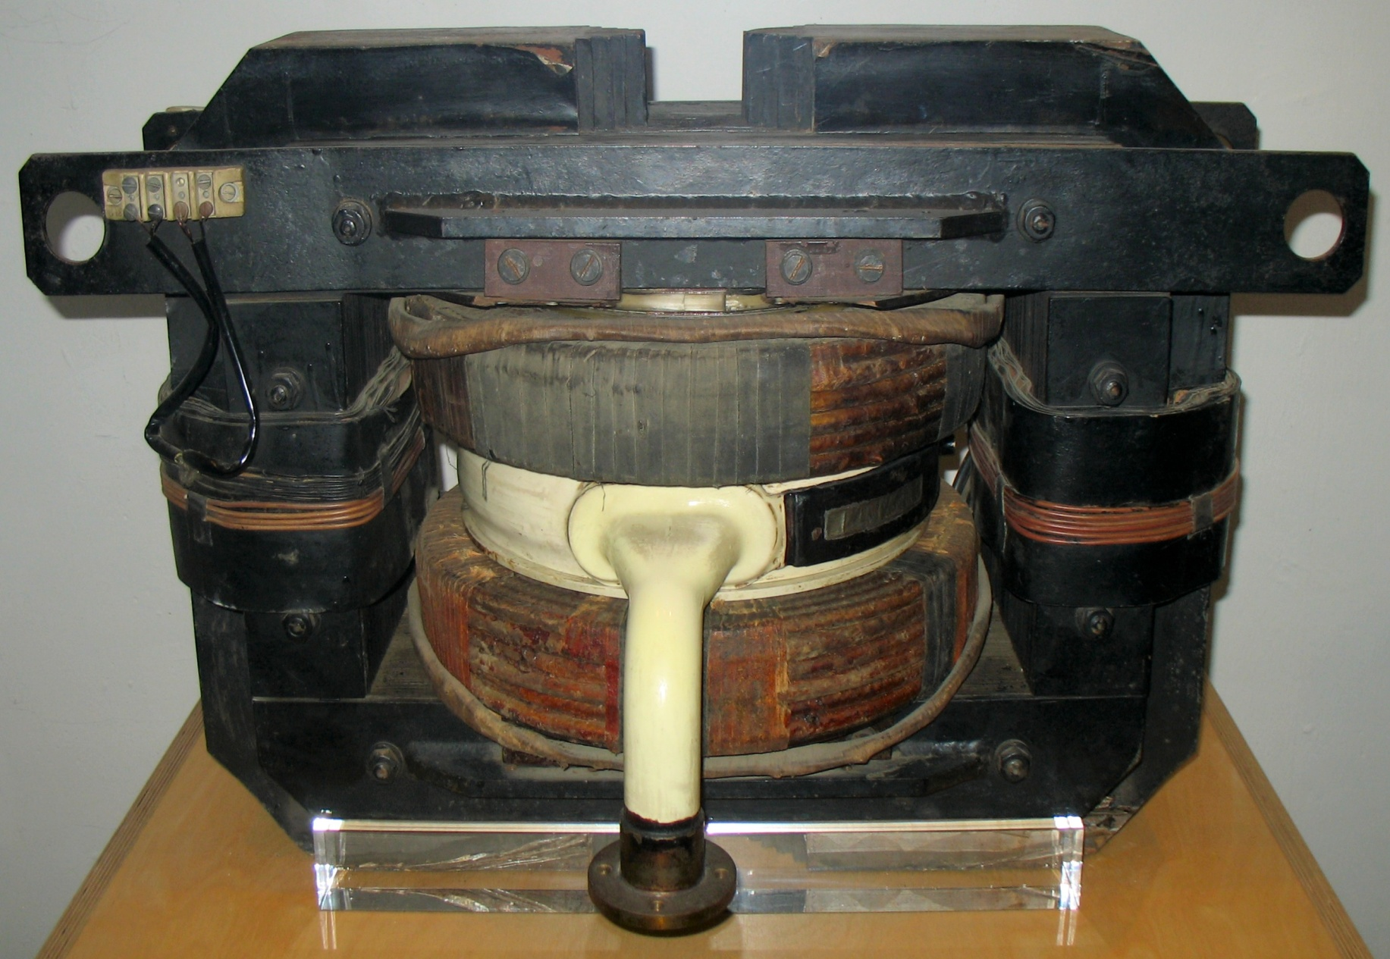
Betatron

