Slide 1
CHAPTER- IV
NUCLEAR
RADIATION
DETECTORS

Slide 2
POINTS TO BE STUDY
Classification of detectors
Geiger Muller counter
i. Construction and working
ii. Dead time, recovery time and resolving time
iii. Self quenching mechanism
Bubble chamber
Scintillation counter
Cloud chamber

Slide 3
CLASSIFICATION OF DETECTORS
Based on measuring discharge current due to ionization current
e.g. G M counter, proportional counter
B) Based on visualization of track of ions
e.g. bubble chamber, Cloud chamber
C) Based on Light emission
e.g. Scintillation counter, Cerenkov counter.

Slide 4
SCINTILLATION COUNTER
A scintillation counter is an instrument for detecting and measuring ionizing radiation by using the excitation effect of incident radiation on a scintillator material, and detecting the resultant light pulses.
It consists of a scintillator which generates photons in response to incident radiation, a sensitive photomultiplier tube (PMT) which converts the light to an electrical signal and electronics to process this signal.
Scintillation counters are widely used in radiation protection, assay of radioactive materials and physics research because they can be made inexpensively yet with good quantum efficiency, and can measure both the intensity and the energy of incident radiation.

Slide 5
PRINCIPALE
When high energetic α- particles strikes the screen coated with Zinc sulphide (ZnS), then flash of light i.e scintillations are emitted by the screen. These scintillations are converted into electric pulse by photomultiplier tube and then recorded and counted.
α- Particles Scintillations
ZnS

Slide 6
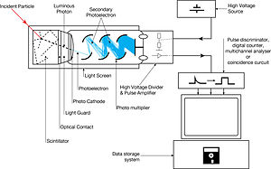
CONSTRUCTION

Slide 7
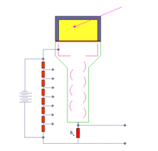

Slide 8
When an ionizing particle passes into the scintillator material, atoms are ionized along a track. For charged particles the track is the path of the particle itself. For gamma rays (uncharged), their energy is converted to an energetic electron via either thephotoelectric effect, Compton scattering or pair production. The chemistry of atomic de-excitation in the scintillator produces a multitude of low-energy photons, typically near the blue end of the visible spectrum. The number of such photons is in proportion to the amount of energy deposited by the ionizing particle. Some portion of these low-energy photons arrive at the photocathode of an attached photomultiplier tube. The photocathode emits at most one electron for each arriving photon by the photoelectric effect. This group of primary electrons is electrostatically accelerated and focused by an electrical potential so that they strike the first dynode of the tube. The impact of a single electron on the dynode releases a number of secondary electrons which are in turn accelerated to strike the second dynode. Each subsequent dynode impact releases further electrons, and so there is a current amplifying effect at each dynode stage. Each stage is at a higher potential than the previous to provide the accelerating field. The resultant output signal at the anode is in the form of a measurable pulse for each group of photons that arrived at the photocathode, and is passed to the processing electronics. The pulse carries information about the energy of the original incident radiation on the scintillator. The number of such pulses per unit time gives information about the intensity of the radiation. In some applications individual pulses are not counted, but rather only the average current at the anode is used as a measure of radiation intensity.
The scintillator must be shielded from all ambient light so that external photons do not swamp the ionization events caused by incident radiation. To achieve this a thin opaque foil, such as aluminized mylar, is often used, though it must have a low enough mass to minimize undue attenuation of the incident radiation being measured.
The article on the photomultiplier tube carries a detailed description of the tube's operation.

Slide 9
Geiger Muller counter (GM)
The Geiger counter is an instrument used for measuring ionizing radiation used widely in such applications as radiation dosimetry, radiological protection, experimental physics and the nuclear industry.
It detects ionizing radiation such as alpha particles, beta particles and gamma rays using the ionization effect produced in a Geiger–Müller tube; which gives its name to the instrument.
In wide and prominent use as a hand-held radiation survey instrument, it is perhaps one of the world's best-known radiation detection instruments.

Slide 10
The Geiger counter is an instrument used for measuring ionizing radiation used widely in applications such as radiation dosimetry,radiological protection, experimental physicsand the nuclear industry.
It detects ionizing radiation such as alpha particles, beta particles and gamma rays using the ionization effect produced in a Geiger–Müller tube; which gives its name to the instrument.^{[1]} In wide and prominent use as ahand-held radiation survey instrument, it is perhaps one of the world's best-known radiation detection instruments.
The original detection principle was discovered in 1908 at the Cavendish laboratory, but it was not until the development of the Geiger-Müller tube in 1928 that the Geiger-Müller counter became a practical instrument. Since then it has been very popular due to its robust sensing element and relatively low cost. However, there are limitations in measuring high radiation rates and theenergy of incident radiation.^{[2]}
Contents

Slide 11
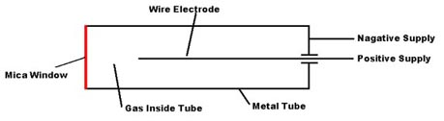
Basic components of GM tube.
A Geiger counter consists of a Geiger-Müller tube, the sensing element which detects the radiation, and the processing electronics, which displays the result.
The Geiger-Müller tube is filled with an inert gas such as helium, neon, or argon at low pressure, to which a high voltage typically 400-600 V is applied.

Slide 12
Principle of operation
A Geiger counter consists of a Geiger-Müller tube, the sensing element which detects the radiation, and the processing electronics, which displays the result.
The Geiger-Müller tube is filled with an inert gas such as helium, neon, or argon at low pressure, to which a high voltage is applied. The tube briefly conducts electrical charge when a particle or photon of incident radiation makes the gas conductive by ionization. The ionization is considerably amplified within the tube by the Townsend discharge effect to produce an easily measured detection pulse, which is fed to the processing and display electronics. This large pulse from the tube makes the G-M counter relatively cheap to manufacture, as the subsequent electronics is greatly simplified.^{[2]} The electronics also generates the high voltage, typically 400–600 volts, that has to be applied to the Geiger-Müller tube to enable its operation.

Slide 13
Geiger- Muller Counter ( Construction)
G-M Tube
P
K
P
Filter
Linear Amplifier
Voltage Discriminator
Scalar Circuit
A
-
R
Variable H.T Supply
+
Recorder
Or
Counter

Slide 14
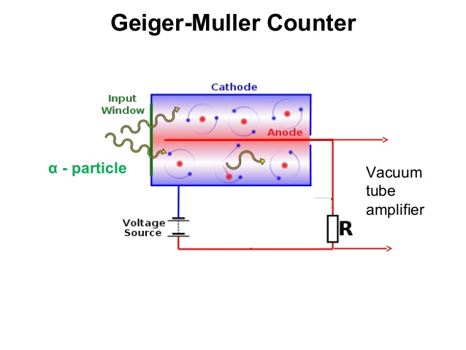

Slide 15
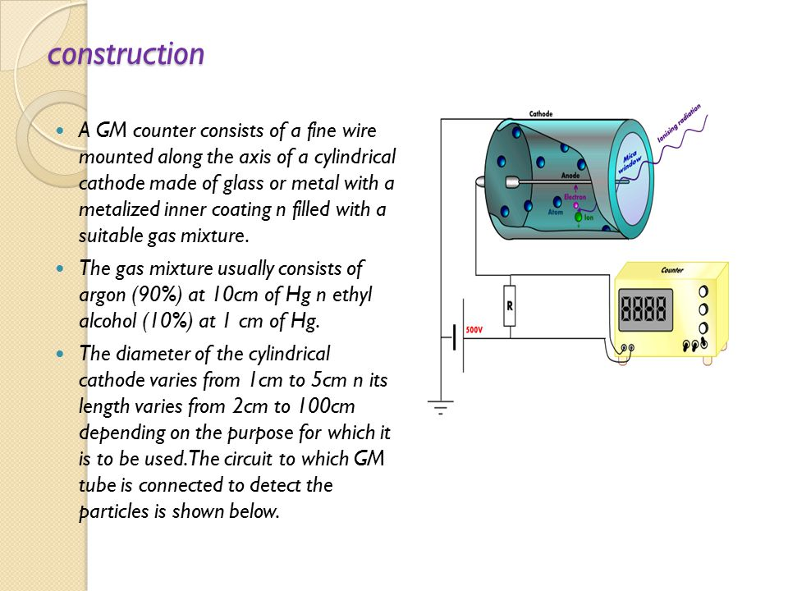

Slide 16
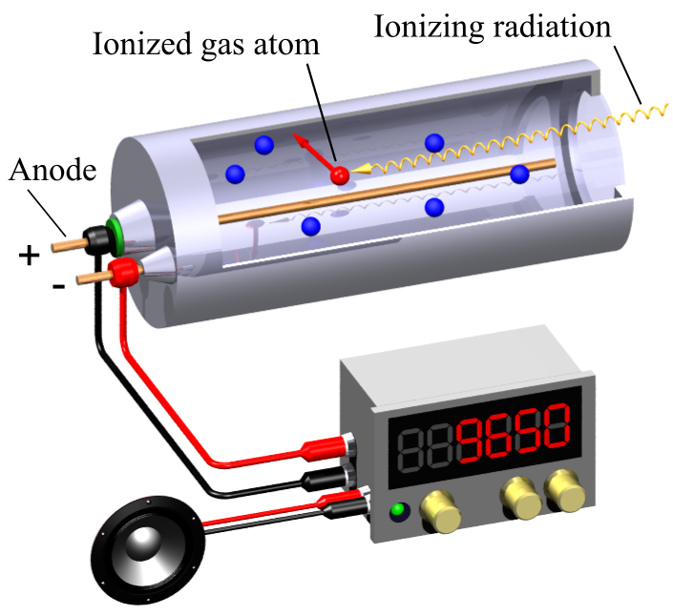
Principle of operation
When a single gamma or beta ray entering the tube, a small amount of ionization is produced.
The center electrode which is at high positive potential attracts the electrons and gives them energy to produce further ionization until the whole volume contains ion pairs.
The electrons are rapidly collected.
The voltage on the center electrode drops and the slow positive ions go to
the outer wall.
5. After 400µsec
(Dead time) the tube is
ready to repeat the
Process.

Slide 17
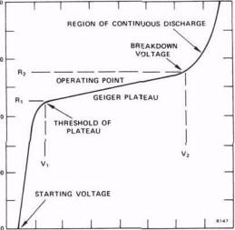

Slide 18
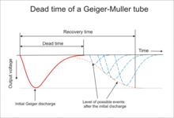

Slide 19
BUBBLE CHAMBER
A bubble chamber is a vessel filled with a superheated transparent liquid (most often liquid hydrogen) used to detect electrically charged particles moving through it. It was invented in 1952 by Donald A. Glaser,^{[1]} for which he was awarded the 1960 Nobel Prize in Physics.^{[2]} Supposedly, Glaser was inspired by the bubbles in a glass of beer; however, in a 2006 talk, he refuted this story, although saying that while beer was not the inspiration for the bubble chamber, he did experiments using beer to fill early prototypes.
Cloud chambers work on the same principles as bubble chambers, but are based on supersaturated vapor rather than superheated liquid. While bubble chambers were extensively used in the past, they have now mostly been supplanted by wire chambersand spark chambers. Historically, notable bubble chambers include the Big European Bubble Chamber (BEBC) and Gargamelle.

Slide 20
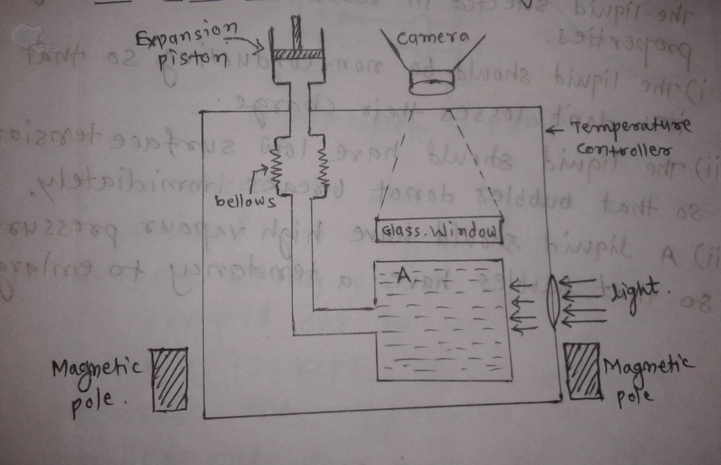
BUBBLE CHAMBER

Slide 21
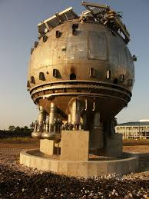
BUBBLE CHAMBER

Slide 22
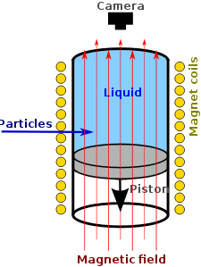

Slide 23
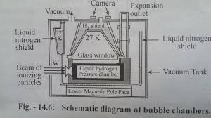

Slide 24
Cloud chamber
A Cloud Chamber, also known as a Wilson Cloud Chamber, is a particle detector used for visualizing the passage of ionizing radiation.
A cloud chamber consists of a sealed environment containing a supersaturated vapor of water or alcohol. An energetic charged particle (for example, an alpha or beta particle) interacts with the gaseous mixture by knocking electrons off gas molecules via electrostatic forces during collisions, resulting in a trail of ionized gas particles. The resulting ions act as condensation centers around which a mist-like trail of small droplets form if the gas mixture is at the point of condensation. These droplets are visible as a "cloud" track that persist for several seconds while the droplets fall through the vapor. These tracks have characteristic shapes. For example, an alpha particle track is thick and straight, while an electron track is wispy and shows more evidence of deflections by collisions.

Slide 25
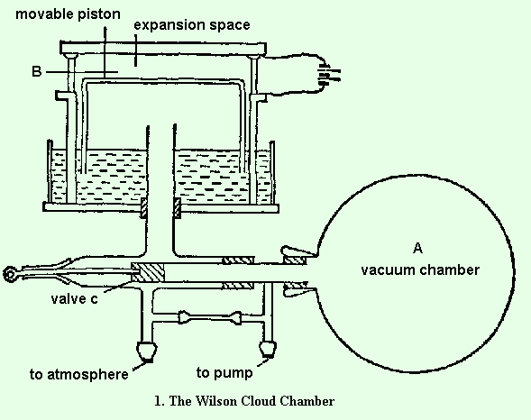
CLOUD CHAMBER

Slide 26
