Slide 1
ELEMENTARY PARTICLES
CHAPTER- VI

Slide 2
POINTS TO BE STUDY
6.1 Types of interactions
6.2 Classification of elementary particles
6.3 Properties of particles

Slide 3
Introduction to Elementary Particles
The branch of physics that deals with the property , Interaction and structure of elementary particles is known as particle physics. Elementary particles are the fundamental constituent of all the matter in this universe. These microscopic scale particles plays an important role in this universe. So, elementary particles are the building blocks of the universe.
The analysis of elementary particles are done in terms of their mass, spin, magnetic moment and interaction properties.
There are more than 100 elementary particles discovered so far.

Slide 4
TYPES OF INTERACTIONS
To understand the behavior of elementary particles, it is important to understand nature of interactions between them.
There are four types of interactions.
Gravitational Interaction.
Electromagnetic Interaction.
Weak Nuclear Interaction.
Strong Nuclear Interaction.

Slide 5
GRAVITATIONAL INTERACTION
It is weakest interaction acts between all bodied having mass. It is described by Newton’s law of gravitation.
The gravitational force acting between two particles of masses m₁ and m₂ is expressed as
m₁m₂
F = G
r²
Where ‘r’ is distance between center of masses and ‘G’ is gravitational constant. The nature of interaction is attractive and it is due to inertia of the particles.
It does not depends upon velocity and orientation of masses.
It’s range extends to infinity
It is responsible for motion of planets.
It is the weakest of the four fundamental interactions of nature. The gravitational attraction is approximately 10⁻³⁹ times the strength of the strong nuclear interaction

Slide 6
ELECTROMAGNETIC INTERACTION
It is charge dependent interaction hence it operates on charge particles.
It provides atomic and nuclear binding forces.
It is of long range interaction and described by Coulomb's Inverse Square law.
Proton acts as field particle of this interaction.
The electromagnetic interaction is weaker than the strong interaction, but stronger than the weak and gravitational interactions.
It is associated with electric and magnetic fields and is responsible for atomic structure, chemical reactions, the attractive and repulsive electromagnetic forces associated with electrically charged particles

Slide 7
WEAK NUCLEAR INTERACTION
Such type of interaction was described by Fermi in 1938 to explain β- decay and weak decay of elementary particles like pions, k-meson and some hyperons.
It is very short range force about 10⁻¹² meter

Slide 8
STRONG NUCLEAR INTERACTION
It is strongest force in nature. It is responsible for holding protons and neutrons together in nucleus.
Hence it occurs between two protons or two neutrons or between proton and neutron.
It is charge independent interaction.
It’s time of interaction is about 10⁻²³ sec.
It is of short range force about 10⁻¹⁴ to 10⁻¹⁵ m.

Slide 9
Classification and Properties of Elementary Particles
Elementary particles are classified on the basis of their nature and properties. They are classified on the basis of mass, charge, average lifetime, spin, interaction etc.
The elementary particles mainly classified into three categories.
Photons
Leptons
Hadrons
These names are taken from Greek.
In Greek hadrons means bulky. Leptons means light in weight.

Slide 10
Photons
Photons represents quantum of radiations having energy E=hγ ,where h is Plank’s constant and γ is frequency.
They travels with velocity of light.
They have stable, neutral and zero rest mass.
They have spin equal to one.
They obey’s Bose-Einstein Statistics hence they are called Bosons.
Photons can be created and destroyed.
It is the force carrier for electromagnetic Interaction

Slide 11
B) Leptons
Leptons means light in weight. They obey’s Fermi-Dirac Statistics hence called Fermions.
They have spin equal to ½.
There are six leptons in total; the three charged leptons are called "electron-like leptons", while three neutral leptons are called "neutrinos". namely
Electrons (е)
Muons (μ)
Tauons (τ)
Electron Neutrino (γe)
Muon Neutrino (γμ)
Tauon Neutrino (γτ)

Slide 12
i) Electron is first elementary particle discovered by J.J Thomson. They have negative charge. They have stable and spin equal to ½. The mass of an electron is approximately 9.109×10⁻³¹kg. It has charge equals to -1.6 × 10¹⁶C.
ii) Muons are first discovered in cosmic rays. They have charge -1. They have spin equal to ½. The muon is an unstable subatomic particle with a mean lifetime of 2.2 µs. Muons have a mass about 207 times that of the electron.
iii) Tauons have recently discovered. It similar to the electron, with negative electric charge and a spin of 1/2. Tau leptons have a lifetime of 2.9×10⁻¹³ s

Slide 13
iv) All three neutrinos are stable, no charge and spin equal to ½. Each neutrino also has a corresponding antiparticle, called an antineutrino. Neutrinos can be created in several ways, including in certain types of radioactive decay.

Slide 14
c) Hadrons
Hadrons are defined as strongly interacting composite particles. Hadrons are further classified as
Mesons and
Baryons.
a)Mesons : Meson means medium in mass. Mesons are unstable subatomic particles composed of one quark and one antiquark with the longest-lived lasting for only a few hundredths of a microsecond.
Mesons includes
Pions ( π⁺ ,π⁻ ,π⁰)
Kaons ( k⁺, k⁻, k⁰)
η-Mesons.

Slide 15
Pions ( π-Mesons):
Pions have three subatomic particles: π⁰, π⁺, and π⁻. Each pion consists of a quark and an antiquark Pions are the lightest mesons because they are composed of the lightest quarks They are unstable, with the charged pions π⁺ and π⁻decaying with a mean lifetime of 26 nanoseconds (2.6×10⁻⁸ seconds), and the neutral pion π⁰ decaying with a much shorter lifetime of 8.4×10⁻¹⁷ seconds. Charged pions most often decay into muons and muon neutrinos, while neutral pions generally decay into gamma rays.

Slide 16
ii) Kaons ( k-Meson):
They exists in three states k⁺, k⁻, k⁰ . they discoved in cosmic rays in 1947. They are unstable. Their mean life is about 10⁻⁸ sec.
iii) η-Mesons:
They have no charge.
They are heavier in mesons.
They are unstable
Their mean life is about 10⁻¹⁸ sec.

Slide 17
b) Baryons:
The baryons means ‘heavy’. A baryon is a composite subatomic particlemade up of three quarks. Baryons belong to the hadron family of particles. They have spin ½.
They includes,
I) Nucleons
II) Hyprons
III) Resonances.

Slide 18
I) Nucleons:
Nucleon is one of the particles that makes up the atomic nucleus. Each atomic nucleus consists of one or more nucleons, and each atom in turn consists of a cluster of nucleons surrounded by one or more electrons.
They have spin ½.
There are two known kinds of nucleon: the neutron and the proton.
i) Neutron:
The neutron is a subatomic particle, symbol n , with no net electric charge and a mass slightly larger than that of a proton.
The number of neutrons in nucleus = Mass number – Atomic number.

Slide 19
ii) Protons:
A proton is a subatomic particle, symbol p , with a positive electric charge of +1e elementary charge and mass slightly less than that of a neutron.
The number of protons in atomic nucleus are equal to atomic number of atom.
II) Hyperons:
They are unstable and spin equal to ½.They are discovered in cosmic rays. They are fermions. Their rest mass is greater than nucleons.
They includes
Sigma( Σ⁺ ,Σ⁻ ,Σ⁰ ) ,
Omega (Ω),
cascade ([-]⁻ ,[-]⁰ ) and
Lambda(λ).

Slide 20
III)Resonance:
The resonance particles, or resonances, is that they are extremely short lived particles. The lifetime of these particles is of the order of 10⁻²³ seconds. Traveling at the speed of light, these particles could only travel about 10⁻¹⁵ meters, or about the diameter of a proton, before decaying.

Slide 21
Elementary Particles
Photon Leptons Hydrons
Electron Muon Tauons Neutrinos
Electron Neutrinos Muon Neutrinos Tauons Neutrinos
Mesons Baryons
π- Mesons η - Mesons k – Mesons Nucleons Hyperons Resonances
π⁺ π⁻ π⁰ Proton Neutron
k⁺ k ⁻ k ⁰ Sigma(Σ) Omega (Ω) cascade ([-]) Lambda(λ)
Σ⁺ Σ⁻ Σ⁰ [-]⁻ [-]⁰

Slide 22
Quarks
A quark is an elementary particle and a fundamental constituent of matter. Quarks combine to form composite and neutrons.
Quarks have various intrinsic properties, including electric charge, mass, color charge, and spin.
There are six types of quarks, known as :up, down, strange, charm, top,and bottom.

Slide 23
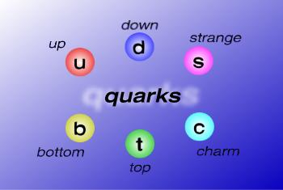
Quarks

Slide 24
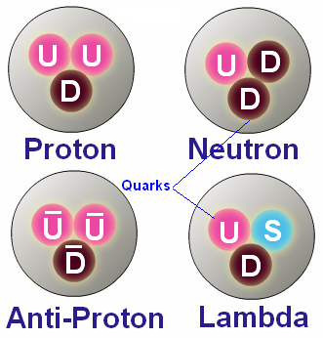
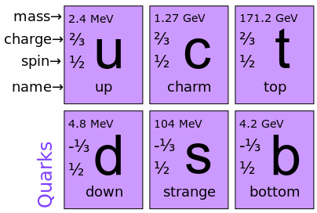
Quarks

Slide 25
Thank You
BEST OF LUCK FOR EXAMINATION

