Slide 1
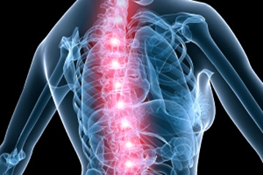
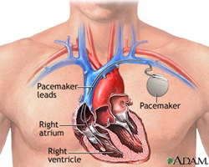
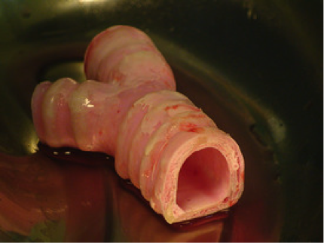
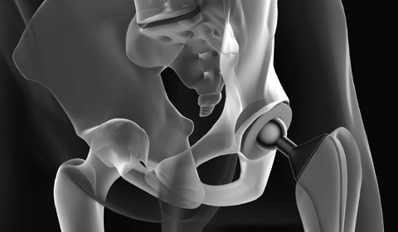
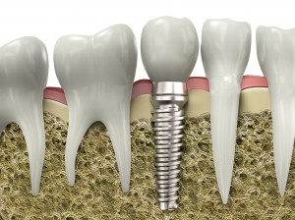
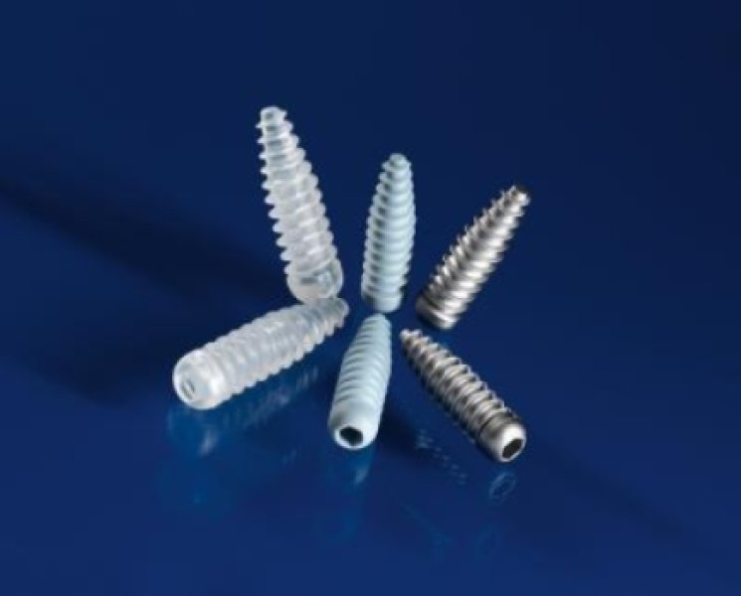
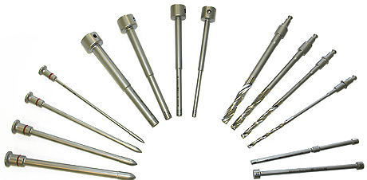
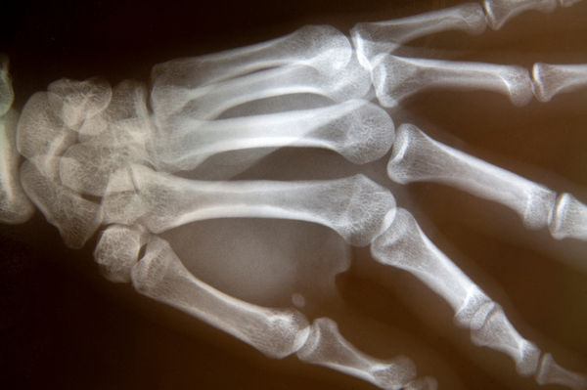
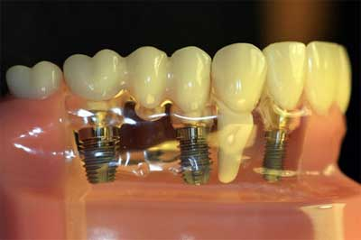
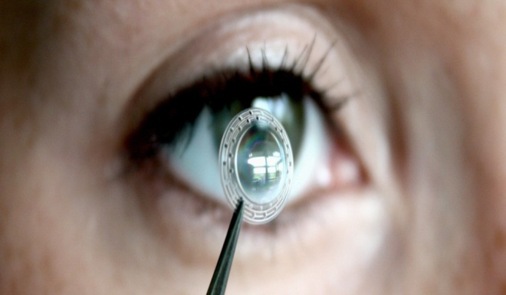
Chapter-6 : Biomaterials

Slide 2
Introduction
The materials which are used for structural applications in the field of medicine are called Biomaterials.
Such materials are used to replace the damaged or diseased body parts in human or animal bodies. This is possible because the mechanical, physical and chemical properties of biomaterials are comparable with that of host body.

Slide 3
BIOMECHANISM
The implants that are used for the improvement in the quality of the life producing new biomaterials. The implant materials react with tissues in different ways depending on material type. Thus , the tissue attachment mechanism depends on the response of tissue to the implant surface. In general , one can classify the mechanism as inert and bioactive. The inert materials such as titanium, alumina are nearly chemically inert in the body and show minimum chemical interactions with adjacent tissues. The bioactive materials such as glass, ceramics contains oxides of silicon, sodium, calcium forms chemical bonds with living bone leading to strong mechanical implant bone bond

Slide 4
CLASSIFICATION OF BIOMATERIALS
The biomaterials which finds applications in the field of medicine are classified as.
Metals and Alloys
Glass and Glass- Ceramics
Polymers
Composites
In some cases single material mentioned above can not fulfills the requirement of specific application. In such cases combinations of more than one material are required.

Slide 5
METALS AND ALLOYS
The pure metals like gold, silver and copper were used for different medical applications. The use of above metals were restricted due to the poor surgical conditions. To overcome this difficulty the alloys such as 316L stainless steel, Co-Cr and Ti-6Al-4V have been developed for orthopedic applications. These materials are fixed to the bones by mechanical interlocking and they do not form any chemical bonds with the living bones . Now a days above materials are coated with bioactive glasses and glass- ceramics to make them bioactive with natural bones and to increase mechanical strength.

Slide 6
BIOACTIVE GLASSES AND GLASS CERAMICS
These biomaterials plays important role as bone repairing materials in the field of medicine. They provides chemical and mechanical environment for bone tissue attachment . All bioactive glasses and glass ceramics bond with the living bones through the formation of layer on the surface of living bones. The surface forms a biologically active hydroxyl carbonate apatite (HCA)layer, which provides the bonding interface with natural tissues. The materials such as glasses, glass ceramics, metals polymers and composite cements can form HCA layer and hence bond with living bone and are known as bioactive materials.

Slide 7
POLYMERS
The common polymers that are used in biomedical fields are linear chains of repeating subunits. The properties of these polymers depend on the chemical structure and macromolecules of the polymer chains. The change in the properties of polymers plays important role in different medical applications. These polymers are biodegradable. When it is implanted within the human body, the polymer is gradually absorbed by the human body which regenerates tissues. The polymers which are used in medical field are polyactide acid, polyglycolic acid and their copolymers.

Slide 8
COMPOSITES
The use of composite technology produces a wide range of biomaterials namely biocomposites that improve the quality of life of many people. The ceramic materials alone do not possess the required mechanical properties to replace the natural bone. Therefore in order to increase the strength of biomaterials the reinforcement of bioactive glasses to polymers leads production of biocomposite materials. The stiffness of biocomposite materials is very close to that of natural bone, hence they finds wide applications in medical industries.

Slide 9
Skin/cartilage
Drug Delivery Devices
Ocular implants
Polymers
Orthopedic screws/fixation
Bone replacements
Heart valves
Metals
Synthetic BIOMATERIALS
Ceramics
Dental Implants
Dental Implants
Semiconductor Materials
Biosensors
Implantable Microelectrodes

Slide 10
PROCESSING OF BIOMATERIALS
In order to use biomaterials for different biomedical applications the biomaterials are prepared by conventional techniques.
The tanning operations on skin of animal produces leather which was used as clothing b ancient man and today it was used for making belts, boxes, purses, shoes etc. Tanning is used for preserving leather. Two tanning techniques are used .
1. Vegetable Tanning: In this method skin is preserving in tanning liquor for many days and then drying to produce leather.

Slide 11
2. Chrome tanning: In this method skin is inserted in acidic solution and then revolving in a drum which contains chromium salt solution and finally leather is dried and rolled.
Bones of animals are used to make tools and weapons. They are laminated with organic substances.
Bones and teeth are made from naturally formed ceramic known as hydroxyapatite.

Slide 12
PROPERTIES OF BIOMATERIALS
In order to use biomaterials for different biomedical applications, the study of properties and their interaction with the natural tissues are very important.
The mechanical properties of biomaterials such as fracture strength, compressive strength, fracture toughness, elastic modulus etc. are taken into consideration while processing the biomaterials.
The evaluation of properties and their relations with natural tissues will help to study the biocompatibility of biomaterials for proper orthopaedic and dental restoration applications.
Physical Requirements
  Hard Materials.
  Flexible Material.
Chemical Requirements
  Must not react with any tissue in the body.
  Must be non-toxic to the body.
  Long-term replacement must not be biodegradable.

Slide 13
PROPERTIES OF BIOMATERIALS
Biomaterials have hard and flexible.
They do not react with tissues in the body.
  3. They must be non-toxic to the body.
  4. Biomaterial has similar deformable properties with the material it is going to replace.
  5. Biomaterial hardness is desirable as equal to bone hardness.
  6. They have high fracture toughness.

Slide 14
APPLICATIONS OF BIOMATERIALS
Following are some applications of biomaterials in medical fields.
1. The biomaterials are used for productions of Heart Valve, Artificial Tissue, Dental Implants etc.
2. The biomaterials such as Silicone-acrylate, hydro gel etc. are used for production of contact lenses.
3. Teflon, Dacron, Polyurethane are used for blood vessels.
4. Titanium, alumina, calcium phosphate are used for dental implants.
5. Titanium, stainless steel, polyethylene are used for joint replacement.
6. Polyurethane is used for artificial heart.

Slide 15
APPLICATIONS OF BIOMATERIALS
7. Stainless steel, Co-Cr alloy are used for production of bone plates.
8. Cellulose, polyacrylonitrile are used for artificial kidney.
9. Biomaterials are used in: Joint replacements, Bone cement, Blood vessel Skin repair devices (artificial tissue) Drug delivery mechanisms, surgical instrumrnts etc.
10. Biocomposites are used for coupling of dental filler materials.
11. Bioceramics are used for production of synthetic bones.

Slide 16
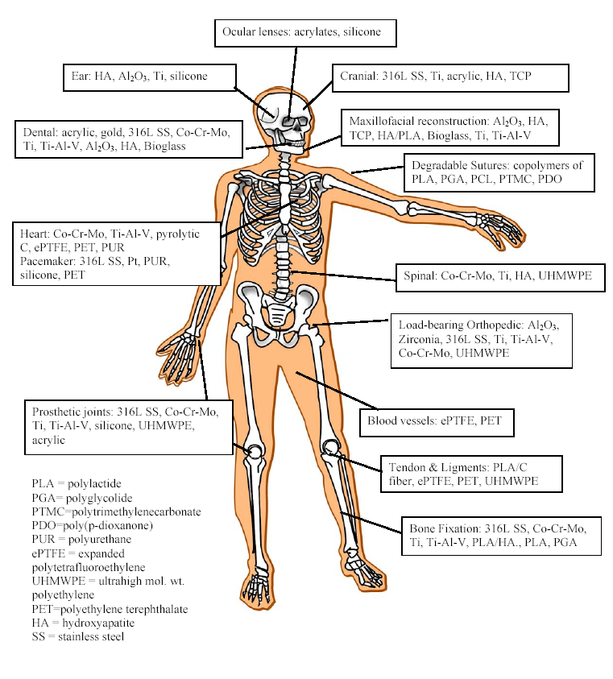
Biomaterial Science
Notes:
Biomaterials cover all classes of materials which includes metals, ceramics, and silicone. This diagram shows some examples of where certain types of materials can be used. For example ….

