Slide 1
CHAPTER NO. 3
CERAMIC MATERIALS

Slide 2
Introduction
The word “ceramic” comes from Greek word “keramos” means pottery.
The ceramics are inorganic non metallic solid materials with varying properties due to their difference in bounding and structure. Ceramics usually consists of metallic and non metallic elements bounded by ionic and covalent bonds.
The ceramics are generally hard, brittle, poor conductivity, high melting point, resistant to creep, low toughness, low ductility etc. They are good electrical and thermal insulators due to absence of free electrons.
Ceramics includes clay articles, silicate, metallic oxides and their combinations, pottery objects. New ceramic materials were developed for use in advanced ceramic engineering, such as in semiconductors.

Slide 3
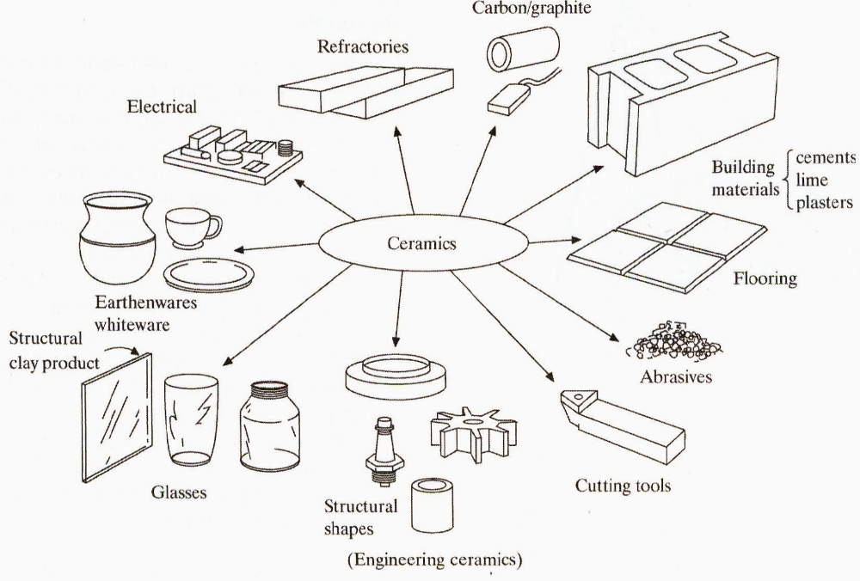
Spectrum of Ceramics Uses
http://www.ts.mah.se/utbild/mt7150/051212%20ceramics.pdf
06.01.2018

Slide 4
CLASSIFICATIONS OF CERAMICS
Ceramic materials can be classified into following basic groups, according to their fields of use.
1) Structural Ceramics : The ceramic materials that are used for constructing buildings and other various structures are called structural ceramics.
e.g. Bricks, floors, pipes, roof tiles etc.
2) Facing ceramic materials: Such ceramic materials are used for internal and external facing of building and structures.
e.g. Facing bricks, tiles, slabs etc.
3) Refractorie’s ceramics: These are ceramic materials whose mechanical properties at high temperatures do not changes.
These materials are used in ovens for making various parts in industries. Also used for lab furnaces, ovens and apparatus for operating at high temperature.
4) Fine ceramics: They are used domestically in electrical appliances and in laboratories.
e.g. Dishes, wash basins, porcelain wares, chemical wares glassed pottery sanitary wares etc.

Slide 5
CLASSIFICATIONS OF CERAMICS
Special ceramics: Ceramics belonging to this class have specific properties hence they are used in instrument manufacture, radio industries etc.
Ceramics are also classified in two categories on the basis of characteristic properties and applications of ceramic materials in many fields they are
Traditional ceramics
Advanced / Modern or technical ceramics.
Traditional ceramics
Traditional ceramics are composed of three naturally occuring basic components clay, silica and feldspar. The structure of clay is plate like. It is hydrated compound of alumina, silicate minerals. This clay like structure of clay provides strength after converting into ceramic products such as bricks, tiles, porcelain, sanitary wares etc.

Slide 6
Traditional ceramics
At a temperature about 1000ºC, alumina and silica mixture forms mullite ( 3Al₂O₃2SiO₂) which is stable compound.
Second compound silica is used in ceramic industries in the form of sand, sand stone, quartz.
Third compound feldspar is basically potash ( K₂OAl₂O₃6SiO₂) and soda ( Na₂OAl₂O₃6SiO₂) which is common minerals.
In traditional ceramics, the mined raw materials are converted into small particles either by milling or grinding. Then powder of desired size of ceramics is obtained by sizing or screening. The powders are then well mixed usually with water and additives to import flow characterizations before melting.

Slide 7
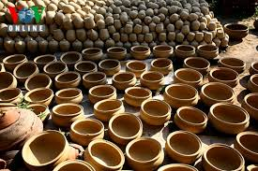
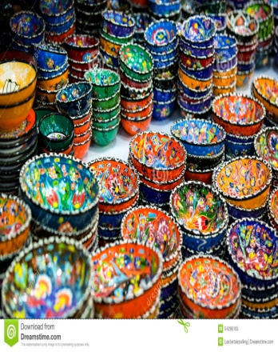
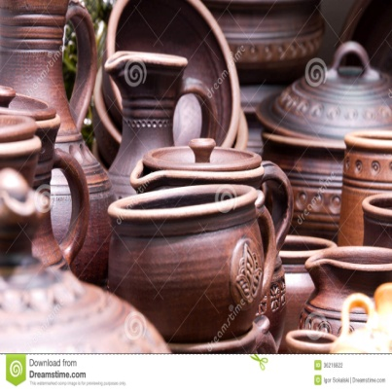
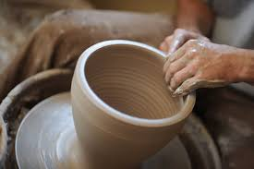
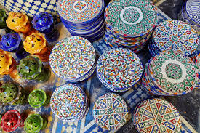
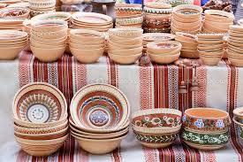
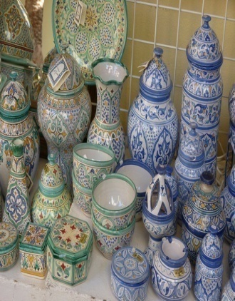
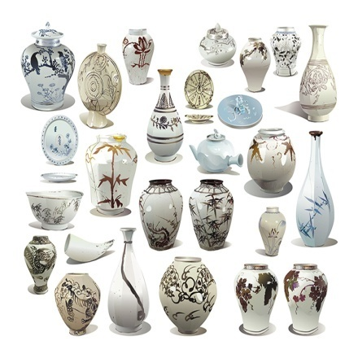
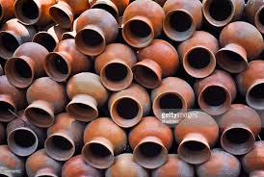
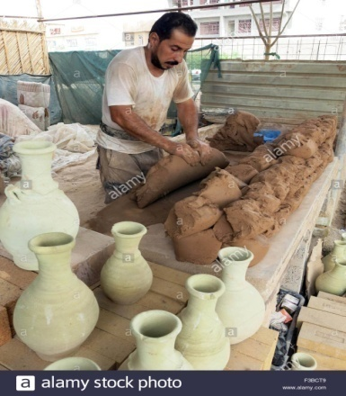
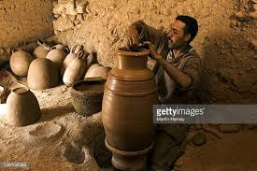
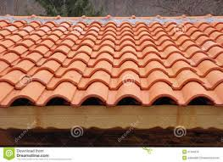
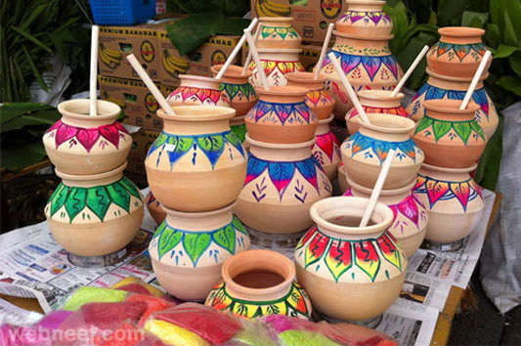
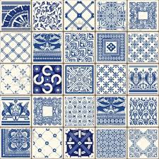
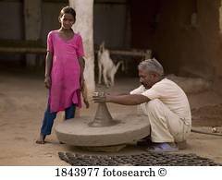
Traditional ceramics

Slide 8
Modern Ceramics
Modern ceramics widely used for industrial applications such as in the field of electronics, communications, medicines, transportations, optics, energy conversion and construction. Here ceramic material is made by objects from inorganic, non-metallic materials by the action of heat.
The modern ceramics are pure compounds such as magnesium oxide, aluminium oxide, barium titanate, silicon carbide and silicon nitrate. Thus starting materials for the modern ceramics are synthesized by chemical reactions.
The examples of modern ceramics are Al₂O₃, MgO,ZrO₂, BeO, SiO₂, MgAl₂O₄, BaTiO₃ etc.

Slide 9
Classification of Ceramics
Ceramic Materials
Glasses
Clay
Refractories
Abrasives
Cements
Advanced
products
ceramics
-optical
-whiteware
-bricks for
-sandpaper
-composites
-engine
-
composite
-
structural
high T
-
cutting
-
structural
rotors
reinforce
(furnaces)
-
polishing
valves
-
containers/
bearings
household
Adapted from Fig. 13.1 and discussion in Section 13.2-8, Callister & Rethwisch 8e.
-sensors

Slide 10
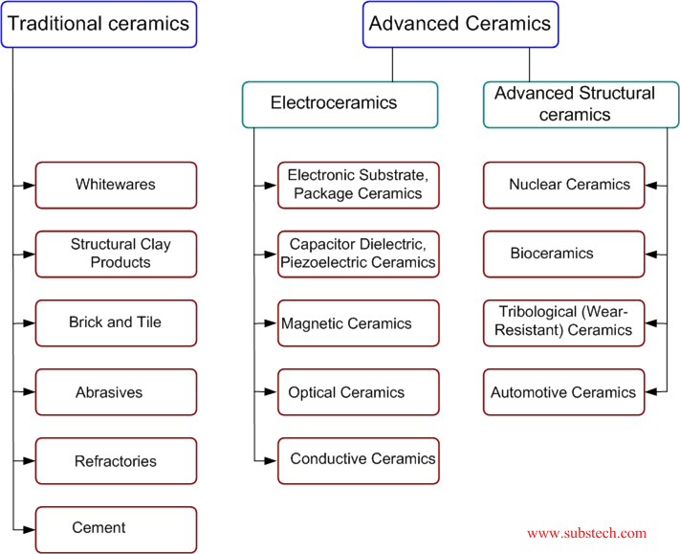
Classification of ceramics
06.01.2018

Slide 11
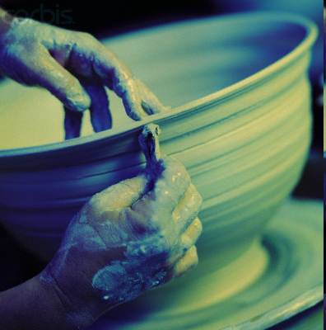
Classification of ceramics
Traditional Ceramics
the older and more generally known types (porcelain, brick, earthenware, etc.)
Based primarily on natural raw materials of clay and silicates
Applications;
building materials (brick, clay pipe, glass)
household goods (pottery, cooking ware)
manufacturing ( abbrasives, electrical devices, fibers)
Traditional Ceramics

Slide 12
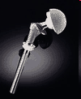
Classifications of ceramics
Advanced Ceramics
have been developed over the past half century
Include artificial raw materials, exhibit specialized properties, require more sophisticated processing
Applied as thermal barrier coatings to protect metal structures, wearing surfaces,
Engine applications (silicon nitride (Si3N4), silicon carbide (SiC), Zirconia (ZrO2), Alumina (Al2O3))
bioceramic implants

Slide 13
Classification of ceramics
CERAMICS
Oxides
Nonoxides
Composite
Oxides: Alumina, zirconia
Non-oxides: Carbides, borides, nitrides, silicides
Composites: Particulate reinforced, combinations of oxides and non-oxides

Slide 14
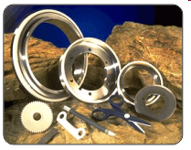
Classification of ceramics
Oxide Ceramics:
Oxidation resistant
chemically inert
electrically insulating
generally low thermal conductivity
slightly complex manufacturing
low cost for alumina
more complex manufacturing
higher cost for zirconia.
zirconia

Slide 15
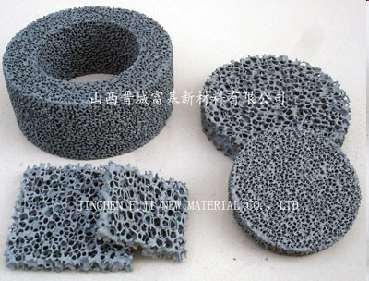
Classification of ceramics
Non-Oxide Ceramics:
Low oxidation resistance
extreme hardness
chemically inert
high thermal conductivity
electrically conducting
difficult energy dependent manufacturing and high cost.
Silicon carbide cermic foam filter (CFS)
http://images.google.com.tr/imgres?imgurl=http://www.made-in-china.com/image/2f0j00avNtpdFnLThyM/Silicon-Carbide-Ceramic-Foam-Filter-CFS-.jpg&imgrefurl

Slide 16
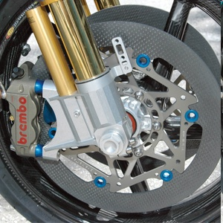
Classification of ceramics
Ceramic-Based Composites:
Toughness
low and high oxidation resistance (type related)
variable thermal and electrical conductivity
complex manufacturing processes
high cost.
Ceramic Matrix Composite (CMC) rotor
http://images.google.com.tr/imgres?imgurl=http://www.oppracing.com/images/cmsuploads/Large_Images/braketech%2520cmc%2520rotor%2520oppracing%2520cbr1000rr.jpg&imgrefurl

Slide 17
Structures of Ceramics
Most of ceramics have crystalline structures. They are made by two or more elements. Structure of ceramics is complex than metals. The ceramic material is formed due to ionic bonding between two elements resulting Columbic force of attraction between negatively charged ( non-metal) ions called anions and positively charged (metal) ions called cations.
The cations and anions are formed respectively due to loss of valence electrons from the metallic elements and conversions of non-metallic elements.
Following are the structures of the technical ceramic compounds.
Rock Salt ( NaCl) Structure.
Cesium Chloride Structure.
Zinc blend Structure.
Perovskite Structure.

Slide 18
Rock Salt ( NaCl) Structure
In Rock salt, Sodium atom losses its valance electron and acquire positive charge. While chloride atom has acquired the electron lost by Sodium atom resulting chlorine ion. Both Na⁺ and Cl⁻ ions attract each other because of electrostatic force and forms NaCl crystal. Unit cell of NaCl is as shown below.

Slide 19
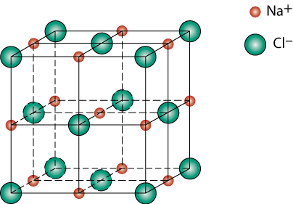
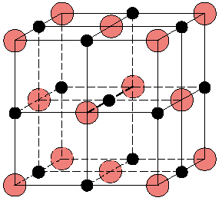
Rock Salt Structure( NaCl)
r_{Na} = 0.102 nm
r_{Cl} = 0.181 nm
r_{Na}/r_{Cl} = 0.564
cations (Na⁺) prefer octahedral sites
Adapted from Fig. 12.2, Callister & Rethwisch 8e.

Slide 20
Rock Salt ( NaCl) Structure
Each cation and anion has six neighbours hence it has six co-ordination number. The unit cell of NaCl crystal has FCC arrangement of anions with one cation at centre of each 12 cube edges. The compounds that are crystallize with NaCl structure includes refractory carbides and nitrates of titanium zirconium. The important ceramic compounds displaying the NaCl structure is MgO. The Na+ ions are replacing by Mg²⁺ ions and Cl ions are replaced by O²⁻ ions. As the result the properties of MgO in NaCl structure such as melting point, hardness increases which leads to many industrial applications. E.g. MgO is used as good insulating material at elevated temperatures in electric stoves and ovens. It is also used in steel plant furnaces as a refractory material. It has zero porosity and high optical transparency hence it is used in infrared transmission.

Slide 21
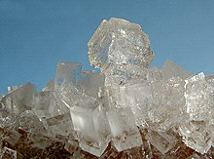
Sodium chloride

Slide 22

MgO and FeO
MgO and FeO also have the NaCl structure
O²⁻ r_{O} = 0.140 nm
Mg²⁺ r_{Mg} = 0.072 nm
r_{Mg}/r_{O} = 0.514
cations prefer octahedral sites
So each Mg²⁺ (or Fe²⁺) has 6 neighbor oxygen atoms

Slide 23
Cesium Chloride (CsCl) structure
The unit cell of CsCl crystal has two interpenetrating simple cubic lattices. The corners of one sub-lattice is the body centre of the another one sub-lattice is occupied by Cs ions while the other by Cl ions. The resultant structure of Cesium Chloride is shown below.
There are eight ions at cube corners and one cation at centre of cube which forms simple cubic structure. The co-ordination number is eight.

Slide 24
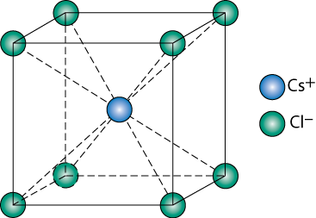
CsCl Crystal Structures
∴ Since 0.732 < 0.939 < 1.0,
cubic sites preferred
So each Cs⁺ has 8 neighbor Cl⁻

Slide 25
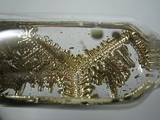
High-purity caesium-133 stored in argon.

Slide 26
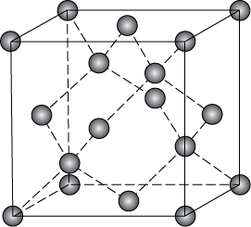
Zinc Blend ( ZnS) Structure
Zinc Sulphide crystal structure is formed when two face centred cubic sub-lattices are occupied by different elements. It has FCC structure of S with Zn at interior tetrahydral positions. The co-ordination number is four. Unit cell of Zinc Blend is as shown below.

Slide 27
Perovskite ( CuTiO₃) Structure
The structure of CuTiO₃ is known as perovskite structure as shown below.
The substitution of barium in place of calcium forms very important technical ceramics BaTiO3 which has applications in radios, televisions because it increases dielectric constants due to the large dipole moments.

Slide 28
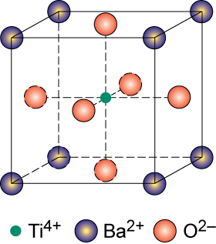
Perovskite Structure
complex oxide
BaTiO₃

Slide 29
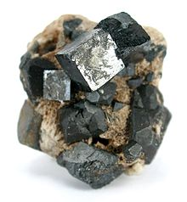
Perovskite

Slide 30
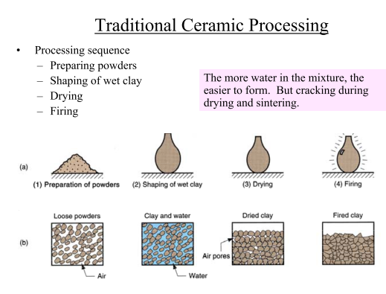
06.01.2018

Slide 31
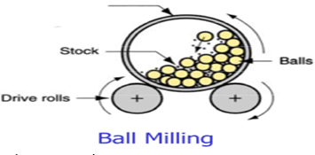
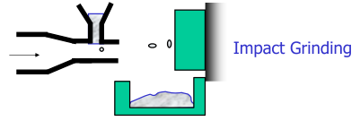
Preparation of Raw Materials
Crushing & Grinding (to get ready ceramic powder for shaping)
06.01.2018

Slide 32
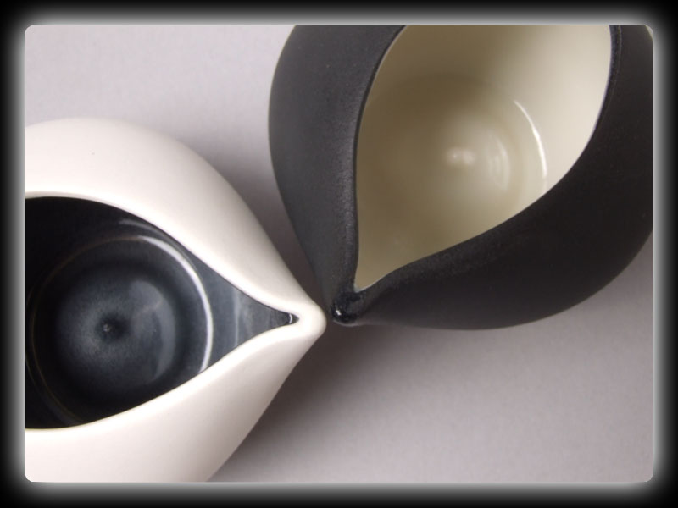
Powder processing
Ceramic powder is converted into a useful shape at this step.
Processing techniques
  Tape casting
  Slip casting
  Injection molding
http://janereynoldsceramics.co.uk/images/ceramic1.jpg
06.01.2018

Slide 33
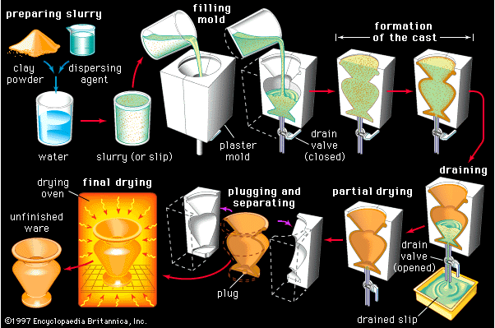
Slip casting
A suspension of seramic powders in water , slip, is poured into a porous plaster mold
Water from the mix is absorbed into the plaster to form a firm layer of clay at the mold surface

Slide 34
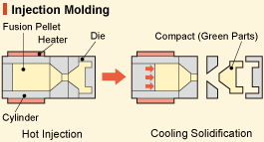
http://global.kyocera.com/fcworld/first/process06.html
Raw materials are mixed with resin to provide the necessary fluidity degree.
Then injected into the molding die
The mold is then cooled to harden the binder and produce a "green" compact part (also known as an unsintered powder compact).
06.01.2018

Slide 35

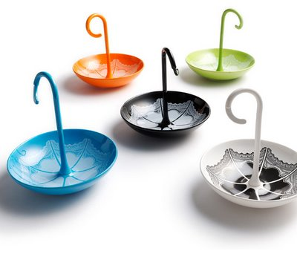
Difference between casting and molding
Slip Casting
Mixed raw materials are combined with solvating media and a dispersant
Then fed into an absorbent die.
The materials are dehydrated and solidified
Injection molding
raw materials are mixed with resin.
Then fed injected into the molding die
The mold is then cooled to harden the binder.

Slide 36
Drying process
Water must be removed from clay piece before firing
Shrinkage is a problem during drying. Because water contributes volume to the piece, and the volume is reduced when it is removed.
06.01.2018

Slide 37
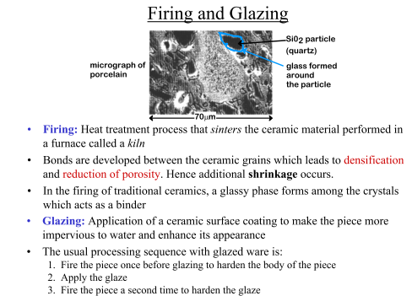
06.01.2018

Slide 38
Ceramic Processing

Slide 39
Properties of Ceramics
Extreme hardness
– High wear resistance
– Extreme hardness can reduce wear caused by friction
Corrosion resistance
Heat resistance
– Low electrical conductivity
– Low thermal conductivity
– Low thermal expansion
– Poor thermal shock resistance
06.01.2018

Slide 40
Properties of Ceramics
Low ductility
– Very brittle
– High elastic modulus
Low toughness
– Low fracture toughness
– Indicates the ability of a crack or flaw to produce a catastrophic failure
Low density
– Porosity affects properties
High strength at elevated temperatures
06.01.2018

Slide 41
General Comparison of Materials
Property Ceramic Metal Polymer
Hardness Very High Low Very Low
Elastic modulus Very High High Low
Thermal expansion High Low Very Low
Wear resistance High Low Low
Corrosion resistance High Low Low
06.01.2018

Slide 42
General Comparison of Materials
Property Ceramic Metal Polymer
Ductility Low High High
Density Low High Very Low
Electrical Depends High Low
Conductivity on material
Thermal Depends High Low
Conductivity on material
Magnetic Depends High Very Low
on material
06.01.2018

Slide 43
Thermal properties
most important thermal properties of ceramic materials:
Heat capacity : amount of heat required to raise material temperature by one unit (ceramics > metals)
Thermal expansion coefficient: the ratio that a material expands in accordance with changes in temperature
Thermal conductivity : the property of a material that indicates its ability to conduct heat
Thermal shock resistance: the name given to cracking as a result of rapid temperature change
06.01.2018

Slide 44
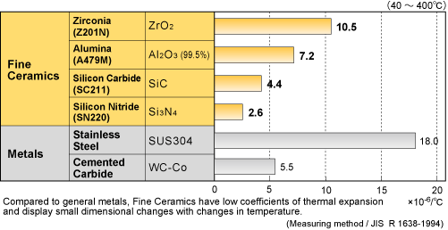
Thermal properties
Thermal expansion
The coefficients of thermal expansion depend on the bond strength between the atoms that make up the materials.
Strong bonding (diamond, silicon carbide, silicon nitrite) → low thermal expansion coefficient
Weak bonding ( stainless steel) → higher thermal expansion coefficient in comparison with fine ceramics
Comparison of thermal expansion coefficient between metals and fine ceramics

Slide 45
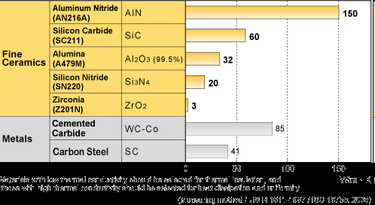
Thermal properties
Thermal conductivity
generally less than that of metals such as steel or copper
ceramic materials, in contrast, are used for thermal insulation due to their low thermal conductivity (except silicon carbide, aluminium nitride)
http://global.kyocera.com/fcworld/charact/heat/images/thermalcond_zu.gif

Slide 46
Thermal properties
Thermal shock resistance
A large number of ceramic materials are sensitive to thermal shock
Some ceramic materials → very high resistance to thermal shock is despite of low ductility (e.g. fused silica, Aluminium titanate )
Result of rapid cooling → tensile stress (thermal stress)→cracks and consequent failure
The thermal stresses responsible for the response to temperature stress depend on:
-geometrical boundary conditions
-thermal boundary conditions
-physical parameters (modulus of elasticity, strength…)
06.01.2018

Slide 47
Electrical properties of ceramic
Electrical conductivity of ceramics varies with
  The Frequency of field applied effect
charge transport mechanisms are frequency dependent.
  The temperature effect
The activation energy needed for charge migration is achieved through thermal energy and immobile charge career becomes mobile.
06.01.2018

Slide 48
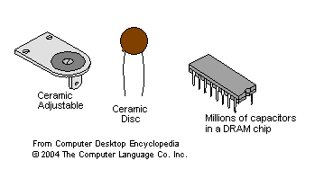
Electrical properties of ceramic
Most of ceramic materials are dielectric. (materials, having very low electric conductivity, but supporting electrostatic field).
Dielectric ceramics are used for manufacturing capacitors, insulators and resistors.
06.01.2018

Slide 49
Properties of Ceramics
Ceramics are Very brittle ,Low ductility and High elastic modulus
2) Ceramics are Low electrical conductivity, Low thermal conductivity and Low thermal expansion.
3) They have High strength at elevated temperatures
4) Most of ceramic materials are dielectric
5) Hardness of ceramics isVery High
6) Wear resistance is High
7) Elastic modulus is Very High
8) Heat capacity of Ceramics is greater than metals
9) A large number of ceramic materials are sensitive to thermal shock
10) Thermal conductivity of ceramics is generally less than that of metals
11) Oxide ceramics are generally bad conductors

Slide 50
APPLICATIONS OF CERAMICS
Ceramic materials have several industrial and technical applications due to their wide range of properties. Following are some applications of the advanced ceramics in different fields.
Dielectric ceramics are used for manufacturing capacitors, insulators and resistors, semiconductors, Lasers magnets etc.
The blade of a ceramic knife will stay sharp for much longer than that of a steel knife, although it is more brittle.
Advanced ceramics are largely used in aircraft, thermal protection system in rockets, insulating tiles for space shuttle etc.
Advanced ceramics has low expansion which finds applications in automotive field for catalytic converters, oxygen sensors, turbocharger rotors etc.
The high temperature structural property of ceramics finds applications for cutting tools, dies, molding materials etc.
Ceramics are used in nuclear energy production, nuclear core, control rods in nuclear reactors etc.
Ceramics are commonly used in biomedical applications for bone repairing, tooth replacement, hearing devices etc.

Slide 51
APPLICATIONS OF CERAMICS
8. Ceramic brake disks for vehicles are resistant to abrasion at high temperatures.
9. Ceramic material is used to protect the cockpits of some military airplanes, because of the low weight of the material.
10. Ceramics can be used in place of steel for ball bearings due to their higher hardness.
11. High-tech ceramic is used in watch making for producing watch cases due to its light weight, scratch resistance, durability and smooth touch.
12. Turbine engines made with ceramics could operate more efficiently, giving aircraft greater range.
13. In the early 1980s, Toyota researched production of an adiabatic engine using ceramic components in the hot gas area. The ceramics would have allowed temperatures of over 3000 °F (1650 °C).

Slide 52
Ceramics
☺ Thank You ☺
52

