Slide 1
CHAPTER :2
SINGLE
PHASE
MATERIALS

Slide 2
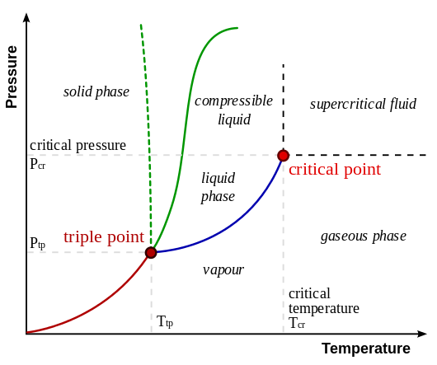
Phase Diagram for Single Material

Slide 3
Alloy
An alloy is a mixture of metals or a mixture of a metal and another element. An alloy may be asolid solution of metal elements (a single phase) or a mixture of metallic phases (two or more solutions
Alloys are used in a wide variety of applications. In some cases, a combination of metals may reduce the overall cost of the material while preserving important properties. In other cases, the combination of metals imparts synergistic properties to the constituent metal elements such as corrosion resistance or mechanical strength.
Examples of alloys are steel, solder, brass, pewter, duralumin, bronze and amalgams.

Slide 4
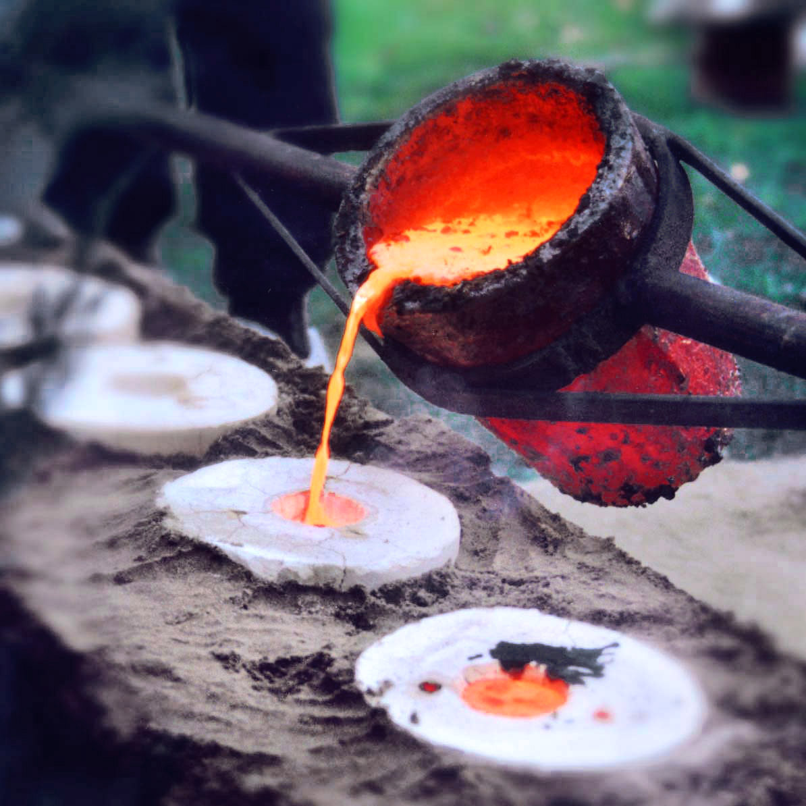
Bronze Alloy ( Copper and Tin)

Slide 5
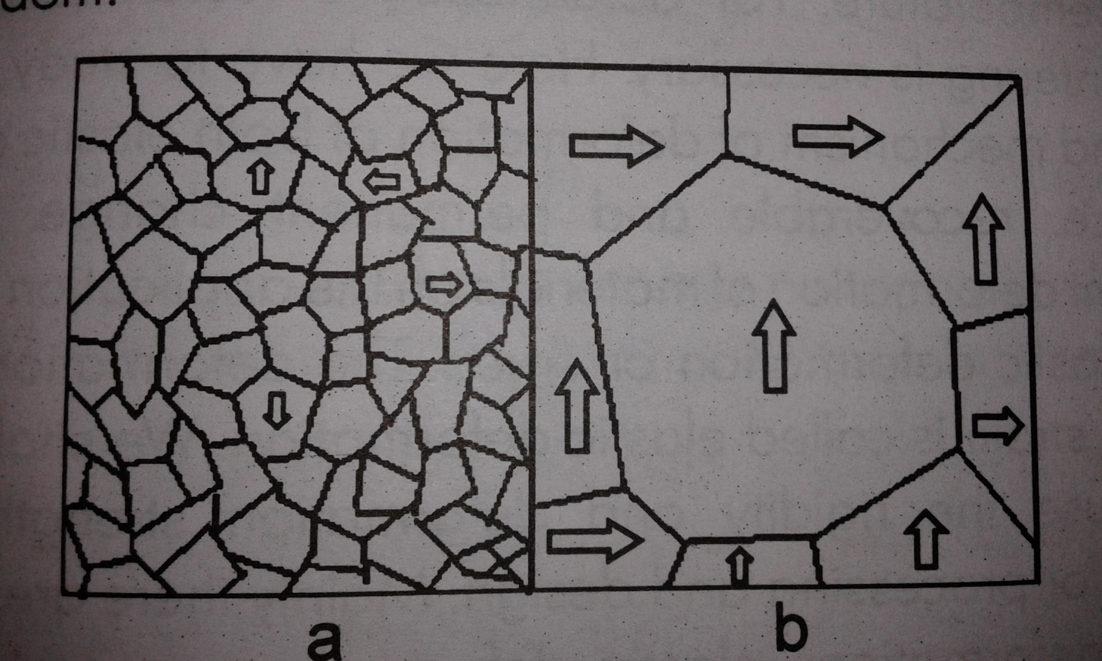
Single Phase Alloys
Grain Shape and Size

Slide 6
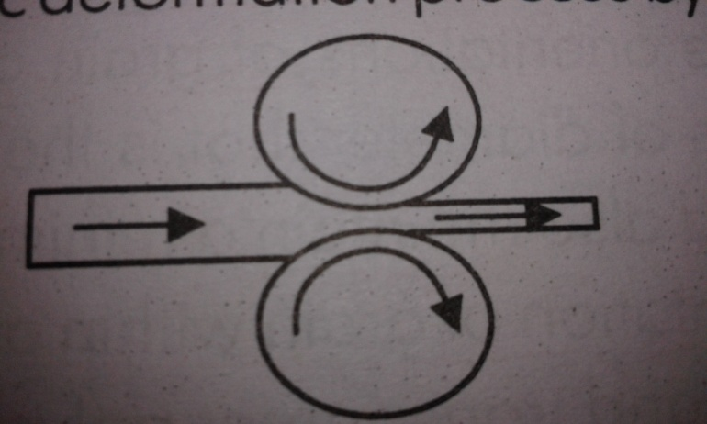
DEFORMATIONS
ELASTIC DEFORMATION
PLASTIC DEFORMATION

Slide 8
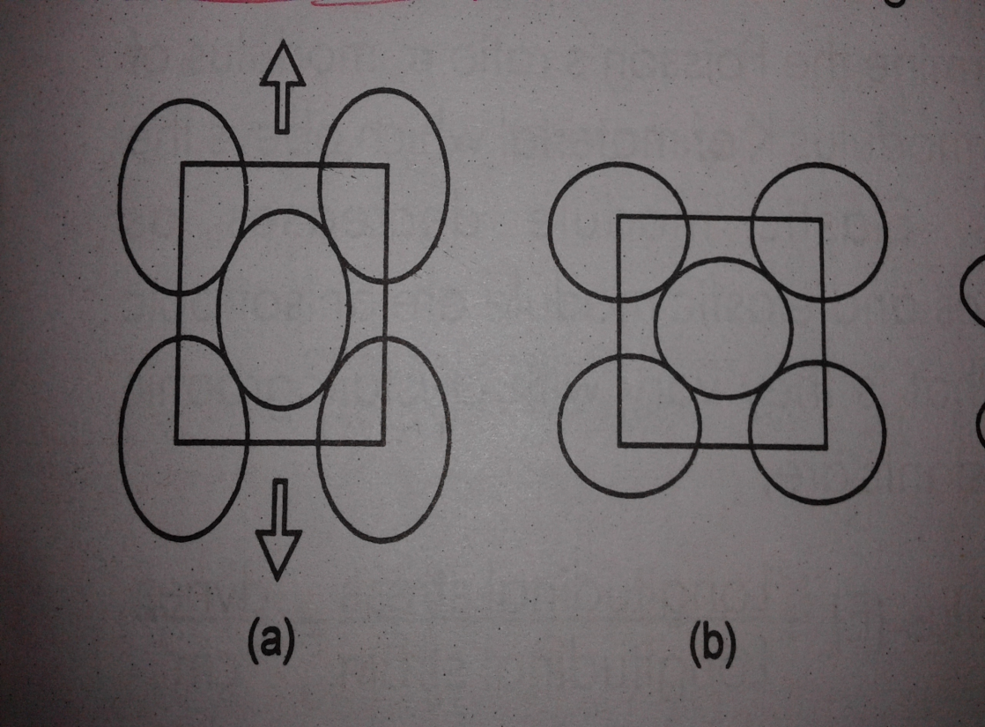
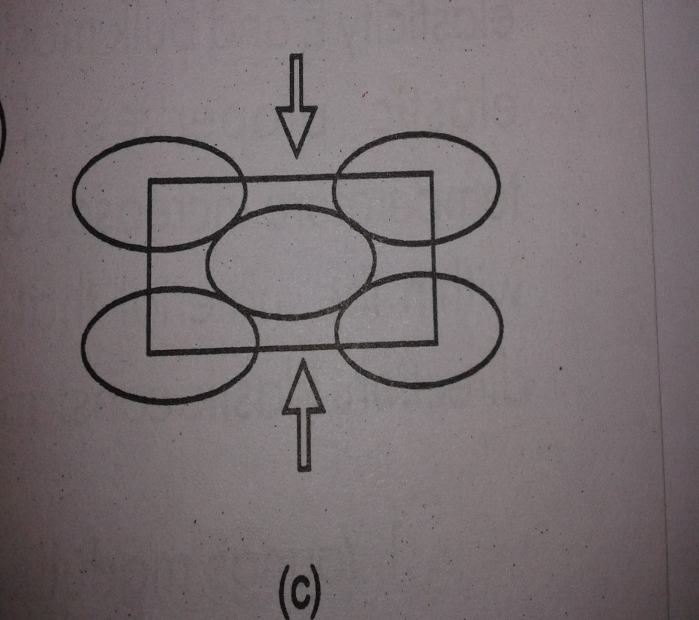
Elastic Deformations
a) Tension (+) b) No Strain c) Compression (-)

Slide 9
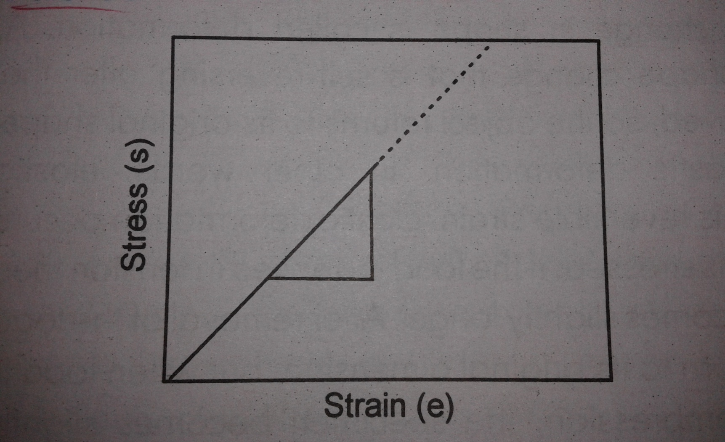
Elastic stress- strain curve
Slope = Young’s Modulus

Slide 10
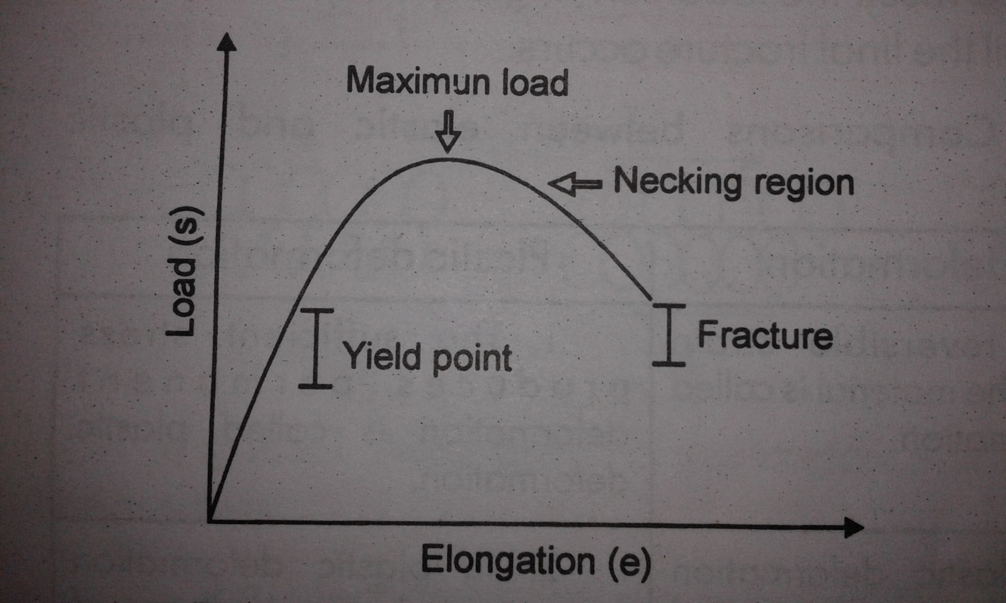
Plastic Deformation
Tensile Stress- Strain Curve

Slide 11
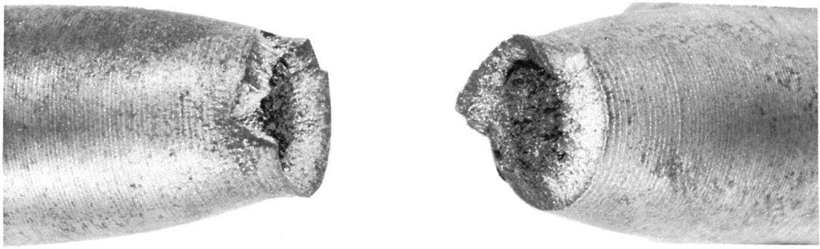
Necking
(c)2003 Brooks/Cole, a division of Thomson Learning, Inc. Thomson Learning™ is a trademark used herein under license.
Localized deformation of a ductile material during a tensile test produces a necked region.
The image shows necked region in a fractured sample

Slide 12
Comparison between Elastic and Plastic Deformations
Elastic Deformation
The reversible strain produces in the material is called elastic deformation.
Elastic deformation produces temporary change in shape of material.
After removal of load or force the specimen comes to it’s original dimensions.
Specimen is elastic up to the yield point.
Due to elastic deformation ductility of material do not changes.
Due to elastic deformation there is no change in strength and hardness of material.
Examples of elastic materials are springs, metal bar etc.
Plastic Deformation
The sufficient stress produces permanent deformation is called plastic deformation.
Plastic deformation produces permanent change in shape of material.
After removal of load or force the specimen does not comes to it’s original dimensions.
Specimen becomes plastic beyond yield point.
Due to elastic deformation ductility of material do not changes
Due to elastic deformation there is increase in strength and hardness of material.
Examples of plastic materials are polythene bag, stainless steel, aluminium alloy etc.

Slide 13
DEFORMATION BY SLIP

