Slide 1
Semester VI
PHYSICS PAPER- XIV
MATERIAL SCIENCE

Slide 2
Syllabus
Physics Paper XII (Materials Science)
1. Materials and their properties: (8)
1.1 Classification of materials
1.2 Organic, inorganic and biological materials
1.3 Properties of materials
1.3.1 Mechanical properties
1.3.2 Thermal properties
1.3.3 Optical properties
1.3.4 Electrical properties
1.3.5 Magnetic properties
2. Polymer materials: (12)
2.1 Polymers
2.2 Polymerization mechanism
2.2.1 Additional polymerization
2.2.2 Condensation polymerization
2.2.3 Homo-polymer
2.2.4 Co‐polymer
2.3 Degree of polymerization
2.4 Defects in the polymers
2.5 Mechanical properties of polymers, deformation, reinforced polymers
2.6 Applications of polymers.
3. Ceramic Materials: (6)
3.1 Classification of ceramic materials
3.2 Structure of ceramics
3.3 Ceramic possessing
3.4 Properties of Ceramics
3.5 Applications of Ceramics

Slide 3
4. Composite Materials: (6)
4.1 Fabrication of composites
4.2 Mechanical properties of composites
4.3 Particle-Reinforced Composites
4.4 Fiber-Reinforced composites
4.5 Applications of composites
5. Nano-structured Materials: (7)
5.1 Synthesis of nano-structured materials (Different Types with advantages and
disadvantages)
5.1.1 Chemical Bath Deposition method (CBD)
5.1.2 Laser Ablation
5.2 Properties of nano-structured materials
5.3 Characterization of nano-structured materials
5.4 Carbon nano tubes (CNT)
5.5 Applications of nano-structured materials
6. Biomaterials: (6)
6.1 Bio-mechanism
6.2 Classification of biomaterials
6.3 Processing of biomaterials
6.4 Properties of biomaterials
6.5 Applications of biomaterials

Slide 4
Chapter- 1
MATERIALS AND THEIR PROPERTIES
PHYSICS PAPER- XIV
MATERIAL SCIENCE

Slide 5
Materials science involves the discovery and design of new materials
The basis of materials science involves studying the structure of materials, and relating them to their properties.

Slide 6
Classification of Materials
The materials are classified into different categories based on their nature and properties as follows
Metals
Polymers
Ceramics
Composites
Nanocrystalline
Nonlinear
Biomaterials

Slide 7
MATERIALS
Metallic & Non-Metallic
Metals :
A metal is a material (an element, compound, or alloy) that is typically hard, opaque, shiny, and has good electrical and thermal conductivity

Slide 8
Properties of metals
High melting point ,
High thermal and electrical conductivity
They may be magnetic or non magnetic in nature
The metals have free electrons to move easily from one atom to the next
Metallic Materials are further classified into Ferrous & Non-Ferrous
The metals which contains ferrite or iron atoms are ferrous and those which do not contains ferrite or iron atoms are Non- Ferrous
Ferrous metals are magnetic in nature while non-ferrous metals are non-magnetic
As atoms of non-ferrous materials are arranged in a periodic or regular manner hence they are crystalline in nature.

Slide 9
The most common structure of metallic materials face centred (FC), body centred and closed packed hexagonal structure
Examples of Metallic Materials
Iron/steel- Steel alloy
Aluminium and it’s alloy
Copper and it’s alloy nickel and it’s alloy

Slide 10
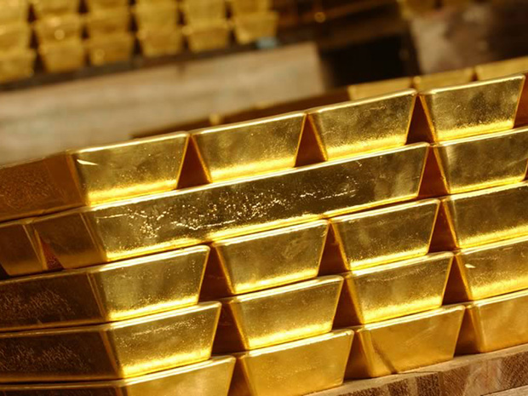
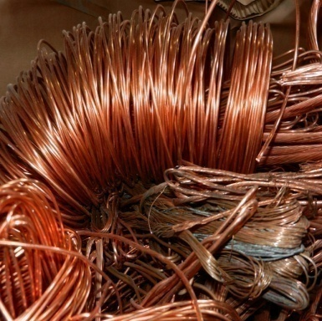
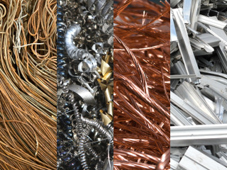
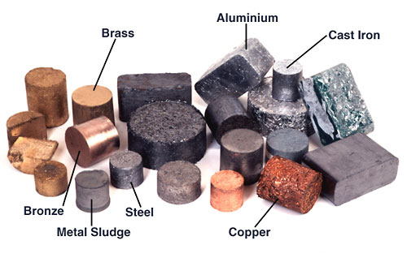
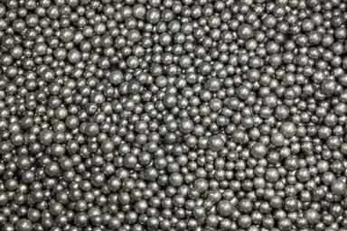
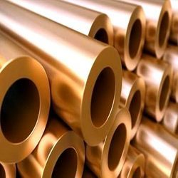
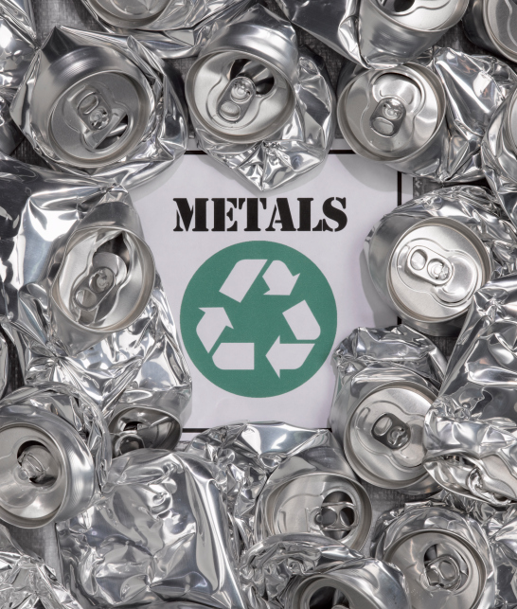
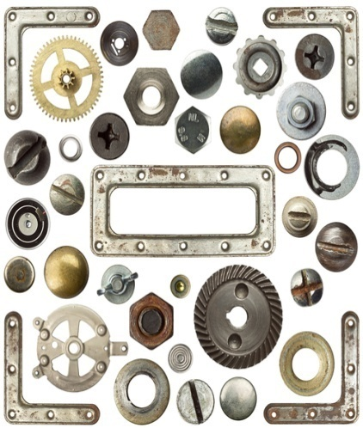
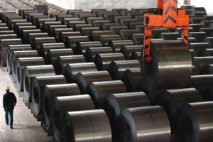
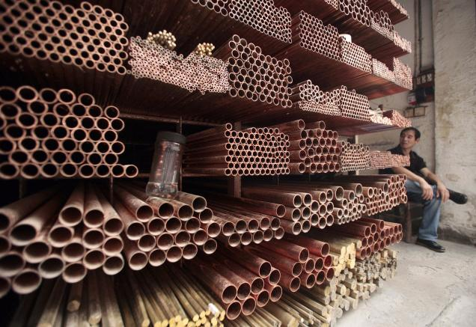
Metal Images

Slide 11
POLYMERS ( Many Parts)
The materials which are deformable at higher temperatures and becomes hard again on cooling.
Polymeric materials are Plastics and elastomers
Density of polymers is less than metals
Plastics:
They are large and varied group of synthetic materials which are processed by forming or modulating into shape
There are man types of Plastics such as Polyethylene and nylon

Slide 12
Elastomers or Rubber
Elastomers can be elastically deformed when force is applied and they return their original shape when the force is released.

Slide 13

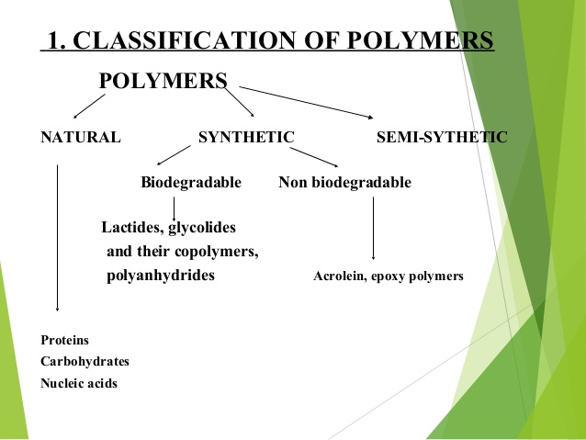
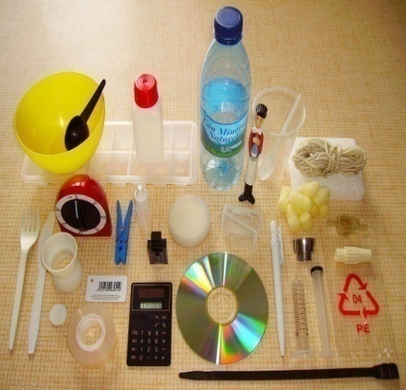
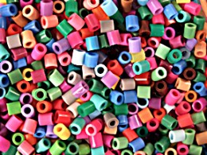

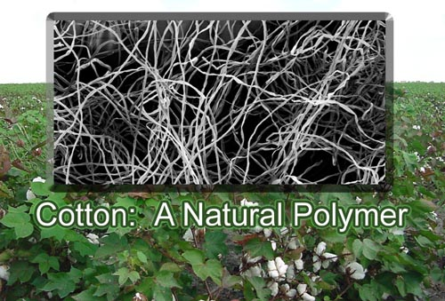
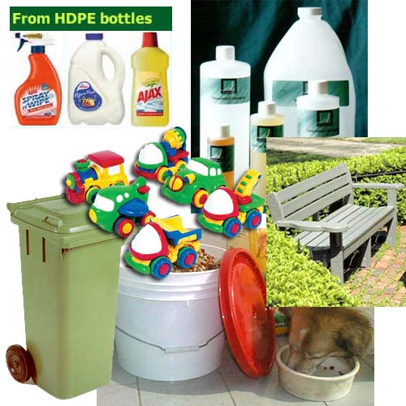
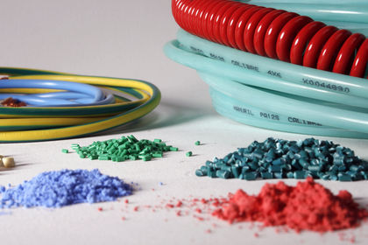
Polymers

Slide 14
Ceramics
A ceramic is an inorganic, nonmetallic solid material
The atoms are arranged in periodic manner and hence are known as crystalline materials
High strength , hard and brittle
The atoms in ceramic materials are held together by common chemical bonds covalent and ionic.
Covalent and ionic bonds are much stronger than metallic bonds
Some are electrically conductive and some are Insulators.
Wide range of applications from industries to household articles.
Examples
Structured clay products ( Bricks, roofing and wall tiles)
glasses ( flat glass windows
container glass ( bottles)
Cements ( for roads, bridges, buildings, dams etc.)

Slide 15
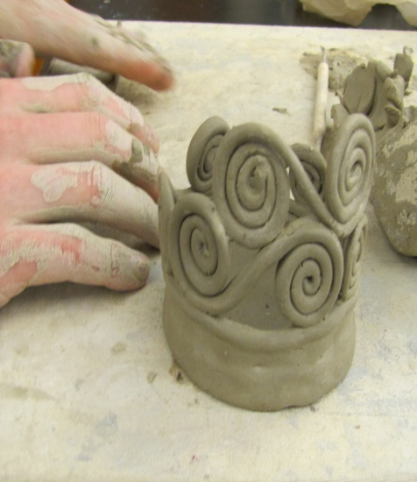
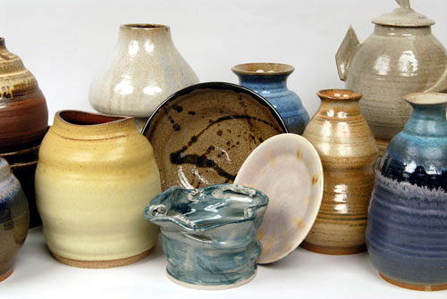
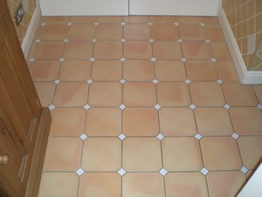
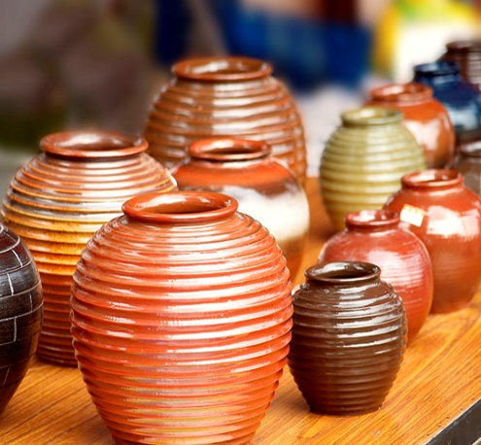
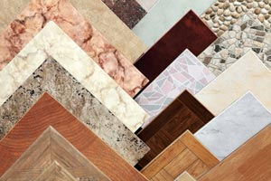

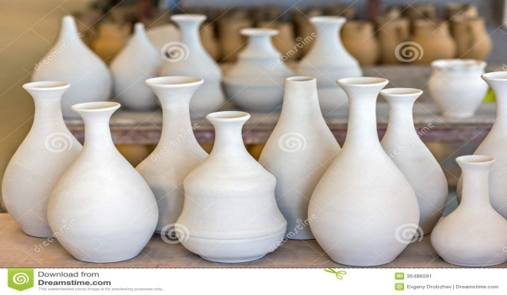
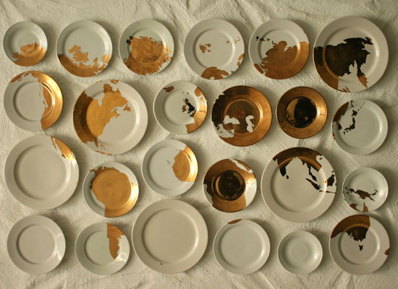

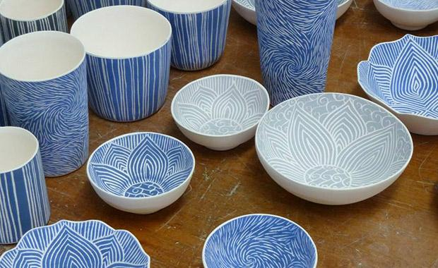
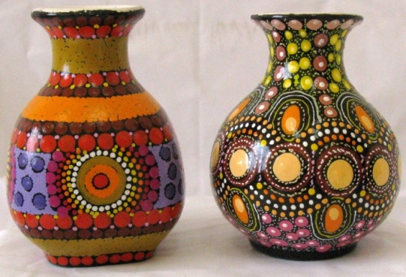
Ceramic Material Images

Slide 16
Composites
A composite material (also called a composition material ) is a material made from two or more constituent materials with significantly different physical or chemical properties
High strength, Heat resistance, stiffness, stability etc.
They have combined properties of glass, fibre and plastics.
Examples
Glass Reinforced Plastic (GRP)
wide range of engineering materials

Slide 17
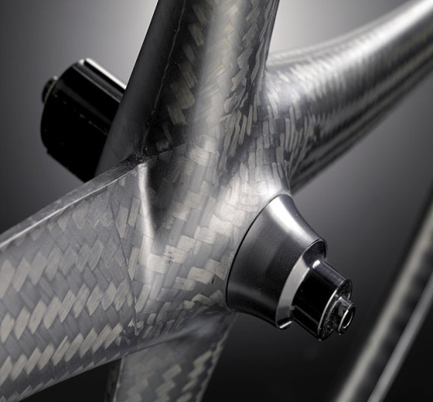
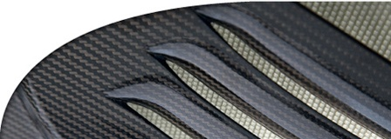
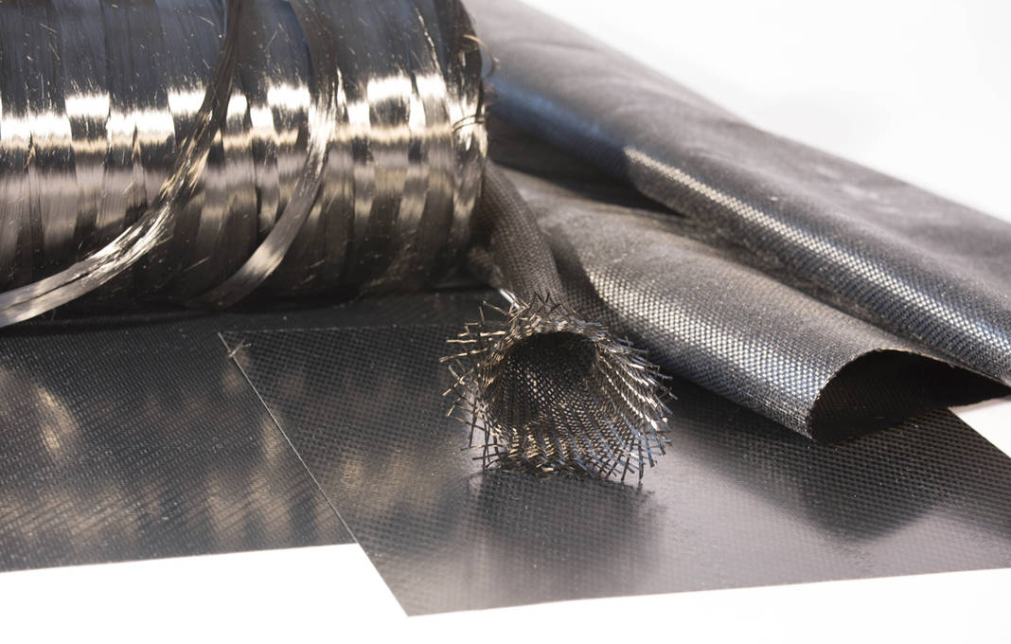
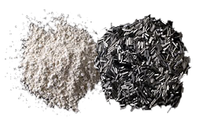
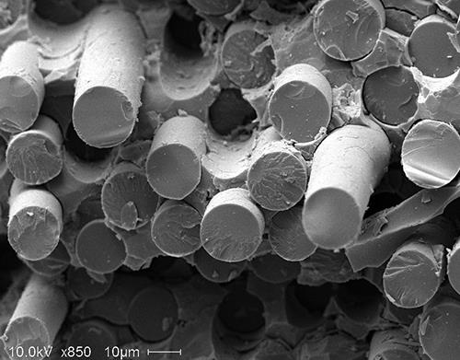
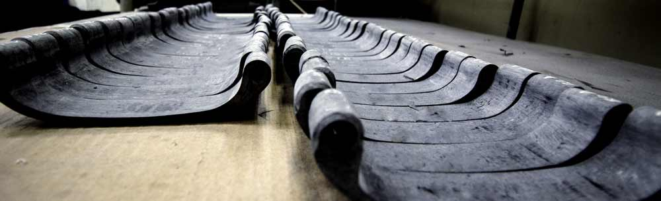
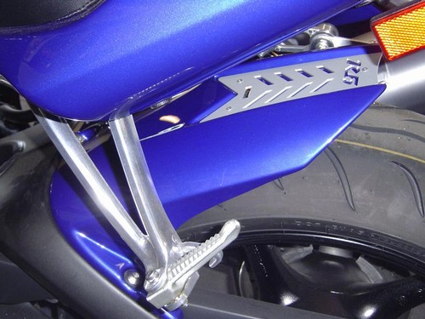
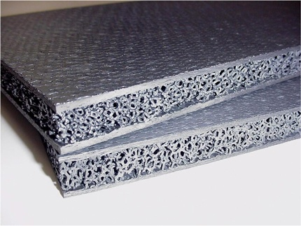
Composite Material Images

Slide 18
Nanocrystalline Material
A nanocrystalline (NC)material is a polycrystalline material with a crystallite size of only a few nanometers.
The reduction in the size of the grains held the big impact on bulk properties of those materials.
When grain size reduces to nanoscale then the materials becomes stronger and hard
The nanocrystalline metals, semiconductors, ceramics and other materials can be made by variety of techniques.
Examples
Nanosolar
Zeolites
Nano carbon tubes

Slide 19
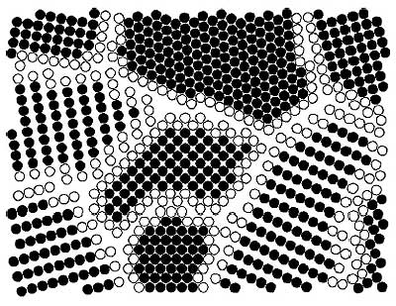
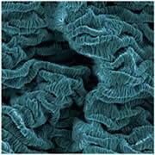
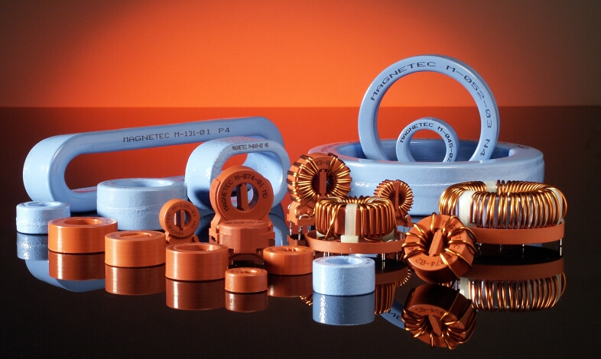
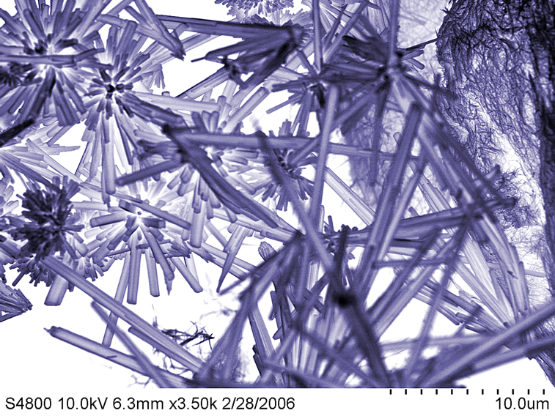
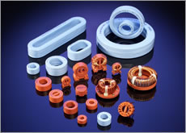
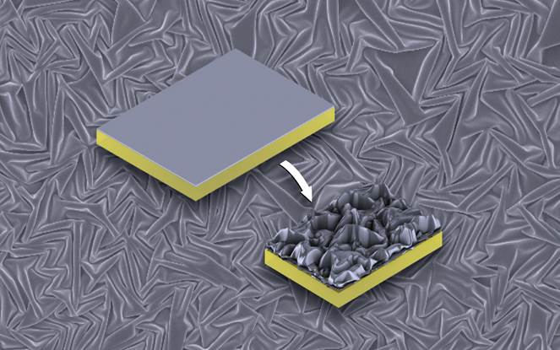
Nanocryatalline Material Images

Slide 20
Nonlinear Materials
A nonlinear metamaterial is an artificially constructed material that can exhibit properties not found in nature.
The intensity and frequency of light coming out of the materials is not directly related to the intensity and frequency of incident light due to non linearity. The materials exhibiting this behavior are known as non linear materials.
The technological applications of these materials are quite important in the field of electronics and communications.
Examples
Bismuth, Germanium, Cadmium, Zinc Telluride, Gallium(II) Selenide, Lithium Niobate, Yttrium Iron, Garnet etc.

Slide 21
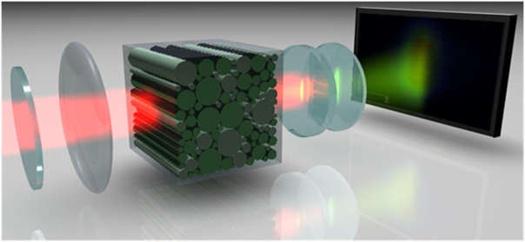
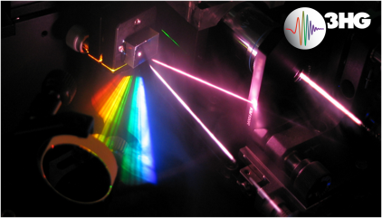
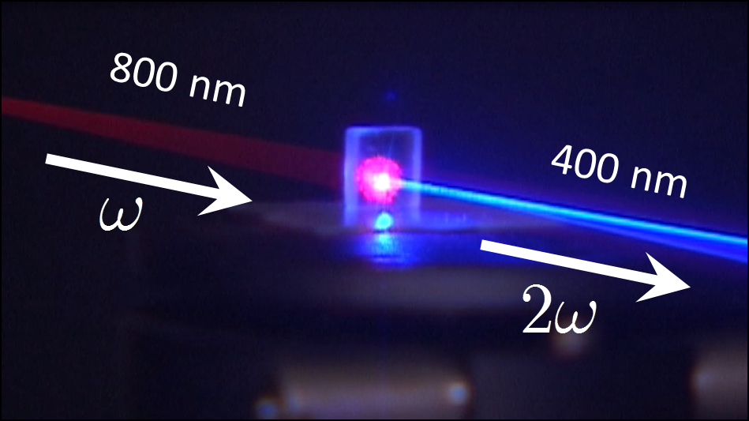
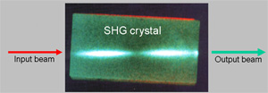
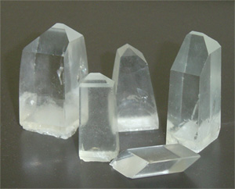
Nonlinear Material Images

Slide 22
Biomaterials
A biomaterial is any matter, surface, or construct that interacts with living systems
or
The materials that found applications in the field of medicine such as replacements of damaged body parts are known as biomaterials
The are used in joint replacement, Bone plates, Heart valves, skin repair devices and contact lenses.
Examples
The bioactive glass and glass ceramics with specific compositions will form a firm chemical bond with living tissue and natural bone

Slide 23

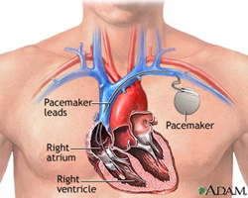
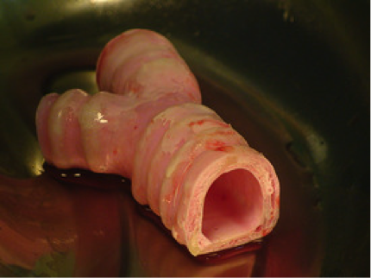
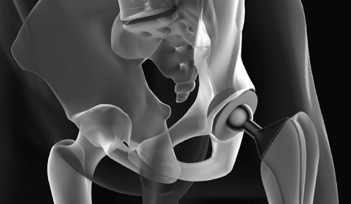
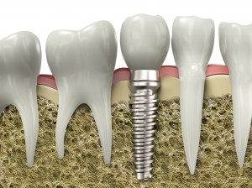
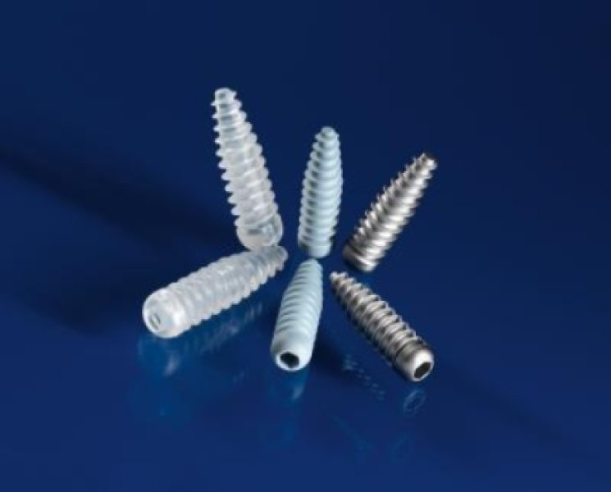
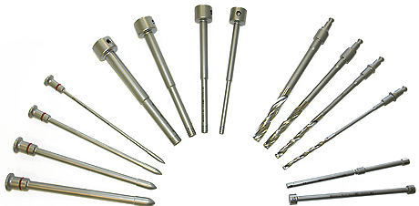



Biomaterial Images

Slide 24
PROPERTIES OF MATERIALS
Mechanical Properties
Thermal Properties
Electrical Properties
Magnetic Properties
Optical Properties

Slide 25
Mechanical Properties
Those characteristics of the materials which describes their behaviour under external loads are known as Mechanical Properties
1) Sterss: Applied force per unit cross sectional area is called stress
Stress= Applied force/ area = F/A ( N/m² or Pascal’s)
Longitudinal or tensile Stress: When applied force produces change in length of a body then the stress associated is called longitudinal or tensile stress.
Longitudinal Stress = Applied force/ Area of cross section
= F/A = F/πr² = Mg/ πr²
Shearing Stress: When applied force produces change in shape of body , the stress associated is called shearing stress.
Volume Stress : When applied force produces change in volume of a body, the stress associated is called Volume Strain
Volume Stress = Applied force/A= F/A = A dp/ A = dp

Slide 26
2) Strain : The change in dimensions per unit original dimensions is called Strain
Longitudinal or tensile Strain: It is the ratio of Change in length to the original length ( dL/L)
Volume Strain: It is the ratio of change in volume to the original volume (-dV/V) ( volume decreases as pressure increases hence it is negative)
Shearing Strain: It is the ratio of relative displacement of any layer to its perpendicular distance from fixed layer(θ)

Slide 27
3) Elastic Strain: Elasticity is property of the body that it tends to regain it’s original dimensions on removal of deforming force.
Elastic strain is reversible i.e. When stress is removed the strain disappears. It is commonly a linear function of stress which obeys Hook’s law : For elastic materials, stress is linearly proportional to strain and is independent of time.
The ratio of stress to strain is the modulus of elasticity ‘E’ (or Young’s modulus)
F/A
E= Stress/Strain=S/e =
dV/L

Slide 28

Elastic deformation
Gives Hooke's law for Tensile Stress
σ = E ε
E = Young's modulus or modulus of elasticity (same units as σ, N/m² or Pa)
Unload
Stress
Slope = modulus of
elasticity E
Load
Strain
Higher E → higher “stiffness”

Slide 29
4) Plastic Strain: It occurs when stress exceeds critical values that initiate a permanent displacement of atoms from their neighbours. Thus plastic strain is not reversible. It is an important property and widely used in several mechanical processes like forming, shaping and many other hot and cold working processes.
It increases with increase in temperature.
5)Strength: It is critical stress required to initiate failure.
Failure is permanent deformation i.e material bends but not breaks.
Strength is resistance offered by material when external load is applied.
6) Ductility: It is permanent strain that produces fracture. It is commonly expressed in percent(%).
Second measure of ductility is the reduction of area at a point of fracture.
Reduction of Area(R) = (A₀-A_{f})/A₀
% R of A = (A₀-A_{f})/A₀ X 100
Where A_{f} = fracture area of applied strain
A₀= Original area.

Slide 30
7)Hardness: It is resistance of material to penetrate and scratching. It is directly proportional to tensile strength.
According to Brinell , hardness is load applied per unit area i.e. Hardness= load/area it’s unit is kg/mm².
8) Toughness: It is amount of energy absorbed by material before actual fracture takes place. It’s unit is joule.
The toughness can be calculated from area under stress- strain curve.
9) Creep: The slow and continues fracture of a material with time at constant stress and high temperature below elastic limit is called Creep.
Creep is permanent deformation of a material under the load as a fraction of time. It occres onl at a temperature above 0.4Tm.
Room temperature for iron is 0.16Tm and for copper it is 0.22 Tm. So creep at room temperature is negligible in these materials.

Slide 31
10) Fatigue: The fatigue strength of material is the maximum stress at which failure may occurs after a certain number of cyclic load applications.
Rotating shafts , connecting rods, aircrafts wings are some examples of some examples of structural and machine components that are subjected to millions of cycles of alternating stresses during services.
The majority of failures of such components in service are due to fatigue.
11) Malleability: It is the ability of the materials to exhibit large deformation when being subjected to compressive force. Mallleable materials can be made into thin and flat sheet without tearing.
Copper, gold silver, iron and aluminium are used in flat sheet, foil and wire because the are highly malleable and ductile.
12) Stiffness: The resistance of a material to deflection is called stiffness or rigidity. It is measured by Young’s modulus.
As Young’s modulus is higher, material is more stiffer

Slide 32
THERMAL PROPERTIES
Thermal properties have important role in material deformation and structure of the materials
Specific Heat: Heat is the energy that is transferred from the regions of higher temperature to those of lower temperature.
Specific heat of a substance is the quantity of heat absorbed or used to increase the temperature of unit mass of the substance through one degree Celsius.
The quantity of heat energy absorbed ‘Q’ by a substance of mass ‘M’ and specific heat ‘C’ for rise in temperature ‘ΔT’ is
Q = CMΔT hence, C = Q/MΔT
If, M=1unit, ΔT = 1⁰C then C=Q
Heat unit of specific heat is Kcal/Kgk
Work unit of specific heat is JKg⁻¹K⁻¹ or erg/g⁰C
Specific heat of different materials is different.

Slide 33
2) Thermal Expansion: As the temperature of the material increases then inter-atomic distances with change in thermal energy increases hence expansion occurs.
The property of the material which tends to expand with application of thermal energy is called thermal expansion.
There are mainly two types of thermal expansions a) linear Expansion & b) Volume Expansion
* Linear Expansion: It is one dimensional expansion. Consider an object of initial length Li and at a temperature Ti. When it heated then Lf and Tf are final length and temperature of an object.
Then the change in length of the object is ΔL = Lf – Li which is given by ΔL = αLiΔT
Where, ΔT = Tf – Ti is the change in temperature of the object and α is constant which is characteristics of the materials called coefficient of linear expansion

Slide 34
* Volume Expansion: the volume expansion works almost identically to linear expansion.
If an object or substance of initial volume Vi undergoes change in temperature ΔT, then it’s volume will changes by an amount ΔV= βViΔT
Here β is constant called coefficient of volume expansion.
Volume and linear expansions are related as β = 3α
3) Thermal Conductivity: It is the ability of a material to transfer heat in a solid. Thermal conductivity is high in the materials with metallic bonds because delocalized electrons are efficient carriers of the thermal as well as electric energy.
In general the material which is good conductor of heat is also good conductor of electricity.

Slide 35
ELECTRICAL PROPERTIES
Electrical properties are related to the atomic bonding , energy levels and free electrons.
Resistivity: Resistivity of a material is the property which apposes to the flow of current.
Since resistance of wire is proportional to the length and inversely proportional to cross sectional area.
i.e. Rα L/A R=ρL/A
Here ρ is proportional constant called electrical resistivity.
The amount of resistance depends on type of material.
Materials with low resistivity are good conductor of electricity and the materials with high resistivity are good insulators.
S.I unit of electrical resistivity is ohm meter (Ωm)

Slide 36
ii) Electrical conductivity: The reciprocal of resistivity is called electrical conductivity (σ) i.e. σ= 1/ρ.
It’s unit is ohm⁻¹ m⁻¹(Ω⁻¹m⁻¹) or mho/m
Electrical conductivity depends on nature of atomic bonds.
Both ionically and covalently bonded materials are poor conductors because electrons are not free. For semiconductors conductivity is controlled by movement of their electrons.
Iii) Dielectric Strength: the dielectric materials separate two electrical conductors without passage of current.
Thus metals can not be dielectrics but many ceramics and polymers are dielectrics. Dielectric is an insulators.
Dielectric strength is potential gradient value V/mm.
Dielectric strength is function of thickness. Good insulators has high dielectric strength. Dielectric materials do not conduct electricity.

Slide 37
MAGNETIC PROPERTIES
The materials are classified according to their response to applied magnetic field as diamagnetic which not having permanent magnetic moments and paramagnetic or ferromagnetic which having permanent magnetic moment. The best known magnetic contains metallic iron.
i) Magnetic field strength (H): It is the force experienced by unit north pole placed at a given point in a magnetic field.
It can be defined by the relation H = B₀/μ₀
Where B₀ is applied magnetic field and μ₀ is magnetic permeability of space
H has unit amperes/meters ( A/m)
ii) Magnetization or Intensity of Magnetization (M): It is defined as magnetic moment per unit volume.
i.e. M = Magnetic Moment/Volume = μ_{total}/V
The unit of M is Ampere/meter (A/m)

Slide 38
iii) Magnetic Susceptibility (χ): It is the ratio of magnetization produced in a sample to the magnetic field strength. i.e. χ = M/H iv) Magnetic Permeability (μ): It is defined as the ratio of magnetic flux density B in the sample to the applied magnetic field intensity H i.e. μ = B/H
It is measure of amount of magnetic lines of force penetrating through a material

Slide 39
Optical Properties
The most of the materials are used for optical purpose.
For light transmission some materials plays filtering action.
Optical lenses are used for refraction and reflection of light.
These Optical properties are used in new technological applications
As optical fibres communication.
Refractive index property of materials is important for optical materials.
Refractive Index (μ): It is the ratio of velocity of light in air to the velocity of light in optical or denser medium
i.e. μ = Va / Vd
Absorption coefficient is another optical properties.
Prisms, lenses and mirrors are used for different purposes.
Light emission, light amplification takes in some optical materials.

Slide 40
Organic, Inorganic and Biological Materials
Organic materials:
Organic materials are defined in modern chemistry as carbon-based compounds. Most are combinations of a few of the lightest elements, particularly hydrogen, carbon, nitrogen, and oxygen. Organic materials include the wood from which furniture is made, leather, and synthetic materials such as petroleum-based plastics.
Organic materials are further divided into three categories based on their source
Cellulosic Materials: Plant materials are living matter made of cellulose and lignin. Examples include grass, wood, roots, bark, leaves, even flowers
Proteinaceous materials have an animal origin. Common categories include Leather and Skin, parchment, gut, hides, fur and hair, wool and silk, feathers and quills, baleen, and tortoiseshell.
3. Organic Polymers are derived from fossil fuels or other oils.

Slide 41
Inorganic Materials
Inorganic materials are generally derived from non-living sources, such as rocks or minerals. Examples are glass, ceramics, and metals
Biological Materials
Biological materials are part of a living structure or biomedical device that replaces a natural function. Biological materials are most often engineered for medical, biotechnology applications.
Biological materials are present inside living organisms. They do not contain any metal, ceramic, or synthetic polymer material

Slide 42
Thank You

