Slide 1
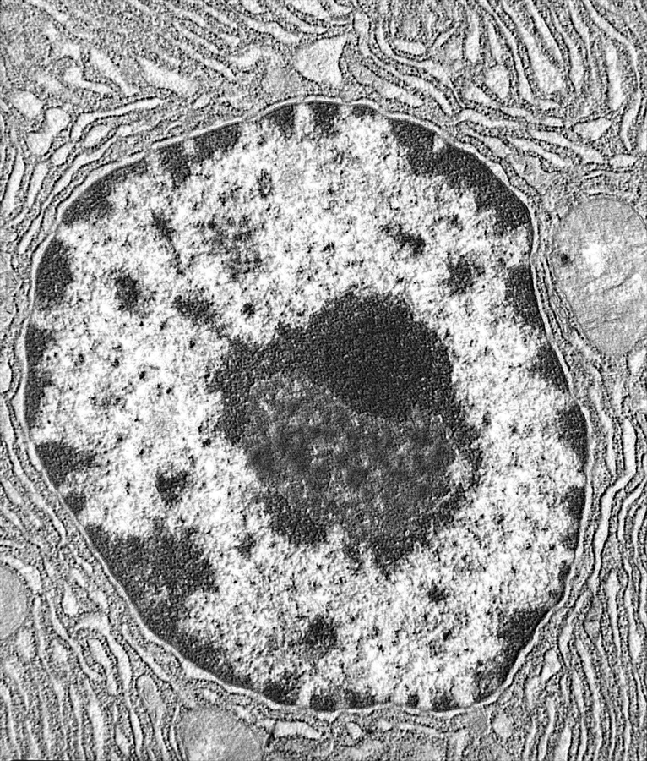
Nucleus
&
Nucleolus

Slide 2
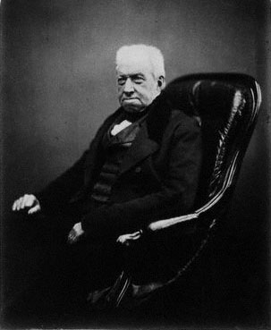
History
-Discovered in 1831 by Scottish botanist Robert Brown
-Suggested the nucleus played a key role in fertilization and development of the embryo in plants
-Name (nucleus) derived from the Latin word for kernel/nut
Robert Brown
1773-1858

Slide 3
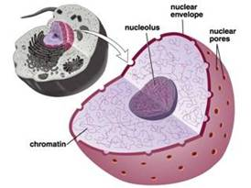
Main Characteristics
Membrane-enclosed organelle found in eukaryotic cells
Generally found in the central region of the cell (in animal cells)
Roughly spherically shaped
Largest and most easily seen organelle

Slide 4
Primary Functions within the Cell
Repository of genetic information (DNA & RNA)
Enables the synthesis of nearly all proteins
Houses the nucleolus
Responsible for production of ribosomes
Selective transportation of regulatory factors and energy molecules through nuclear pores

Slide 5
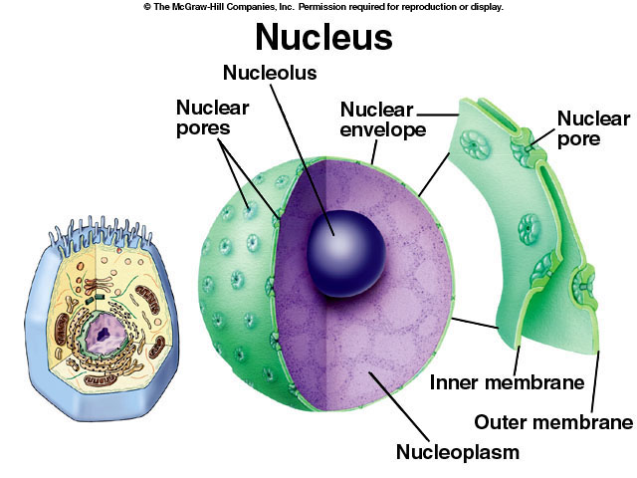
Structure

Slide 6
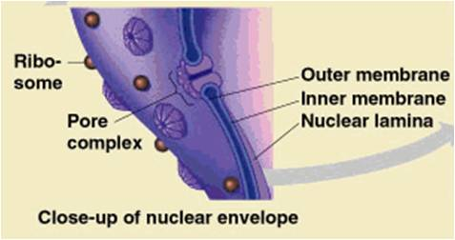
Nuclear Envelope
Consists of:
Phospholipid bi-layer membrane
Nuclear Pores
Ribosomes

Slide 7
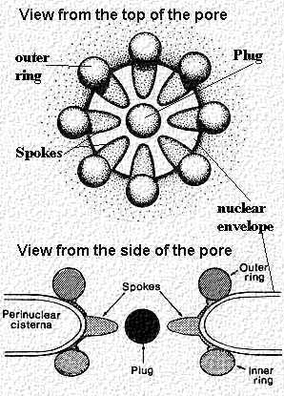
Nuclear Pores
Allow small molecules to diffuse easily between nucleoplasm & cytoplasm
Control passage of proteins & RNA protein complexes
  Import: proteins moving in to be incorporated into nuclear structure or to catalyze nuclear activities
  Export: RNA / RNA-protein complexes to the cytoplasm

Slide 8
Nucleolus
Largest structure present inside the boundaries of the nucleus
Dark staining zone in center of nucleus
Where intensive synthesis of ribosomal RNA takes place
Main components are ribonucleic acid (RNA), deoxyribonucleic acid (DNA) and proteins

Slide 9
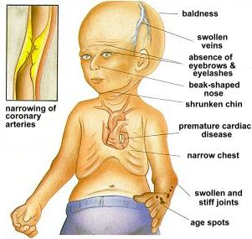
Progeria
Caused by a mutation in gene LMNA (Lamin-A)
LMNA gene produces the Lamin A protein, which is the structural scaffolding that holds the nucleus of a cell together
Defective Lamin A protein makes the nucleus unstable. That nuclear instability appears to lead to the process of premature aging in Progeria.

Slide 10
Questions
What is the dark spot at the center of the nucleus called?
  Golgi apparatus
  Nuclear pore
  Nucleolus
  Ribosome
What are the primary functions of a nuclear pore?
  Photosynthesis
  Production of proteins
  Storage of genetic material
  Import / Export of specific molecules

