Slide 1

RESPIRATORY SYSTEM

Slide 2
Cutaneous Respiration - skin
Cutaneous Respiration - skin
o The gaseous exchange between the skin of the frog and the external environment -water and air.
o The skin of the frog is supplied with blood capillaries.
o The skin contains glands called the cutaneous glands, which secrete mucous. This keeps the skin always moist and retains a thin film of water underneath the surface of the skin. This condition enables the exchange of air between the blood vessels and the outside environment. They also resort to cutaneous respiration when they undergo either hibernation or aestivation.

Slide 3
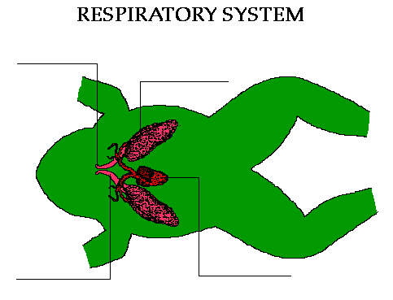
LUNGS

Slide 4
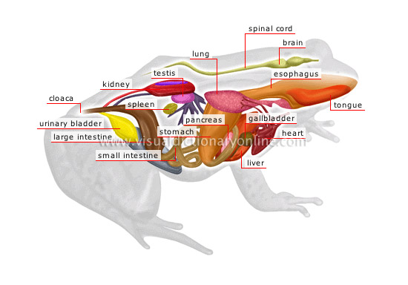
ANATOMY OF FROG

Slide 5
Buccal Respiration - mouth
Buccal Respiration - mouth
o When the frog floats on the surface of water or while resting on land they respire through the buccal cavity.
o Atmospheric air is sucked in through the nasal openings when the floor of buccal cavity is lowered.
o In the same manner the air is send out when the cavity rises.
o The alternate lowering and rising of the buccal cavity, buccal respiration is bought about.
o The buccal respiratory system of the frog accounts for 5% of the oxygen intake.

Slide 6
Pulmonary Respiration - lungs
Pulmonary Respiration - lungs
o This type of respiration comprises of: the nasal cavity, buccal cavity, larynx, trachea, a pair of lungs and the alveoli inside them.
o The adult frog has very simple, pinkish, sac like organs called lungs. They are not well developed and are placed in the anterior of the frog's body.
o The numerous sac like structures inside the lung called the alveoli are richly supplied with blood capillaries.
o Pulmonary respiration accounts for 65% of total oxygen intake.
Read more: http://wiki.answers.com/Q/What_is_a_frog's_respiratory_system#ixzz1mFZnJvKE

